Slide 1
Community-Based Participatory Research Approaches in the West Philadelphia Promise Neighborhood
Drexel University urban health collaborative
Erikka GilliaM
Christina Brown

Slide 2
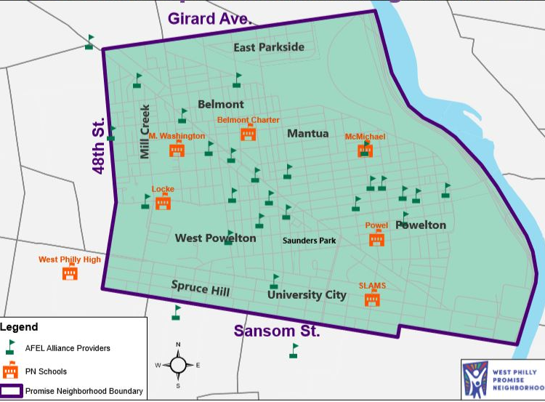
West Philly Promise Neighborhood
US Dept of Education-funded grant to support “cradle-to-career” opportunities for children living or going to school in specific area of West Philadelphia with the goal to improve education, health and economic successes for children, their families and communities
  2017-2023
  $30 million
Requires data collection and integration at multiple levels; individual, school and neighborhood
westphillypn.org

Slide 3
University/ Neighborhood Context
  Widespread development, gentrification, and community displacement
    Mistrust of academic, healthcare, and governmental institutions
  High research burden
  Residents rarely see results of research, let alone benefits/improvements
  Concerns about stewardship of funding

Slide 4
Guiding Principles for Our Research Model
We acknowledge and honor the experiences and concerns of the communities that we are working with/within
  Past harms
  Current pressures
We provide our community partners with substantive, frequent and meaningful opportunities for input and we incorporate that input into research questions, study design, and measures
We establish and honor a transparent accountability structure.
  We do not conduct research or release products that are not reviewed/approved by community partners.
The data that we collect belongs to the community.
  We have an obligation to make it accessible to the community in multiple formats that are useful for program planning, evaluation, and advocacy.

Slide 5
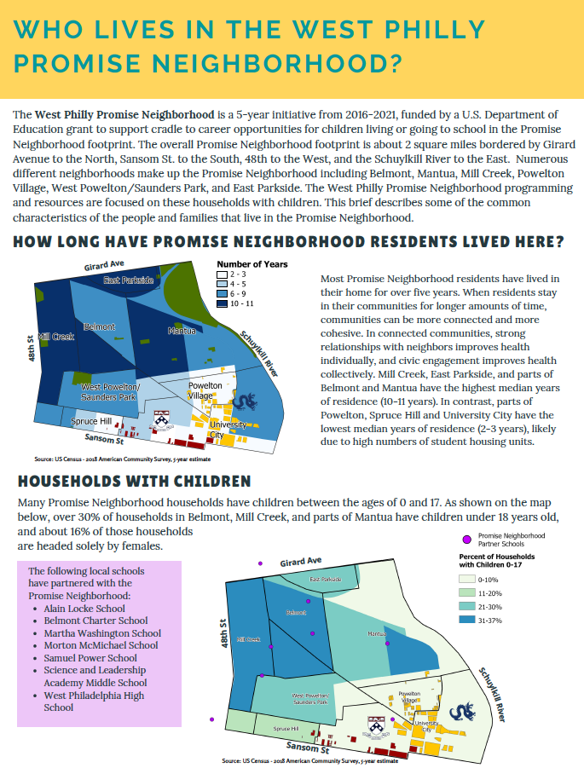
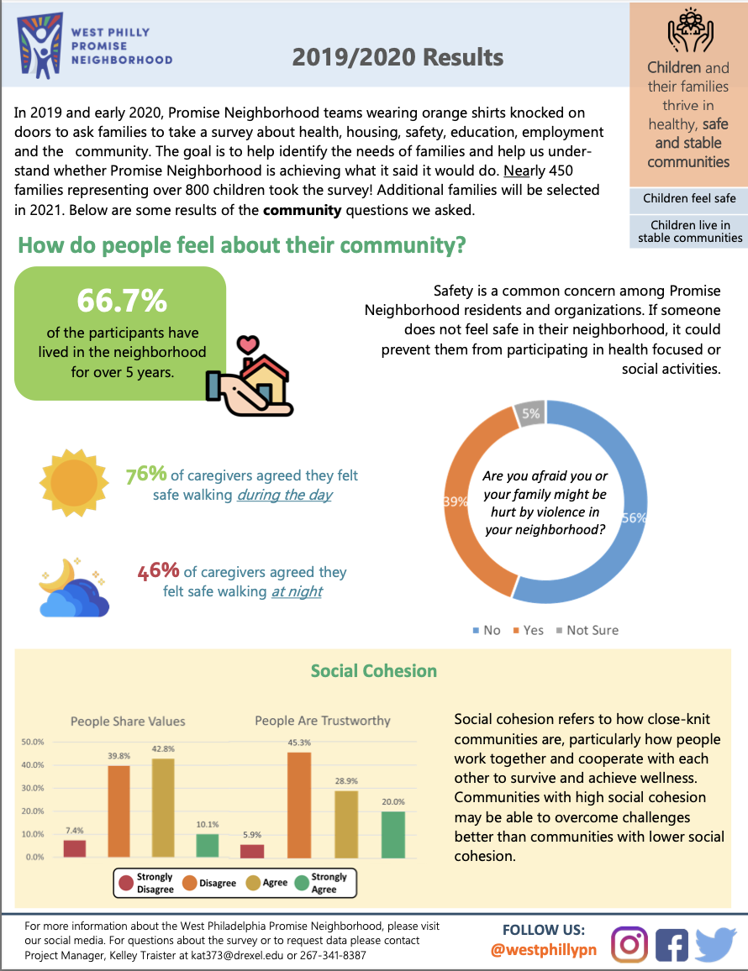
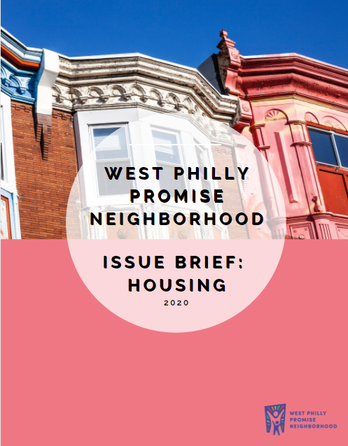
Examples of dissemination products: Community Snapshots
Notes:
I’m now going to hand this off to my colleague Rich Dollery

Slide 6
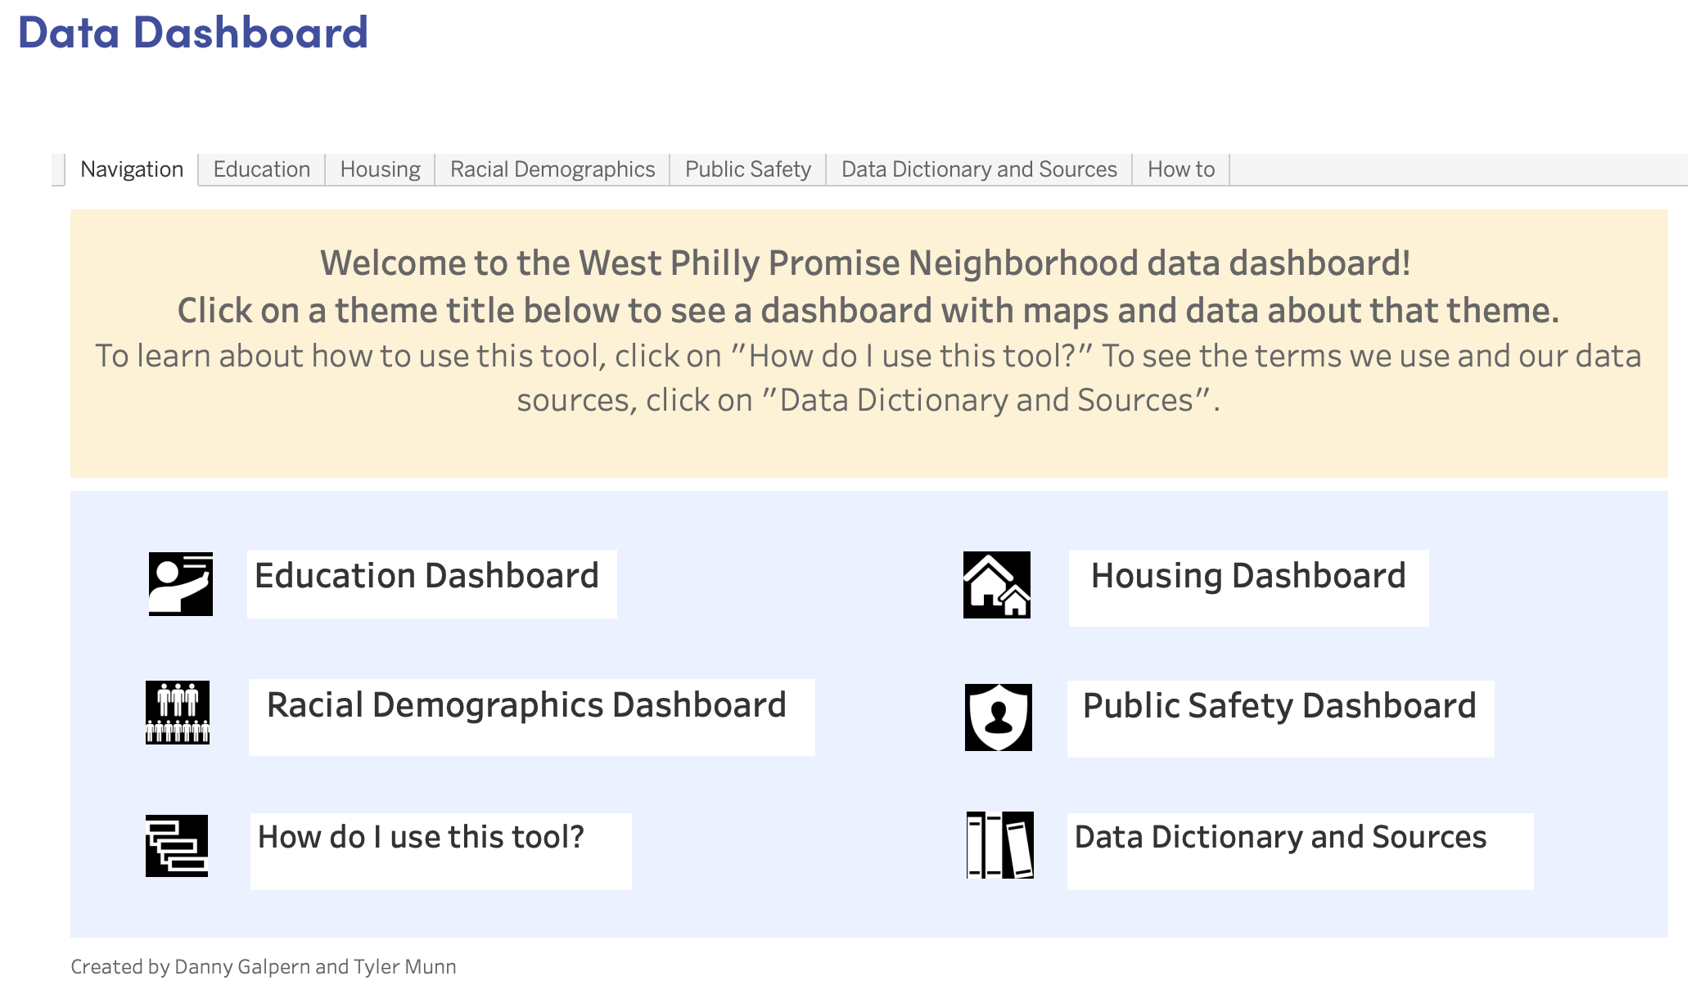
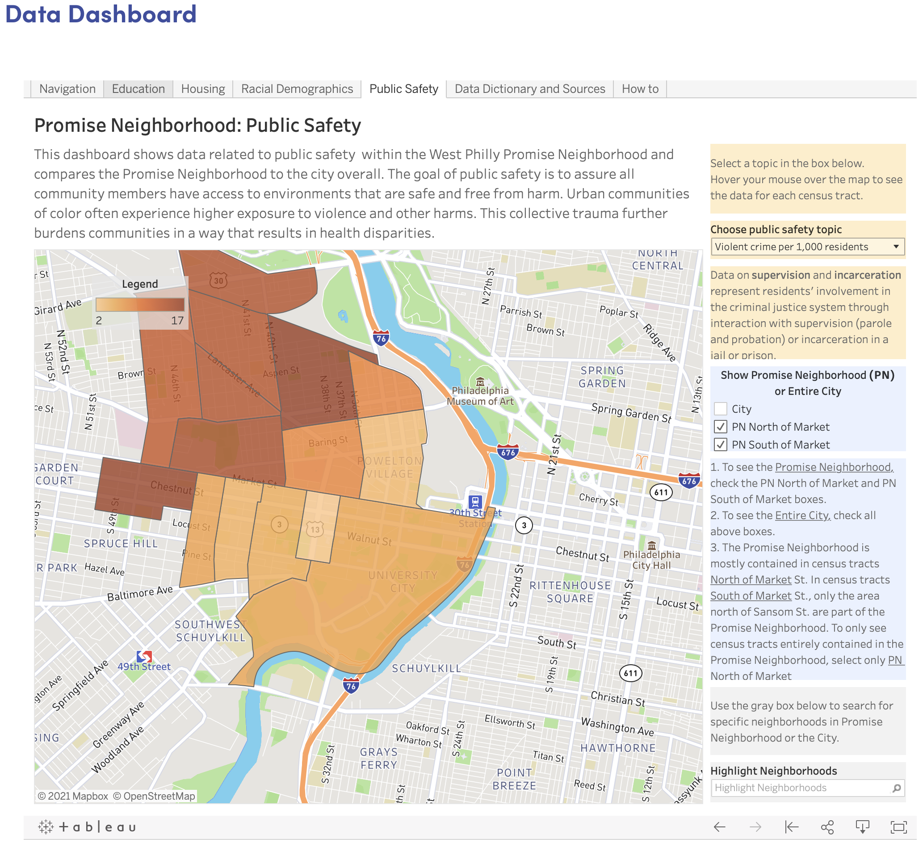
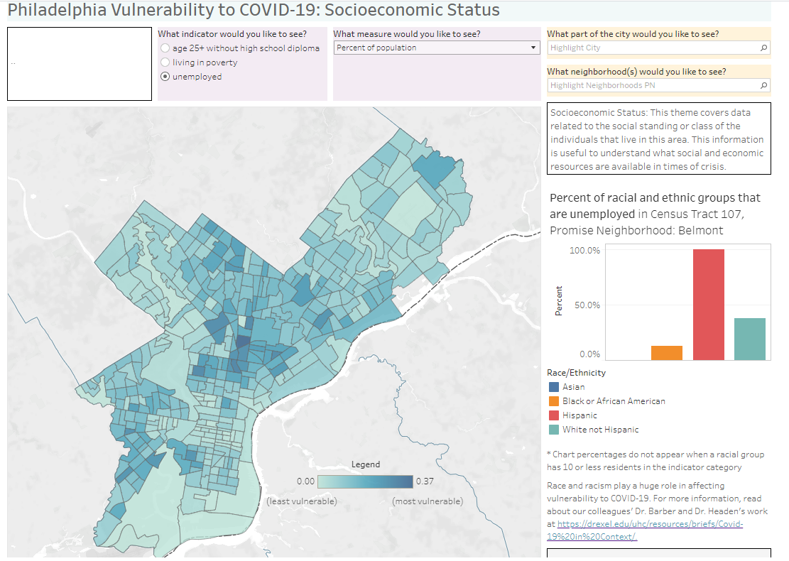
Examples of dissemination products:
Data dashboards

Slide 7


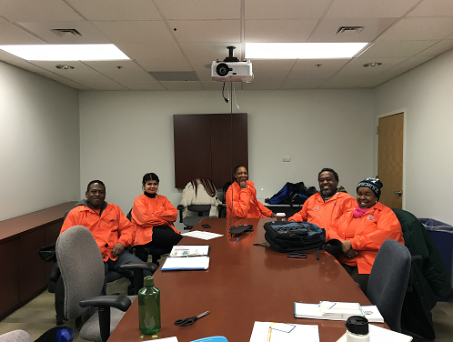
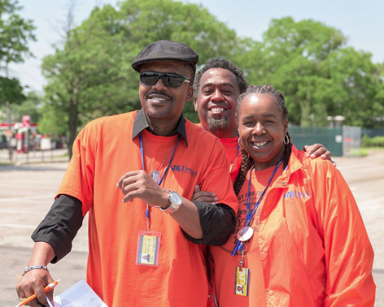
Neighborhood Survey
Survey design: longitudinal cohort design
  Three waves (2018, 2019, 2021)
Eligibility: households with children 0-18 years old
Topics: health, housing, safety, education, employment, and perceptions of neighborhood built environment, social cohesion, and resources
Surveys were programmed into Qualtrics and interviewer-administered via tablet in person
20 community member hired/trained surveyors

Slide 8
 | Wave 1 | Wave 2 New Participants | Wave 2 Returning Participants | Wave 2 All Participants | Wave 3 New Participants | Wave 3 Returning | Wave 3 Total
Total | 2843 | 2658 | 302 | 2870 | 1489 | 549 | 2038
Had Children | 565 | 621 | 249 | 870 | 236 | 541 | 777
Not Interested | 69 | 93 | 12 | 105 | 52 | 28 | 80
Surveyed | 297 | 274 | 174 | 448 | 121 | 305 | 426
Response Rate | 52.3% | 44.1% | 69.5% | 51.4% | 51.3% | 56.4% | 54.8%

Slide 9
2021 Neighborhood Survey
N=426 Caregivers

Slide 10

Percent of Caregivers Who Report Having Trouble Affording Food
Notes:
We can show you a lot of data that displays the resource needs of this sample of caregivers, and how much worse many household needs got since COVID began. But we chose this data point because it demonstrates what can happen when funding and partnerships can create more of a safety net than existing programs. Although this family food insecurity rate is high, we were pleasantly surprised to see it did not change between 2019 and 2021!

Slide 11
Community-Led Data Dissemination

Slide 12
Goals
Build a Community Based Research team by providing us with the tools and skills to effectively engage community residents and other stakeholder.
Engage community residents directly through sharing relevant and meaningful data in an accessible and understandable way.
Promote the benefits and importance of Community Researcher positions within Drexel (and other institutions) to further expand their use.
Notes:
This would be where Christina introduces Rita and Hyden

Slide 13
Data Lead Training and Skill Building
Identifying data sources, understanding how to read survey code books, and creating various data visualizations
Utilizing technology to create new data products such as using Canva for data stories
Data analysis to identify priority points for Survey Snapshots
Presenting data to various audiences such as neighbors, policy makers, academics, etc.
Participation in group facilitation and community-based participatory research methods courses

Slide 14
Sharing Data & Our Model
Creation of Data Stories
Engaging one on one with community members at schools and local events
Attended 15 community events this year
  6 school sponsored events
  9 community events
  Presented about our model at national conferences:
  American Public Health Association
  UHC Forum and Research Day
  Social Interventions Research & Evaluation Network (SIREN) national research meeting, UCSF
  NNIP!

Slide 15
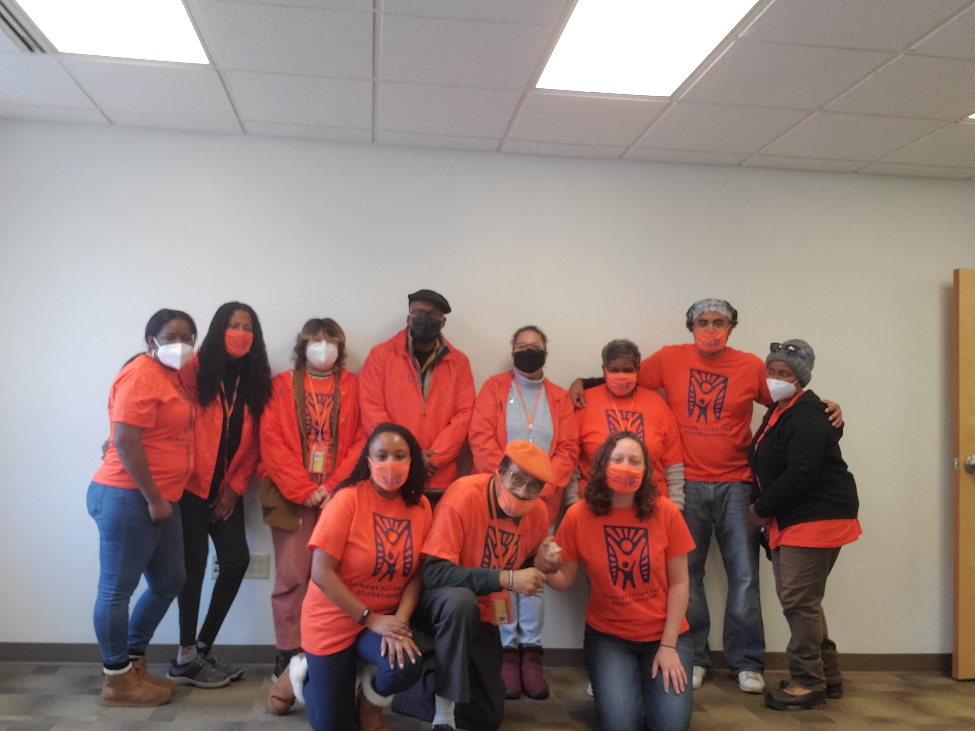
Thank you!
Get in touch.
Amy.Carroll-Scott@drexel.edu
Felice.Le-Sherban@drexel.edu
Erikka.Gilliam@drexel.edu
Richard.Dollery@drexel.edu
Christina.Brown@drexel.edu
Rita.Nelson@drexel.edu
Hyden.Terrell@drexel.edu

