Slide 1
Redefining Community Safety Research in Arizona
National Neighborhood Indicators Partnership,
October 28, 2022
Notes:
Cover Page Option 1

Slide 2
MISSION: To create, foster, and resource new models for safety and justice outside the punishment system. We work with people impacted by the punishment system to promote a holistic view of safety that encompasses physical, emotional, and economic health and wellness; cultivate the next generation of community leaders; and build community-based solutions.
Notes:
Cover Page Option 1

Slide 3
JCA Values
Every person has inherent and undeniable dignity, and every community has immeasurable worth.
Those directly impacted by the current punishment system must be leaders in the movement to end mass incarceration.
Local communities know best how to create safety and wellbeing for themselves; they should have agency in decisions that impact their lives, and these efforts should be fully supported and funded.

Slide 4
“Those closest to the problem are closest to the solution—but farthest from the resources” — Glenn Martin

Slide 5
Barrio Centro Community Safety Survey
https://afscarizona.org/wp-content/uploads/2021/10/Barrio-Centro-Report.pdf

Slide 6
“ Safe communities invest in arts, leisure, sustainable food systems, and take a proactive approach to ensuring people are active, healthy, and living in a thriving environment. ”
César Ruiz
BARRIO CENTRO, TUCSON, AZ

Slide 7
Tucson Community Safety Survey

Slide 8
Survey Objective
Using data to tackle racial injustice & inequity for low-income communities of color and drive progress toward a more equitable justice system
Organizing affected communities in Tucson, AZ to generate their own evidence of what constitutes safety in their neighborhoods.
Notes:
In this way, they will demonstrate a dramatically different road map for how City government can invest in real public safety for low-income communities of color.

Slide 13
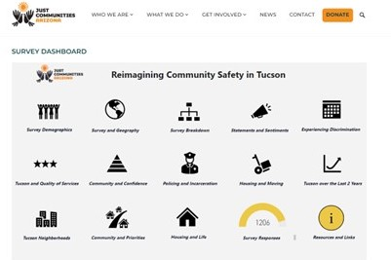

Slide 14
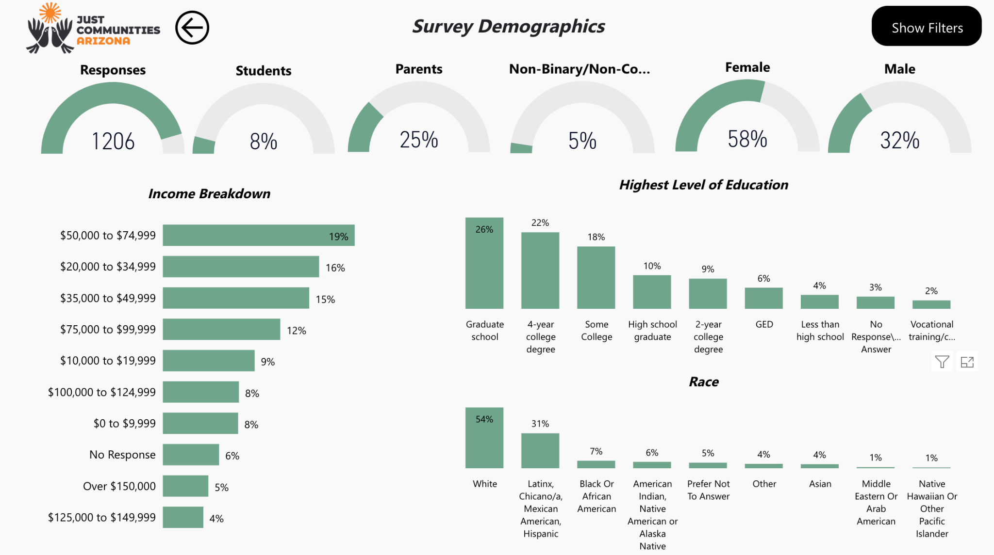

Slide 15
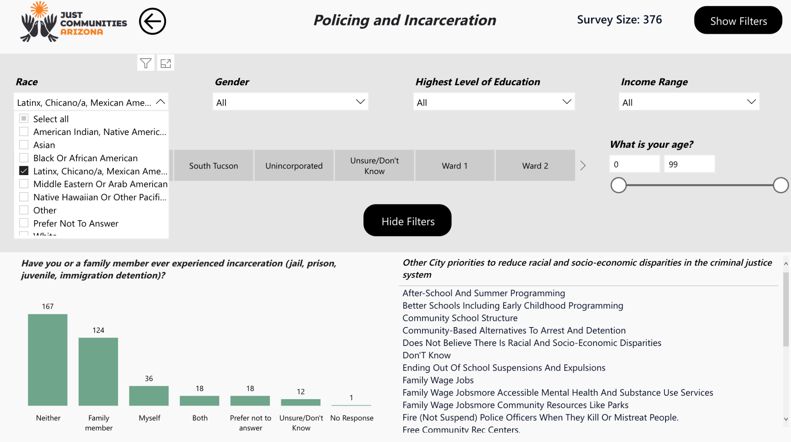

Slide 16
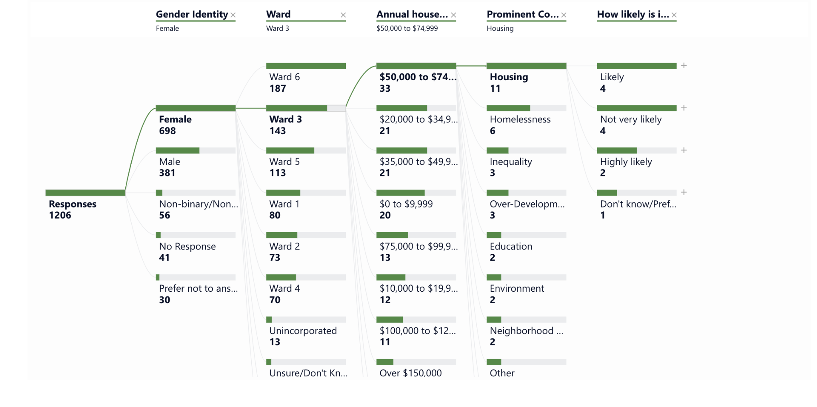

Slide 17
Survey Results

Slide 18
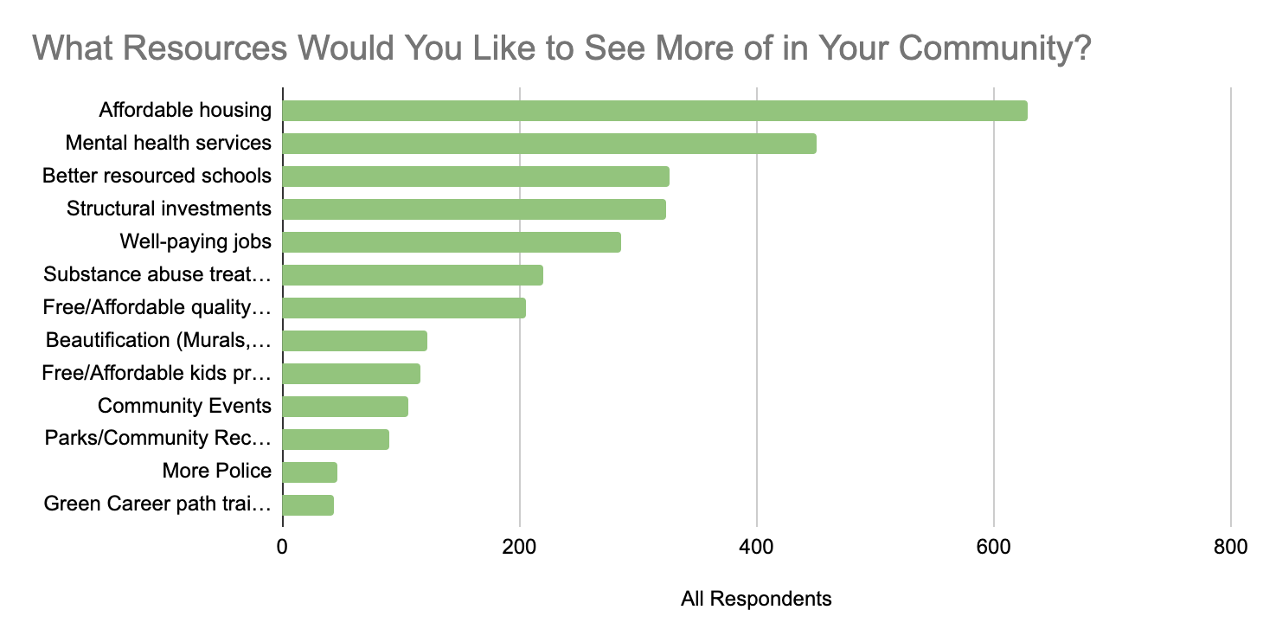

Slide 19
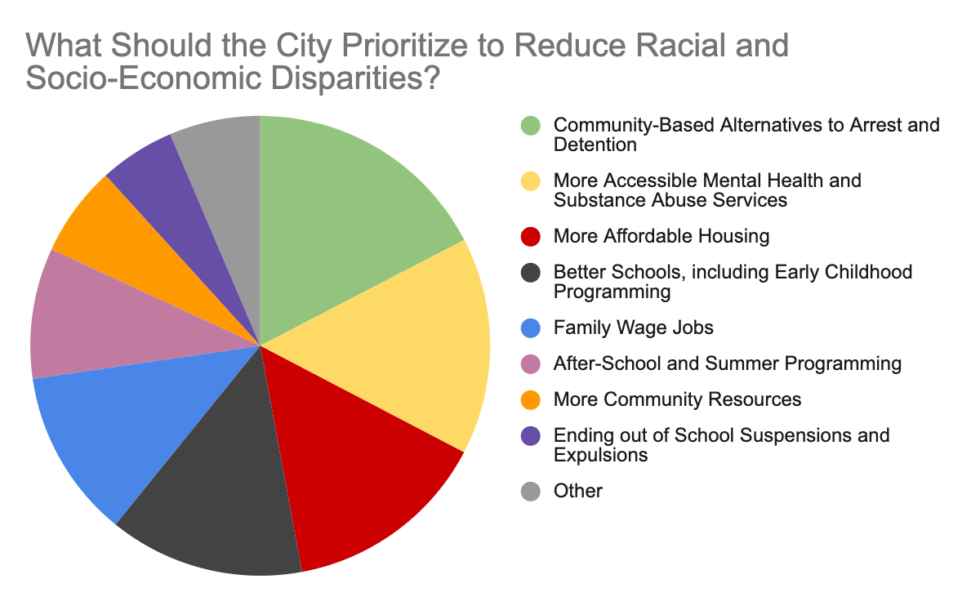

Slide 20
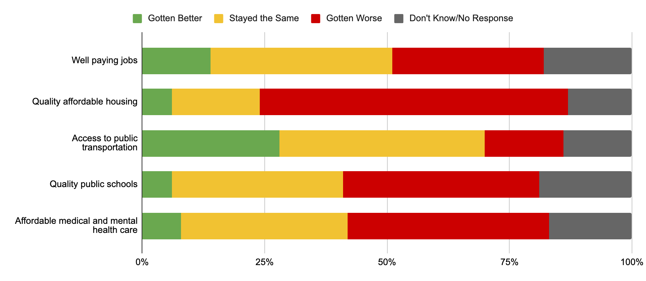

Slide 21
Thank you for your time!
Link to Survey Dashboard: https://justcommunitiesarizona.org/community-safety-survey/

