Slide 1
Integrating history and community data
SAVI 2022

Slide 2
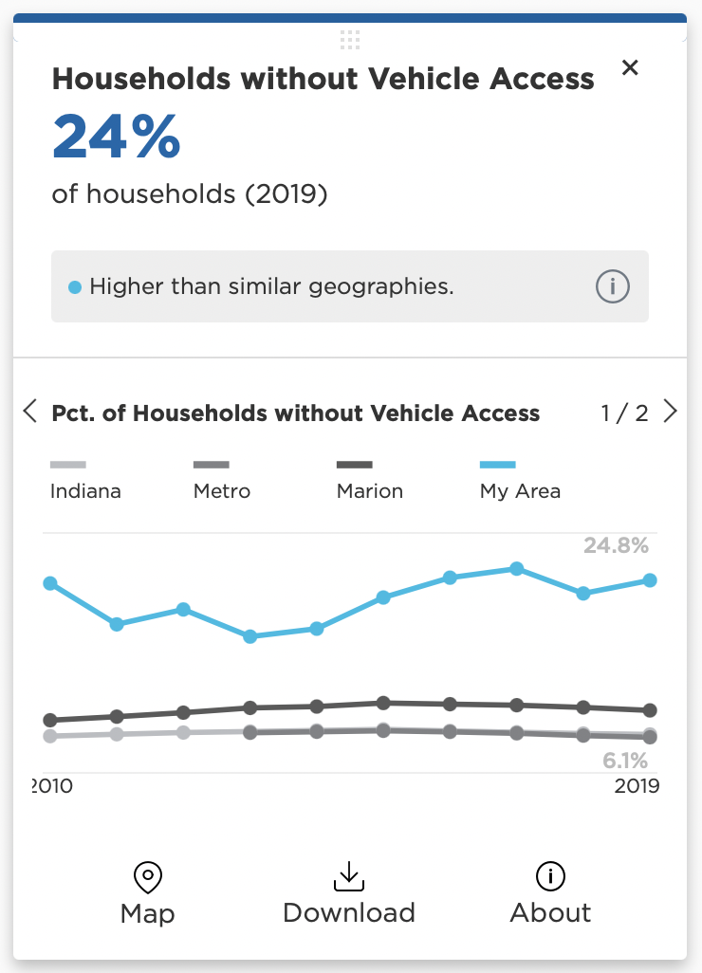
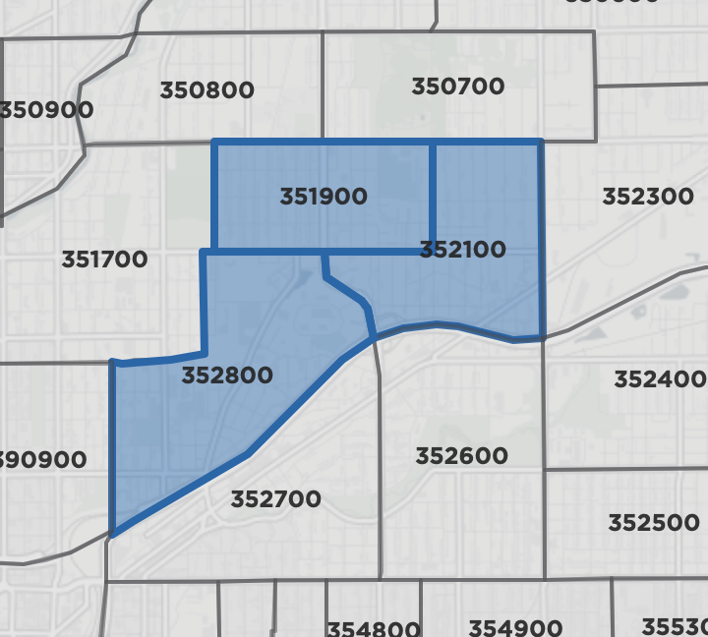
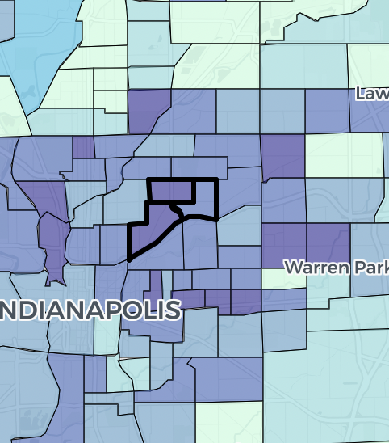
As a community data center, we’ve got our data tool…

Slide 3
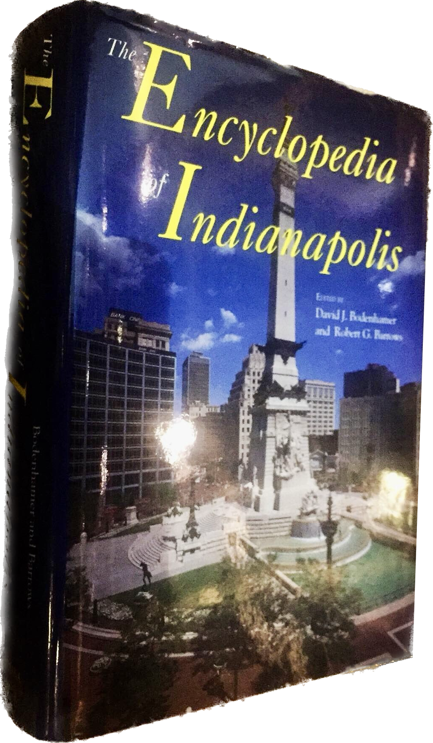
…and we’ve also got the Encyclopedia of Indianapolis.

Slide 4
In 2021 we launched the online Encyclopedia of Indianapolis.
This was a great opportunity to integrate data with history.

Slide 5
We did this two ways:
Include community data in encyclopedia entries
Link to encyclopedia entries from community data tools

Slide 6
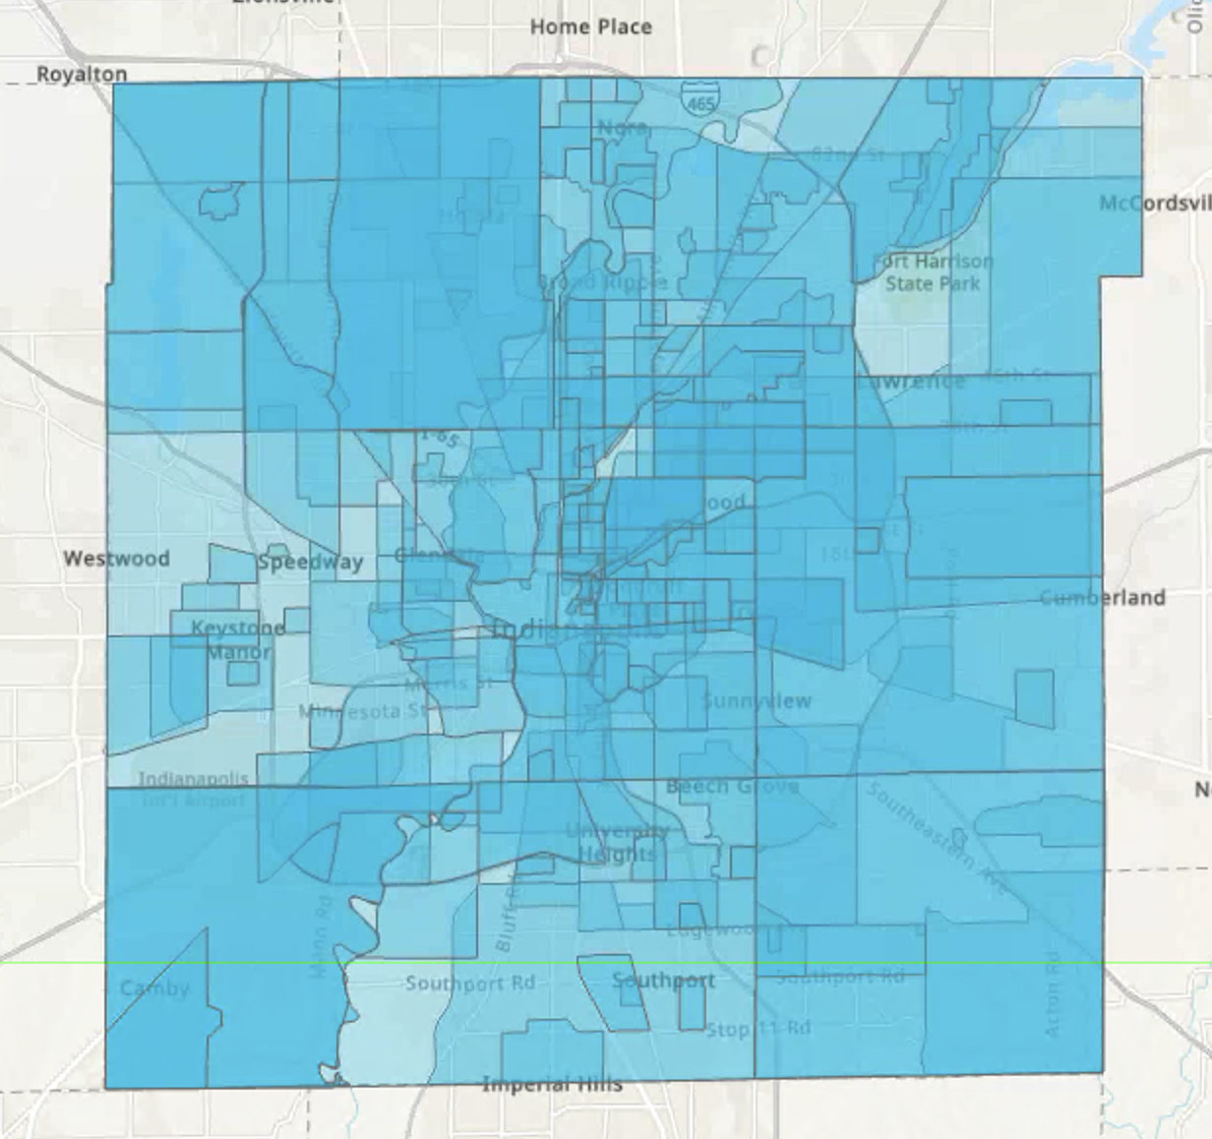
Indy neighborhoods are messy
We couldn’t have a 1:1 relationship between neighborhoods in SAVI and neighborhoods in the encyclopedia.

Slide 7
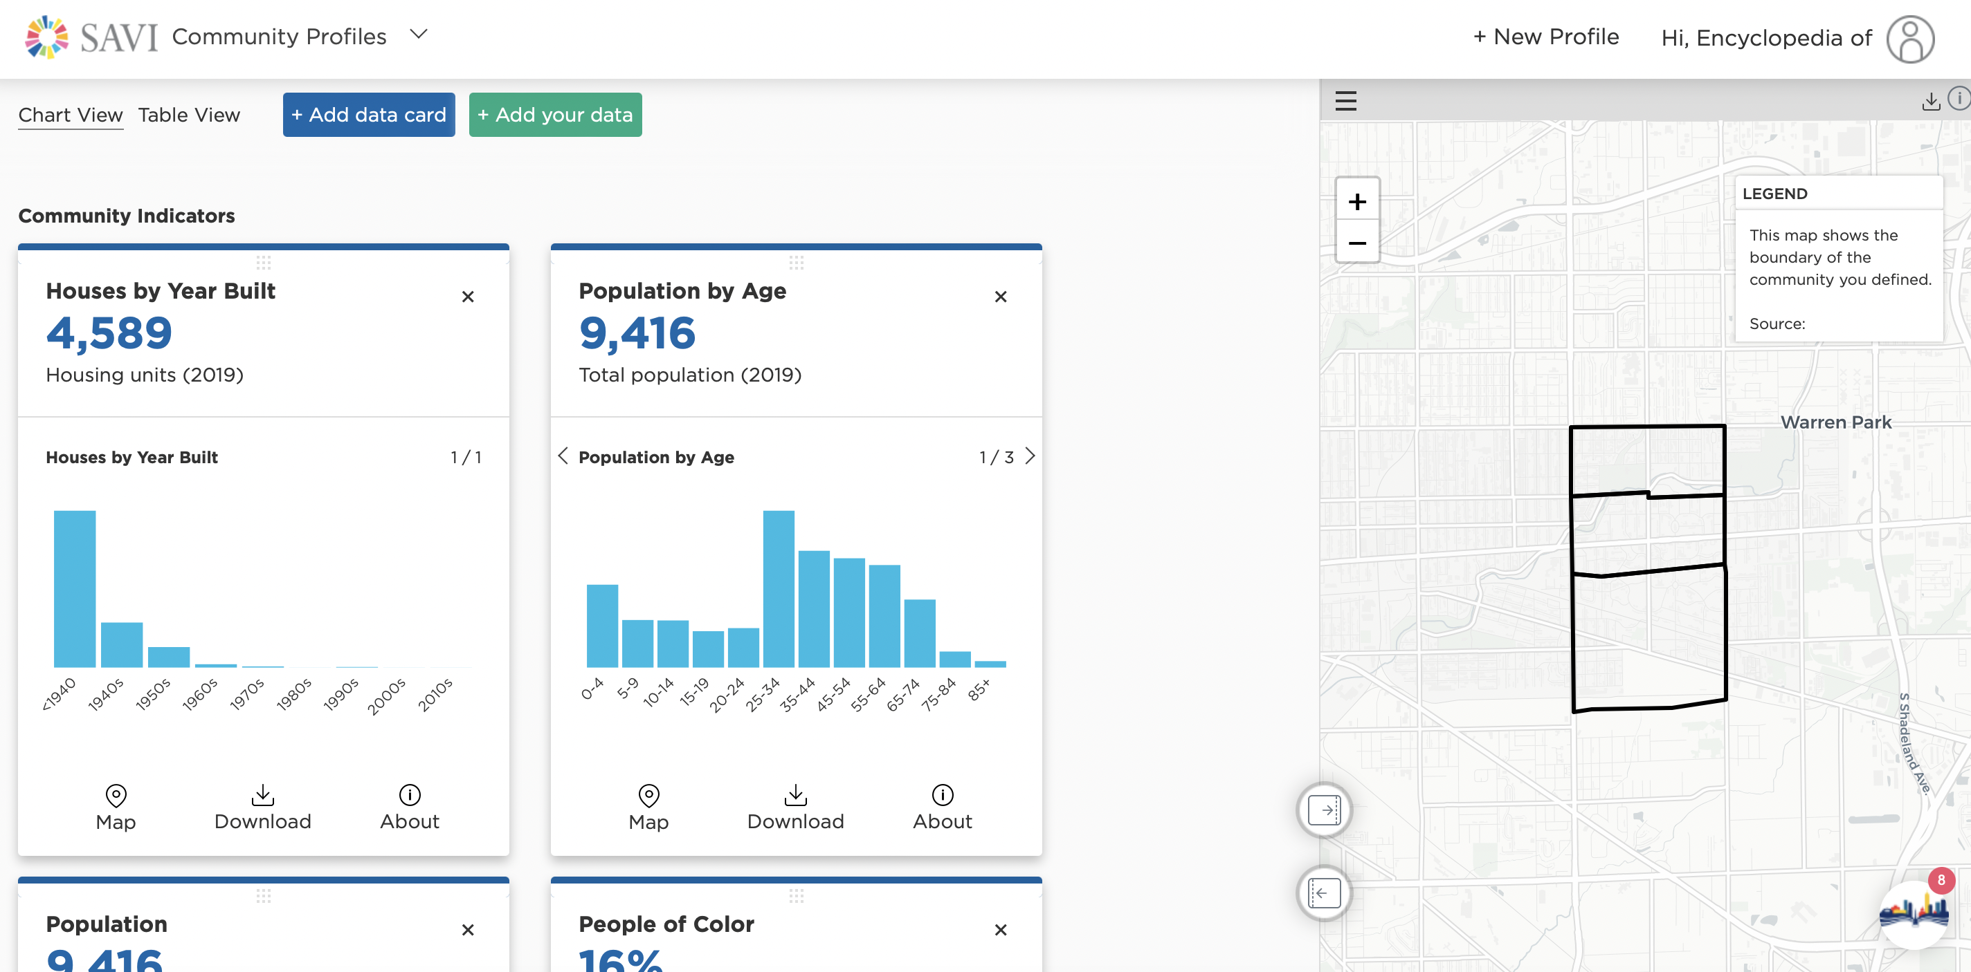
Instead, we built custom boundaries for each neighborhood in the encyclopedia.

Slide 8
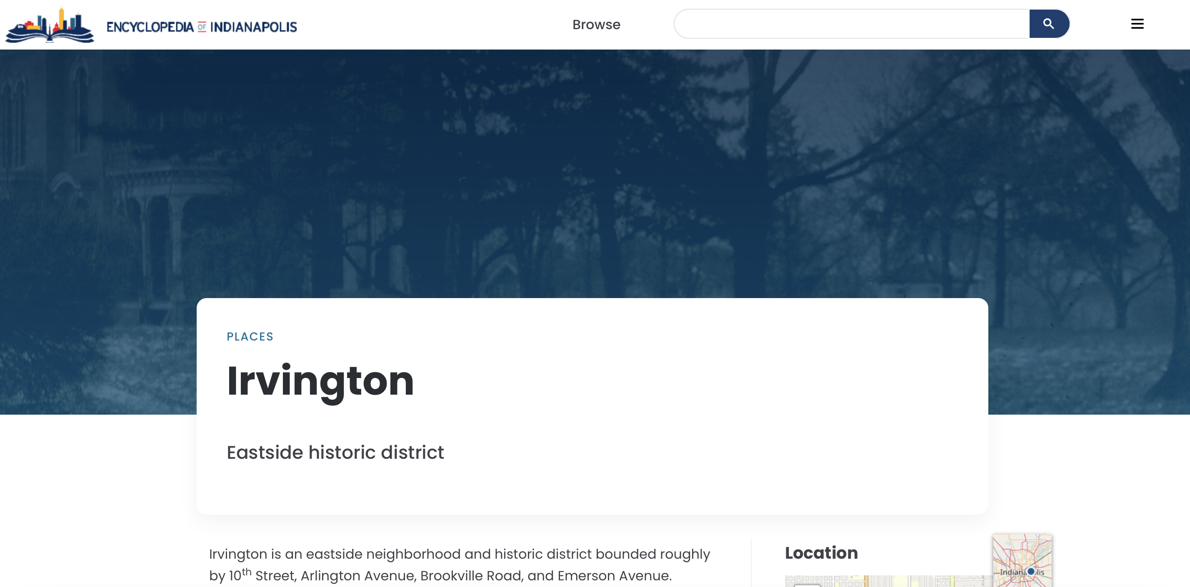
Now we could pull in this data through our API into the encyclopedia to visualize it.

Slide 9
Now we could pull in this data through our API into the encyclopedia to visualize it.

Slide 10
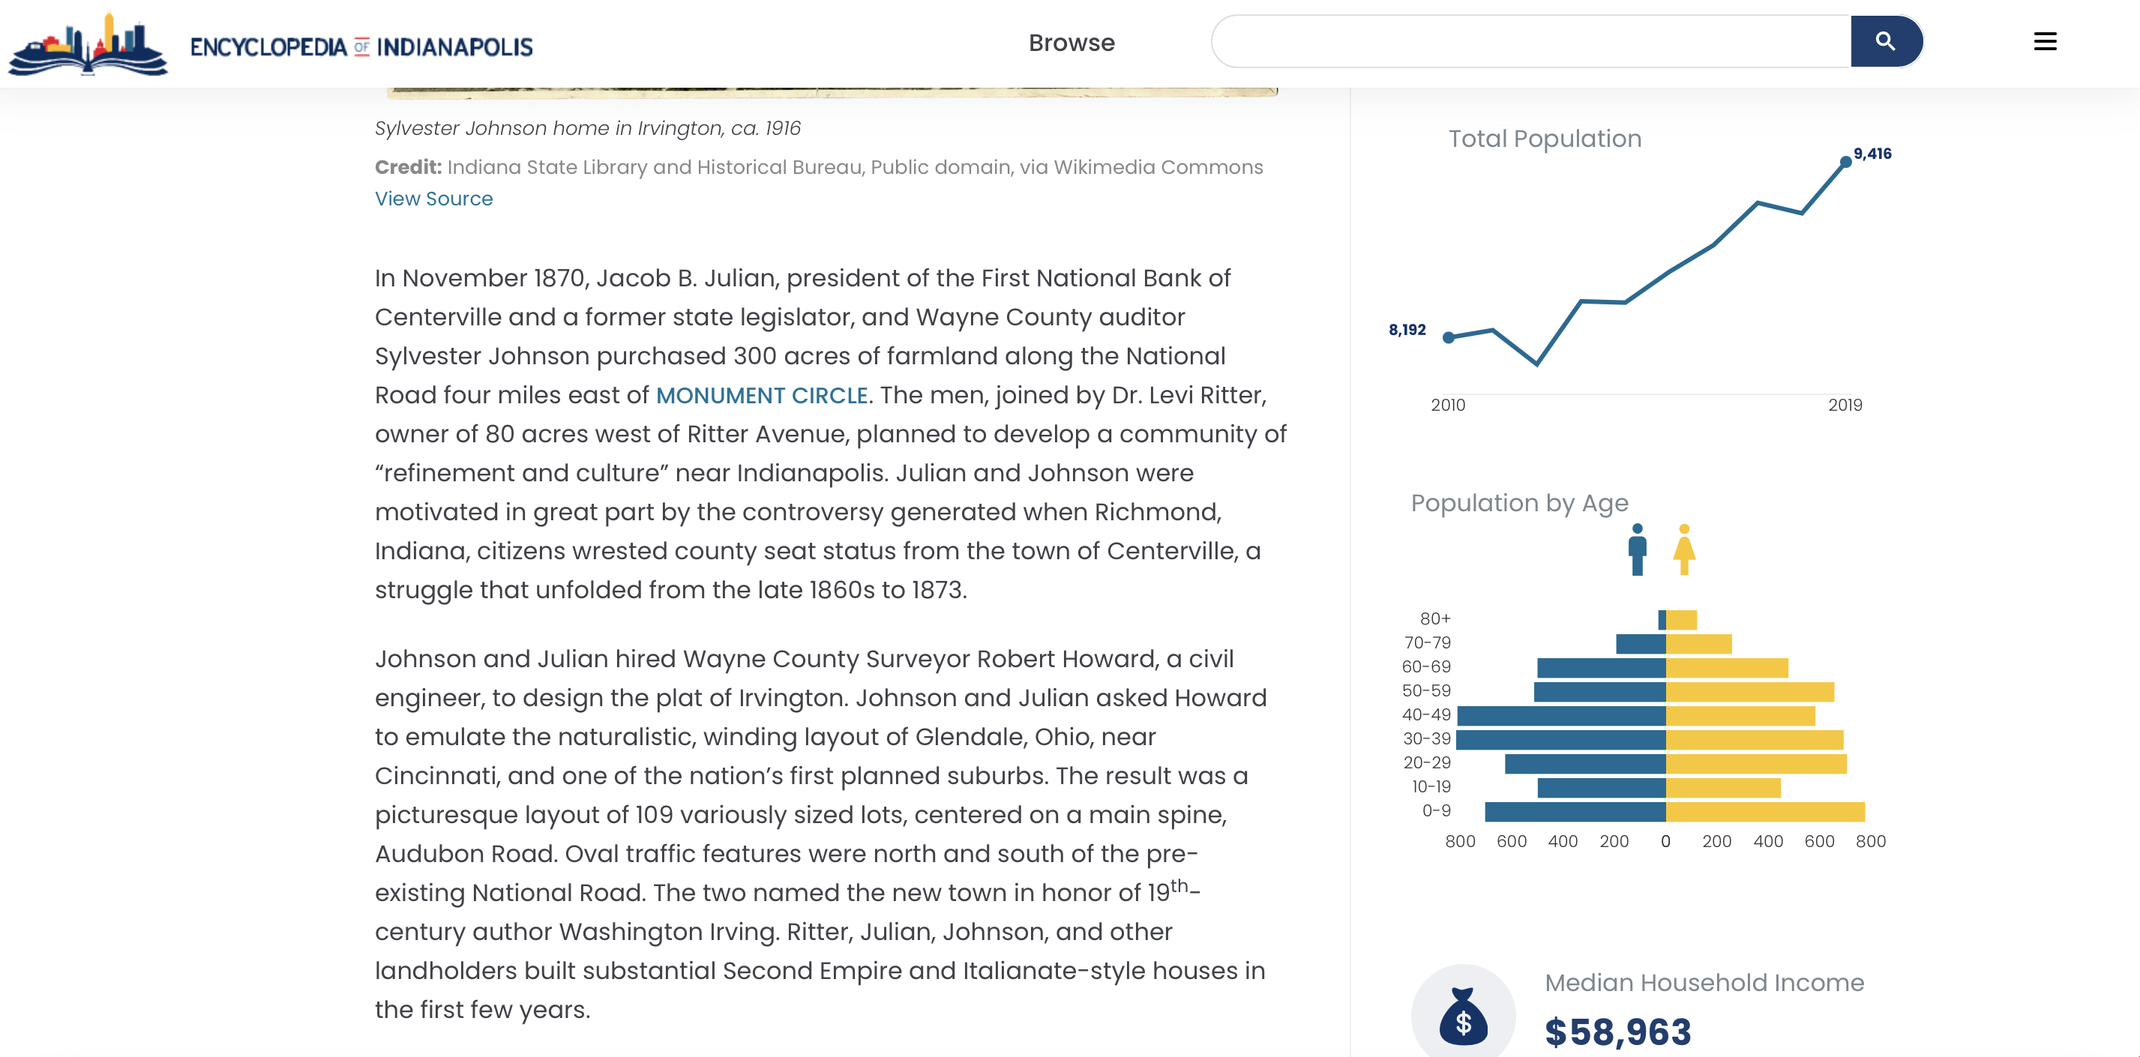
Now we could pull in this data through our API into the encyclopedia to visualize it.

Slide 11
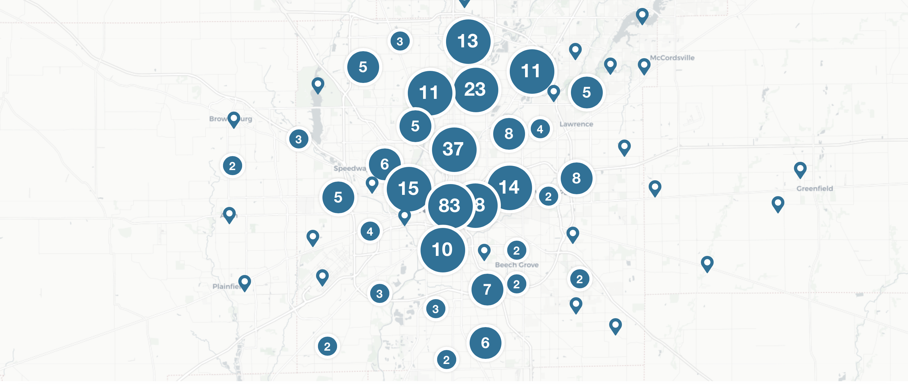
We had geolocated entries across the whole region, and not just neighborhoods.

Slide 12
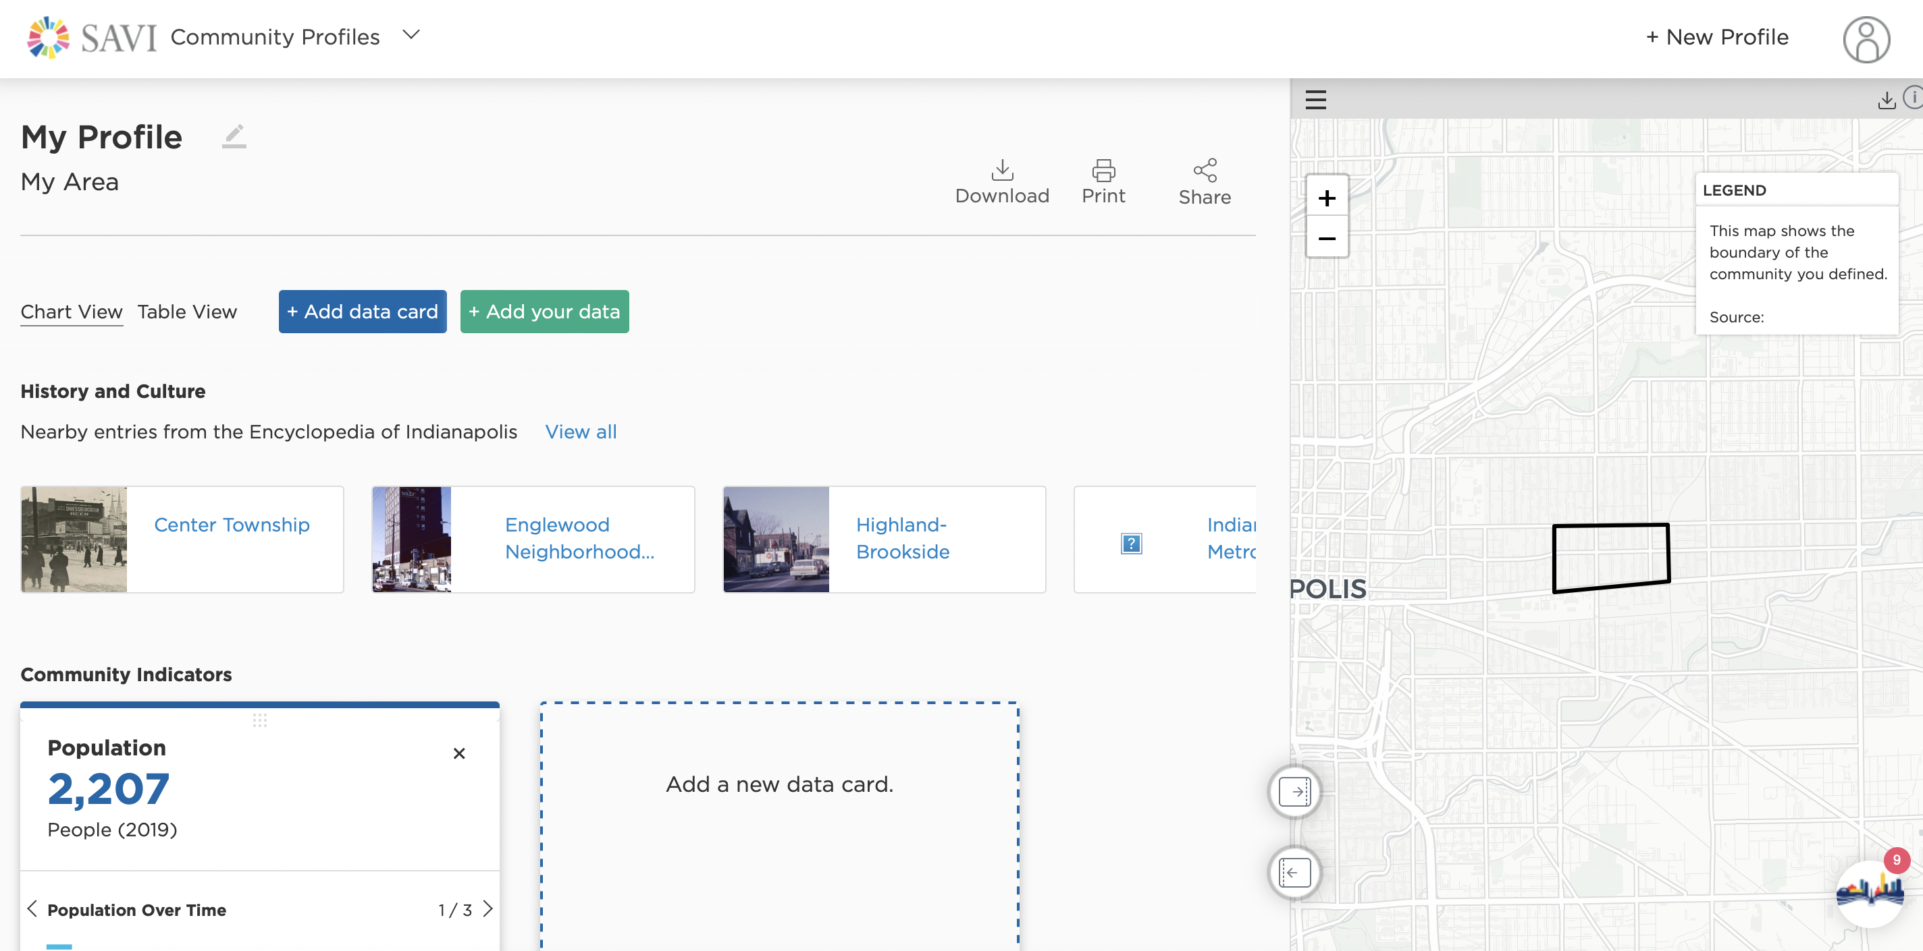
These can be pulled into SAVI when they intersect your community polygon.

Slide 13
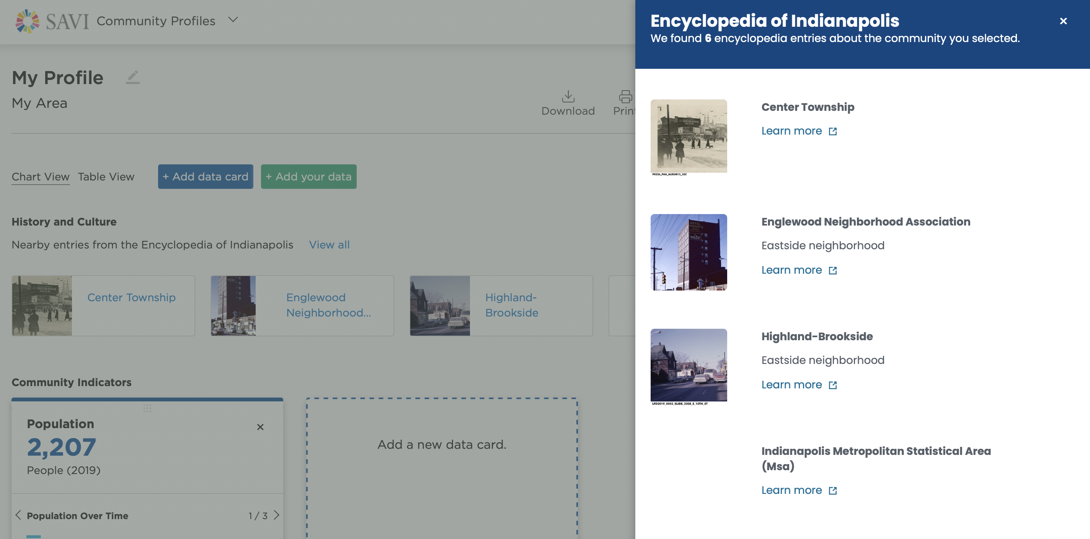
These can be pulled into SAVI when they intersect your community polygon.

