Slide 1
Michigan Statewide Nonprofit Leadership Census 2022
Jordan Graves, Data Analyst, Data Driven Detroit
Melyssa Tsai O'Brien, Research Manager, Community Data and Research Lab, Dorothy A. Johnson Center for Philanthropy
Jeff Williams, Director, Community Data and Research Lab, Dorothy A. Johnson Center for Philanthropy
NNIP Partnership Meeting | October 28, 2022

Slide 2
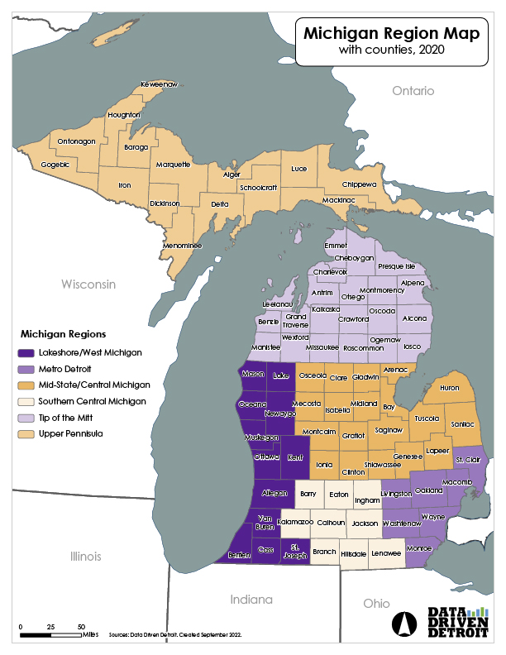
PROJECT GOALS
Build the first detailed dataset about the demographics of nonprofit leaders, board members, and staff in Michigan
Focus on nonprofit leaders who are Black, Indigenous, and People of Color in the state

Slide 3
PROJECT SCOPE

Slide 4
OVERSIGHT GROUPS
Statewide advisory council | Design of survey instrument
Regional taskforce | Messaging for data collection

Slide 5
DATA COLLECTION
Pilot survey Oct 2021
Survey
Jan – April 1, 2022
Participatory data analysis
Aug – Sep 2022

Slide 6
RESPONSE RATE

Slide 7
REPRESENTATIVENESS BY NONPROFIT UNIVERSE
Region
Annual
revenue
Organizational age
Subsector

Slide 8
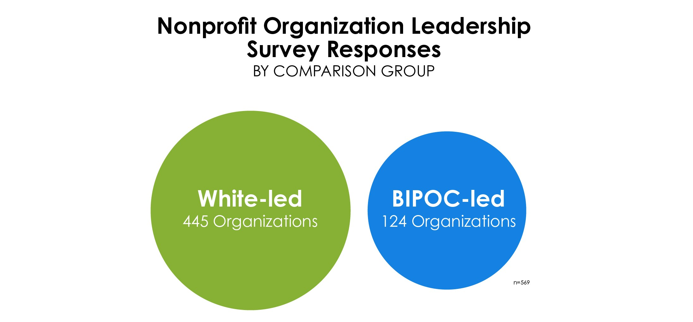
FINDINGS

Slide 9
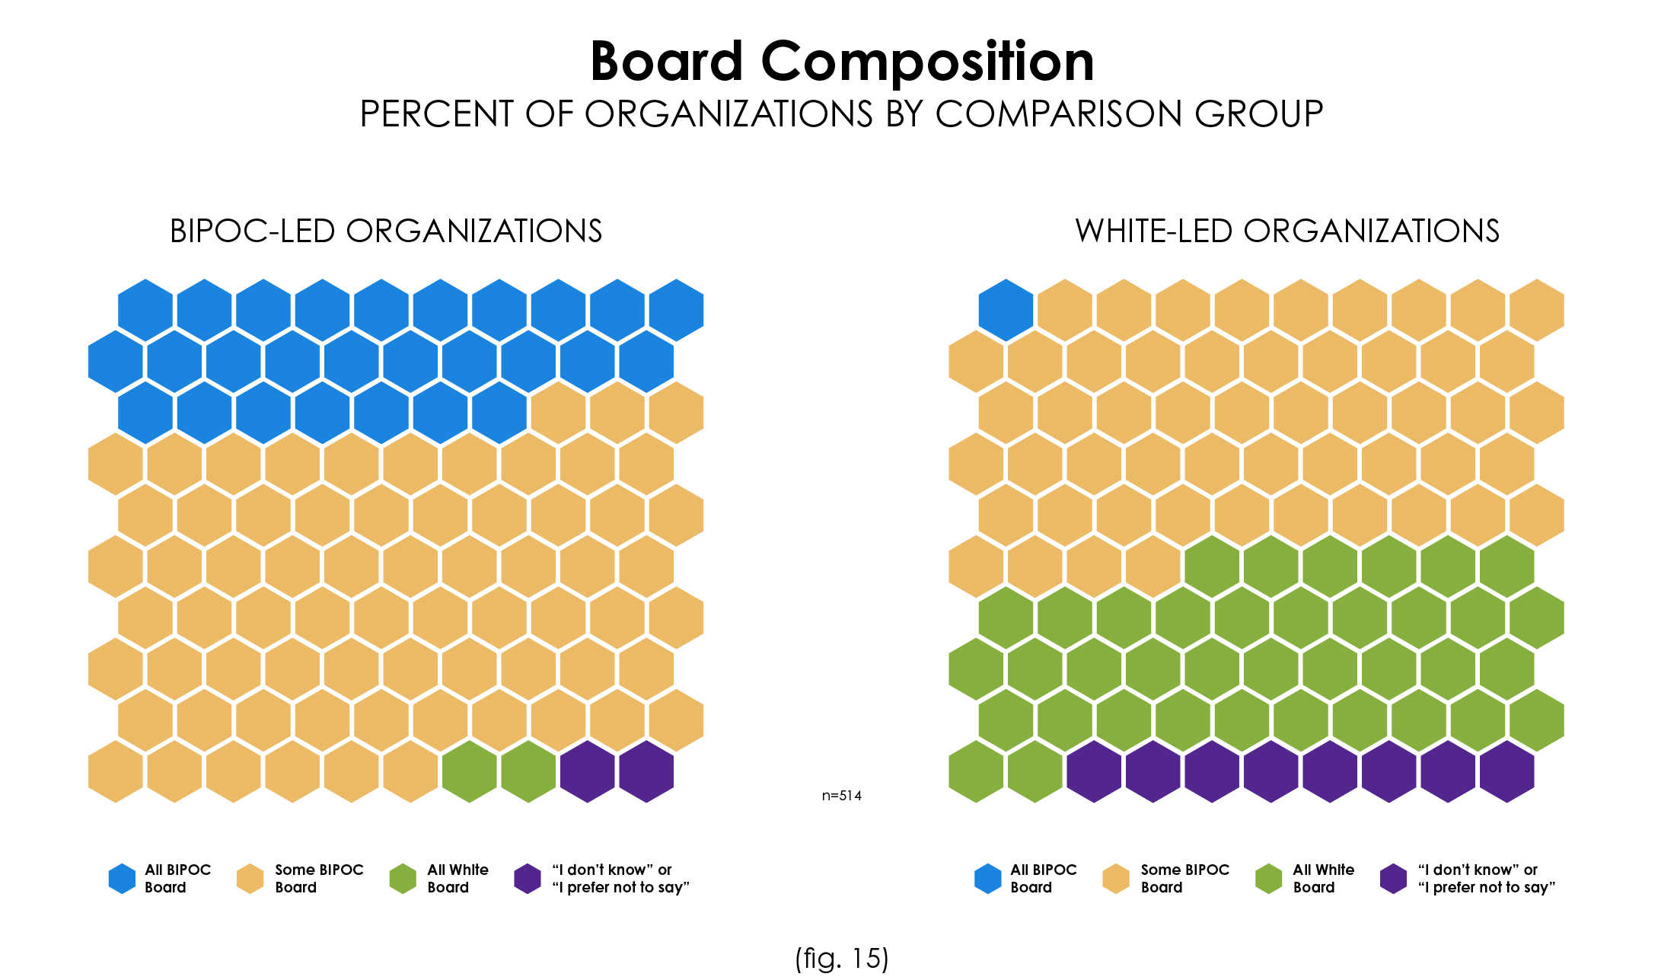
FINDINGS

Slide 10
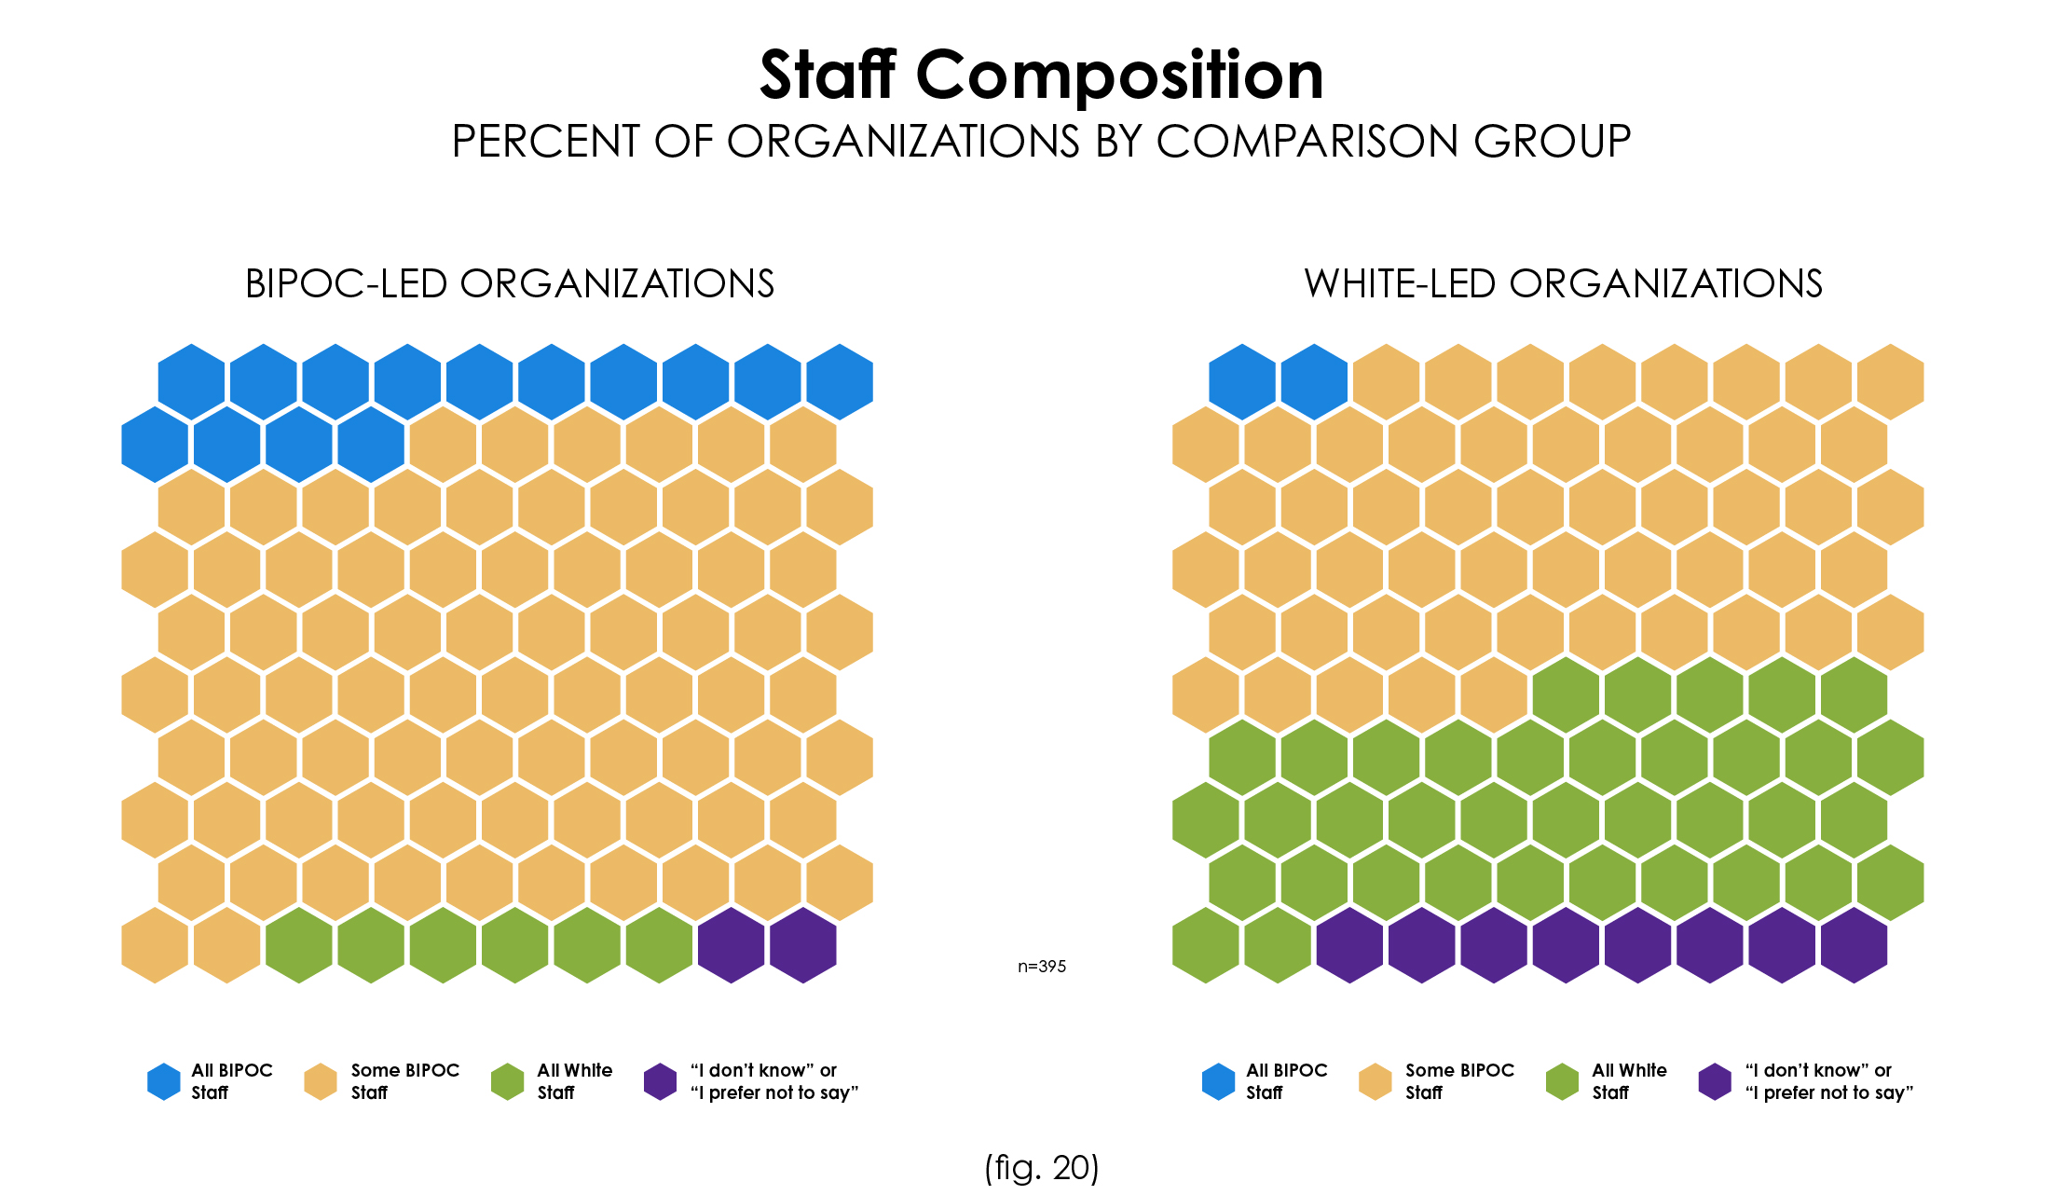
FINDINGS

Slide 11
KEY TAKEAWAYS
The power of networks
Sample was representative at the statewide level
Not enough respondents for regional data
Curious to see additional state-to-state comparisons
Being honest and accurate about scope of what we could collect helped guide process
What nonprofits want to see next: comparisons to communities served

Slide 12
Want to know more?

Slide 13
STORYMAP

Slide 14
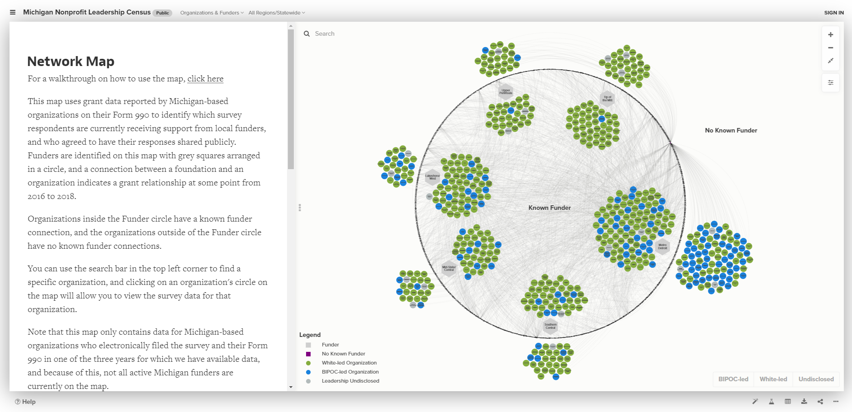
NETWORK MAP

Slide 15
QUESTIONS?
Contact Us
Jeff Williams
jeff.williams@gvsu.edu
Melyssa Tsai O'Brien
tsaim@gvsu.edu
Jordan Graves
jordan@datadrivendetroit.org

