Slide 1
The Ghost Neighborhoods of Columbus project
Nicole Hall
Center for Urban and Regional Analysis
October 2022

Slide 3
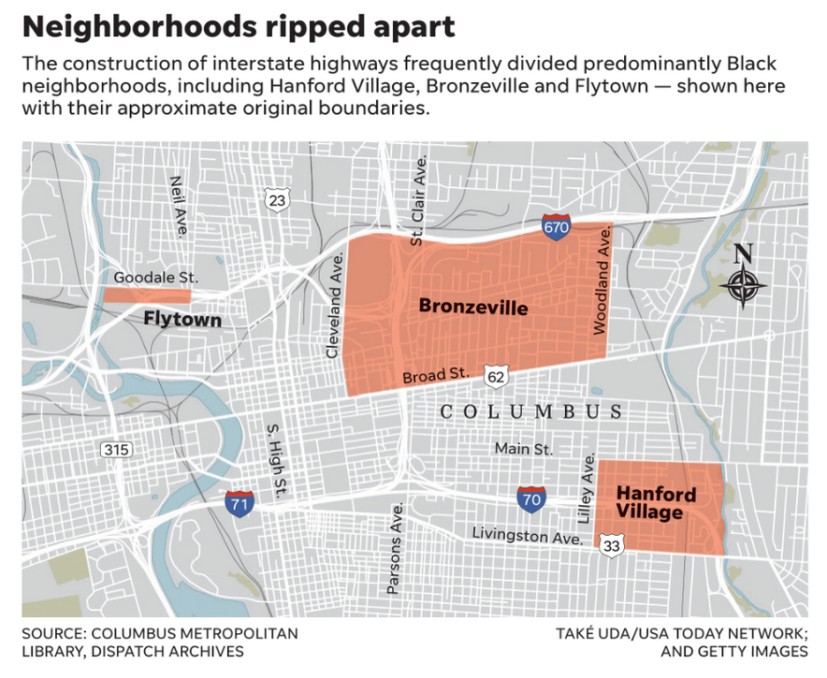
Columbus Dispatch December 3, 2020

Slide 4
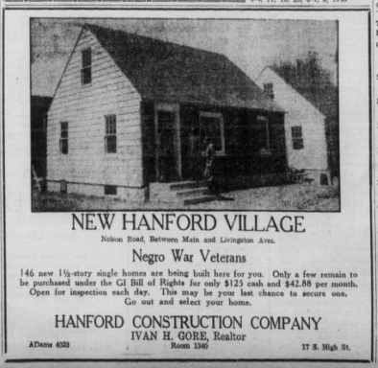
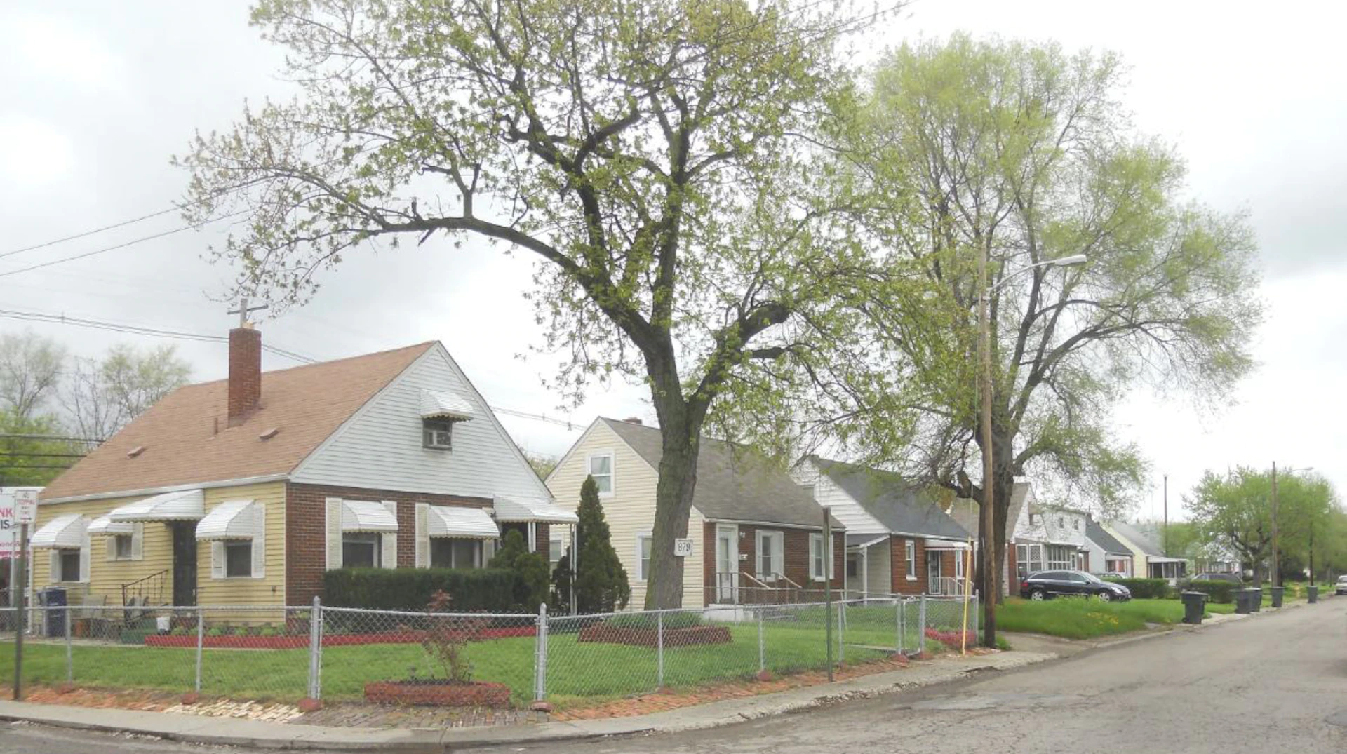
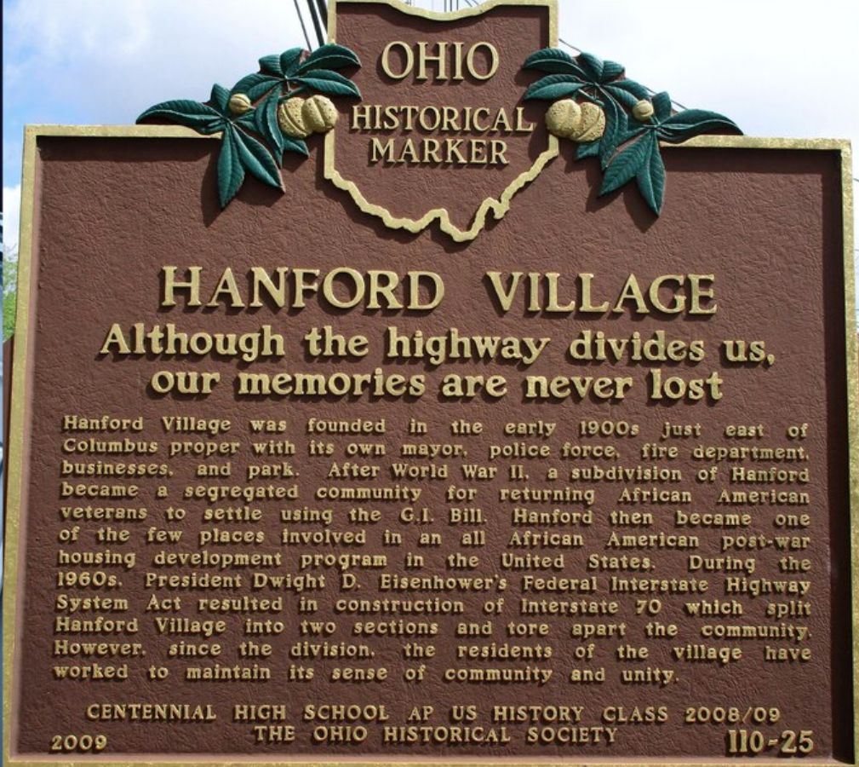
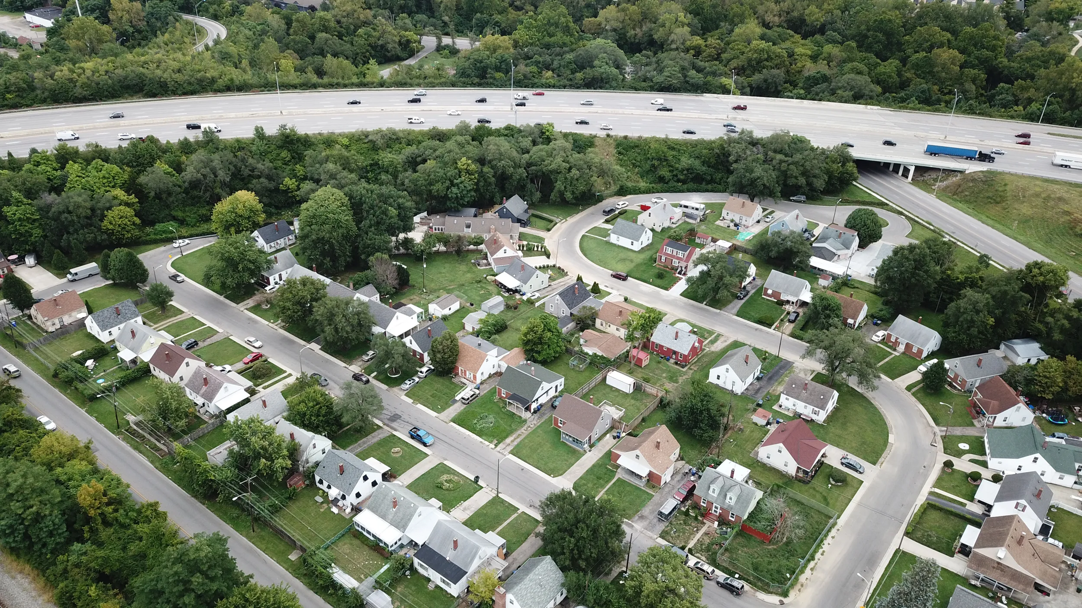

Slide 5
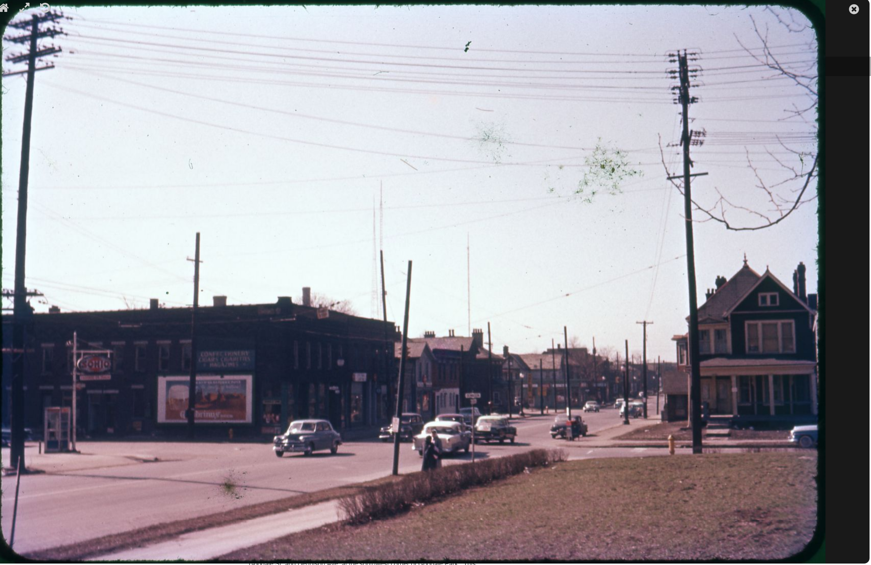
Flytown: Looking southwest from Goodale Park at the intersection of Goodale and Dennison
March 3, 1957 (prior to construction)
Source: Columbus Metropolitan Libraries

Slide 6
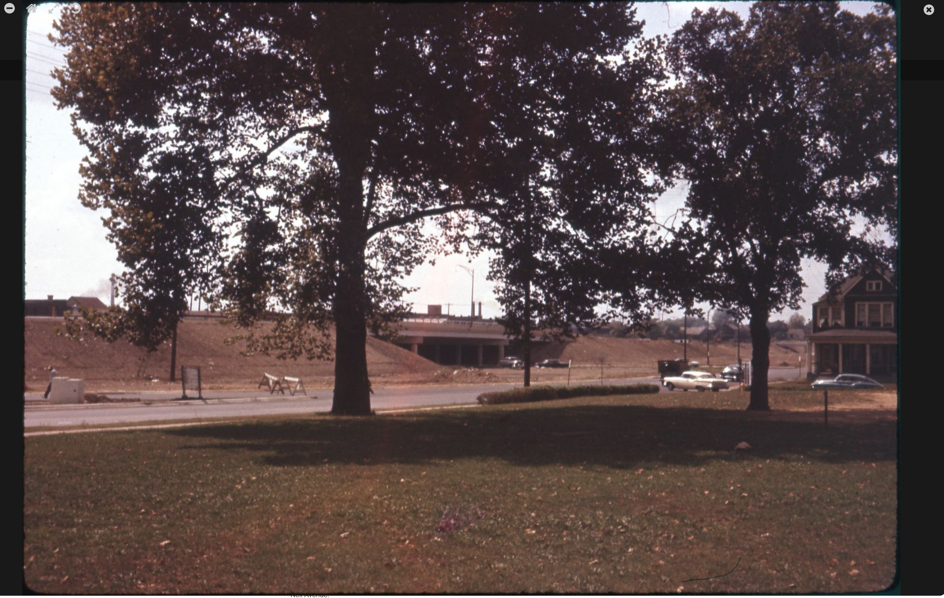
Flytown: Looking southwest from Goodale Park at the intersection of Goodale and Dennison
September 8, 1959 (after construction)
Source: Columbus Metropolitan Libraries

Slide 7
Ghost Neighborhoods project
Objectives
Reconstruct lost neighborhoods in Columbus
Hanford Village
Flytown
East Franklinton
Others…
High resolution digital reconstructions
Parcels, buildings - # floors, construction material, usage
Products
Maps with database
3D visualizations via ArcGIS Urban
Story maps
Scalable: Automated or semi-automated

Slide 8
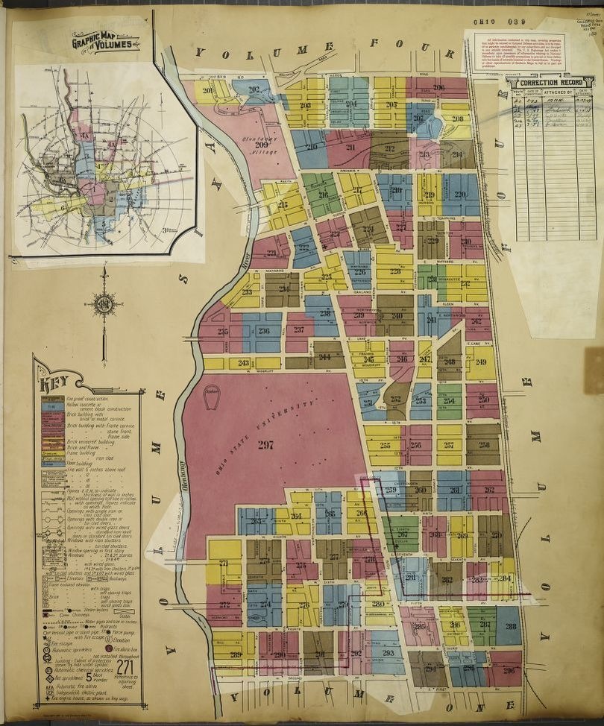
Data
Sanborn Fire Atlas
Building level maps
Columbus: 1887, 1891, 1901, 1921-1922, 1951
Availability
OSU Library – print and microfilm
Ohio Public Library Information Network – B&W only
Library of Congress – full color high resolution scans

Slide 9
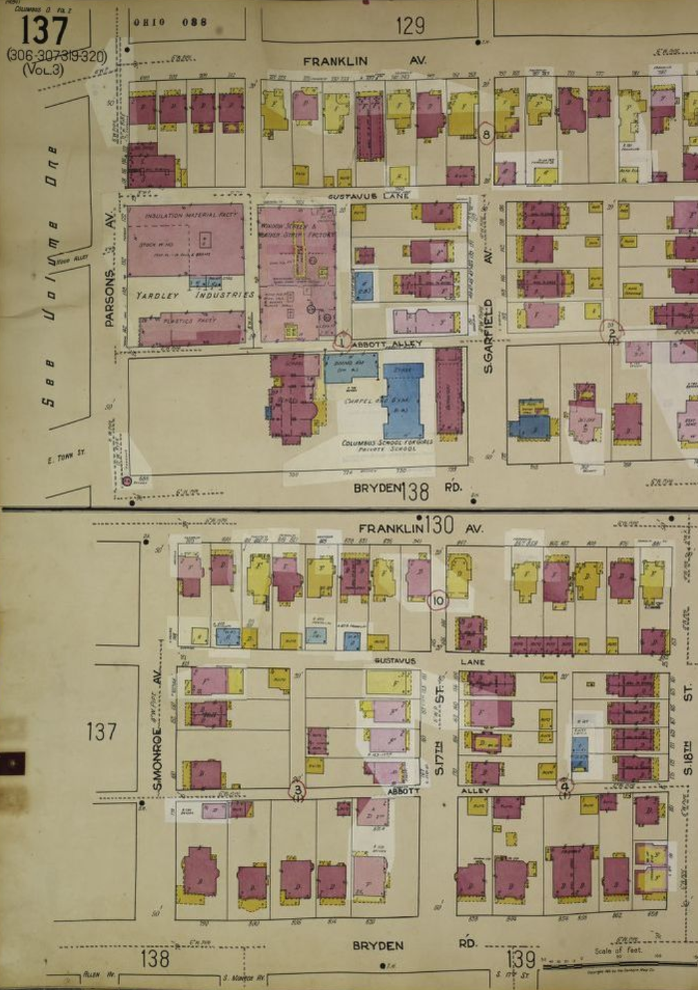
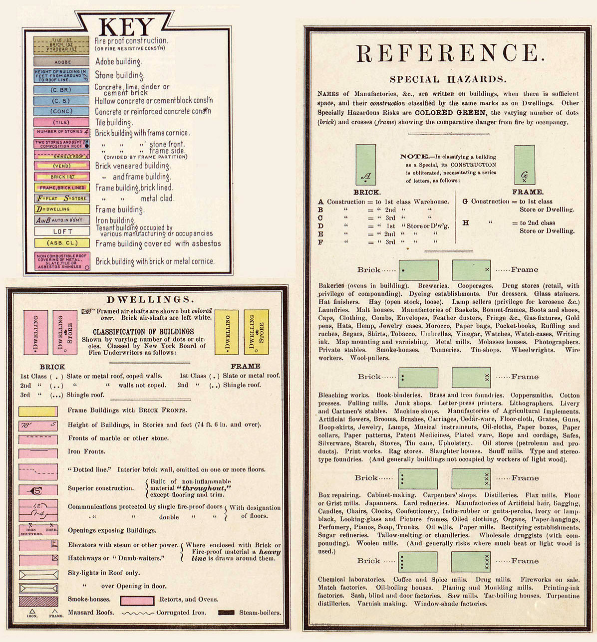
Steps
Georeference atlas sheets
Segment objects (building footprints) and extract attributes from annotations

Slide 10
Methods
SVM – Support Vector Machines – a form of machine learning

Slide 11
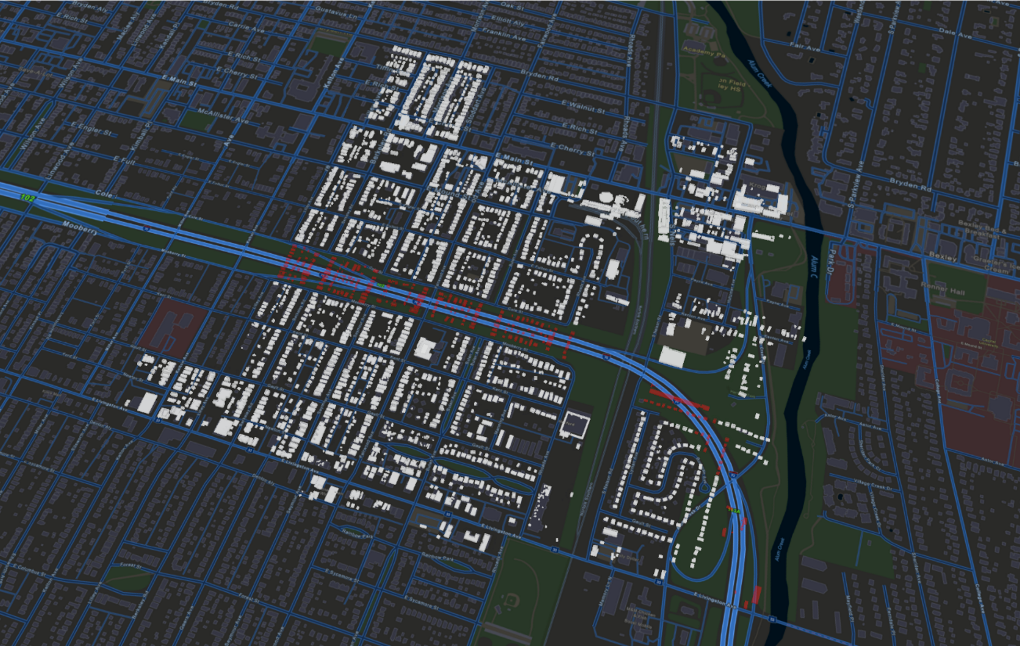
Preliminary results
First generation product: Abstract buildings (ArcGIS Scene Viewer)

Slide 12
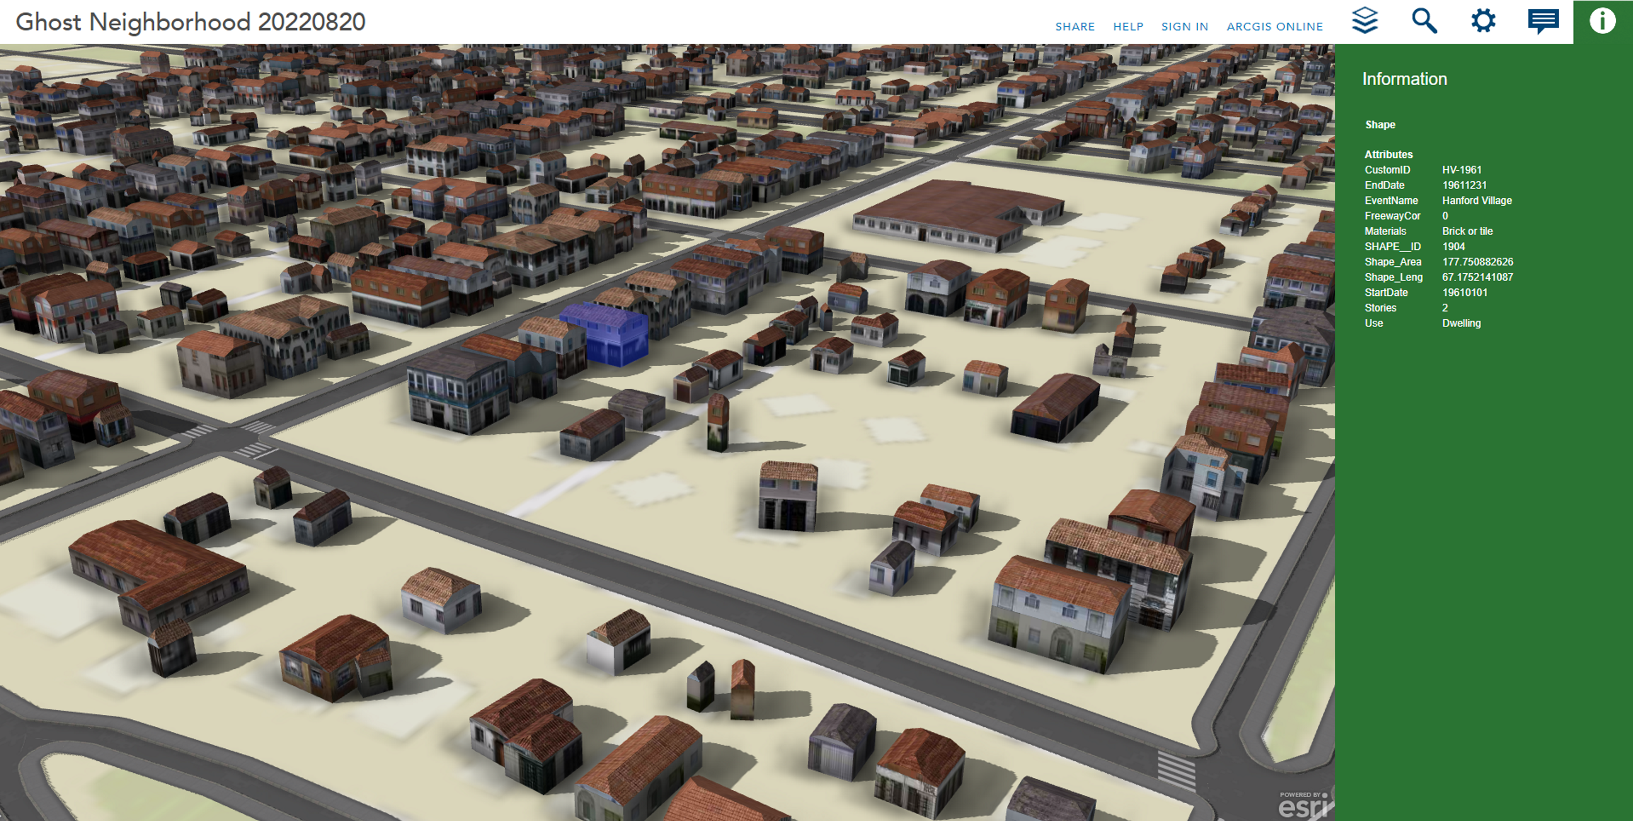
Preliminary results
Second generation product: Abstract buildings (ArcGIS City Engine)

Slide 13
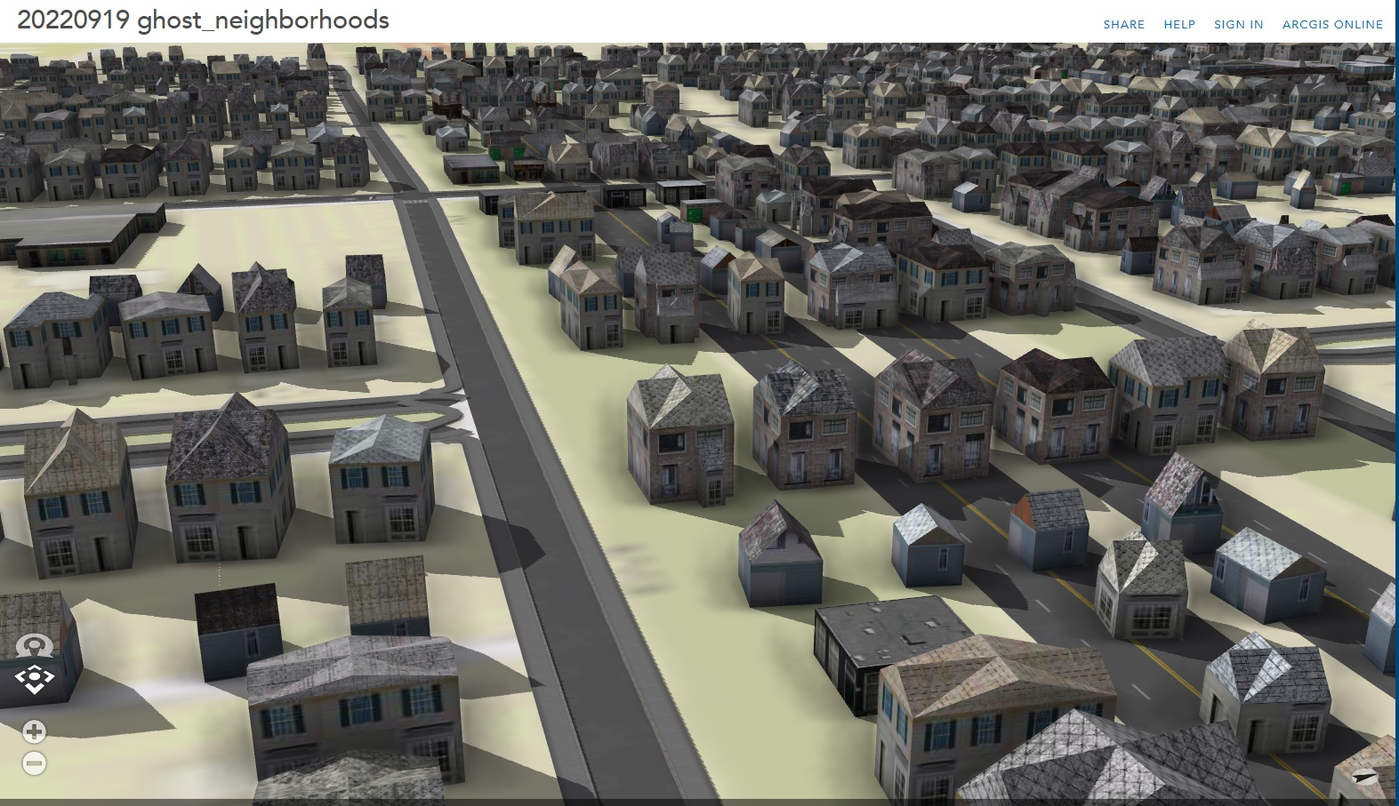
Preliminary results
Second generation product: Architectural Character Refined (ArcGIS City Engine)

Slide 14
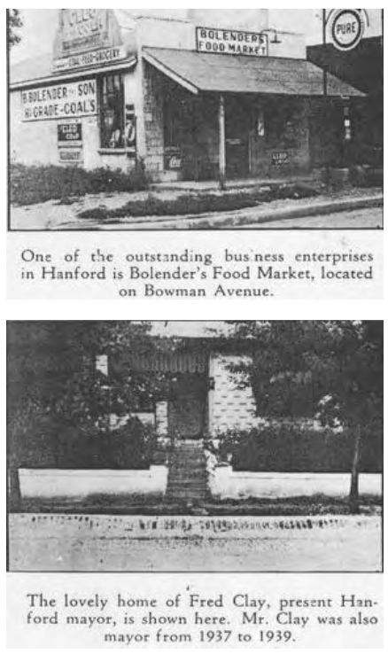
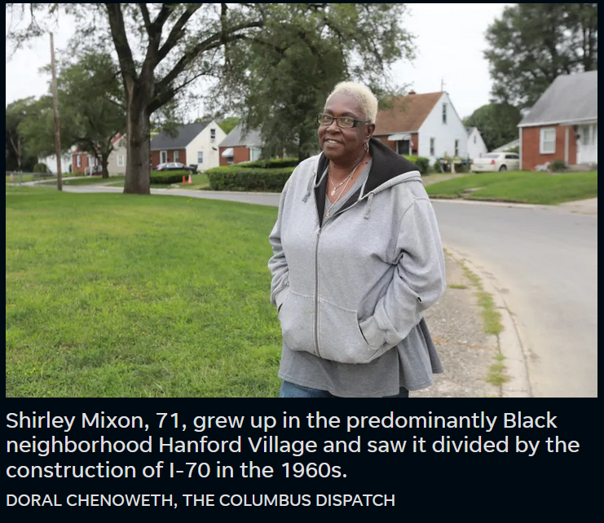
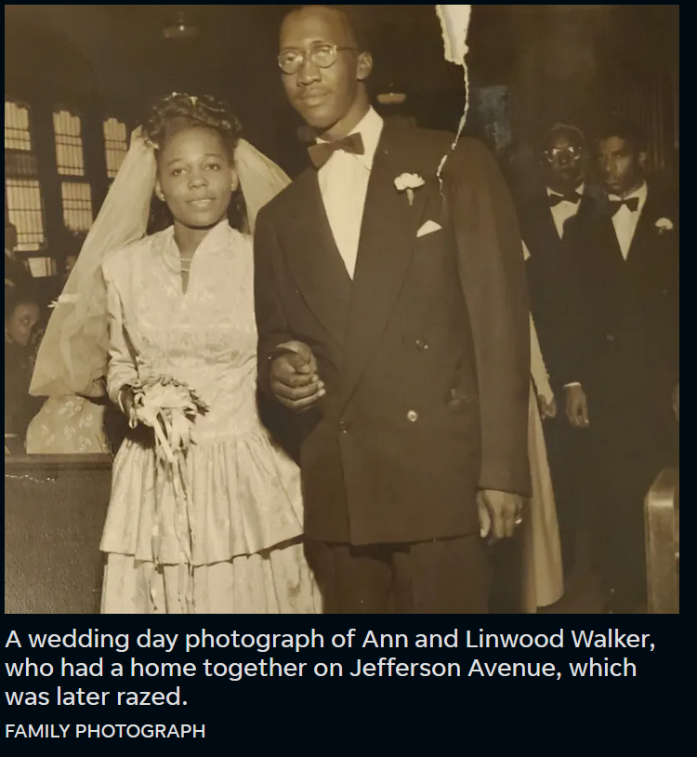
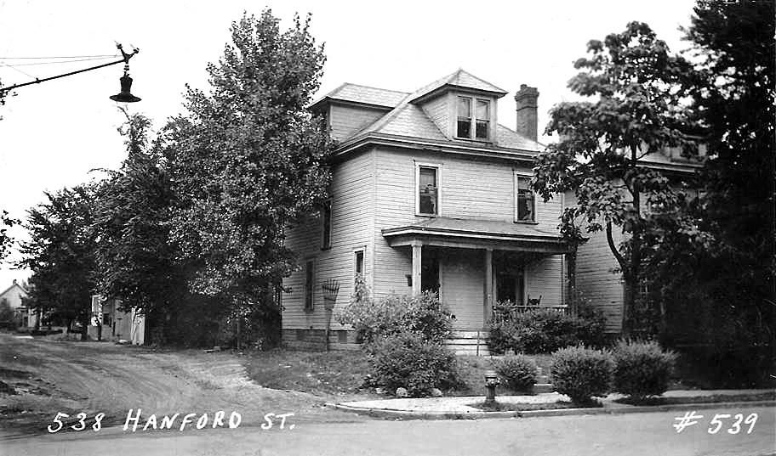
Data
Other data
Historic parcel data
Business permits
Street imagery
Historical documents
National Historic GIS
Stories, memories from residents
Source: Columbus Dispatch; Columbus Metropolitan Libraries

Slide 15
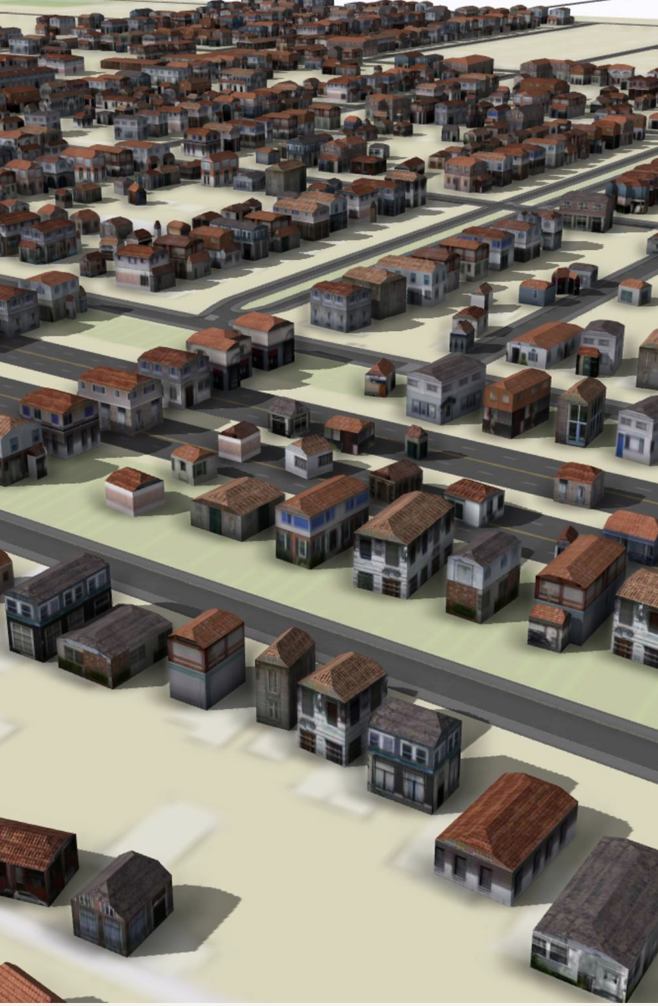
Department of Geography
Center for Urban and Regional Analysis (CURA)
Project team
CURA
Harvey Miller – Director
Ningchuan Xiao – Associate Director
Gerika Logan – Outreach Coordinator
Nicole Hall – Consulting Manager
Yue Lin – Graduate Research Associate
Jialin Li – Graduate Research Associate
Michael Smith – Undergraduate Research Associate
Eva Heyer - Undergraduate Research Associate
Collaborators
Jason Reece – Knowlton School
Joshua Sadvari – OSU Libraries
Adam Porr – Mid-Ohio Regional Planning Commission
Follow our progress at cura.osu.edu

