Slide 1
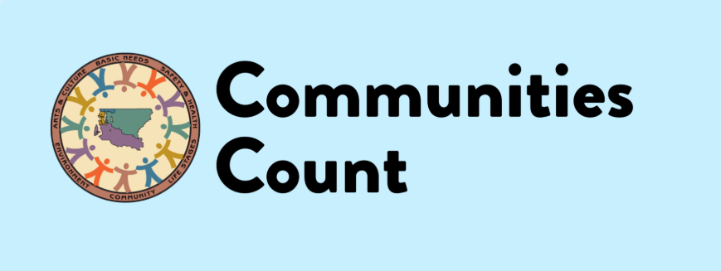
Data Biographies:
Transparency for Equity
Sara Jaye Sanford
October 2022
Notes:
Hi Everyone. My name is Sara Jaye and today I’ll be sharing my experience developing data biographies. I work as an epidemiologist at Public Health – Seattle and King County, in our Assessment, Policy Development, and Evaluation Unit, which is home to Communities Count, a public – private partnership, with staff based in the health department. Communities Count is a resource that supports King County communities using data to promote equity by providing data resources and trainings to King County communities & Highlighting data on disparities, inequities and strengths in our community.

Slide 2
So. Much. Data.
Healthy Youth Survey
Death
Medicaid
American Community Survey
Birth
Behavioral Risk Factor Surveillance System
Hospitalization
Housing Authorities
Medicare
Unemployment
Best Starts for Kids Health Survey
Notes:
So how do we do that? Like any good indicator project, we use data from lots of different sources.
If this slide looks a little wild, it’s meant to, because our data sources are very different too. Our data comes in all shapes and sizes, and this list is NOT exhaustive. It includes administrative data from government programs like unemployment, public education, and Medicaid. It includes survey data, vital statistics, and more.

Slide 3
So. Many. Data owners.
Washington State Department of Health
US Census Bureau
Washington State Health Care Authority
US Centers for Disease Control and Prevention
Housing Authorities
Office of the Superintendent of Public Instruction
Public Health – Seattle & King County
Notes:
We work with data from many different “owners” or stewards. Again, this is just a small sample of partners who share data with us, and again you can see that it’s a bit of a “crazy quilt.” Really only a little of our data is actually collected by us at the health department. I am guessing this is also familiar to most indicator projects!

Slide 4
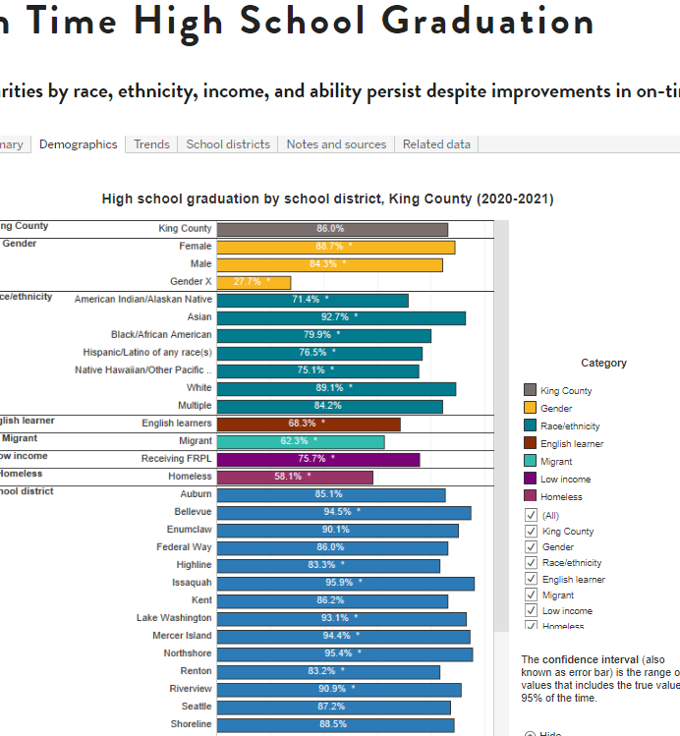
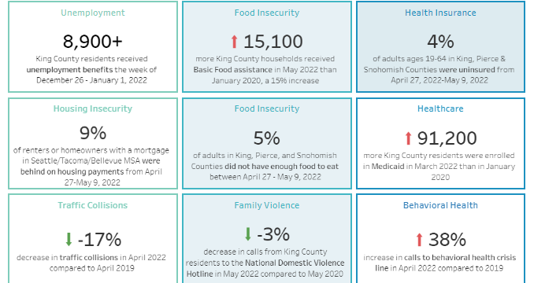
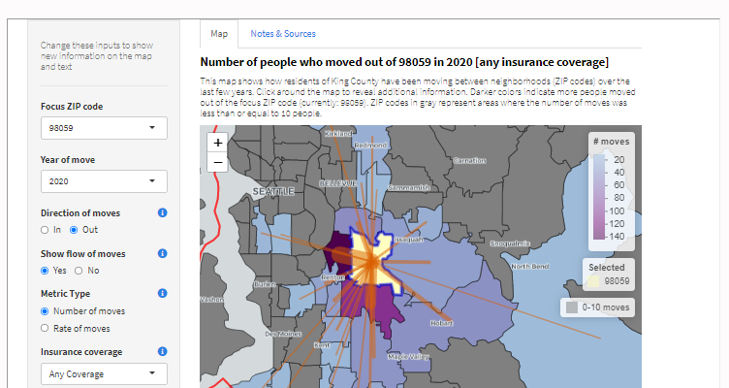
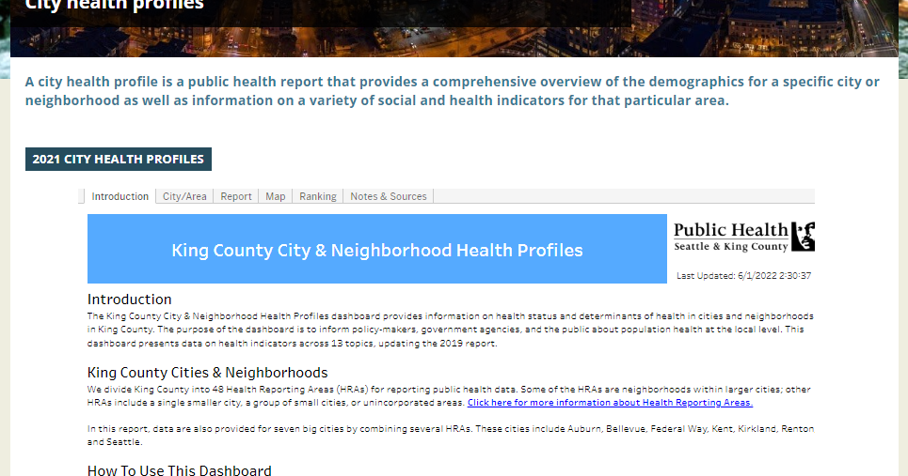
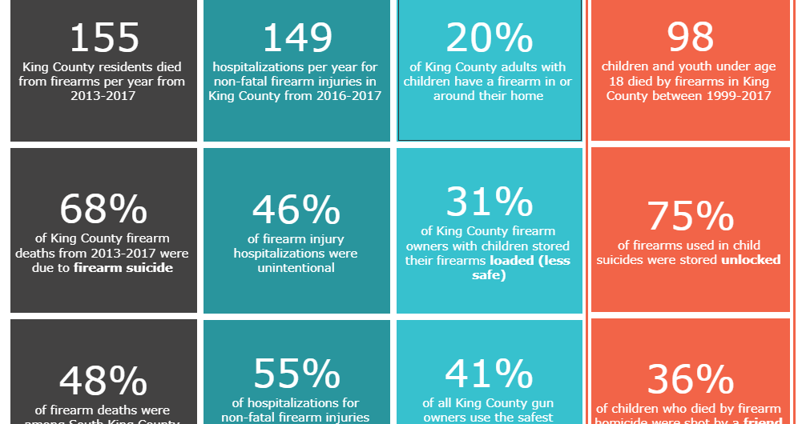
So. Many. Data products.
Notes:
We disseminate data in a wide variety of ways – including reports, infographics, and of course: dashboards. Most of our products integrate data from multiple different sources.
Again, this is just a sample of a few of our dissemination products. And it’s worth noting that along with different products, we have different audiences – ranging from partners in local government and healthcare to community organizations and the general public.

Slide 5
So. Many. questions.
Where does this data come from?
Can I trust this data to accurately represent my community?
Notes:
If my slides have been a bit of a busy mess, that’s intentional. Maybe they’ve looked like a lot to take in, or you’re a little confused about the relationships between different items on the same slide or on different slides. I think that many users who attempt to navigate our data resources have a similarly confusing or overwhelming experience.
We get lots of different questions. But there’s one question that comes up frequently: Where does this data come from?
I suspect that underlying this question, when it comes from community partners especially, is can I trust this data to provide accurate information about my community?

Slide 6
How to answer them?
“Source: American Community Survey”
Data Biographies!
Notes:
Of course, we ALWAYS cite our sources. But simply saying “American Community Survey” or “Washington State Office of Financial Management” doesn’t tell anyone what they need to know about where our data comes from. What are its strengths and limitations? Who is well represented and who may be excluded?
When our team did a training with We All Count, we learned about “data biographies” and decided this could be a good tool to address these questions in a consistent and transparent way.

Slide 7
Content of a data biography
Maximum of two pages; clear and accessible language
Who collects the data?
Who owns the data?
How is the data collected?
Who is included and excluded from the data?
Where is the data collected?
Notes:
I mentioned our template. It’s built around answers to what we considered the most basic and important questions about each data source, drawing inspiration from examples provided by We All Count.
A key goal is to provide information that is clear and accessible to community members, and part of that is not overwhelming readers with too much dense detail. You can imagine that sticking to a maximum of two pages, the answers to each of these questions is pretty brief. And we really do aspire to jargon-free, nontechnical language, although I think there’s always room for us to improve there.

Slide 8
Content of a data biography continued…
Why is the data collected?
How often is the data collected?
What else is important to know about this data?
Where can I learn more about this data?
Data privacy and security statement
Notes:
I mentioned our template. It’s built around answers to what we considered the most basic and important questions about each data source, drawing inspiration from examples provided by We All Count.
A key goal is to provide information that is clear and accessible to community members, and part of that is not overwhelming readers with too much dense detail. You can imagine that sticking to a maximum of two pages, the answers to each of these questions is pretty brief. And we really do aspire to jargon-free, nontechnical language, although I think there’s always room for us to improve there.

Slide 9
Biography of a data biography
Draft
New staff assigned a data source
Review
Internal subject matter expert
Share
Posted online (html and pdf)
Internal editor
Research and draft bio using template and internal and external documentation
Linked to in data products
Notes:
We knew this would be a lot of work and we’re all busy, so we decided to make it a team process.
-We created our first batch of biographies with our six most commonly used data sources last winter and a team that included myself and a colleague who do a lot of dissemination support, and new epidemiologists who had recently joined our unit.
-We worked together to create and refine a template and come up with shared standards for some common content – for example, how do we explain “weighting” to a lay audience? We imagine we’ll continue to improve on these, but having them has really smoothed the process.
-We’ve found review by internal subject matter experts to be very helpful for accuracy.
-We’ve found review by an editor who is skilled in writing for lay audiences to be very helpful for consistency and clarity.

Slide 10
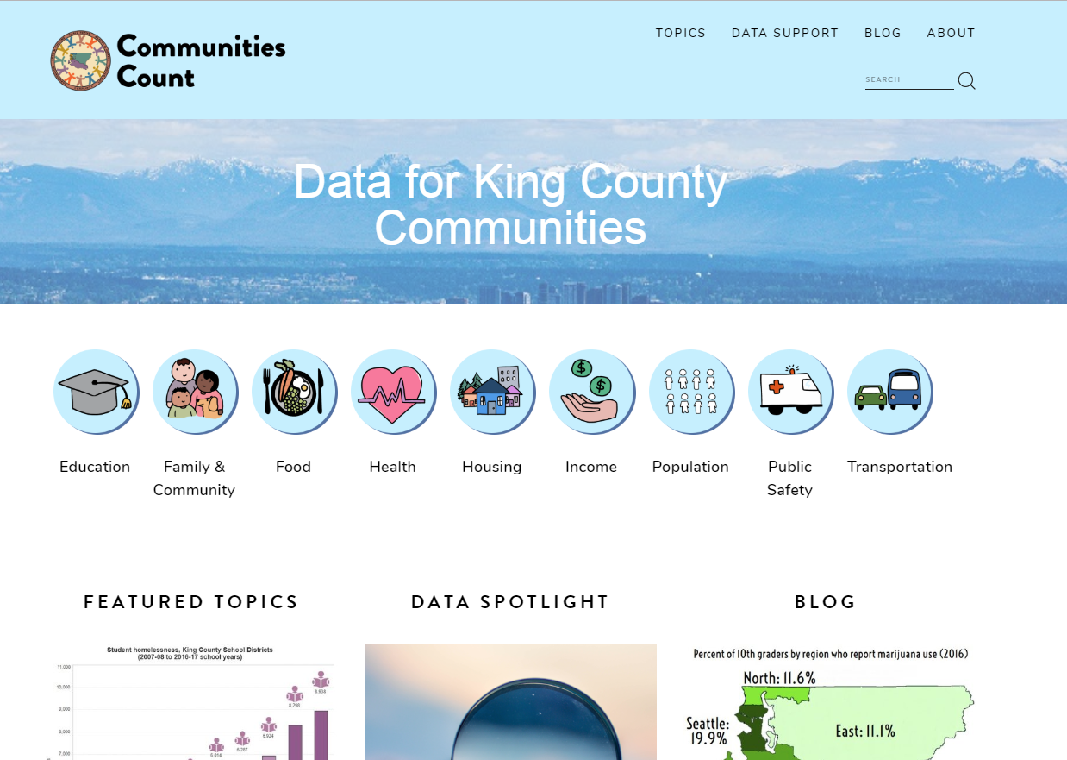
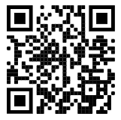
Communities Count
www.communitiescount.org/
data-biographies
Notes:
We’ve posted the biographies on Communities Count, a platform that allows us to share data and build capacity with community partners.

Slide 11
So. Many. Benefits.
Onboard new colleagues to data sources they’ll be using
Connect colleagues who wouldn’t otherwise work together (especially helpful in a remote environment)
Learn about data sources we’ve been using for years!
But…
What about users?
Notes:
Share example of learning about birth data collection. In the data biographies, we thought we were asking pretty basic questions, but the difficulty of finding answers to them in our often extensive documentation really underscores, to me, the need for this kind of resource!
These have been great benefits to us internally, which we didn’t anticipate.
What I’m looking forward to learning more about is whether we are reaching our intended goal, of providing clear and transparent information to our data users! Are they finding our biographies, and are the biographies answering their questions?
Moving forward, we’re going to be disseminating these biographies more; continuing to add new data sources to our library of biographies; and hopefully continuing to adapt them as we get feedback and as our own processes change. If we move towards a query-based system for sharing some of our data, or contribute to open data portals, how could data biographies adapt to support users in new ways?

Slide 12
Next steps:
Share with Communities Count User Group
Working on next “batch” of biographies
Adapting as we get feedback and continue to improve how we disseminate data
Notes:
Share example of learning about birth data collection. In the data biographies, we thought we were asking pretty basic questions, but the difficulty of finding answers to them in our often extensive documentation really underscores, to me, the need for this kind of resource!
These have been great benefits to us internally, which we didn’t anticipate.
What I’m looking forward to learning more about is whether we are reaching our intended goal, of providing clear and transparent information to our data users! Are they finding our biographies, and are the biographies answering their questions?
Moving forward, we’re going to be disseminating these biographies more; continuing to add new data sources to our library of biographies; and hopefully continuing to adapt them as we get feedback and as our own processes change. If we move towards a query-based system for sharing some of our data, or contribute to open data portals, how could data biographies adapt to support users in new ways?

Slide 13
Part of broader data equity work
Participatory data interpretation
Community-led data collection, analysis, and dissemination
Improving race/ethnicity, sexual orientation, and gender identity questions in surveys we use
Building capacity of community partners to find, create, and use data
Multilingual data collection and dissemination
Integrating qualitative and quantitative data
Creating local timeline of policies and events that have impacted health equity (providing historical context for health disparities)
Collecting and sharing data about local BIPOC communities’ experiences of racism
Notes:
We really see the data biographies as just one piece of our data equity work, that can hopefully support other processes by offering transparent and clear information about data sources to many different audiences and different products. Here’s a partial list of some other ways that we are incorporating equity into our data work.
This is aligned with, and essential to, our broader mission of health equity, and the health department’s commitment to addressing racism as a public health crisis.

Slide 14
Many thanks!
Colleagues who have helped to write and review data biographies
Cassidy Chang, former work-study student who created web resources for biographies AND wrote one!
We All Count, data equity organization who introduced us to the concept of data biographies – check out their resources!

Slide 15
Get in touch
Sara Jaye: sjsanford@kingcounty.gov
Communities Count: communitiescount@kingcounty.gov
Notes:
I’d love to talk more about data equity work we have in common, please reach out.

