Slide 1
Uncertainty & error
Different types of data or data communication call for different ways to explain error. How NNIP copes with uncertainty in data.
Jenna Losh, Oct. 2022

Slide 2
The importance of error and uncertainty
Error is present in so much of the data we use, and the more "interesting" (specific) the data, the worse the error is
Error is something we ignore all the time
When we or our users dismiss data uncertainty, it can lead to overconfidence in results and about how the world works

Slide 3
Addressing error in our data
Assess: Compare with other sources (employment rates)
Reduce:
Show over a longer time span (3 or 5-year estimates)
Show with less disaggregation (neighborhood instead of tract)
Smooth
Explain:
Text
Widgets
Visualization

Slide 4
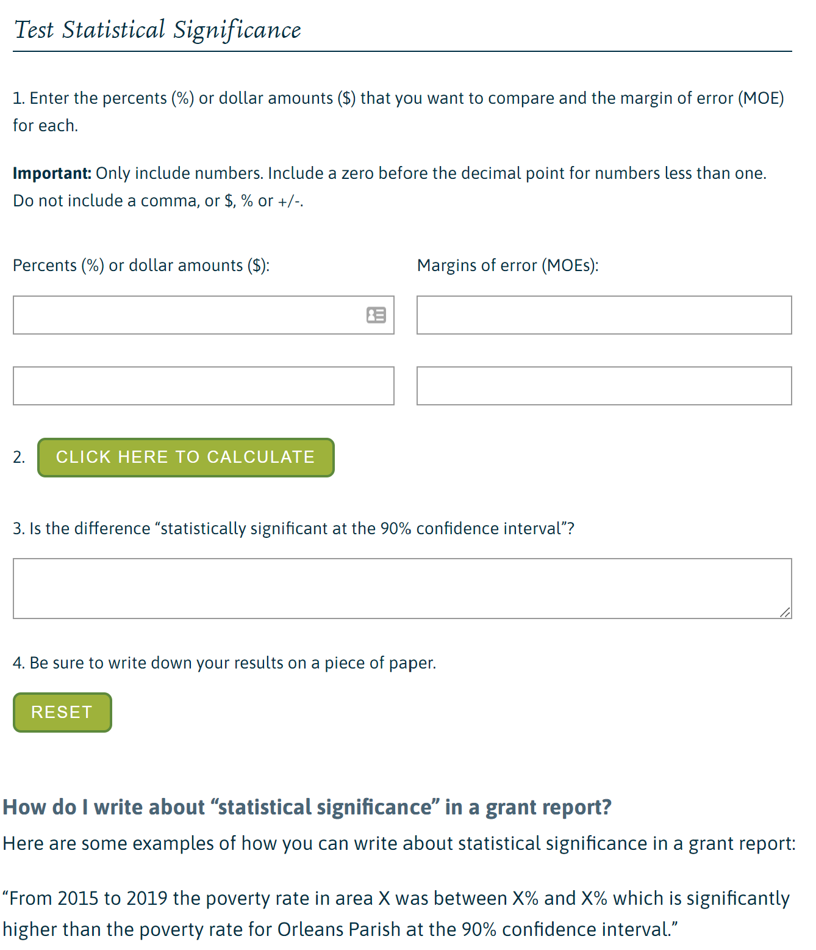
Good old-fashioned tabular data

Slide 5
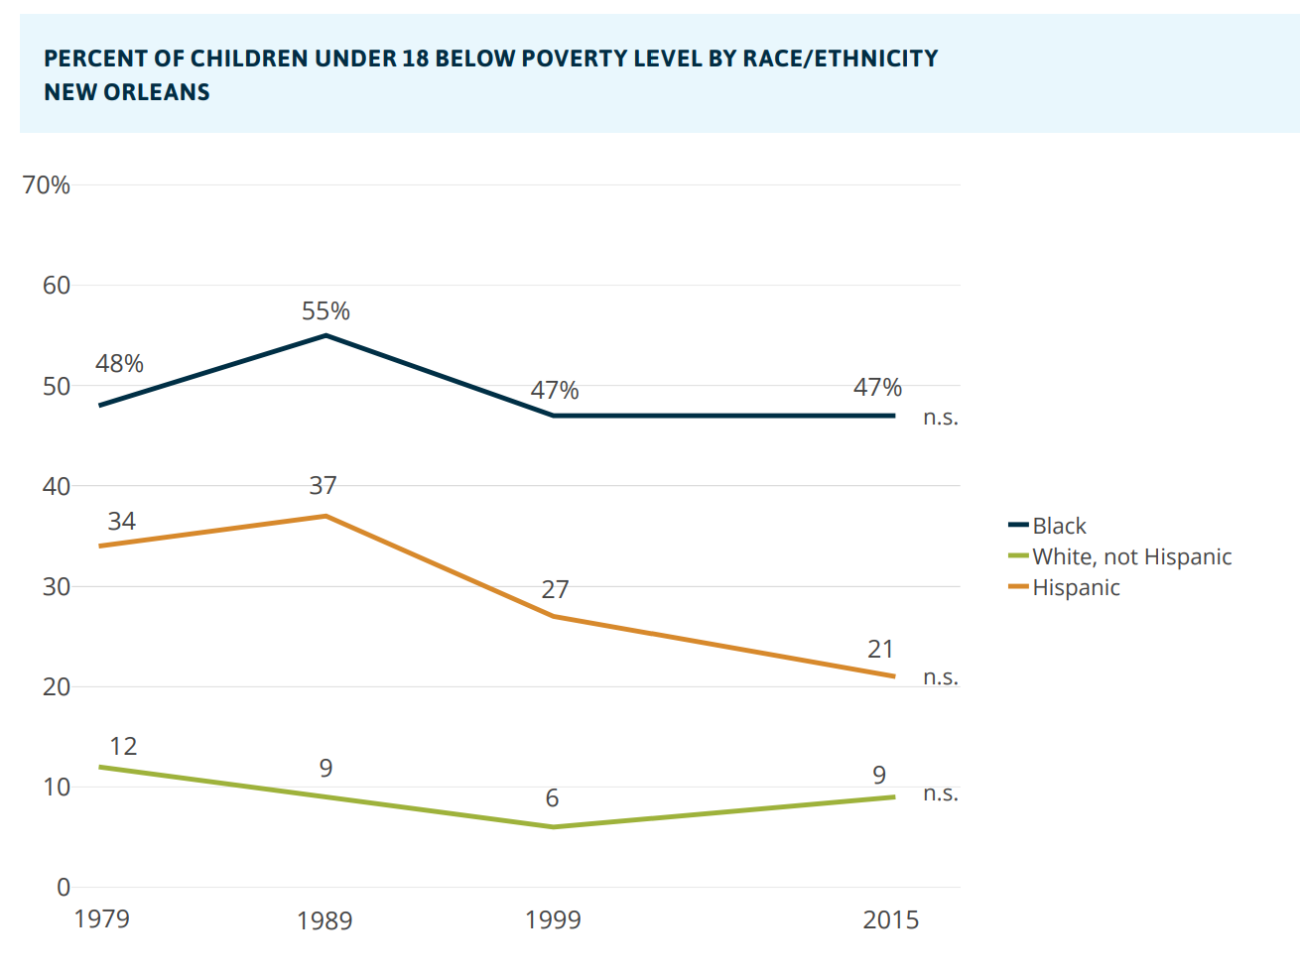
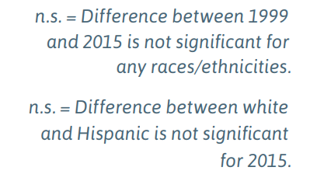
When there is reference data

Slide 6
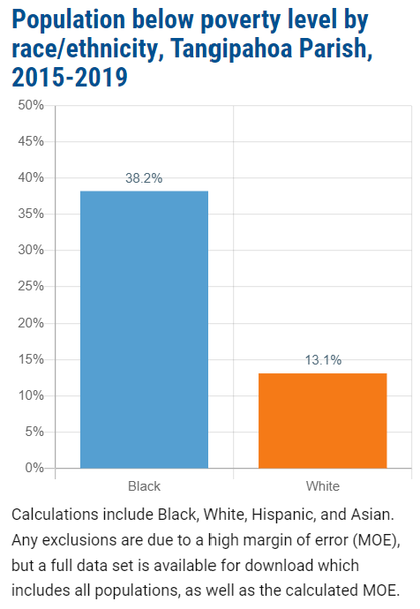
When there is not reference data

Slide 7
When it’s a map
Poverty rate data meets our 15% CV threshold for reliability for only 105 out of 1126 Census tracts in Louisiana (9%)
We smoothed the data buy averaging each tract with all of its neighbors
65% of tracts saw a decrease of 10 percentage points or more from their raw CV to their smoothed CV

Slide 8
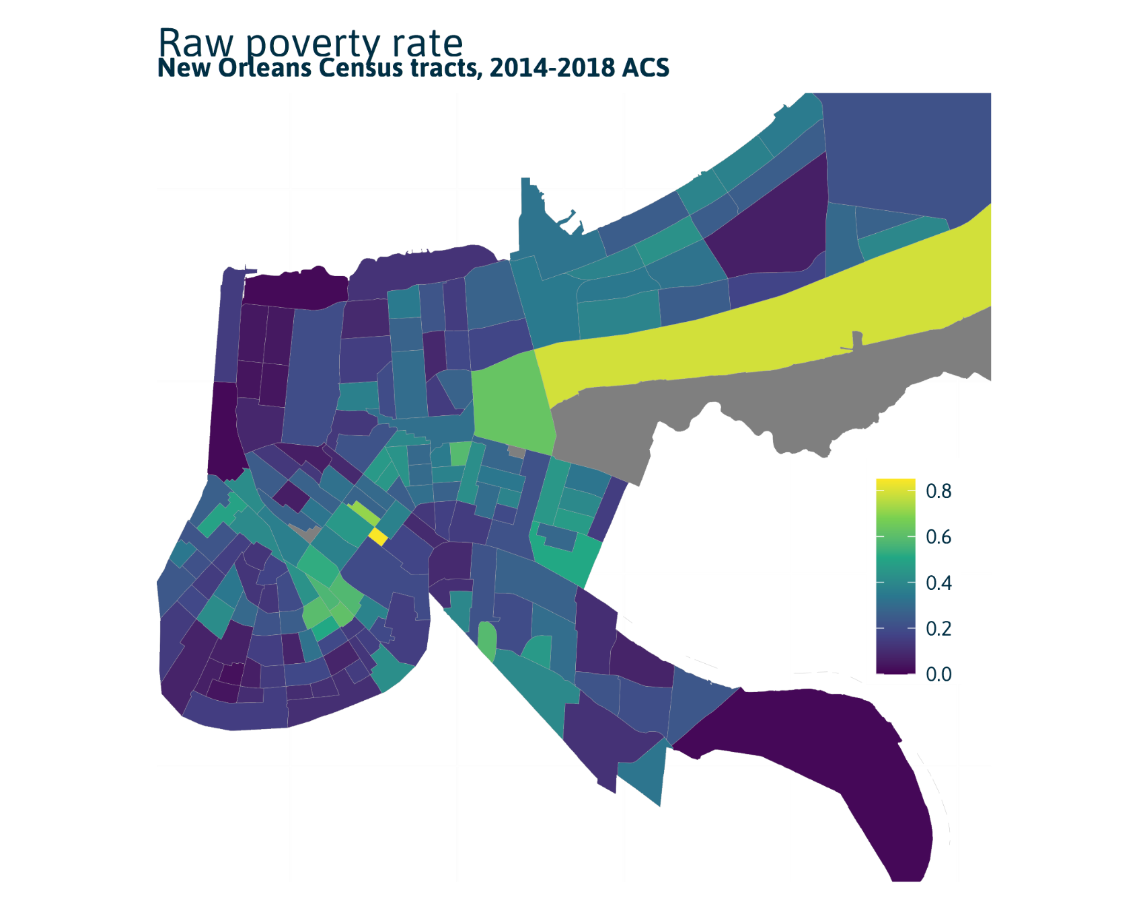
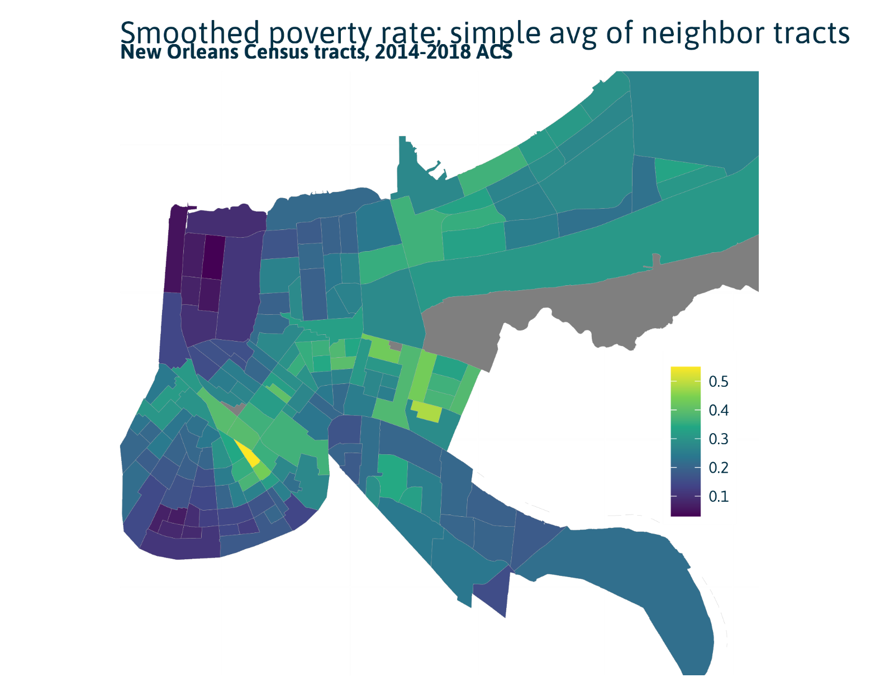

Slide 9
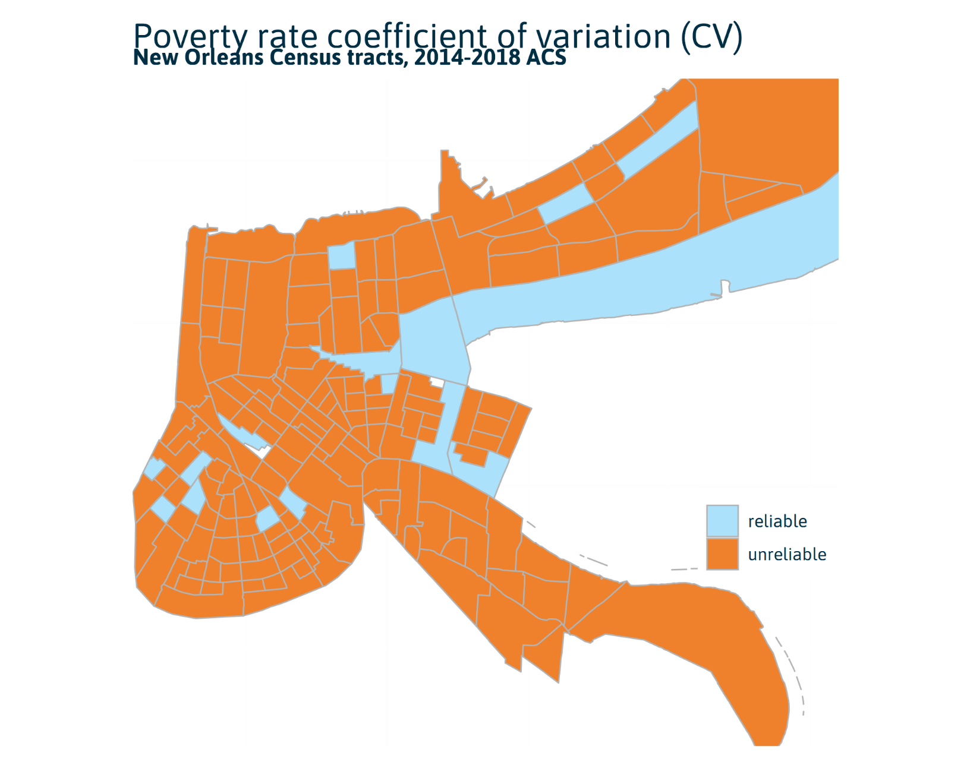

Slide 10
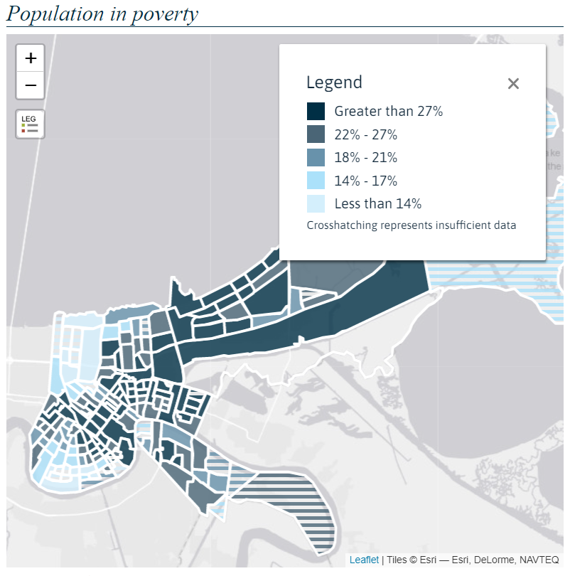
Display smoothed results
Using new CVs, indicate data that is still unreliable with striping

Slide 11
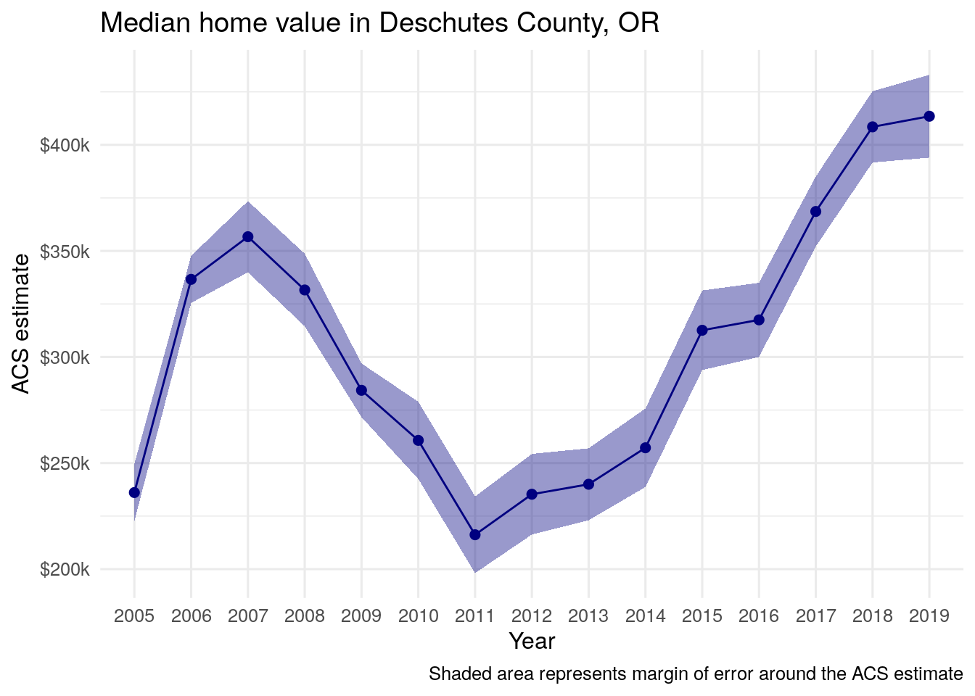
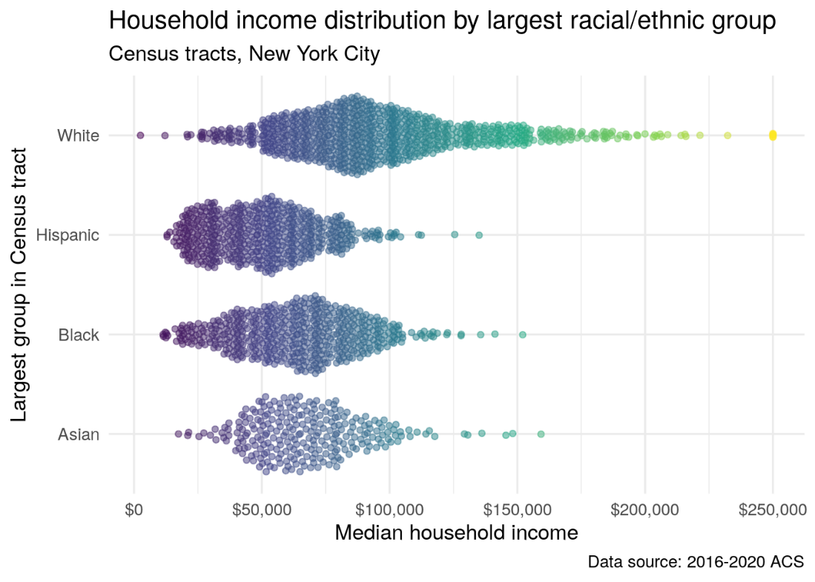
Suggestions from NNIP

Slide 12
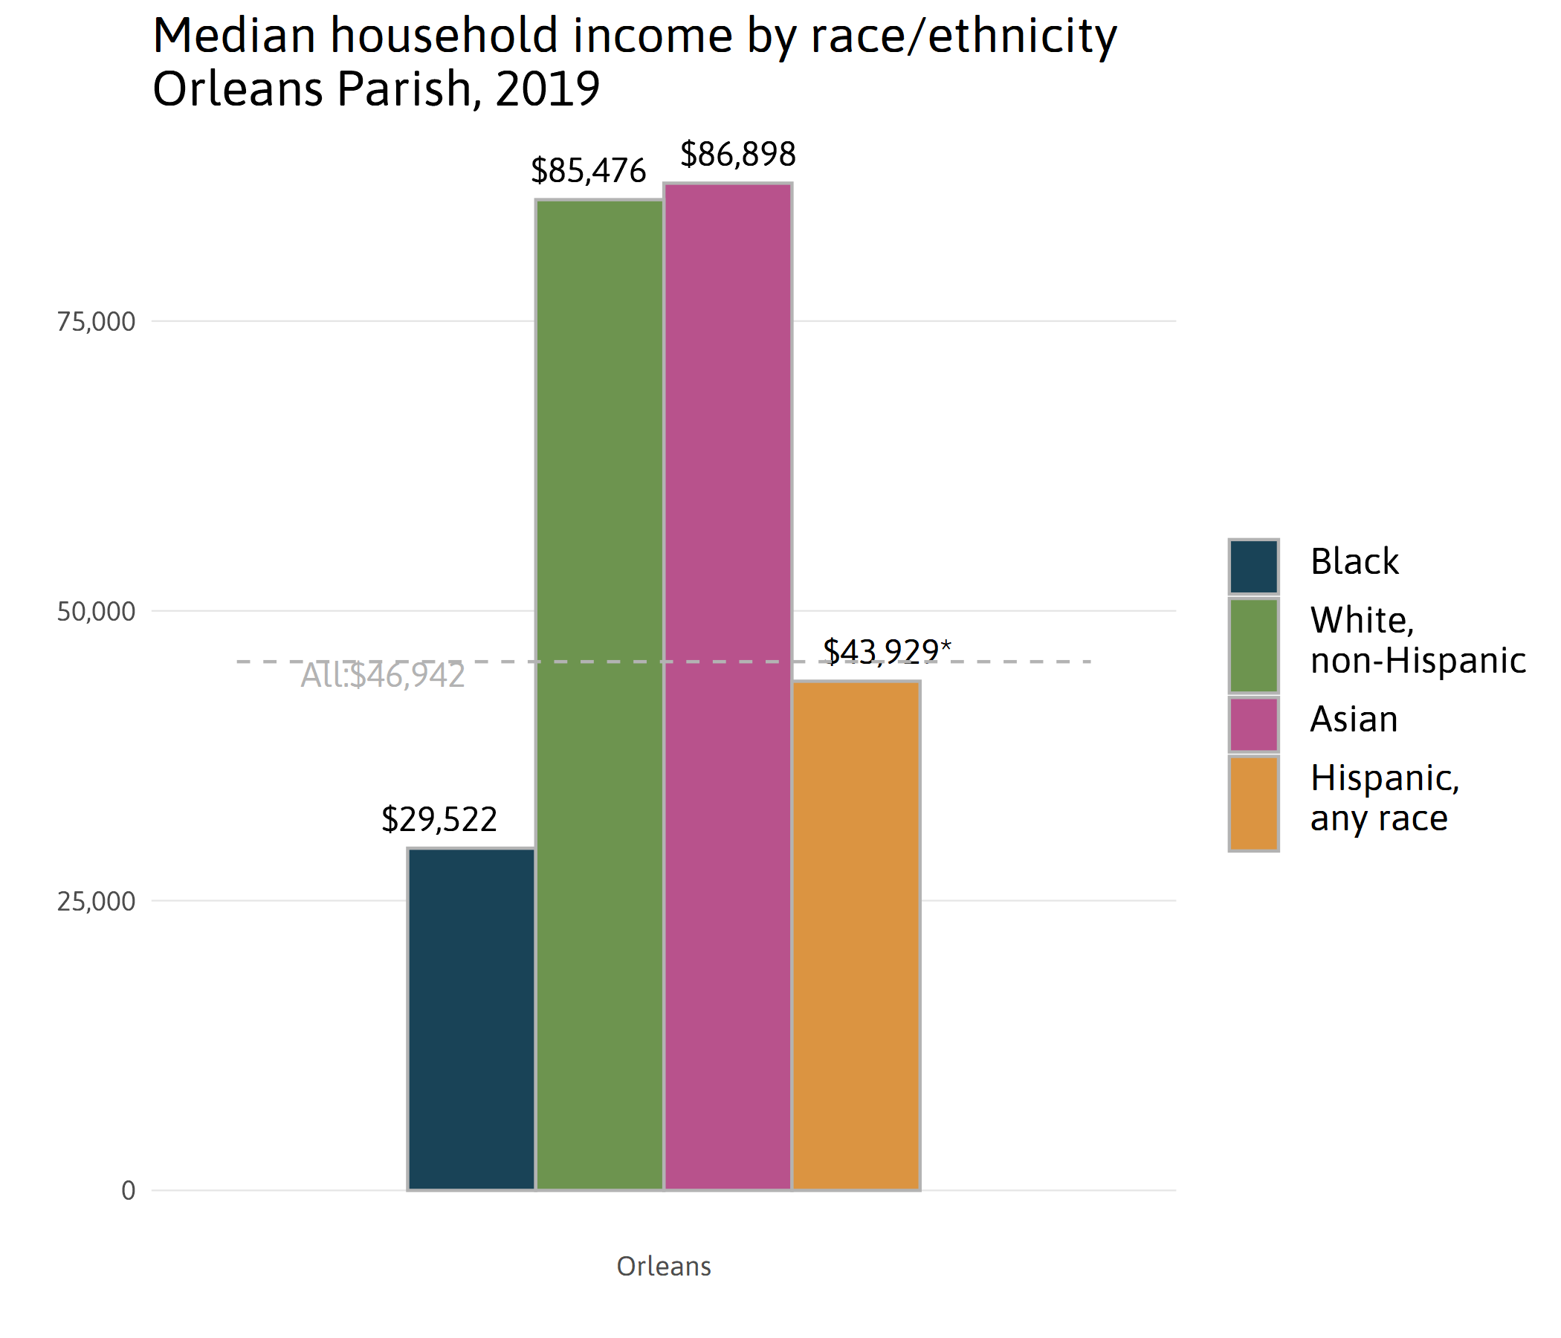
An experiment
Benefit of most timely measure (1-year ACS)
Stat tested against overall median income: Hispanic & overall; White & Asian are not significantly different

Slide 13
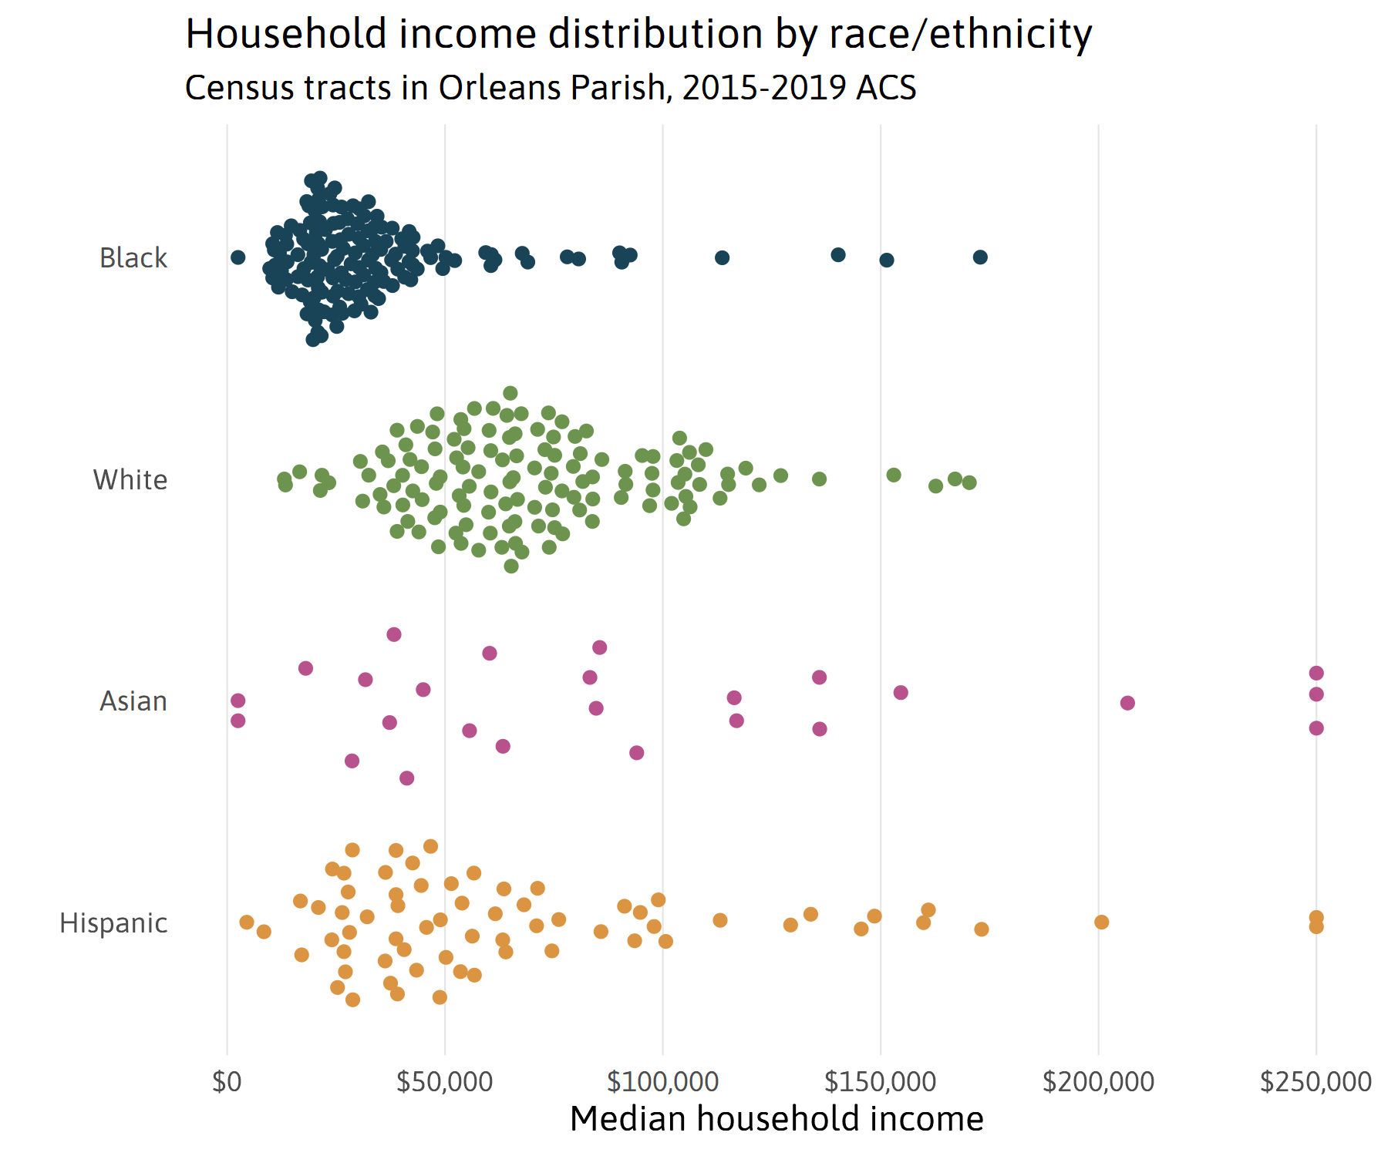

Slide 14
How else can we communicate error?
Flip the script on confidence:
“We’re 90% sure that income for Asians is between $63,742 and $100,884” vs.
“We’re X% sure that income for Asians is between $79,020 and $85,605”
(+/- 5% of measure)

Slide 15
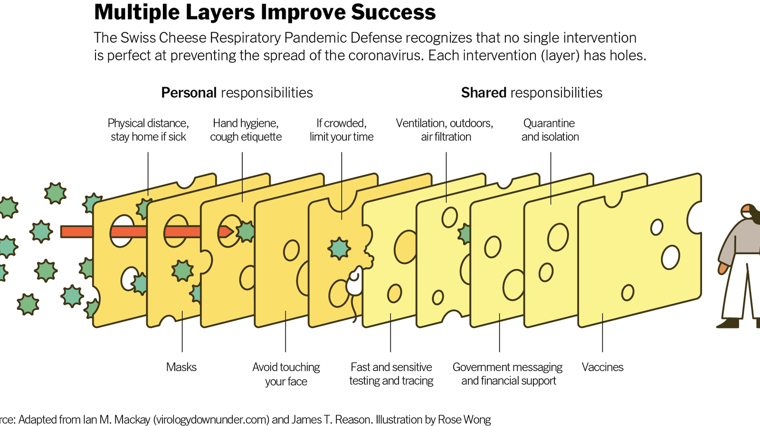
The Swiss cheese model
If we keep attacking this problem from many and possibly new angles, we’ll continue to reach a diversity of learning styles as well as build a case for allocating more resources to better data collection!
Many thanks to the NNIP Google Group users, especially Laura McKieran, Joseph Andre, Kathy Pettit, Frank Lenk, and Mark Abraham, whose ideas are in this presentation either directly or indirectly.

