Slide 1
Leveraging Data for Collective Impact in the South LA Transit Empowerment Zone (SLATE-Z)
Elly Schoen, Systems & Data Manager
USC Price Center for Social Innovation
@NDSC_LA

Slide 2
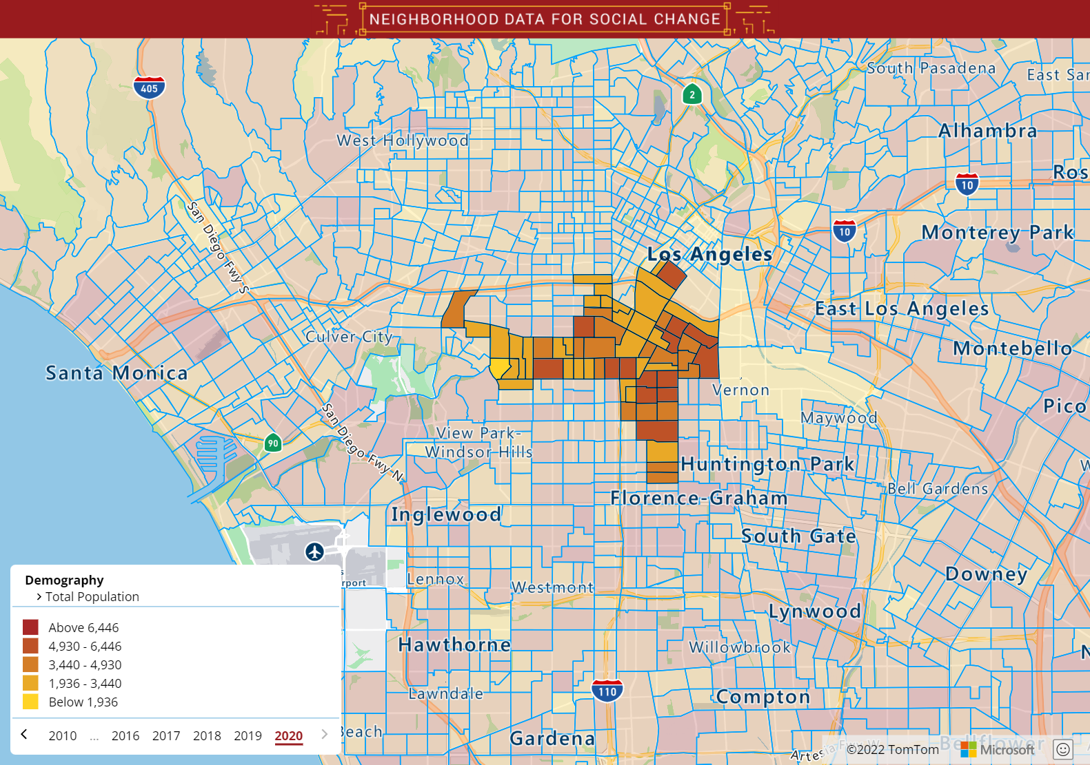
About SLATE-Z
A historic and unprecedented partnership of over 50 public, private, and community-based organizations dedicated to revitalizing South Los Angeles by moving residents to economic opportunity.
Total Population: 234,000
@NDSC_LA

Slide 3
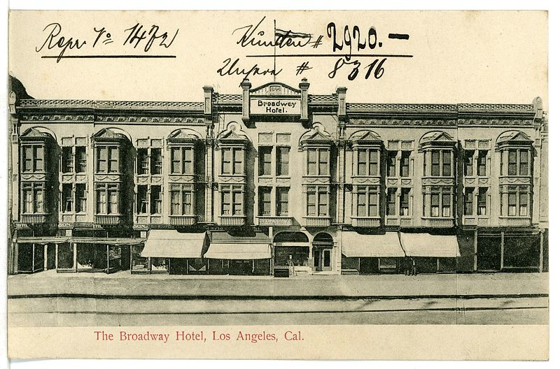
About the Neighborhood
Hispanic/ Latino/a:
72%
Black/African American:
14%
Photos courtesy of: Tom Zimmerman, Paul Nadar & William P Gottlieb, Wikimedia Commons
Source: 2020 American Community Survey 5-year estimates
@NDSC_LA

Slide 4
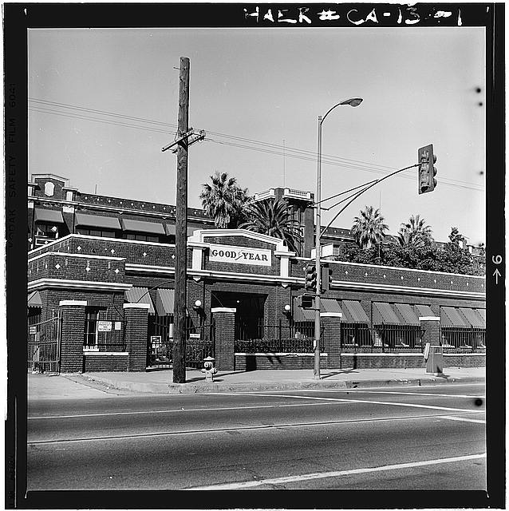
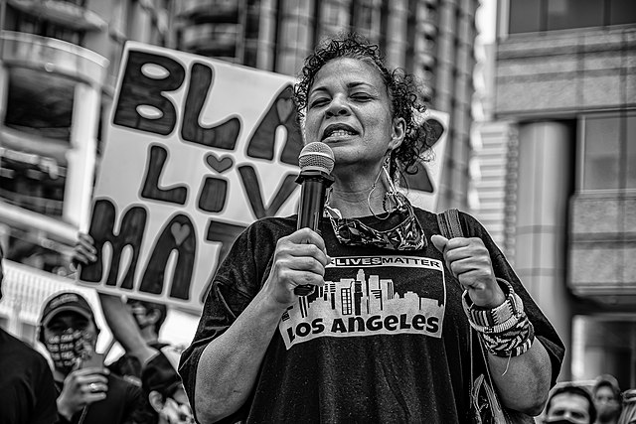
About the Neighborhood
Structural Barriers to Wealth Creation
Over Policing
Closed Manufacturing Plants
75% of residents make less than 80% of area median income
Photos courtesy of: Tom Zimmerman, Library of Congress & morrisonbrett, Wikimedia Commons
Source: 2018 U.S. Department of Housing & Urban Development
@NDSC_LA

Slide 5
A Decade of Transit Development
Silver (J) Bus, opened in 2009
Expo (E) Rail, opened in 2012
Crenshaw (K) Rail, opened in 2022
Typical home values have increased by over 150% in the South LA region between 2010 & 2021
@NDSC_LA

Slide 6
A Decade of Transit Development
Silver (J) Bus, opened in 2009
Expo (E) Rail, opened in 2012
Crenshaw (K) Rail, opened in 2022
Typical home values have increased by over 150% in the South LA region between 2010 & 2021
@NDSC_LA

Slide 7
Enter SLATE-Z
Job Centers
Collect Impact Framework
Higher Education Institutions
LA Unified School District
Common Agenda
Shared Measurement
Mutually Reinforcing Activities
Continuous Communication
A “Backbone” Team
Community Based Orgs
Elected Officials
Small Business Incubators
Chamber of Commerce
Health Clinics
Shared Vision: Strategically capitalize on neighborhood revitalization opportunities connected to transit oriented development
@NDSC_LA

Slide 8
Enter SLATE-Z
Job Centers
Collect Impact Framework
Higher Education Institutions
LA Unified School District
Common Agenda
Shared Measurement
Mutually Reinforcing Activities
Continuous Communication
A “Backbone” Team
Community Based Orgs
Elected Officials
Small Business Incubators
Chamber of Commerce
Health Clinics
Shared Vision: Strategically capitalize on neighborhood revitalization opportunities connected to transit oriented development
@NDSC_LA

Slide 9
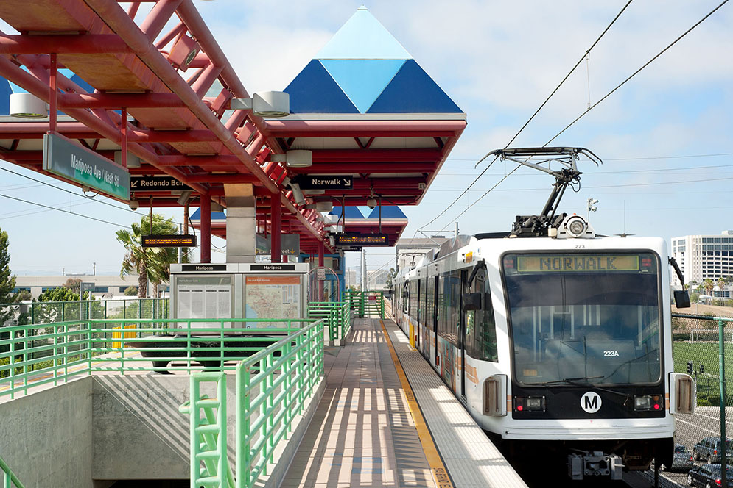
Roadblocks with Shared Measurement
Issues Arising:
Unavailable/Unmeasurable Metrics
Metrics Unaligned with Activities
Centralized Location for Data Viewing
Communicating Impact to South LA Residents
Photo courtesy of: iStock
@NDSC_LA

Slide 10
Solutioning Shared Measurement
Data Technical Assistance
Public-Facing Dashboard Site
Data Expertise (USC)
Community Expertise (SLATE-Z)
Core Audiences:
SLATE-Z Partners
South LA Community Residents
Revamp Collective Impact Metrics
@NDSC_LA

Slide 11
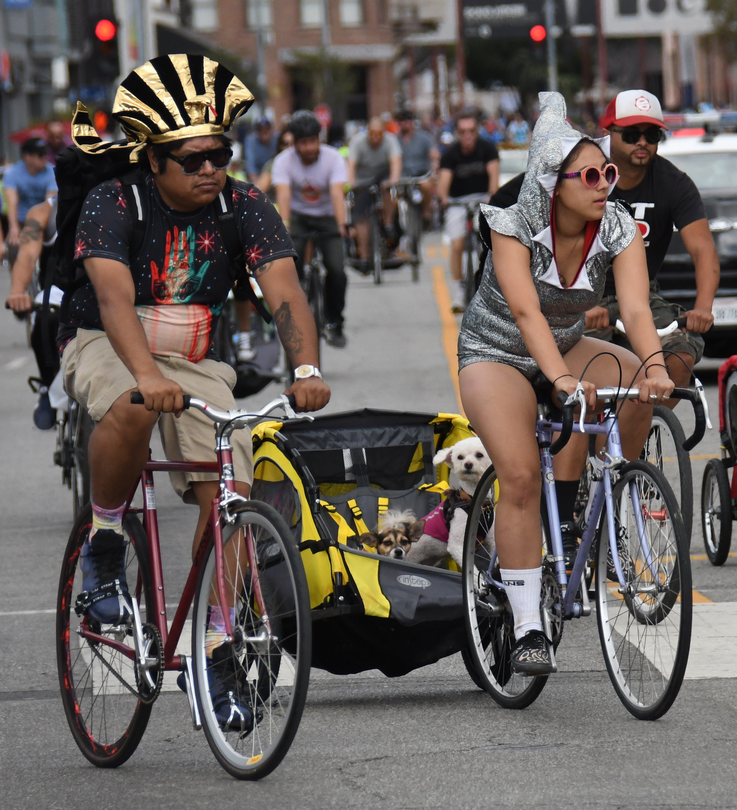
Lessons : Data & Collective Impact Models
Only measure what you can directly impact
Violent Crimes on Public Transit
Traffic Collisions Involving Cyclists
Photo courtesy of: LADOT
@NDSC_LA

Slide 12
Lessons : Data & Collective Impact Models
Only measure what you can directly impact
Violent Crimes on Public Transit
Traffic Collisions Involving Cyclists
Photo courtesy of: LADOT
@NDSC_LA

Slide 13
Lessons: Data & Collective Impact Models
Build for multiple audiences
Summaries & Narrative
Detailed Tools for Planning
Collisions with Cyclists decreased by 42% between 2017 & 2020 in SLATE-Z, but rates still remain higher than the City as a whole.
59% of collisions with cyclists in SLATE-Z happen on roads without bike lanes.
@NDSC_LA

Slide 14
Lessons: Data & Collective Impact Models
Build for multiple audiences
Summaries & Narrative
Detailed Tools for Planning
Collisions with Cyclists decreased by 42% between 2017 & 2020 in SLATE-Z, but rates still remain higher than the City as a whole.
59% of collisions with cyclists in SLATE-Z happen on roads without bike lanes.
@NDSC_LA

Slide 15
Thank You & Stay Tuned! Phase 1 Launch: January 2023
ebschoen@usc.edu
@elly_schoen
@NDSC_LA

