Slide 1
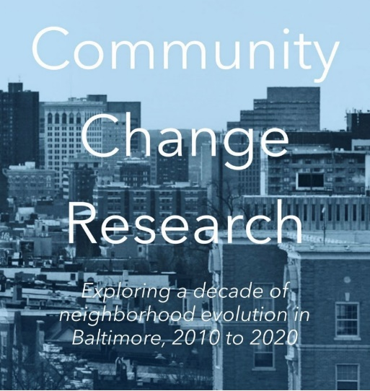
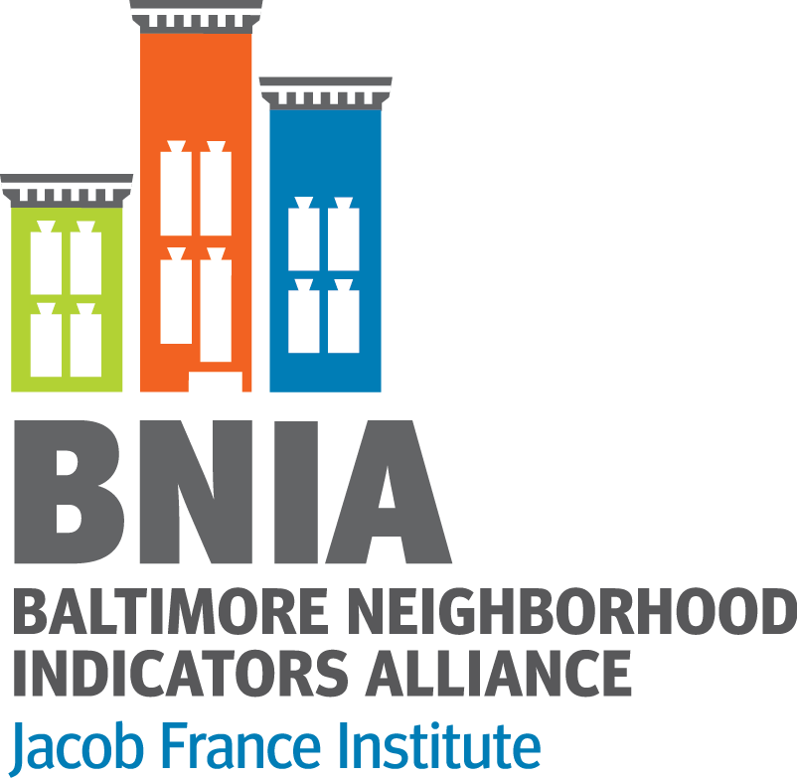
How Have Baltimore's Neighborhoods Changed Over the Past Decade? Visualizations from The Baltimore Community Change 2010-2020 Project
Cheryl Knott
Research Manager Baltimore Neighborhood Indicators Alliance
NNIP Conference
October 27, 2022

Slide 2
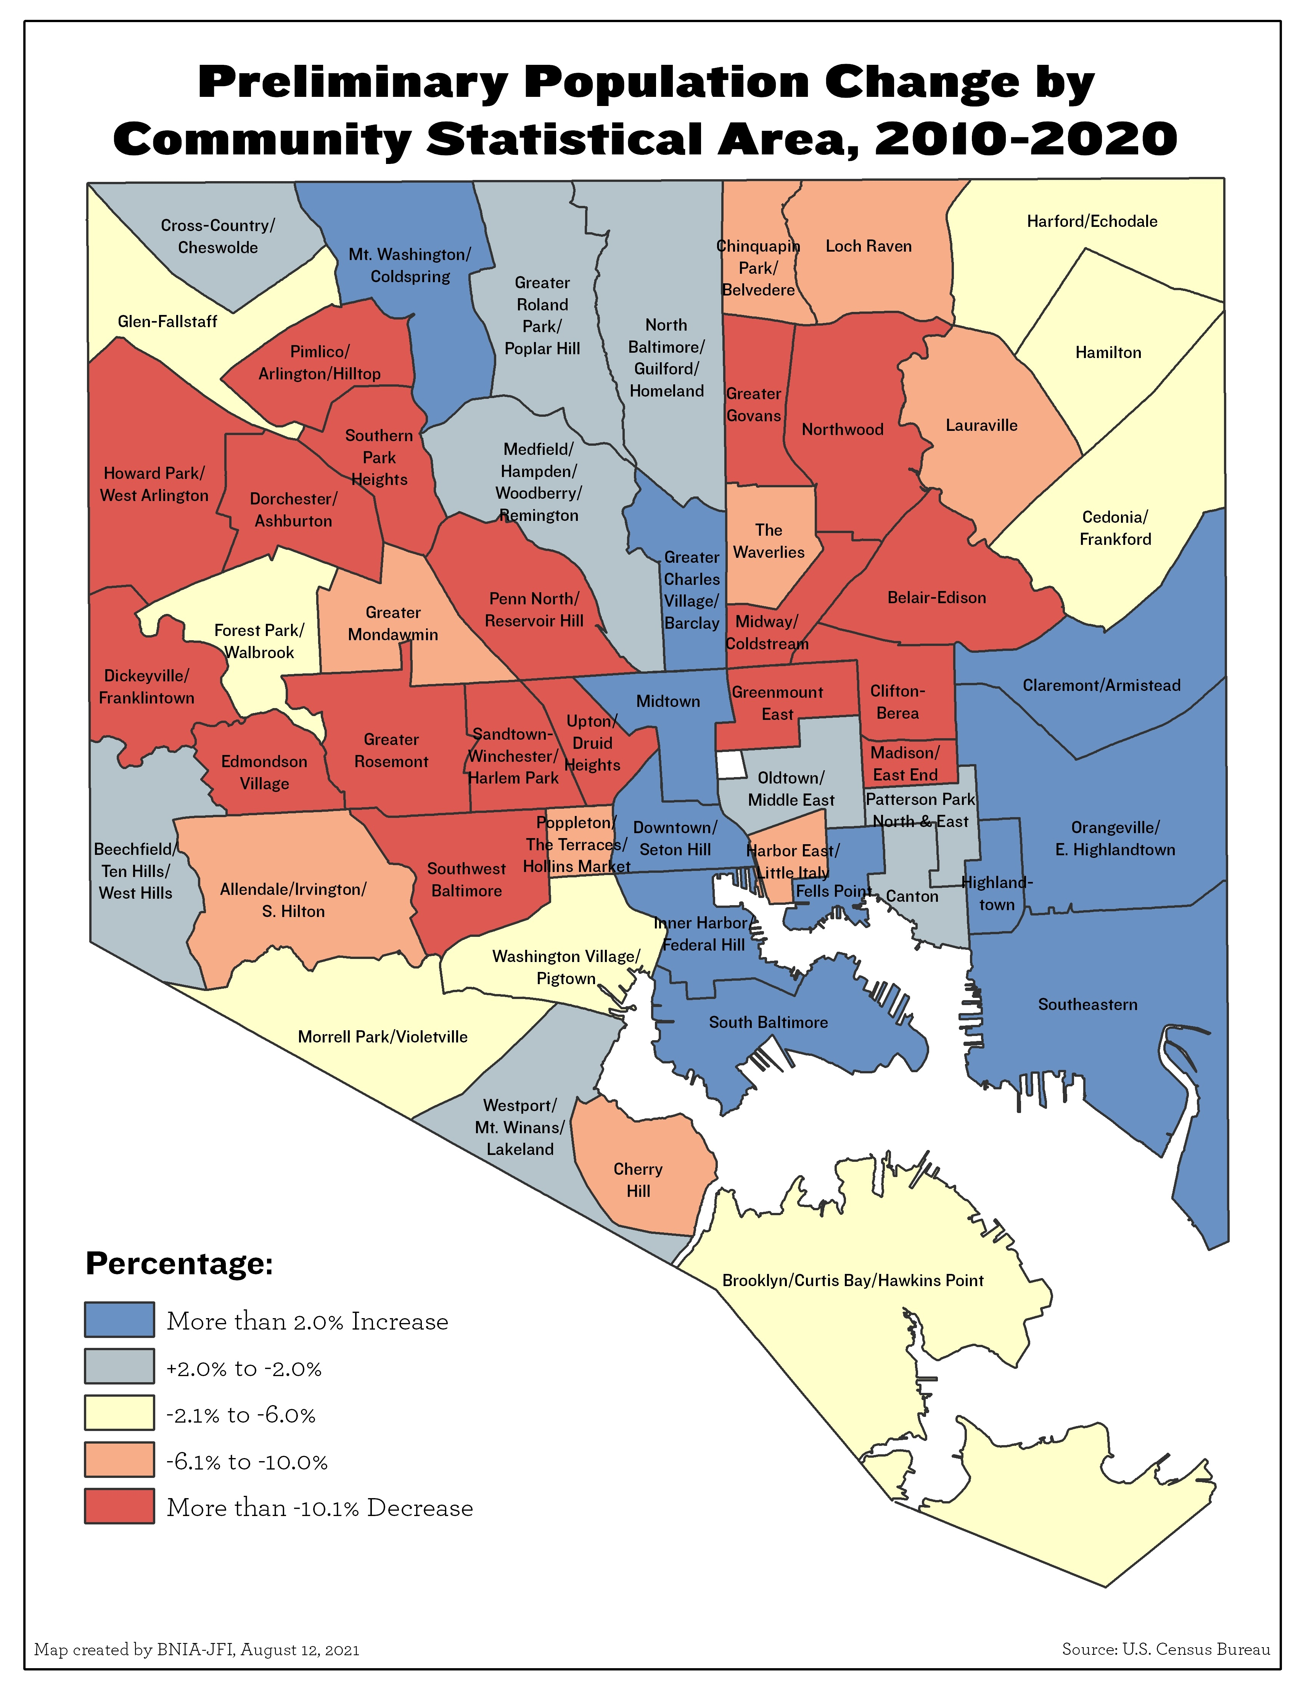
@bniajfi
#BmoreCommunityChange
Baltimore lost 5.7% of its population
…But has significant variation by neighborhood

Slide 3
Telling the Story of Change
@bniajfi
#BmoreCommunityChange
Six in-depth research briefs:
Population and socio-demographics
Housing diversity
Housing occupancy and rehab
Accessibility
Connectivity
Quality of life
https://communitychange-bniajfi.hub.arcgis.com/

Slide 4
Communication Tools
@bniajfi
#BmoreCommunityChange
ArcGIS Hub Site:
Story Maps with Embedded Viz
Interactive AGOL maps
Operations Dashboard bar charts and tables
Tableau charts
Plotly line charts
Data downloads
Solutions database
Compiled resources
https://communitychange-bniajfi.hub.arcgis.com/

Slide 5
Visualization Examples
@bniajfi
#BmoreCommunityChange
Convey spatial and statistical information
Relating back to population change
Visualization cohesion
Red to blue diverging color scheme
https://communitychange-bniajfi.hub.arcgis.com/

Slide 6
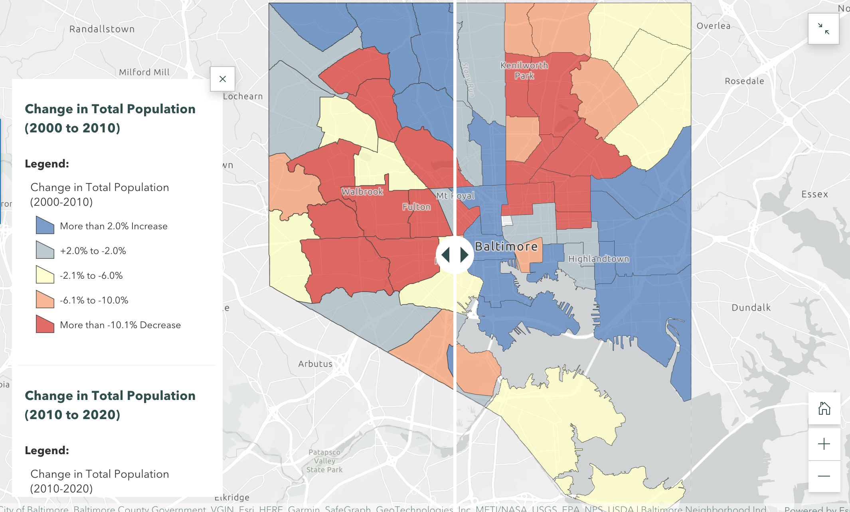
@bniajfi
#BmoreCommunityChange
Map with slider, comparing population change
from 2000 to 2010 and 2010 to 2020

Slide 7
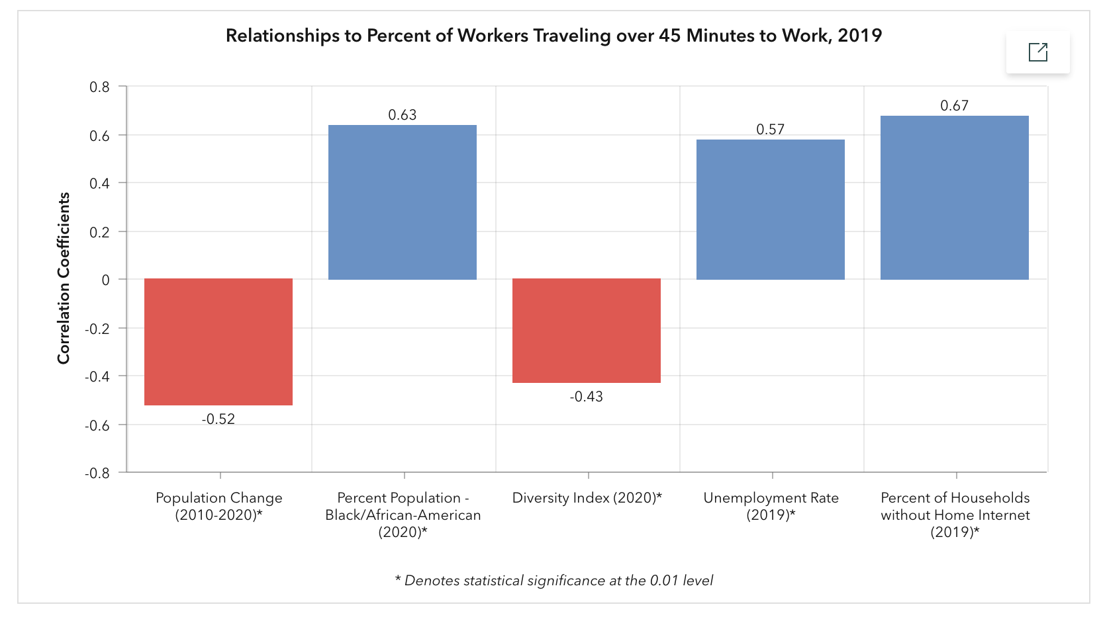
@bniajfi
#BmoreCommunityChange
Visualizing statistical relationships

Slide 8
@bniajfi
#BmoreCommunityChange
Visualizing statistical relationships

Slide 9
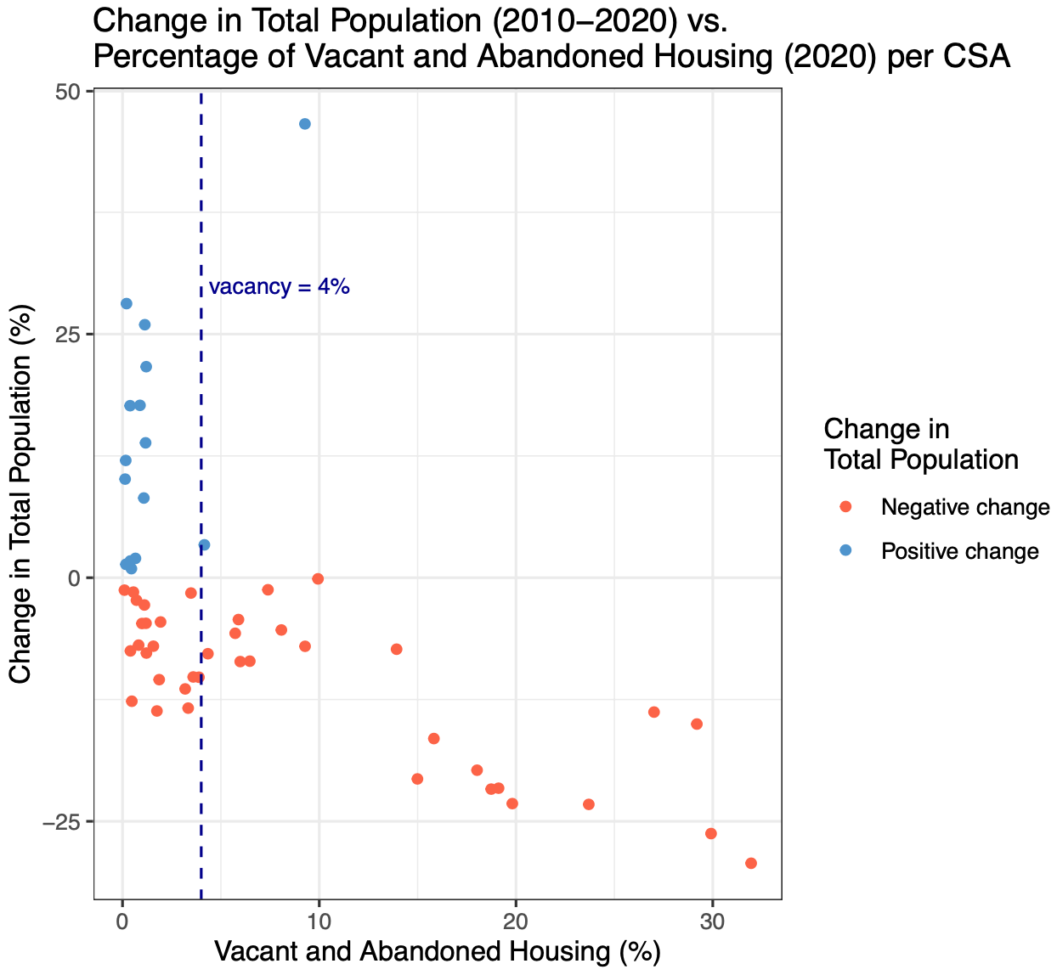
45 Minute Commute Time
@bniajfi
#BmoreCommunityChange

Slide 10
45 Minute Commute Time
@bniajfi
#BmoreCommunityChange

Slide 11
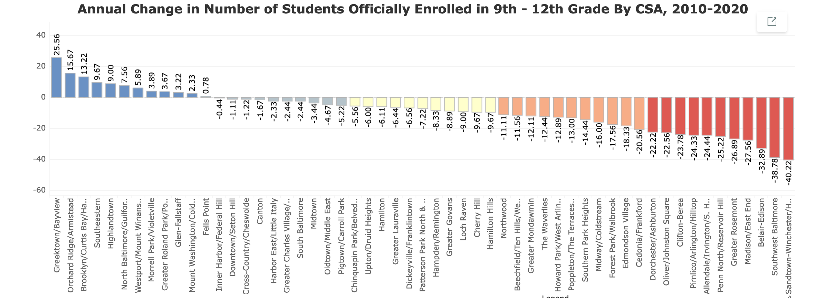
@bniajfi
#BmoreCommunityChange

Slide 12
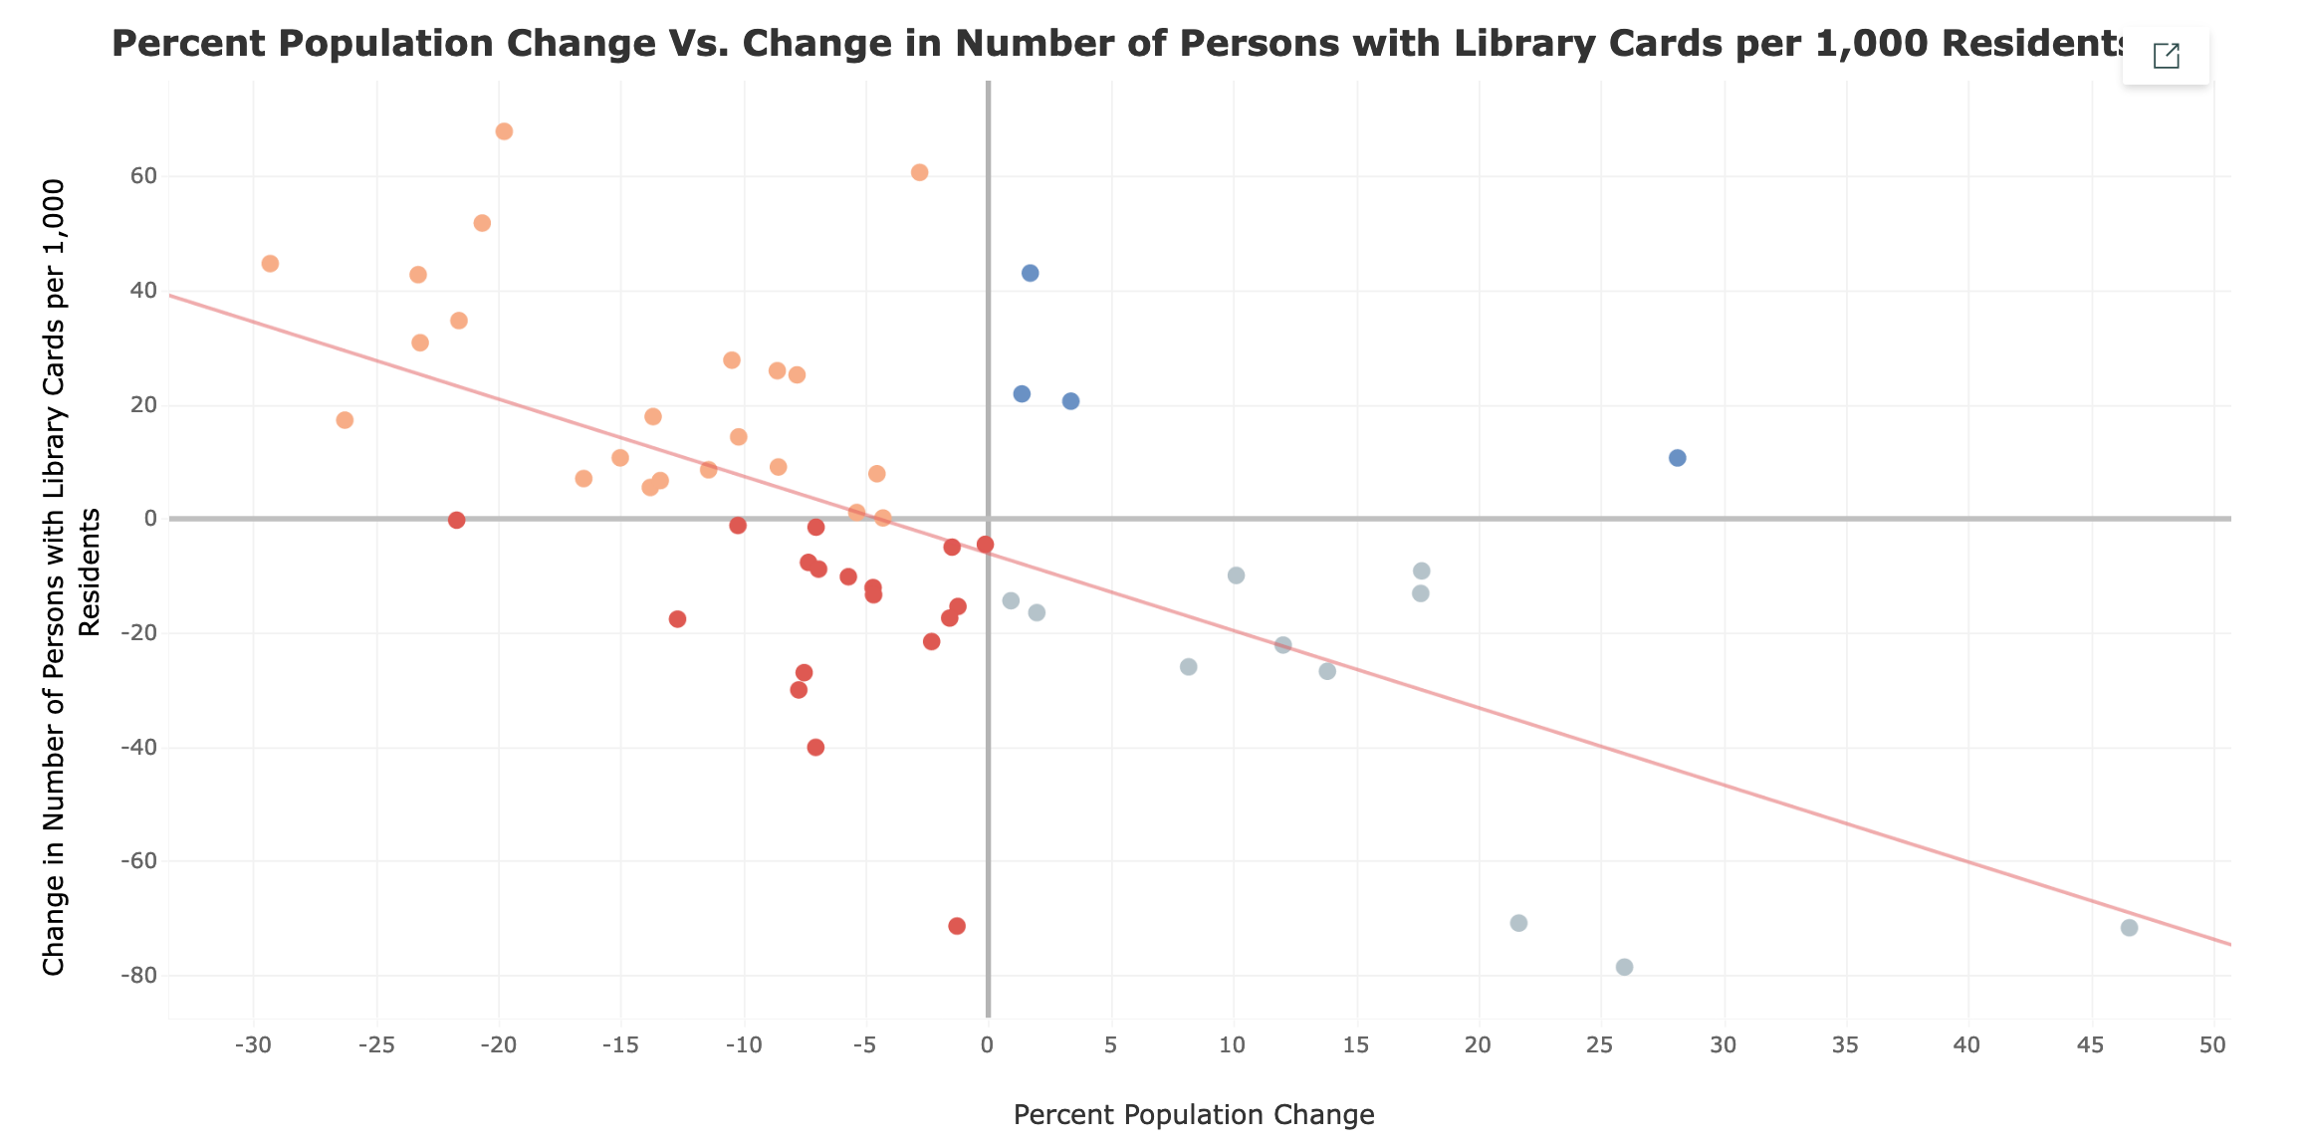
@bniajfi
#BmoreCommunityChange

Slide 13
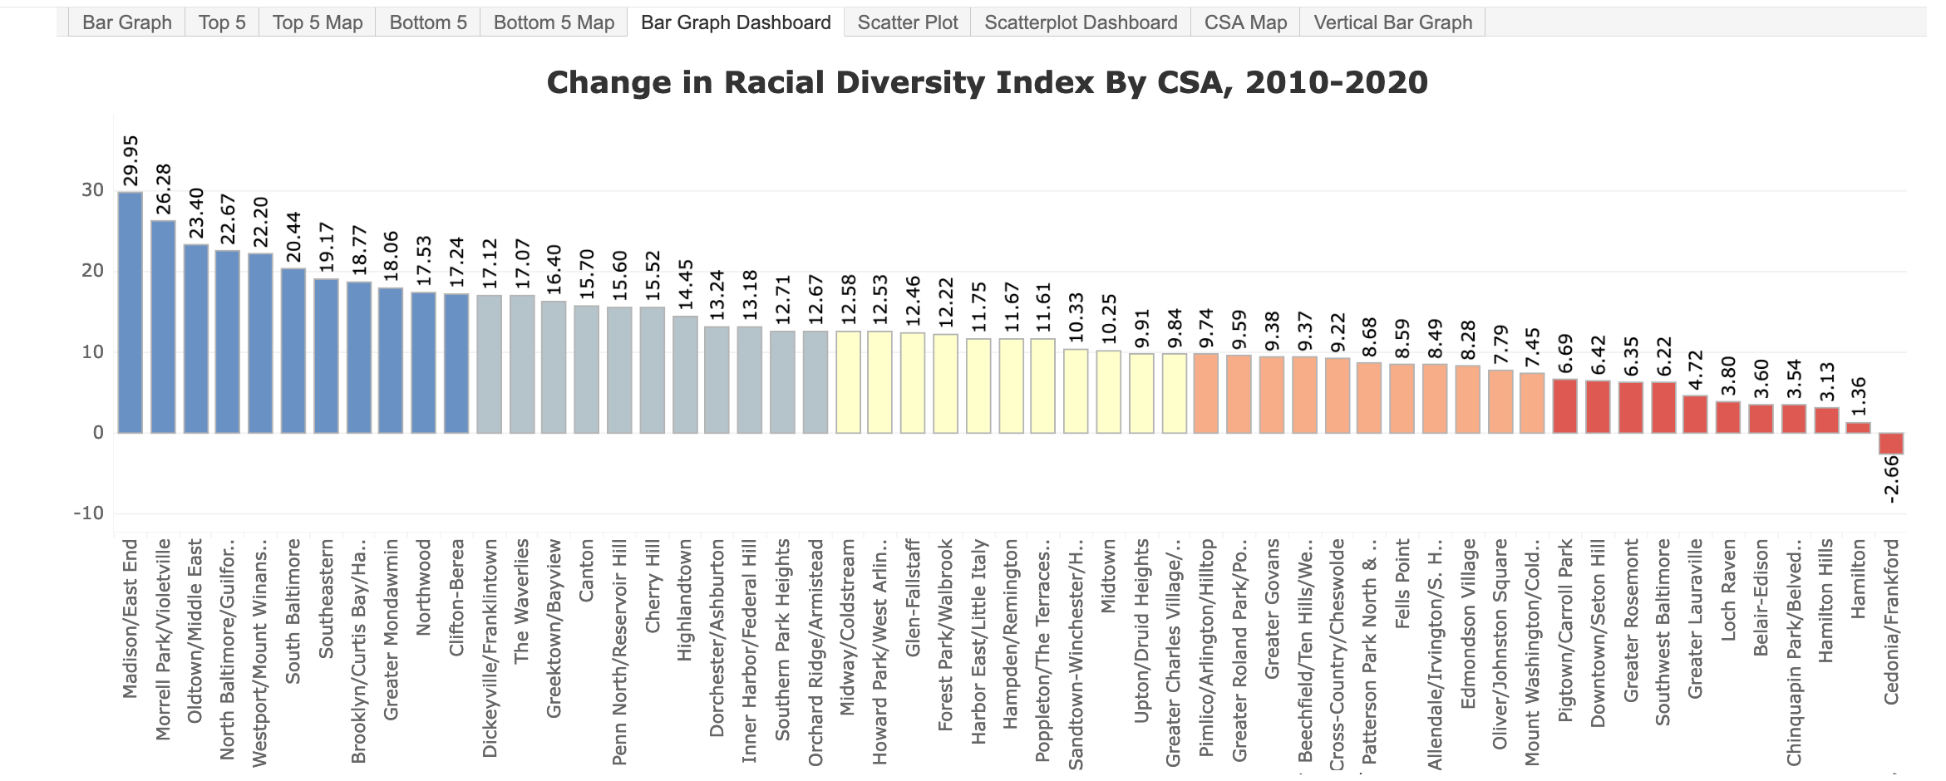
@bniajfi
#BmoreCommunityChange
Tableau dashboard – data by quartiles

Slide 14
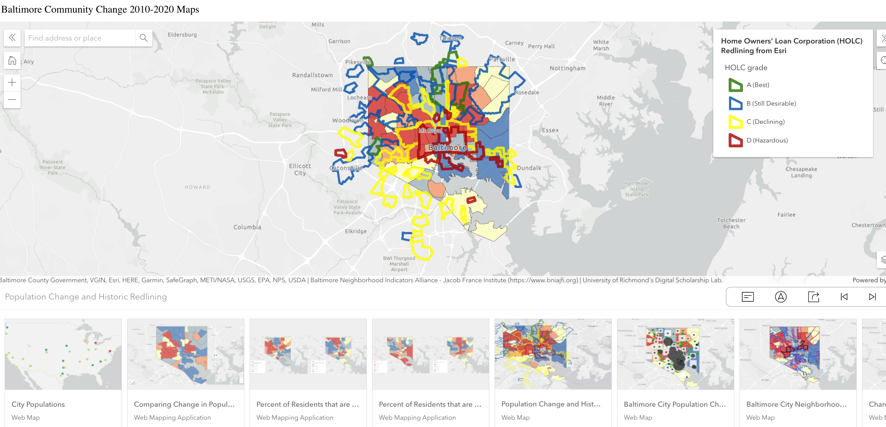
@bniajfi
#BmoreCommunityChange
Compilation of AGOL maps

Slide 15
Thank You!
@bniajfi
#BmoreCommunityChange
Cheryl Knott cknott@ubalt.edu
https://communitychange-bniajfi.hub.arcgis.com/
https://www.bniajfi.org
Sponsored by:

