Slide 1
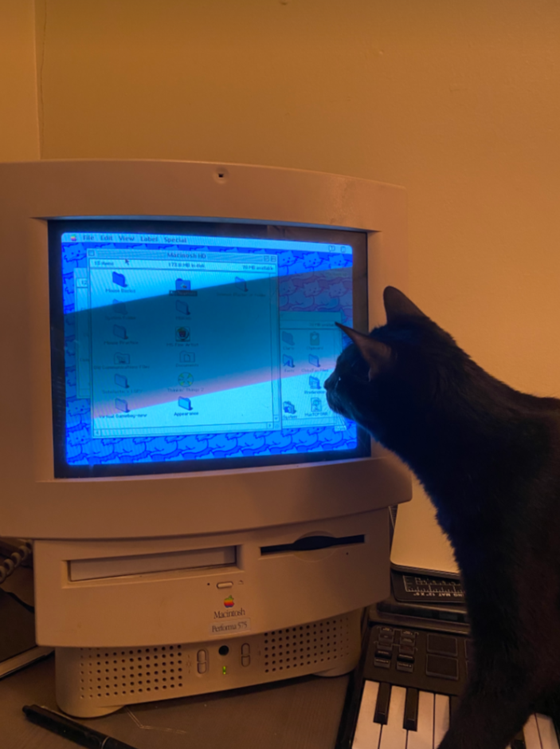
HouseCat
Affordable Housing Information Catalogue
October 26, 2022

Slide 2
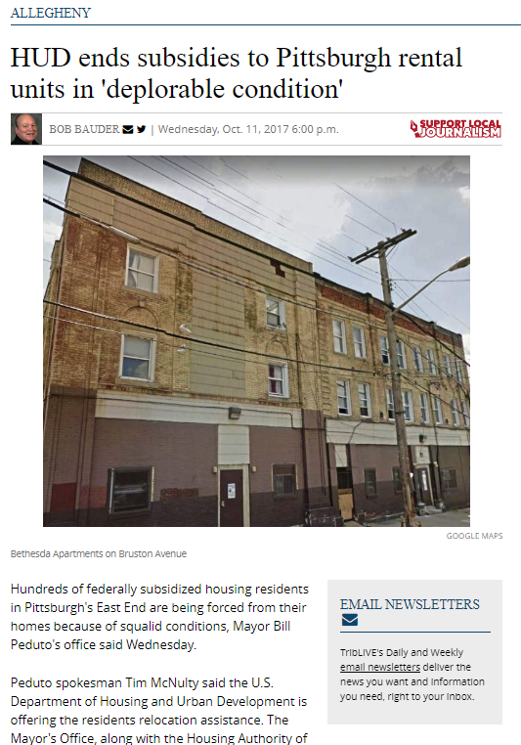
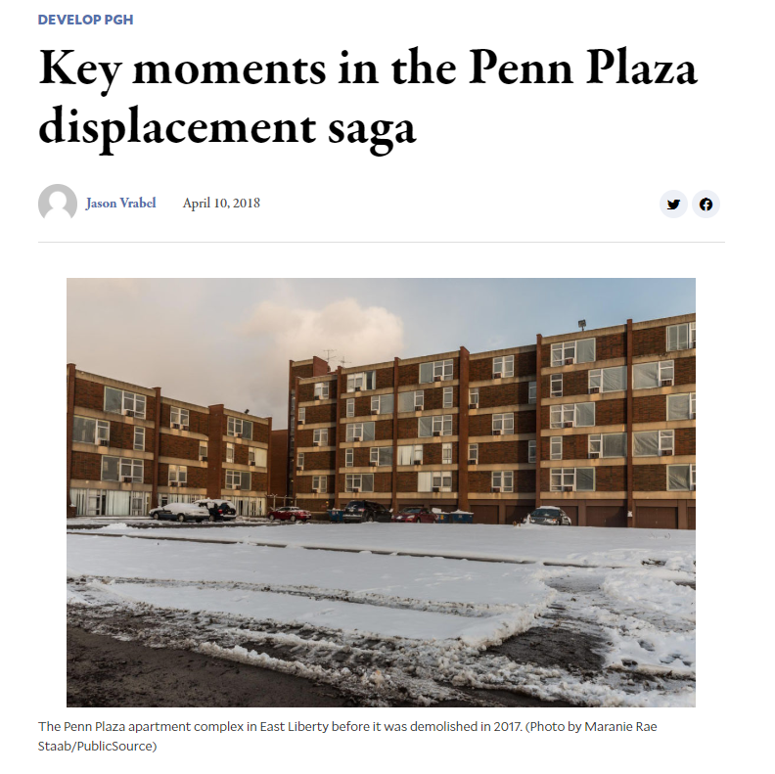
Our community wasn’t proactive in responding to threats to housing affordability
140 Units Lost
312 Units Lost
Notes:
Two separate incidents nearly 10 years ago resulted in the loss of over 450 units, leaving residents of these properties with no alternative beyond housing vouchers. There was little advance notice, but the data was there to show that Penn Plaza’s subsidies expired a decade prior, and the Bethesda Homewood portfolio was in deplorable condition.

Slide 3
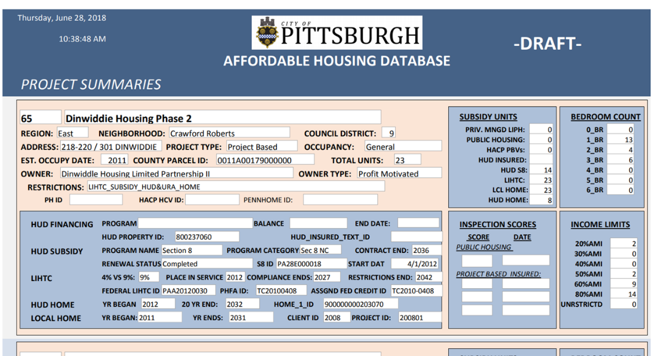
The first effort at assembling data was made by the Pittsburgh Urban Redevelopment Authority through manual processes
Notes:
A guy at the Urban Redevelopment Authority would compile this all manually and put it into an access database. He did great work, but eventually he left and it all fell apart.

Slide 4
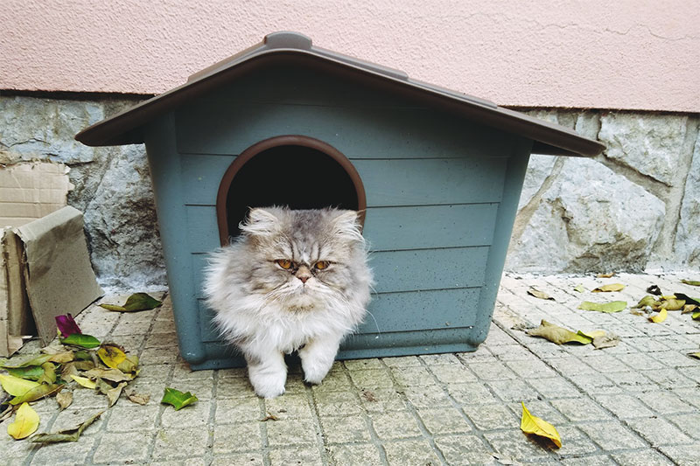
… and then HouseCat came along!
https://kittyclysm.com/waterproof-outdoor-cat-houses/

Slide 5
… and then HouseCat came along!
https://kittyclysm.com/waterproof-outdoor-cat-houses/

Slide 6
… and then HouseCat came along!
https://kittyclysm.com/waterproof-outdoor-cat-houses/

Slide 7
… and then HouseCat came along!
https://kittyclysm.com/waterproof-outdoor-cat-houses/

Slide 8
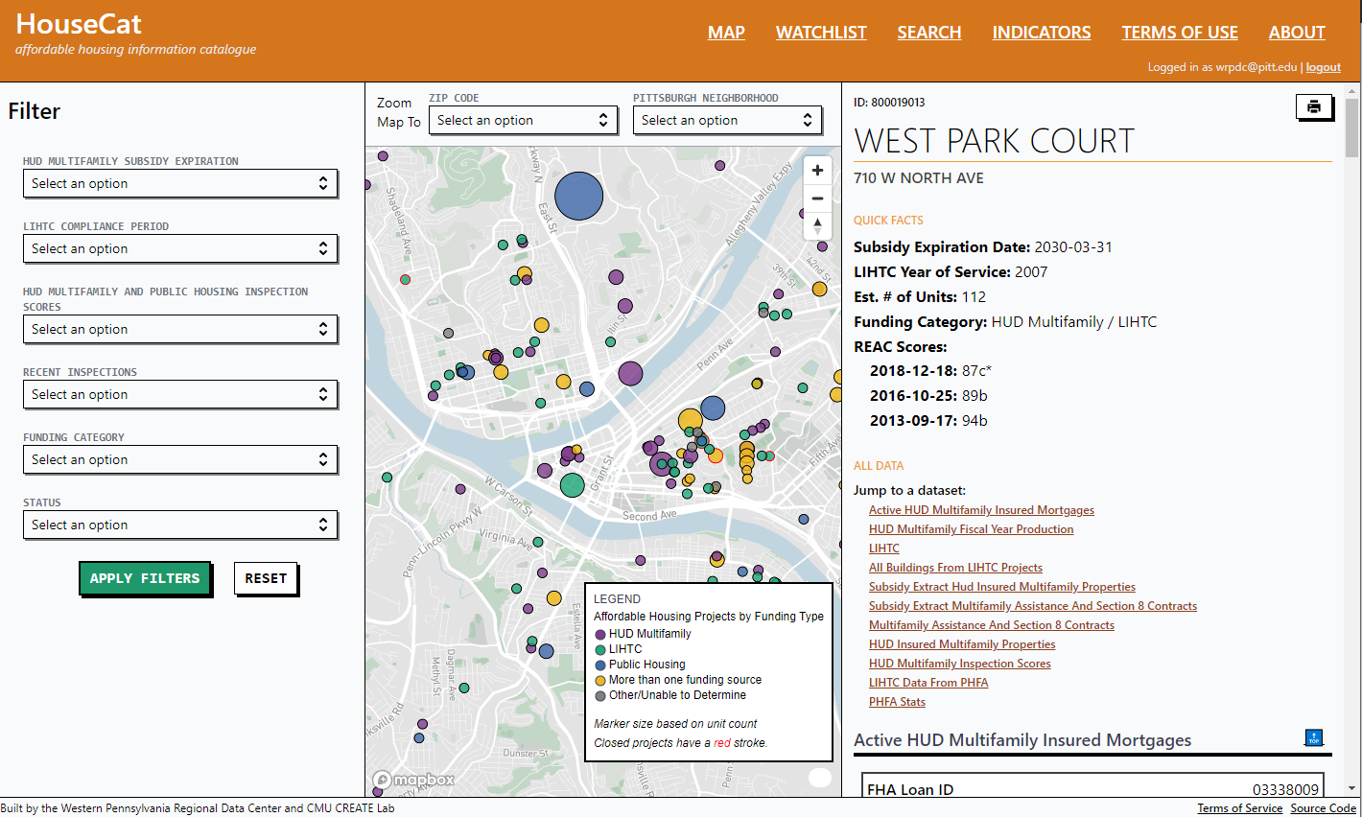
HouseCat - linked data on subsidized property
Notes:
Mention that we pull in data from over 10 different HUD and state housig finance agency sources. Point to the listing under “Jump to a dataset” – We pull in HUD Public Housing, HUD Multifamily, and tax credit data.

Slide 9
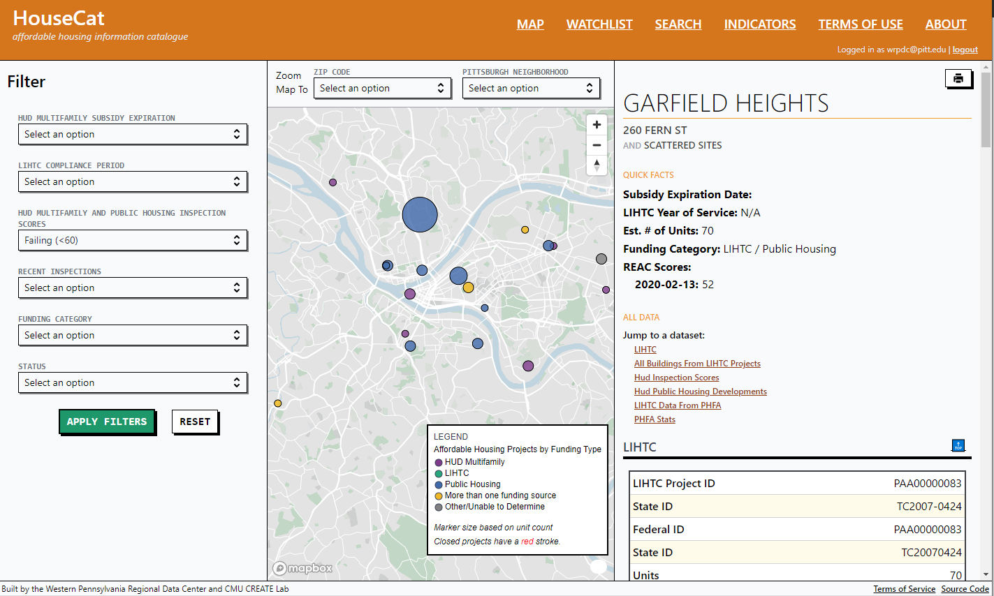
HouseCat filters data to identify the largest threats, and focuses discussion through the watchlist
Notes:
Talk about the filters and watchlist. Our designer Carl DiSalvo encouraged us to have a very simple design focused on two use cases- low scoring inspections and contract expirations

Slide 10
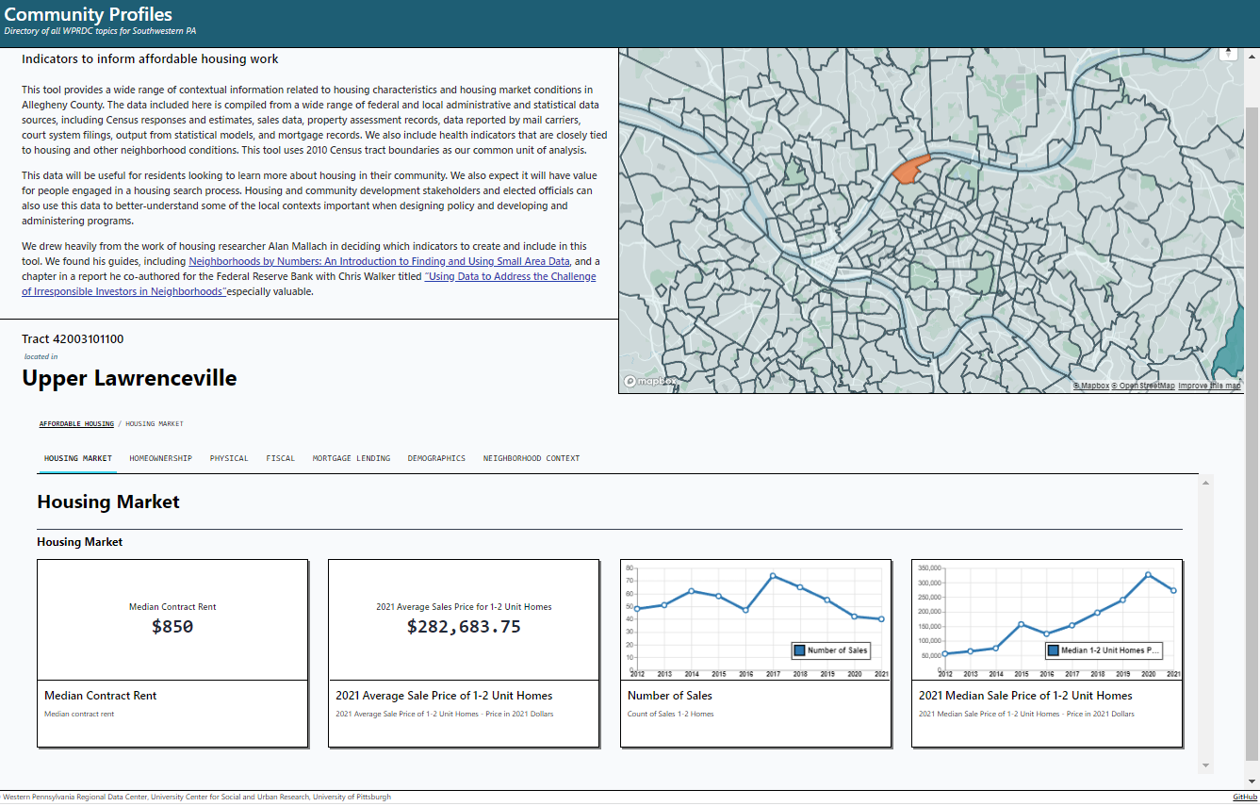
HouseCat provides contextual housing statistics
Notes:
Profiles – data context.

Slide 11
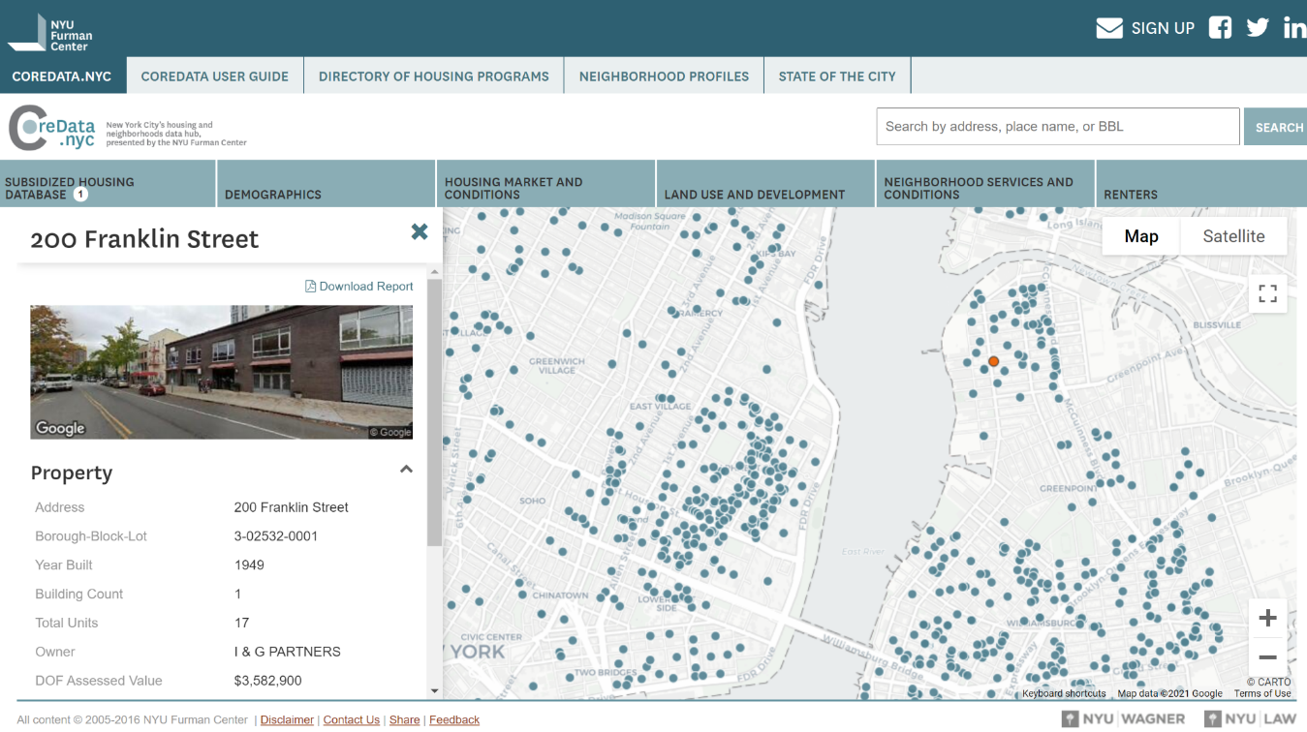
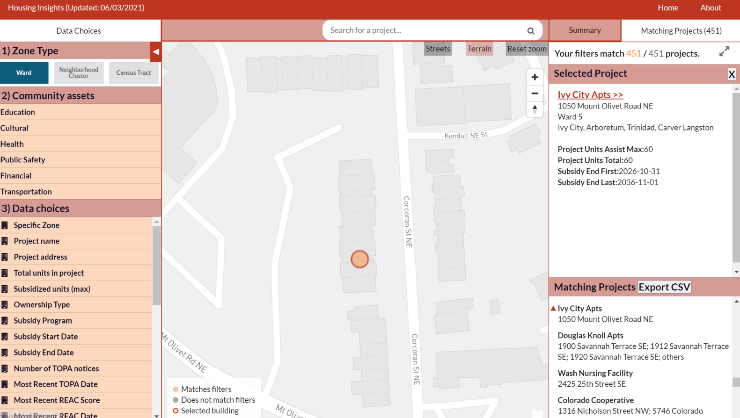
HouseCat builds on the work of our NNIP partners in New York and DC (thank you!)
Housing Insights DC
CoreData.NYC
Notes:
Thanks to our partners Maxwell in NYC and Peter in DC for helping us along the way as we tried to figure it all out.

Slide 12
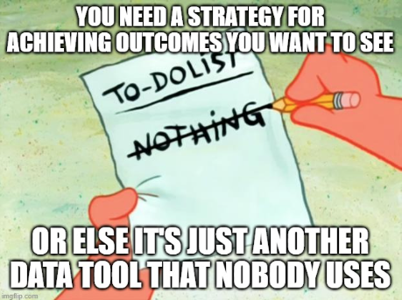
Notes:
You also need to have a strategy for getting people to use your data tool.

Slide 13
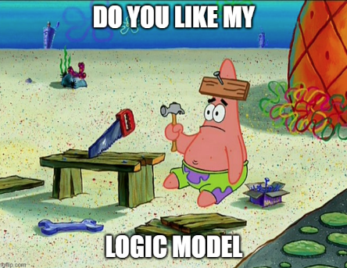
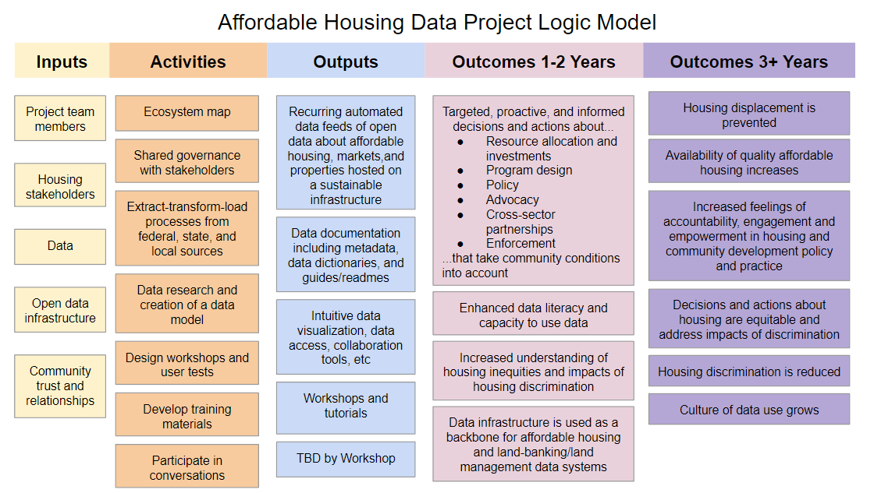
If your logic model is based on “hope,” then you’re a dope.
What you think your logic model looks like
What your logic model actually
looks like
Notes:
Hoping that people use your data tool isn’t enough. Your logic model needs to articulate ways that your project team can drive adoption. Here’s what we did…

Slide 14
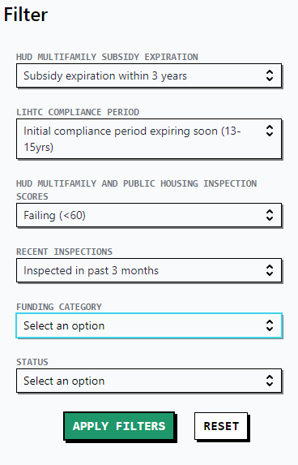
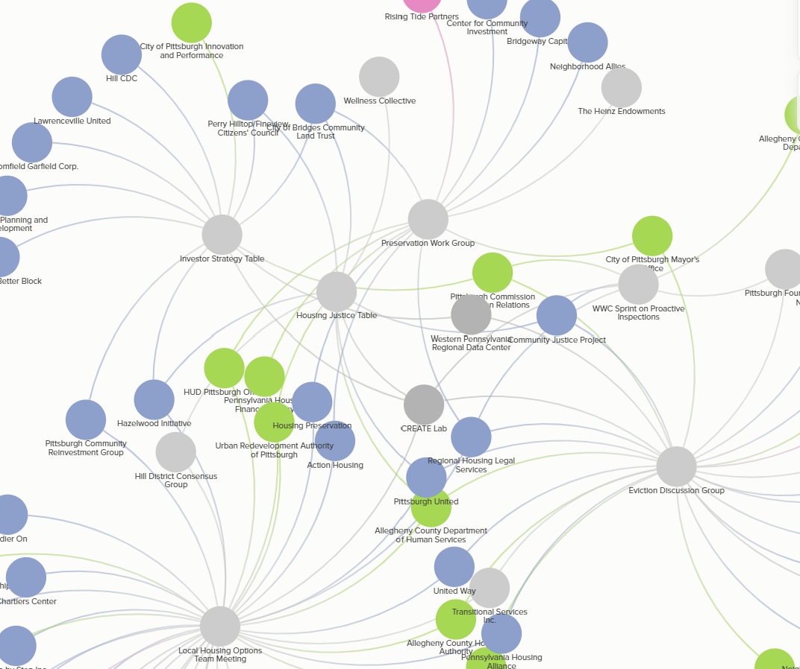
We invested time in building relationships in the ecosystem, and learning about needs and contexts
We focused the design on key threats to affordability – expiration and condition
Notes:
We talked to people all across the ecosystem, and held design workshops at different tables. Our ecosystem map was a helpful guide. Then talk about the importance of keeping it simple when it comes to usability.

Slide 15
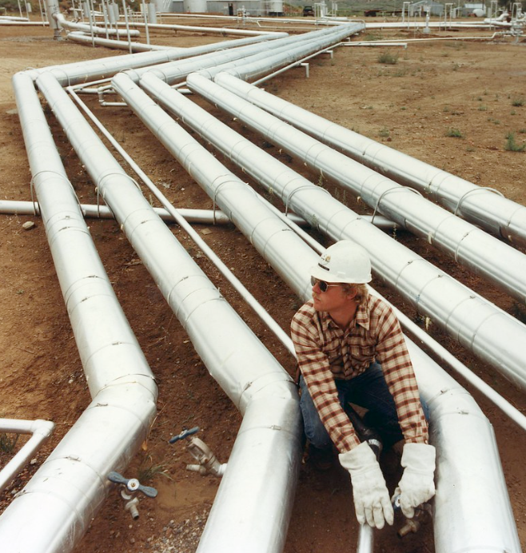
Data pipelines are an investment in sustainability, and give users the earliest warning possible to threats
We partnered with the Carnegie Mellon CREATE Lab to extend our capacity and challenge our thinking
Notes:
If we didn’t have fresh data, people wouldn’t need to visit the site on a regular basis. The National Housing Preservation Database is updated 3x/year. Most of our datasets update daily through code. Doing this was incredibly challenging since we had to account for different data formats, and the data wasn’t shared uniformly.
Also call out support from the CREATE Lab – one or two of them will be there.

Slide 16
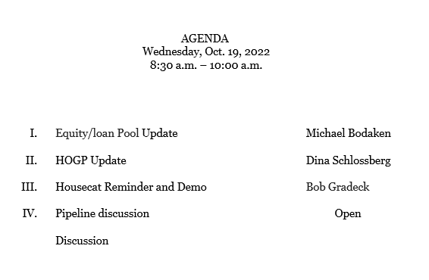
The preservation community is co-owners of HouseCat through the Preservation Working Group
We have a seat at the table, and data is on the agenda at every monthly meeting of the Working Group
Notes:
Bringing community ownership into the work was something that may not have happened without the CREATE Lab.
Community ownership makes them want to use the tool in a way
They set the terms of use – fear that the data would be used by investors. Had several design sessions at Preservation Working Group meetings to design this.
As co-owners, they share responsibility for raising support to maintain and improve the tools. Talking with health insurers involved with the group about $
Being at the table gives us feedback, and we get time on every agenda to talk data.

Slide 17
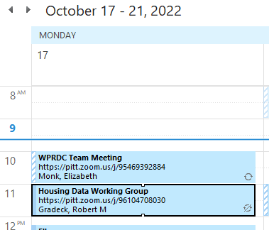
We built new spaces for housing data conversations tied to the Preservation Working Group
We’re building capacity to meet the preservation community’s data needs beyond HouseCat through student projects
Notes:
We realized 10-15 minutes on the meeting agenda isn’t enough. We started a virtual housing data working group to build community and elevate knowledge and practices. Last meeting had a presentation from the data steward at the City for permits and code enforcement.
Working with three separate classes and student groups interested in housing work. Providing capacity in different ways – 2 classes (predictive modeling on who is likely to sell portfolios, contract data management practices)

Slide 18
Apply for HouseCat access!
https://www.housecatpgh.org/accounts/request
Notes:
Apply for access – our partners are responsible for approving or denying accounts.

