Slide 1
Rural Health in Connecticut
Providing small towns with actionable data to improve health outcomes
Kelly Davila | Senior Research Associate | DataHaven October 26, 2022
Notes:
Use this slide to introduce the report and why we did it. CTORH helps rural areas better understand the health of their residents and can assist with grant writing and funding opportunities to improve health outcomes.

Slide 2
Defining “Rural” Towns
169 towns in Connecticut
68 towns rural as defined by the Connecticut Office of Rural Health
Additional 9 towns added per Health Resources and Services Administration (HRSA) definition
~508K people in 77 rural towns, 14% state population (2020)
Notes:
No standard definition. States have their own, and HRSA has one. In our analysis, we used all of CTORH’s towns and added the remaining HRSA towns, since those are also eligible for grants and other funding

Slide 3
Aggregating Towns
North Canaan Pop: 3,269 Pct white: 86% Med HH Inc: $63K
Some rural towns are less than one Census tract. Aggregation necessary to minimize MOE and disaggregate by demographics.
2015 assessment relied on limited public data, web surveys and data requested from public health departments, grouped geographically (NW, SW, E, CRV).
As a small state with strong municipal governance, regional groupings can mask disparity.
For our report, we chose to group towns into demographically-based clusters.
Harwinton Pop: 5,428 Pct white: 96% Med HH Inc: $111K
2020 ACS 5Y estimates
Notes:
This report is an update to the 2015 report which grouped towns geographically. The result was no meaningful differences between those rural regions. CT is the third smallest state by area with 169 individual towns. There’s not as much geographic disparity here as much as an urban/suburban one. So we wanted to incorporate demographics into our method of grouping the towns

Slide 4
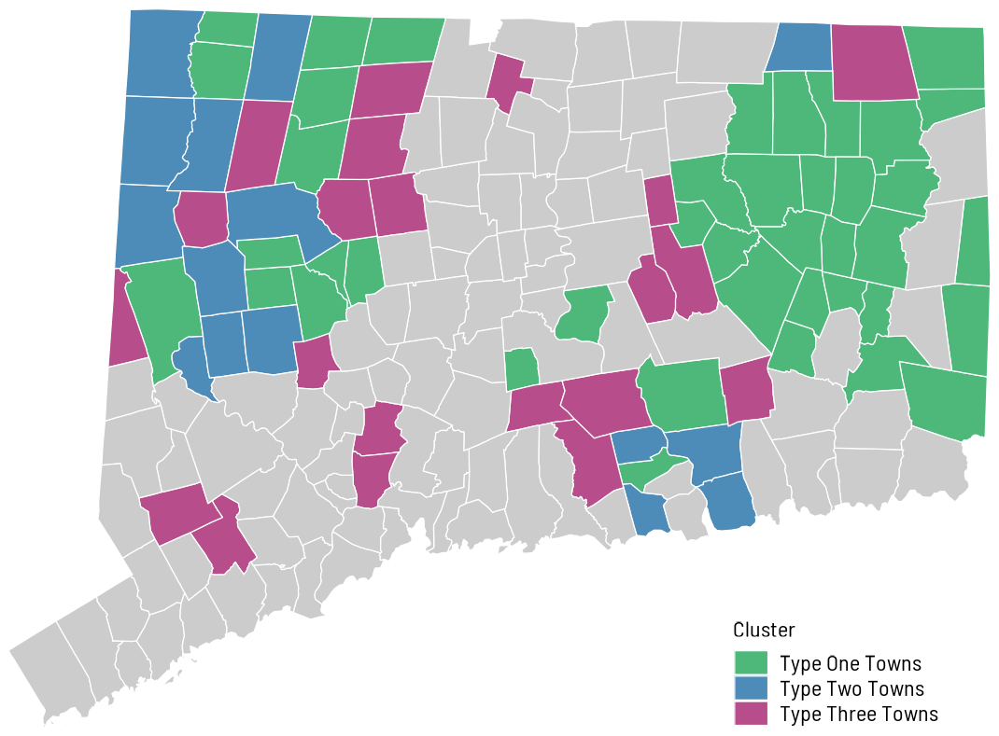
Three Rural Cluster Types
Factor analysis of 8 socioeconomic inputs reduced to 3 most descriptive (age, income, educational attainment).
Type One: greater share of adults with HS or less education (39%, CT avg 35%)
Type Two: greater share of population over age 65 (30%, CT avg 17%)
Type Three: very high HH income ($121K, CT avg $80K)
K-means, elbow method, inputs: 2020 ACS 5Y estimates

Slide 5
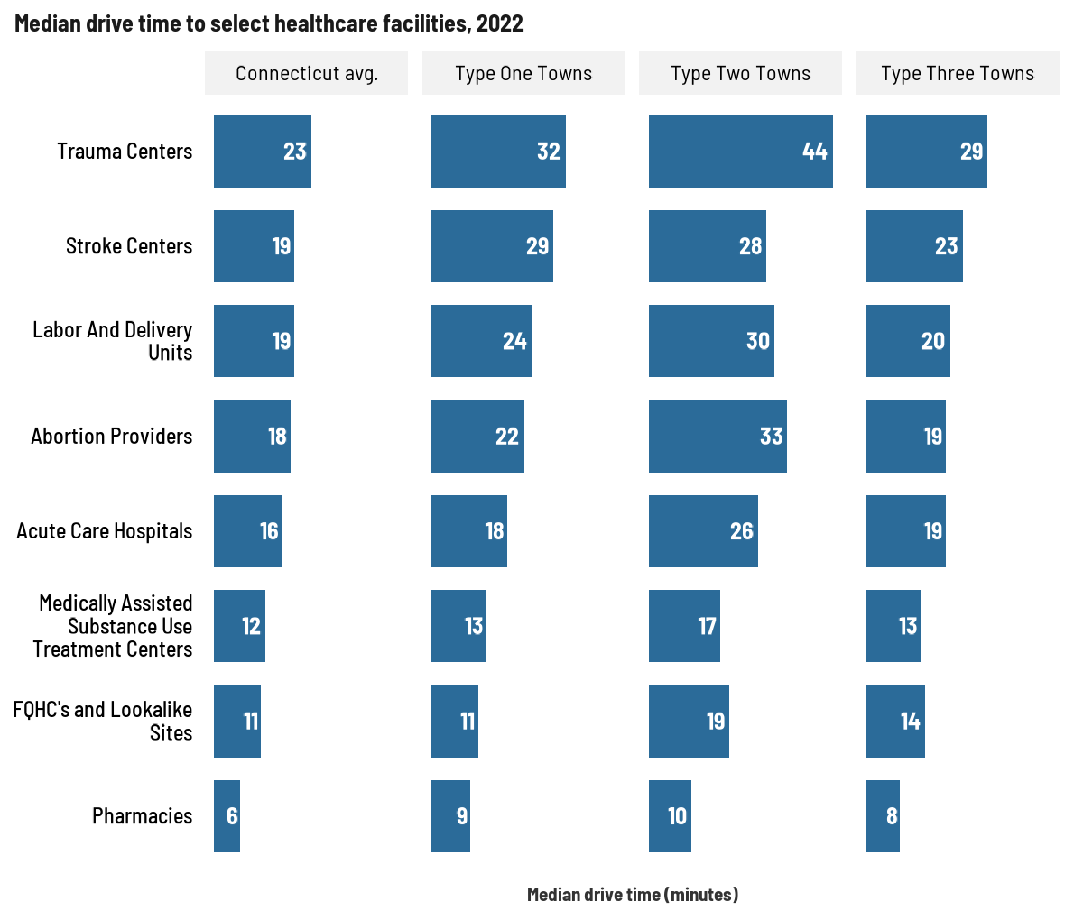
Some Challenges are Shared by Many Rural Towns
Long distances to health care facilities
Used point-location data for several facility types in CT (caveat: RI, MA, NY omitted for data limitation purposes)
Generated distance and drive times from each facility to population weighted centers of all CT towns
Aggregated by cluster, median drive times shown at right
Type Two Towns often face greater drive times
Shout out to Camille for running a 15 hour process for one chart

Slide 6
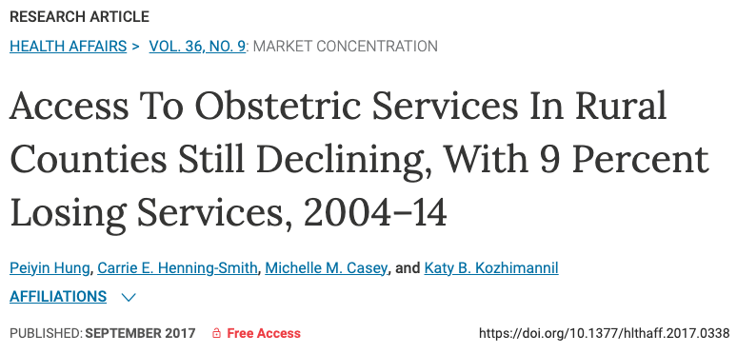
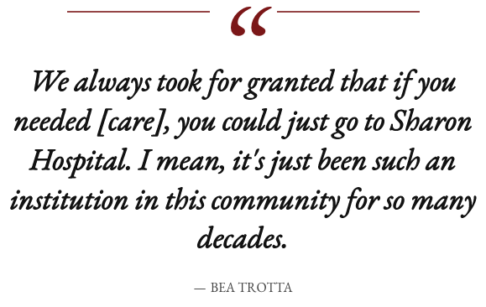
Some Challenges are Shared by Many Rural Towns
Hospital closures and consolidations
Only 4 hospitals serving rural areas in CT (20 more statewide)
Only 6 hospitals in CT remain independent in 2022
Hospital mergers and acquisitions result in closures of “duplicative” services across networks. Closures must be approved, but services are often scaled back before official approval.
Rural towns face the brunt of closures, especially in labor and delivery units.
Katy Golvala for CT Mirror

Slide 7
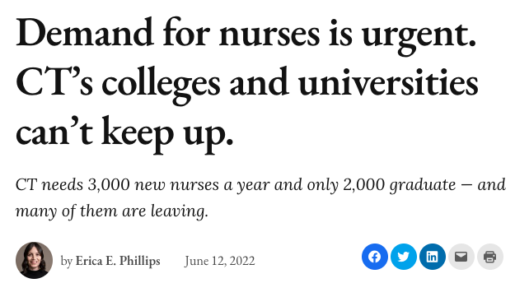
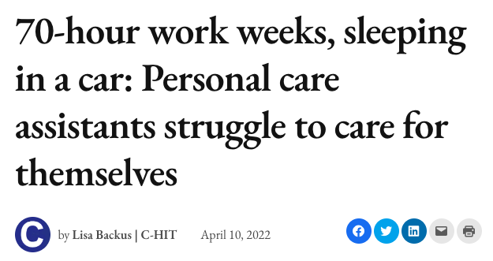
Some Challenges are Shared by Many Rural Towns
Health care workforce shortages
In addition to long drive times to hospitals, 4 rural towns have basic ambulance service but no first responders
Rural counties in CT have fewer primary care providers, dentists, and mental health per capita compared to urban counties
Few substance use treatment facilities serve rural areas—fewer still that provide MAT
Due in part to low wages, lack of organized labor efforts, and high turnover, HRSA estimates workforce shortages in LPNs and RNs statewide
Erica E. Phillips and Lisa Backus for CT Mirror

Slide 8
Racial Inequities are Prevalent Between Cluster Types
Demographics and housing
Approx. 508K people live in rural towns, including 291K in Type One Towns, 61K in Type Two Towns, and 151K in Type Three Towns
Type One Towns less racially diverse than CT but more diverse than other cluster types
Greater shares of Black, Latino, and Native American residents in Type One Towns, affecting disaggregation by race/ethnicity in other clusters
2020 ACS 5Y estimates

Slide 9
Racial Inequities are Prevalent Between Cluster Types
Financial, housing, and food insecurity
Poverty rates in Type One Towns track with CT average (10%), higher than Type Two (5%) or Type Three Towns (4%). Similar trends seen in households receiving SNAP benefits.
When looking at total shares, trends in financial, food, and housing insecurity appear similar across each cluster type, due in part to the large white population in each.
Only Type One Towns have sufficient populations by race/ethnicity to disaggregate these values…
DCWS 2015-2021 pooled data

Slide 10
Racial Inequities are Prevalent Between Cluster Types
Financial, housing, and food insecurity
Due to data limitations and population shares, we cannot disaggregate Type Two and Type Three Towns by race/ethnicity
Black, Latino, and Native American adults are 2.5 times more likely to be housing-insecure
Nearly twice as many Native American adults than white adults in Type One Towns are financially insecure
Food insecurity affects a third of Black and Latino adults, and more than half of Native American adults in Type One Towns
DCWS 2015-2021 pooled data

Slide 11
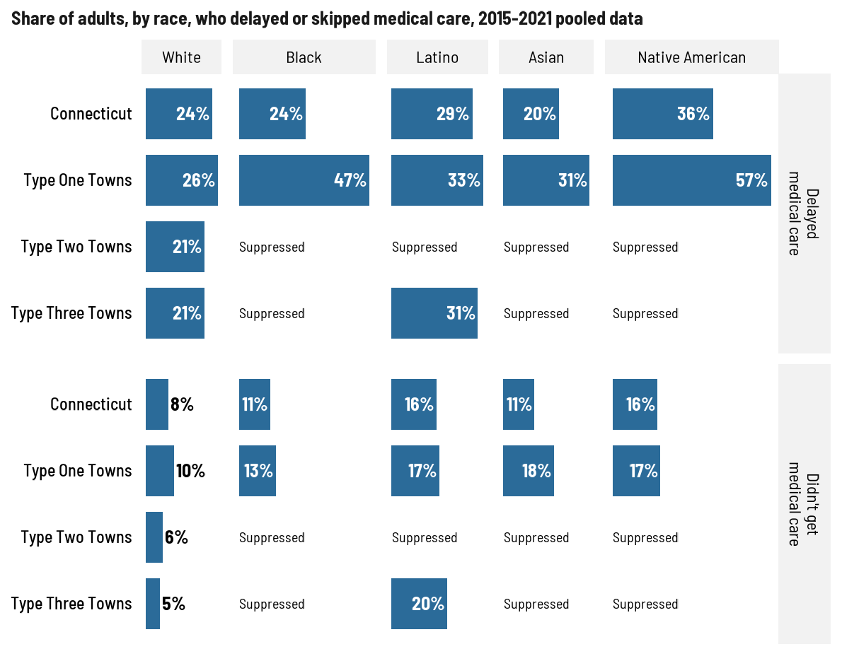
Health Disparities are Apparent by Cluster
Overall uninsured rates and disability rates in rural towns are comparable to the state average, but health risks vary by cluster.
Black and Latino adults in Type One Towns are more twice as likely as white adults to have no medical home.
Adults in Type One Towns are more likely to delay receiving medical care than adults in other rural towns. Within Type One Towns, Black and Native American adults are about twice as likely as white adults to have delayed care.
DCWS 2015-2021 pooled data

Slide 12
Health Disparities are Apparent by Cluster
Adults in Type One Towns have elevated rates of diagnosed depression and poor mental health compared to other rural towns and the CT average.
Adults in Type One Towns also report higher rates of smoking and binge drinking than the CT average. Adults in wealthier Type Three Towns also report elevated rates of binge drinking.
Adults in Type Two Towns (higher shares of seniors) have elevated rates of high blood pressure and high cholesterol, and are more likely to be on BP meds.
Disparities in hospital encounters are common in many clinical features.
DataHaven analysis of CHIME ED encounters, 2018-2021

Slide 13
Some Environmental Issues Disproportionally Affect Rural Towns
Greater shares of children in Type One and Type Two Towns have elevated blood-lead levels.
Ticks are generally more common in wooded or rural areas, and as a result each rural cluster has confirmed Lyme disease case rates nearly three times greater than the state average.
Lyme disease case rates are on the rise, and will likely get worse as New England gets warmer as a result of climate change. Rural towns will be more affected than urban areas.
DataHaven analysis of childhood lead poisoning surveillance data and Lyme disease case data from CTDPH

Slide 14
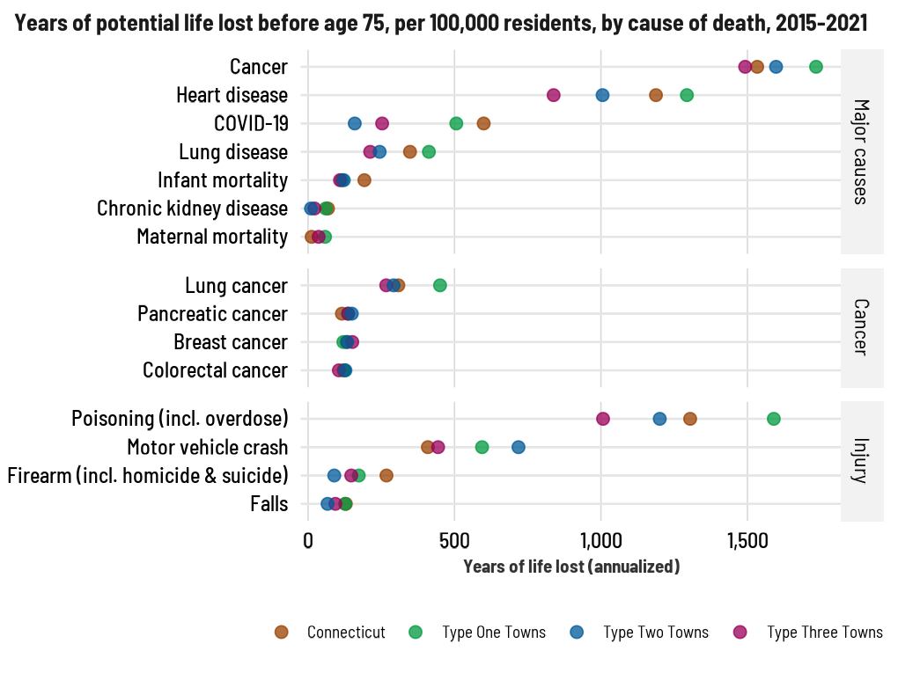
Health Inequities Result in Disparate Mortality
Type One Towns exceed the premature mortality rate across many clinical features, notably lung cancer (recall elevated smoking rates) and overdose.
Cumulatively, there were 500 overdose deaths in Type One Towns between 2017 and 2021, compared to 65 in Type Two Towns and 107 in Type One Towns.
Fentanyl has established a foothold across Connecticut and is now found in more than 90% of overdoses statewide.
Type Two Towns have high rates of premature mortality due to motor vehicle crashes. Recall these towns have greater drive times to health care facilities.
DataHaven analysis of record-level mortality data from CTDPH, 2015-2021

Slide 15
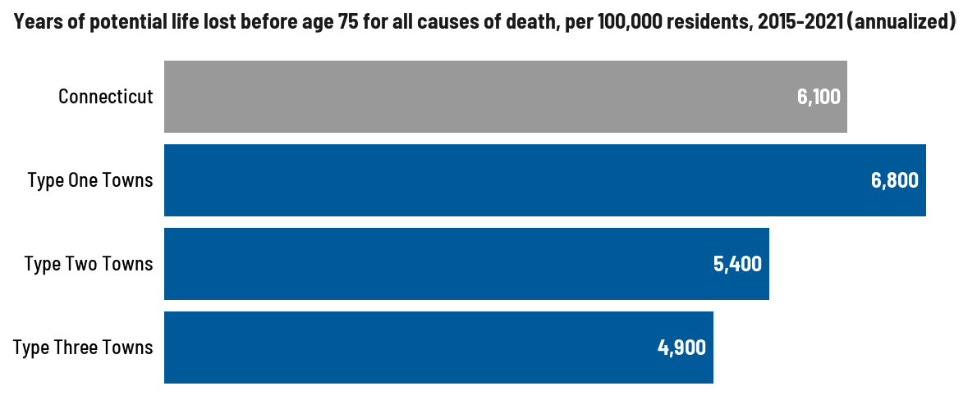
Health Inequities Result in Disparate Mortality
YPLL is 11% greater in Type One Towns than the state average, due in part to wide disparities in health care access and resources.
Wraparound supports and culturally competent health care can help improve community health, including preventable outcomes as a result of smoking, binge drinking, or lacking prenatal care.
Hospital closures and consolidations will continue to negatively affect rural communities. State legislation can help prevent full closure of rural hospitals, especially labor and delivery units.
Workforce development will be necessary to ensure rural areas are adequately staffed with healthcare professionals.
DataHaven analysis of record-level mortality data from CTDPH, 2015-2021

