Slide 1
W8CED Data Walk: A Model for Researcher-Community Collaboration
Notes:
Good afternoon everyone, my name is Donovan Harvey and I am a research analyst in Urban's Metropolitan Housing and Communities Center. Today I'll be presenting on a collaboration between Urban Institute researchers and W8CED to put on (wc) the Ward 8 CED Data Walk

Slide 2
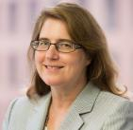
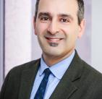
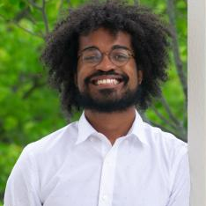
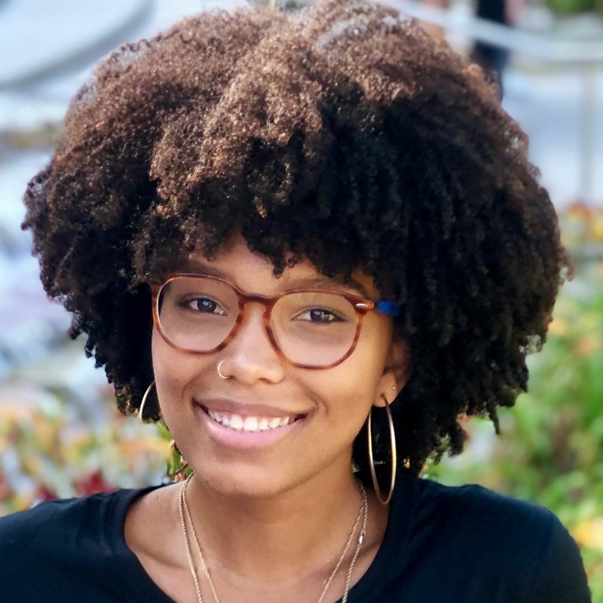
Urban Institute Research Team
Mary Bogle
Co-Principal Investigator; Principal Research Associate
Peter Tatian
Co-Principal Investigator; Senior Fellow
Donovan Harvey
Research Analyst
Camille Braswell
Research Assistant
Notes:
There are two central players in our story: The Urban research team - Mary Bogle, Camille Braswell and myself. With funding from JPMorgan Chase, our team has been conducting a scan of philanthropic giving in Wards 7 & 8 and comparing the results to publicly available community assets and priorities.

Slide 3
Work in Wards 7 & 8
Community Priority Scan
Philanthropic Giving Survey
Gap Analysis
Adding Text Slides
Notes:
As we began work, we quickly ran into a problem. Despite substantial surveying East of the River, which has led to a justified survey fatigue among residents, we found very few systematic efforts to collect and preserve community input.

Slide 4
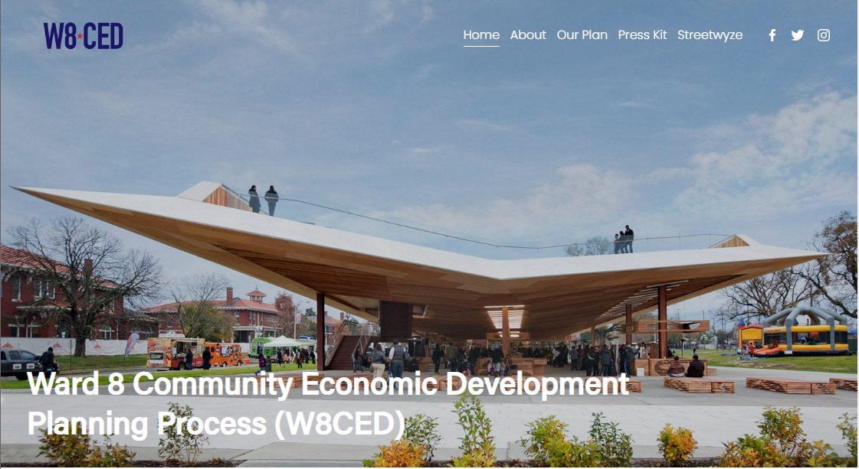
Enter W8CED
Adding Text Slides
What is it
Mary had prior relationship
Asset: Number of engaged community advocates → enter W8CED
Notes:
Unbeknowst to us, our work was running parallel to a community-led effort to gather the very same priorities. Here, we meet the second player in our story: W8CED, a community-based organization led by Mustafa Abdul-Salaam, which aims to create a “bottom-up” community economic development plan in Ward 8

Slide 5
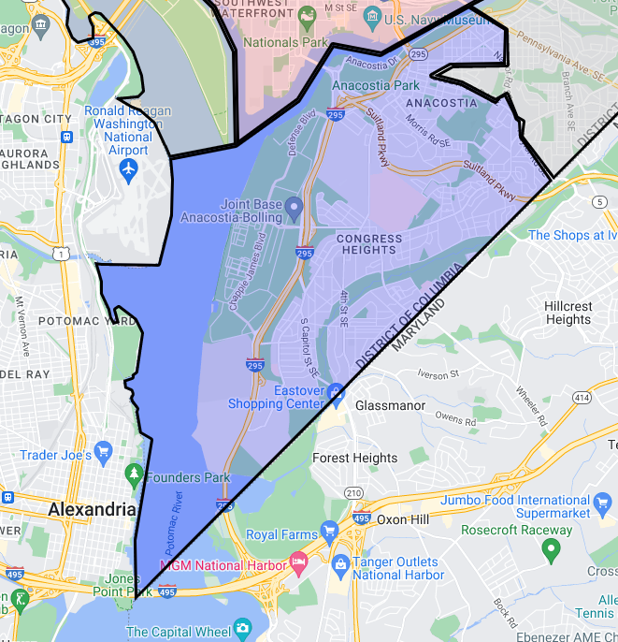
Ward 8 Background
Home to ~23% of DC’s Black population.
Fredrick Douglass House
Barry Farms: First planned community for African-Americans
Notes:
71,236 / 300,829
Slightly less than 25% of DCs Black Population

Slide 6
Ward 8 Background
Unemployment Rate: 11.4%, compared to 5.3% district-wide.
Smallest percentage of taxable land in the district

Slide 7
W8CED Survey
Adding Text Slides
Jan. 2022
Urban Ward 7/8 work begins
Feb. 2022
W8CED conducts survey
July 8, 2022
Mary reaches out to W8CED
Notes:
To inform their recommendations, the organization conducted a survey…

Slide 8
Collaboration Begins!
Jan. 2022
Urban Ward 7/8 work begins
Feb. 2022
W8CED conducts survey
July 8, 2022
Mary reaches out to W8CED
Notes:
Fortunately, Mary Bogle had a prior relationship with W8CED leaders. Shortly thereafter, the Urban research team joined a W8CED data team meeting and a plan emerged.

Slide 9
Nature of Collaboration
Urban
W8CED
Analyzes survey data
Produces posters
Facilitates data walk
Allows Urban to use survey results in community priority research
Notes:
The Urban team would analyze the survey data and create posters for a data walk that W8CED would host in September. In exchange, Urban would be able to use the survey results to inform our community priority research. The Urban team would analyze the survey data and create posters for a data walk that W8CED would host in September. In exchange, Urban would be able to use the survey results to inform our community priority research.

Slide 10
Collaborative Process
Jul. 20 2022
First joint Urban-W8CED meeting
7/21-8/25
7 additional joint meetings
Aug. 31, 2022
W8CED Data Walk!
Notes:
From a process standpoint, our teams met on a weekly basis for [duration]. At each meeting, I presented updates on

Slide 11
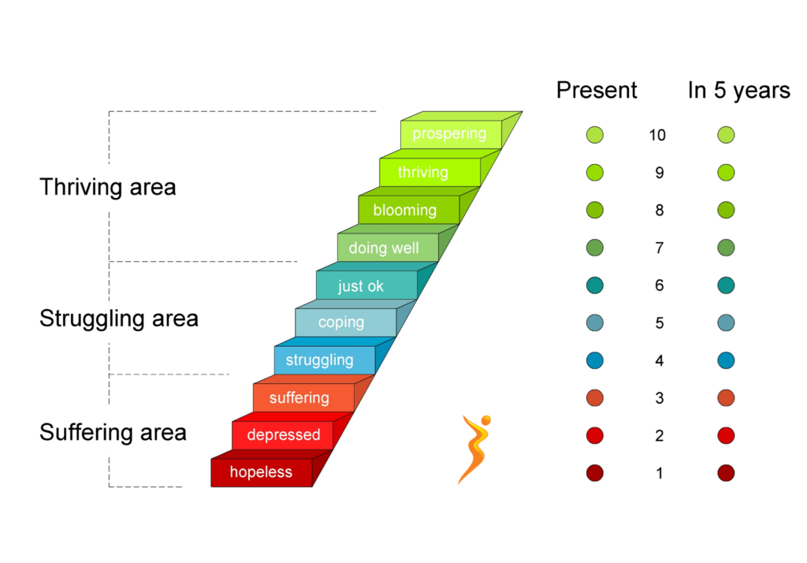
Survey Analysis
N=1009
Based on Cantril’s Ladder, which measures self-reported well-being
Most interested in correlation between well-being subcomponents and self-identification
Notes:
The survey analysis itself was relatively straightforward; primarily consisting of reshaping the data and cross-tabbing wellbeing subcomponents on demographic variables of interest. Ultimately, the crosstabs - along with some counts - were used to create posters for the data walk

Slide 12
586 people (58.1%) said that public safety was their biggest concern in Ward 8
Thriving Struggling
71 people (7%) said they did not feel safe at home, and they had the lowest sense of belonging of all sub-groups
Notes:
In total, Urban prepared and printed ## of posters - like the one featured on this slide. Our team also helped staff the event. Led by Camille Braswell, Urban contributed notetakers and facilitators for the evening's 4 stations

Slide 13
Takeaways
Importance of researcher-community engagement
Mary Bogle had a prior relationship with W8CED, built through meeting attendance and ad hoc support.
Notes:
Takeaways: Project team and funder flexibility

Slide 14
Takeaways
Importance of researcher-community engagement
Mary Bogle had a prior relationship with W8CED, built through meeting attendance and ad hoc support
Importance of funder and project team flexibility
Flexible funding from JPMC and supportive response from partners
Agile project team
Notes:
Takeaways: Project team and funder flexibility

Slide 15
Notes:
Actually have David’s email

