Slide 1
Branding community data
NNIP Washington, DC October 26, 2022
Tommy Pearce tpearce@atlantaregional.org

Slide 3
MISSION
Growing a culture of data-informed decision making across Georgia’s social impact sector.

Slide 4
Theory of change

Slide 7
Brand Identity
Promise
We work the data so the data can work for you — and for the community.
Personality
Friendly but not overeager
Smart but not intimidating
Creative but not chaotic
Provocative but not shocking
Partner but not pushy…or push-overs

Slide 9
MICRO
PRIMARY
SECONDARY
TERTIARY

Slide 10
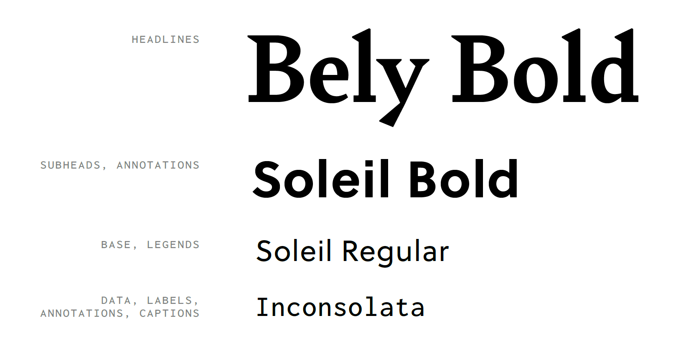

Slide 11
