Slide 1
Measure4Change
A Program of the World bank group and urban institute

Slide 2
Using Small Area Data
Measure4change Learning Curriculum
Revised December 2016
Notes:
Provide to students:
Does neighborhood matter? Assessing recent evidence (Does neighborhood matter Assessing recent evidence.pdf)
Using small area data handout (SmallAreaData_Handout.docx)
Using small area data exercise (SmallAreaData_Exercise.docx)

Slide 3
Welcome and Icebreaker
Notes:
What is your favorite data source OR what data do you most wish you had?

Slide 4
Course objectives
At the end of this session participants will
Understand the usefulness of small area data for social service providers trying to better address the needs of the populations they are serving
Obtain a basic understanding of GIS/mapping
Learn how to geocode and display client locations on a map overlaid with small area data

Slide 5
Introduction
Why look at small area data?

Slide 6
What are small area data?
Small area data are information that can be summarized and compared for places below a city or county level
Examples:
Neighborhood poverty rates within a city
Demand for health care services for towns within a county
Notes:
Different than Census Bureau definitions of small area data, which include state level (Small Area Income and Poverty Estimates) or below 20,000 population (5-year ACS estimates).

Slide 7
Small area data can help you…
Understand the local context of where your clients live, work, or go to school
Dig deeper into why community conditions are changing (or not)
City or countywide data can mask disparities among smaller places or populations
Notes:
Helps you better design, target, and deliver services to populations who need it the most
Evidence that can be used to advocate for resources and more effective programs and policies
Are things improving everywhere in the city/county? Are they getting better in some places and not others?

Slide 8
Why look at small area data?
Research shows that community conditions help shape outcomes for individuals and families
Where you were born or live matters
But not as much as family characteristics
Specifics of what conditions matter most and to whom is still being investigated
Does neighborhood matter? Assessing recent evidence, by Ingrid Gould Ellen and Margery Austin Turner
Notes:
Various neighborhood conditions significantly affect a wide range of individual outcomes.
But, neighborhood effects are generally much smaller than the effects of observed family characteristics (such as parents’ income, socioeconomic status, or educational attainment).
Ethnographic studies suggest that parental access to supportive social and institutional networks may be a critical factor in the development of young children.
Ethnographic literature strongly suggests that neighborhood environment and social interactions play an important role in pushing an adolescent toward (or away from) criminal activities. Quantitative studies consistently find a relationship between neighborhood environment and crime.
Citation: http://www.tandfonline.com/doi/abs/10.1080/10511482.1997.9521280

Slide 9
Small Area Geography
Types of commonly used small areas

Slide 10
Small area geography: Census tracts
Small subdivisions of a county (or equivalent) updated prior to each decennial census
Generally have between 1,200 and 8,000 people, with an optimum size of 4,000
For the 2010 census, Washington, DC, was divided into 179 census tracts, with an average population of 3,400 each
Land area can vary widely depending on population density
In cities, tracts are smaller; in rural areas, tracts are larger
Notes:
Because tracts are defined for the entire US, they are widely used as a proxy for “neighborhoods” or other small areas.
Nevertheless, it can be difficult to get data for census tracts other than Census Bureau data products.

Slide 11
Small area geography: Census tracts
Used in many US Census Bureau and other data products (ex, American Community Survey)
Each census tract is identified by a unique combination of three numeric codes
24 033 8001.02
Tract ID number: 8001.02
County ID number: Prince George’s
State ID number: Maryland
Notes:
Note: some cities are treated as county-equivalents by the Census Bureau. Ex, Baltimore city is a county equivalent because it is not part of another county. So, it has it’s own “county” ID number (510).

Slide 12
Small area geography: Places
Places include cities, towns, villages, and boroughs
Census Bureau recognizes both incorporated and “Census-designated” places
Places are identified by two numeric codes:
51 27200
Place ID number: Falls Church
State ID number: Virginia
Notes:
For orgs working at a state, county or metropolitan area level, places may be a good small geography to use.
But, bear in mind that individual places are not homogenous. Neighborhood conditions can vary widely within a city.

Slide 13
Small area geography: County subdivisions
Census-defined primary subdivisions of counties or county equivalents
Example: Fairfax County, VA, has 9 subdivisions
Subdivisions are identified by two numeric codes:
51 90464
Subdivision ID number: Braddock district
State ID number: Virginia
Notes:
Less familiar to most people, but for Census data this may be a good small area to consider.

Slide 14
Small area geography: ZIP codes
ZIP codes are defined by the US Postal Service to facilitate mail delivery
Not designed for data collection or reporting
Do not necessarily represent geographic areas
Some ZIP codes are post offices or addresses receiving a large amount of mail
Postal Service can change ZIP code boundaries as needed
Notes:
ZIP codes can be very convenient, because most address-based data will have ZIP codes that can be readily used to create summary statistics.
Example: IRS data from tax returns are summarized by ZIP code, since every tax filer provides an address.
But, since ZIP codes are designed for mail delivery they don’t always conform to recognized areas and can change over time.

Slide 15
Small area geography: Legislative districts
Includes both congressional districts and state legislative districts
Can be a useful political jurisdiction since it relates directly to elected representation in legislative bodies
Notes:
A useful small area for groups that do advocacy work. Can show data that is directly relevant to
Census data (ex, American Community Survey) can be obtained for both congressional and state legislative districts.

Slide 16
Small area geography: Neighborhoods
No national standards for neighborhood definitions
Not a geography used by the Census Bureau
Some cities and towns may have formally defined neighborhoods, but not always
Example: District of Columbia Office of Planning has defined “neighborhood clusters,” areas of 3 to 5 neighborhoods, but not individual neighborhoods
May require transforming tract, address, or other data to neighborhoods
Notes:
Availability of maps and data for neighborhoods is generally determined locally.

Slide 17
Small area geography: Resources
Census Bureau geography atlas, https://www.census.gov/geo/reference/webatlas/
Missouri State Data Center, geographic codes lookup (entire US), https://census.missouri.edu/geocodes/
Notes:
Census geo atlas: Provides definitions of different types of geographies used by Census Bureau for collecting and reporting data.
MSDC: Quick way to look up geographic ID numbers for different Census-defined geographic areas. For the entire US, not just Missouri. Also, provides actual summary data for areas from the ACS.

Slide 18
Data Sources
National and local sources of small area data

Slide 19
Data sources: American Community Survey
National ongoing survey of US households
Collects a wide variety of socio-economic data
Population characteristics (age, sex, race, ethnicity)
Education
Employment
Income
Disability status
Language ability
Housing

Slide 20
Data sources: American Community Survey
For most small areas need to use ACS 5-year data
Combines 5 years of household surveys
Census tracts, places under 20,000 population, legislative districts
Margins of error for small areas can be large
A margin of error measures uncertainty for a survey estimate
Comparisons between numbers with large margins of error can be unreliable
New 5-year data are released annually, but cannot reliably compare estimates with overlapping years
Ex: 2009-2013 ACS estimates cannot be compared to 2011-2015
Notes:
Very useful data, but two cautions regarding margins of error and comparisons over time.

Slide 21
Data sources: Resources
List of national data sets with small area data, http://www.neighborhoodindicators.org/library/catalog/list-national-data-sets-small-area-data
National Neighborhood Indicators Partnership (selected areas), http://www.neighborhoodindicators.org/partners/profiles
Notes:
List of national data sets: Various data sources that have small area (usually tract) data. Some are a single source, like the Home Mortgage Disclosure Act data on mortgage lending published by the FFIEC. A few are compilations, like the Child Opportunity Index, which provides opportunity measures for census tracts from a variety of data sources.
If you are in an area with an NNIP Partner (like NeighborhoodInfo DC) then they can be a great data resource for both local and national data.
You should also check your state and local government and state data center for any data resources that might have. Many cities now have open data programs, like opendata.dc.gov, which publish lots of public data sets.
Additional resources in handout.

Slide 22
GIS
Geographic Information Systems

Slide 23
What is GIS?
GIS stands for “Geographical Information System”
Sometimes also called “mapping software”
Software that is capable of displaying and manipulating spatial data
With GIS you can
Make maps displaying geographic features (points, lines, areas) and data associated with those features
Combine data sources based on locations (spatial join)
Calculate spatial measures, like distance and area
Notes:
One of the most useful and powerful ways to analyze and communicate small area data is through maps.
GIS is software that makes maps.
In today’s session, we will learn about the first two ways of using GIS (making maps and combing data). The third is a more advanced topic.

Slide 24
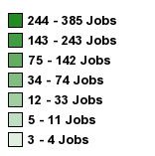
Notes:
Here is an example of a map made with GIS. This is a “thematic” map.
This map was actually created with an online GIS tool, On the Map tool – LEHD (website in handout)
2013 where low-wage workers are living by census tract (green areas with black borders)
Major highways are shown as white lines
County/county equivalent names also shown

Slide 25
GIS basics: Geographic feature types
Points
Display precise locations, such as building street address
Point symbols can vary by shape, size, and color
●  ◻  c 7 7 7 K K K
Lines
Display roads, train tracks, bus routes
Lines can vary by thickness, color, and style
Notes:
Maps use three basic types of “features” (things that can be displayed on the map): points, lines, and areas (polygons).
Use different feature attributes to display different types of information.
For example, you can use different symbols to represent different types of points on the map (schools, health centers, office buildings)
Similarly, different types of lines can represent roads, train tracks, bus routes, etc.

Slide 26
GIS basics: Geographic feature types
Areas (also called polygons)
Display regions, such as counties, neighborhoods, bodies of water
Must be an enclosed space (no openings or gaps)
Interior can be hollow (show boundary only) or filled with color, shading, or symbols
1 dot = 50 people
Notes:
Hollow areas can be used to show boundary lines. Other features (points, lines, other areas) can be displayed inside or outside the boundary.
4th example is a dot density map. Dots are not actual locations (points) but area is filled with dots based on number of persons, families, houses, etc. located within the area. Way of showing concentrations in different areas.

Slide 27
Combine layers with different feature types on same map
Layers
Notes:
In a GIS, you build a map by creating different “layers” that are displayed with each other.
A layer must contain only one type of feature: points, lines, or areas.
Display different types of features by putting different layers on top of each other [advance next slide]

Slide 28
Combine layers with different feature types on same map
Layers
Map
Notes:
Can turn different layers on and off to get different maps [advance next two slides]

Slide 29
Combine layers with different feature types on same map
Layers
Map

Slide 30
Combine layers with different feature types on same map
Layers
Map

Slide 31
GIS basics: Terminology
Coordinate system - A recognized reference frame for locating points in a particular place.
The latitude and longitude of a point are defined in terms of a specific coordinate system
Examples of coordinate systems include North American datum of 1983 and Maryland state plane coordinate system
Geocoding - Process of identifying the coordinates of a location given its address.
Notes:
Useful to know some basic terminology when working with GIS.
We’ve just learned a few terms: points, lines, areas, layers. Here are a few more that are important to know about (and that will be helpful for the exercise).

Slide 32
GIS basics: Terminology
Shapefile (also coverage file) – Digital data for displaying particular map features (points, lines, areas)
A shapefile for 2010 census tracts is needed to display these tract boundaries on a map
Notes:
Generally, you have to get shapefiles from some source for all of the features that you want to display on your map.
Shapefiles contain the geographic information (the locations of points, the length and position of lines and areas). They might also contain some actual data, like the name of a school, the type of road surface, or the number of people living in an area.

Slide 33
GIS basics: Terminology
Table - A file containing rows (records) and columns (variables) of data.
Thematic map – A map using different shades or colors to categorize areas according to specified groupings.
Example: A thematic map of census tracts colored according to poverty rate ranges
Notes:
If the shapefile doesn’t have the data you need, then you need to find the data from other sources (like the ACS and others we discussed). These data will come in the form of tables. Think of a table like a spreadsheet, except a very strict one. Every column contains only one type of information. So, for example, column A might be first name, column B last name, column C address, etc. Every row will have that exact same structure.
We saw an example of a thematic map earlier, and we will be making one in the exercise.

Slide 34
GIS resources
ESRI GIS Dictionary, http://support.esri.com/other-resources/gis-dictionary
MIT OpenCourseWare: Introduction to GIS (w/ArcMap and QGIS exercises), https://ocw.mit.edu/resources/res-str-001-geographic-information-system-gis-tutorial-january-iap-2016/introduction-to-gis/
Notes:
We’ll cover some basic GIS skills today. If you want to start learning more about GIS, here are a couple of resources for you. The MIT intro has exercises using QGIS, which is the GIS software we will be using today.

Slide 35
Exercise
Geocoding client addresses and displaying on a map overlaid with small area data

Slide 36
Exercise
Geocode client address
Prepare small area data
Display client address and small area data on same map
Notes:
Our exercise will have three basic steps. For each of these steps, there’s some tools and resources that we need.
We are providing you with a data set of client addresses (made up), a table of data on DC neighborhood clusters (downloaded from NeighborhoodInfo DC), and shapefiles.

Slide 37
QGIS project
Free, open source GIS software
Download and documentation, http://www.qgis.org/en/site/
Tutorials and tips, http://www.qgistutorials.com/en/
Notes:
For GIS software, we will be using QGIS. It is free to use but has features that you find in commercial software. Again, we’ll be showing you the basics of how to make a map with QGIS, but if you want to learn more here are some additional resources.

Slide 38
Geocoding tools
Convert addresses to geographic points
DC MAR geocoder (works on DC addresses only), http://octo.dc.gov/service/master-address-repository
Texas A&M geocoding services, http://geoservices.tamu.edu/Services/Geocode/Default.aspx
Notes:
We also need to geocode the client addresses to add them to our map. We’ll be using a tool provide by the DC government, created by the Office of the Chief Technology Officer. This works with DC addresses only.
Texas A&M also provides free geocoding services if you want to work with addresses outside of DC.

Slide 39
Shapefiles
Needed to display geographic features on a map
DC open data (DC maps only), http://opendata.dc.gov/
US Census, TIGER/Line shapefiles, http://www.census.gov/geo/maps-data/data/tiger-line.html
Notes:
You also need shapefile. We’ve downloaded a shapefile for neighborhood clusters from DC’s open data portal. They have other useful shapefiles, like ward boundaries, bodies of water, locations of schools, etc.
Outside of DC, your local government might also have a GIS program that provides shapefiles. Otherwise, Census provides shapefiles for the US through it’s TIGER program.

Slide 40
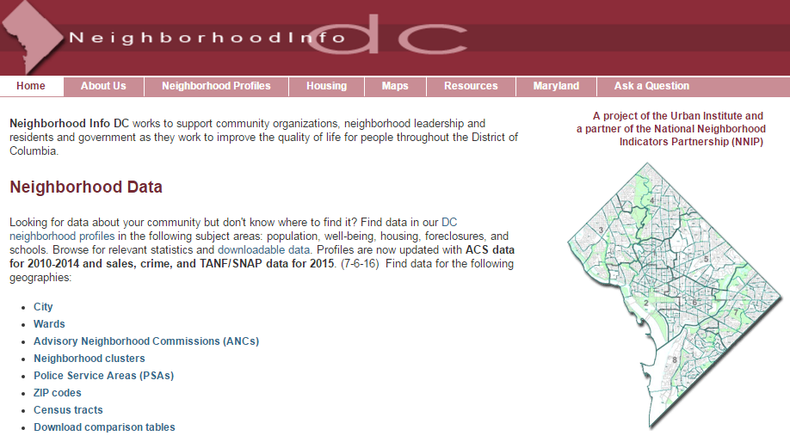
Small area data
NeighborhoodInfo DC downloadable data (DC data only), http://www.neighborhoodinfodc.org
Notes:
And, again, we’ve downloaded the small area (neighborhood cluster) data that we’ll be mapping today from NeighborhoodInfo DC. You can download data for other DC geographies, listed here, by clicking on the “Download comparison tables” link on the homepage. [advance slide]

Slide 41
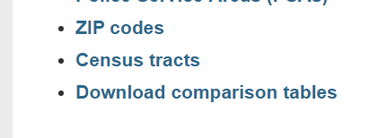
Small area data
NeighborhoodInfo DC downloadable data (DC data only), http://www.neighborhoodinfodc.org

Slide 42
Live demonstration
Follow along:
Measure4Change learning curriculum: Geocoding and mapping client and small area data
Notes:
I’m going to switch to a live demonstration of QGIS and the geocoding tools. You can follow all of the steps using the handout that we’ve provided.

Slide 43
Thank you!

