Slide 1
SAVI Level 4:
Using SAVI to Support Grant Applications
Notes:
The Polis Center @ IUPUI
1
1
SAVI Level 1
2008
The Polis Center @ IUPUI
1

Slide 2
Agenda
Introductions
Outcomes
Basic Components of a Grant
SAVI Tools to Support Grants
On-going Program Evaluation
Examples
Other Resources
Student Exercise
www.savi.org
Notes:
There are day-long workshops about grant writing. I will cover each of the main sections of a grant from a high level and offer pointers to successful grant-writing, but the focus of THIS workshop is using LOCAL DATA to make your case.

Slide 3
Introductions
Notes:
The Polis Center @ IUPUI
3
3
SAVI Level 1
2008
The Polis Center @ IUPUI
3

Slide 4
Introductions
Let’s go around the room and introduce ourselves!
    What is your name?
    What organization are you with?
    Have you used SAVI before?
    What are you hoping to learn from this class?

Slide 5
Outcomes
Notes:
The Polis Center @ IUPUI
5
5
SAVI Level 1
2008
The Polis Center @ IUPUI
5

Slide 6
Objectives
After this workshop, you will be able to:
Understand the basic components of a successful grant
Understand how SAVI can support grant proposals
Understand how SAVI can support the on-going evaluation efforts of your program or initiative
Explore examples of how local data have been used in funded grant proposals
Locate more information to support your grant writing efforts
www.savi.org

Slide 7
Grant Basics
Notes:
The Polis Center @ IUPUI
7
7
SAVI Level 1
2008
The Polis Center @ IUPUI
7

Slide 8
Basic Components of a
Case Statement
Be sure to use the funder’s forms; most have the same general components – some combination or variation of the following:
  Who are you?
    Mission
    History, purpose of organization
    Programs
    Track record
  The need you will address, how you will do it and how much it will cost.
    Convince the donor of the importance of the project.
    Use statistics and data to “make your case.”
www.savi.org
Notes:
When we write a proposal, we’re trying to make a compelling case that there is a need for this program, this is a good and innovative idea, and this is going to have some lasting, positive results.
You are trying to persuade someone that your idea is good and worth funding.

Slide 9



Questions to ask as you write
What do we know about this problem? What does the literature tell us?
What do you intend to accomplish with this program? (goals and objectives)
What are the anticipated outcomes of your project? (lasting change in the community)
How are you going to measure the success of the project? (progress and success factors)
Use plain English.
Be concise and clear.
www.savi.org
Source: http://www.claremontmckenna.edu/research/grant-writing.php
Notes:
THE MOST IMPORTANT SECTION – you are laying your cards on the table, here’s what we’re going to accomplish.

Slide 10
Sample Project
Goals and Objectives
Example:
Goal: Improve obesity prevention knowledge, skills, and behaviors among middle school-aged children
Objectives:
  Implement modified curriculum in six community agencies
  Increase basic nutrition and physical activity knowledge
  Increase basic nutrition/physical activity health literacy
  Increase student intentions to engage in health- enhancing,
  obesity prevention behaviors
  Change nutrition/physical activity behaviors
  Reduce the prevalence of overweight children
www.savi.org

Slide 11
Background and Significance
  Example:
    What do we know about the problem?
      Childhood obesity epidemic is a national concern: 17% of all children 2-17 are overweight and 16% are at risk of being overweight (Holly & Gibson, 2006)
      Primary determinants of overweight are poor dietary intake and limited physical activity
      *Pilot study shows: Kids who know less about healthy nutrition and activity behaviors are 35% more likely to be obese than kids who meet state education health standards
      Kids form most healthy behaviors before high school
      Most success programs documented happen in school setting
www.savi.org
*Hypothetical data used in example
Notes:
You have to convince the funder that this is an important issue.

Slide 12
Background and Significance
  Example:
    Where are the gaps?
      *85% of children in Marion County do not meet state educational standards for health
      Schools do not offer strong health curriculum to address healthy nutrition and physical activity behaviors
    How will we address this problem?
      We will provide health education programs about healthy eating and physical activity programs to middle school students in Marion County.
      We will partner with community-based organizations (e.g., youth and community centers) to build their capacity to offer this education to kids.
www.savi.org
*Hypothetical data used in example
Notes:
You have to convince the funder that this is an important issue.

Slide 13
Making Your Case
Which is more compelling?
This one?
Children do better in school when they are prepared. Kids in Boone County are not prepared for school. We are going to provide education programs for early childcare providers.
www.savi.org
Hypothetical data used in example
Notes:
You have to convince the funder that this is an important issue.
POINT: Using hard, RELIABLE facts and figures makes your case stronger.

Slide 14
Making Your Case
Which is more compelling?
Or this one?
Children are 80% more likely to be successful in school when they are healthy, have supportive families, and receive quality child care, (Smith, 1999).
In Boone County, 50% of children do not receive adequate childcare during their first 5 years of life. 35% of daycares in Boone County do not provide structured learning curriculum.
We will provide education programs for early childcare providers in Boone County to improve the knowledge of the daycare providers and ultimately improve the quality of care that children receive.
Hypothetical data used in example

Slide 15

Background and Significance
How can SAVI help?
SAVI has a variety of information that is useful for the background section of grants.
  Demographic data (example: age and race) helps understand the population in general
  Economic, health, education data (and several other topics) describe the characteristics and needs of the population in terms of the issue you are trying to address
  Several years of data allow you to show trends over time (are things getting worse?)
www.savi.org

Slide 16
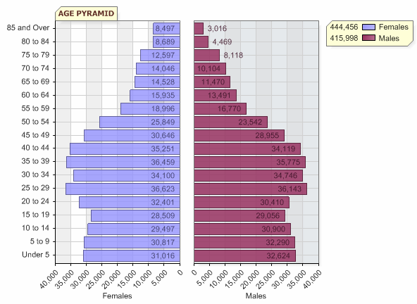
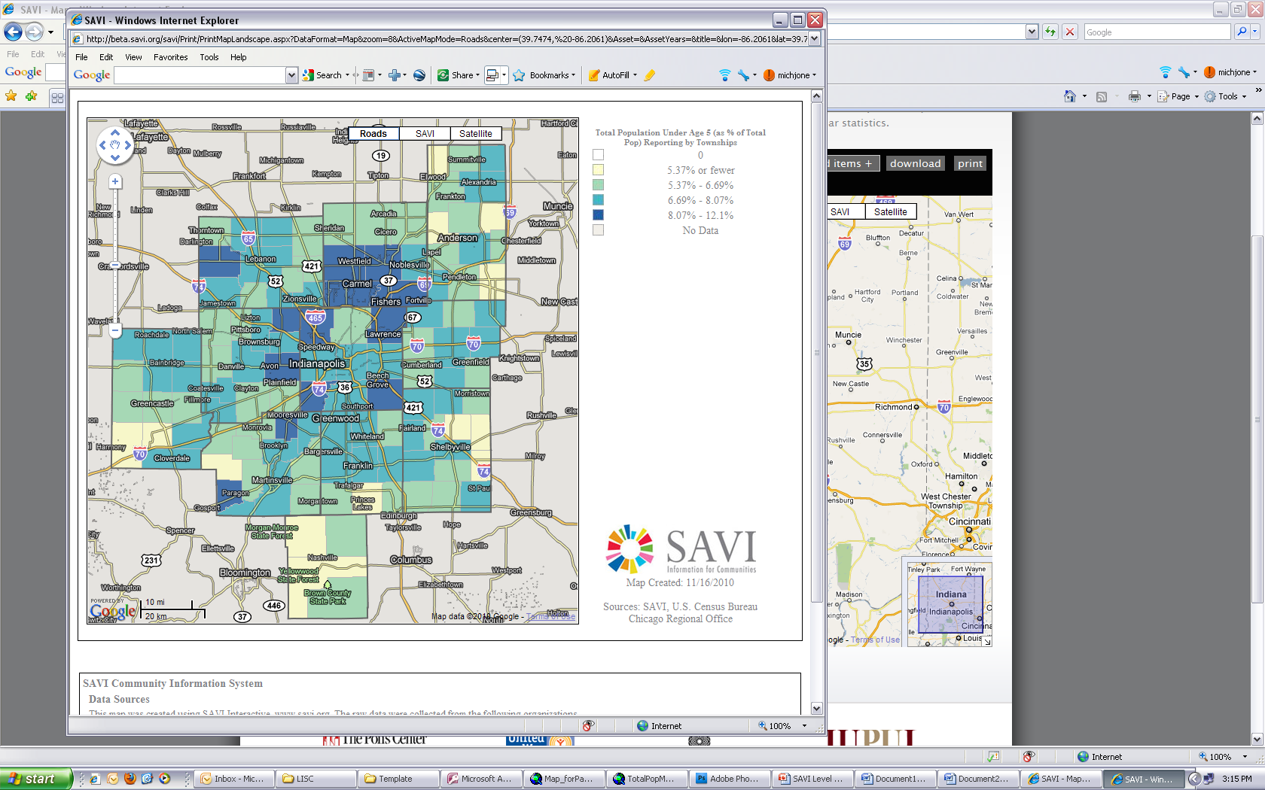
Background and Significance
How can SAVI help?
SAVI demographic data can be useful for the background section of grants
www.savi.org

Slide 17
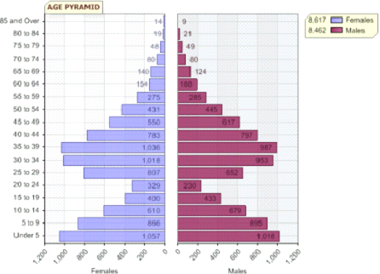
Background and Significance
How can SAVI help?
Age pyramids are very useful.
Observe the differences in these age pyramids.
www.savi.org

Slide 18
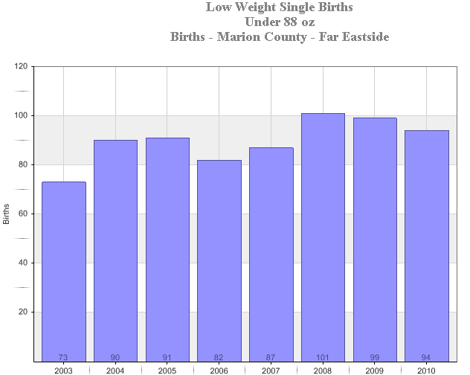
Background and Significance
How can SAVI help?
www.savi.org

Slide 19
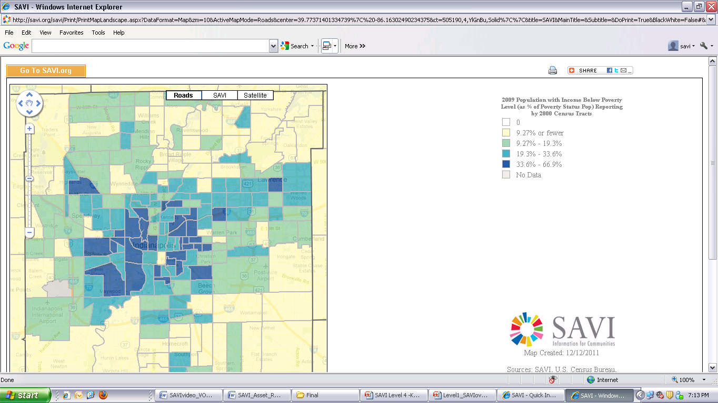
Background and Significance
How can SAVI help?
www.savi.org
Notes:
Maybe the statement is x percent of the population in Marion County is living in poverty, and that is concentrated in center township in x # tracts.

Slide 20
Background and Significance
How can SAVI help?
Make sure your graphics are understandable in black and white. Reviewers often receive photocopies of your application.
Use the black and white print options in SAVI – this is different than printing to a black and white printer.
www.savi.org

Slide 21
Targeted Population - WHO?
Who is your program intended to serve and why?
Could be:
  People in a geographic area
  A particular group based on their demographics (age, race, etc.)
  Organizations
Examples:
  Residents in xx neighborhood
  High school students in Marion County
  Seniors age 65 and older in Center Township
  Hispanic females
  Organizations that provide xx services
Be specific. Use data. Use reliable data. Use LOCAL reliable data.
www.savi.org

Slide 22
Targeted Population
Is this compelling?
This neighborhood experiences some of the highest crime and poverty in the county.
How could we use data to make this case better?
Hypothetical data used in example
www.savi.org
Notes:
Target Area – describe your area in relation to the larger context.
Target Population –
Target

Slide 23
Targeted Population
Is this compelling?
80% of the residents in this area live below the poverty level, and the crime rate is 43 crimes per 100 people.
Hypothetical data used in example
Hypothetical data used in example
www.savi.org
Notes:
Target Area – describe your area in relation to the larger context.
Target Population –
Target

Slide 24
Targeted Population
Is this MORE compelling?
80% of the residents in this area live below the poverty level, which is three times higher than the county. This neighborhood has the highest crime rate in the county, 43 crimes per 100 people, which has been increasing the past 5 years.
Hypothetical data used in example
www.savi.org
Notes:
This neighborhood has high poverty rate

Slide 25
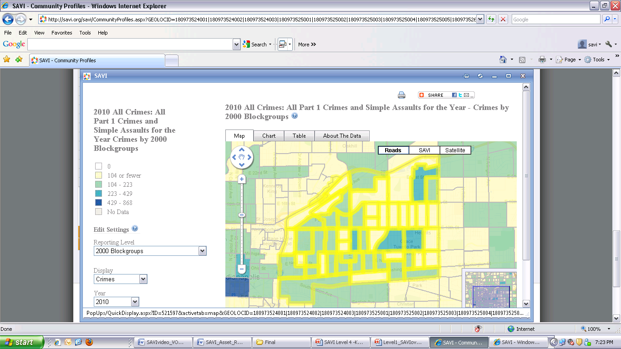
Target Population
How can SAVI help?
www.savi.org
Notes:
Note – this map does NOT match the data in the hypothetical example. The purpose is to show that you can add a map to demonstrate visually how much more this area is effected than other neighborhoods in the county.

Slide 26
Targeted Population - WHO?
How can SAVI help?
Maps help you visually see where the target population is located
SAVI data can help justify why you chose a particular neighborhood, population, etc.
Back to our early childhood school readiness example…
www.savi.org

Slide 27
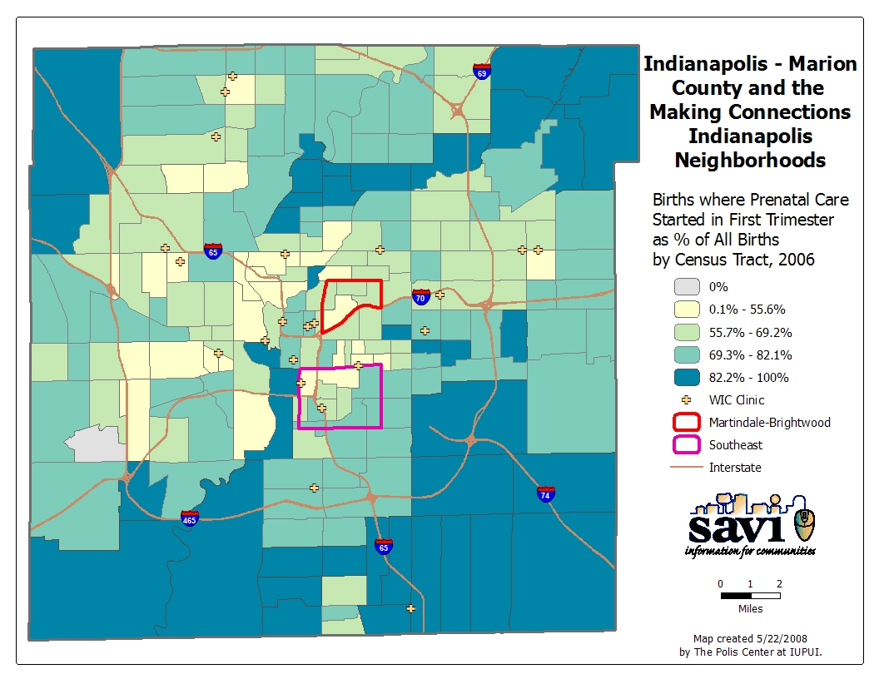
Notes:
Areas where high # of children w/o prenatal care

Slide 28
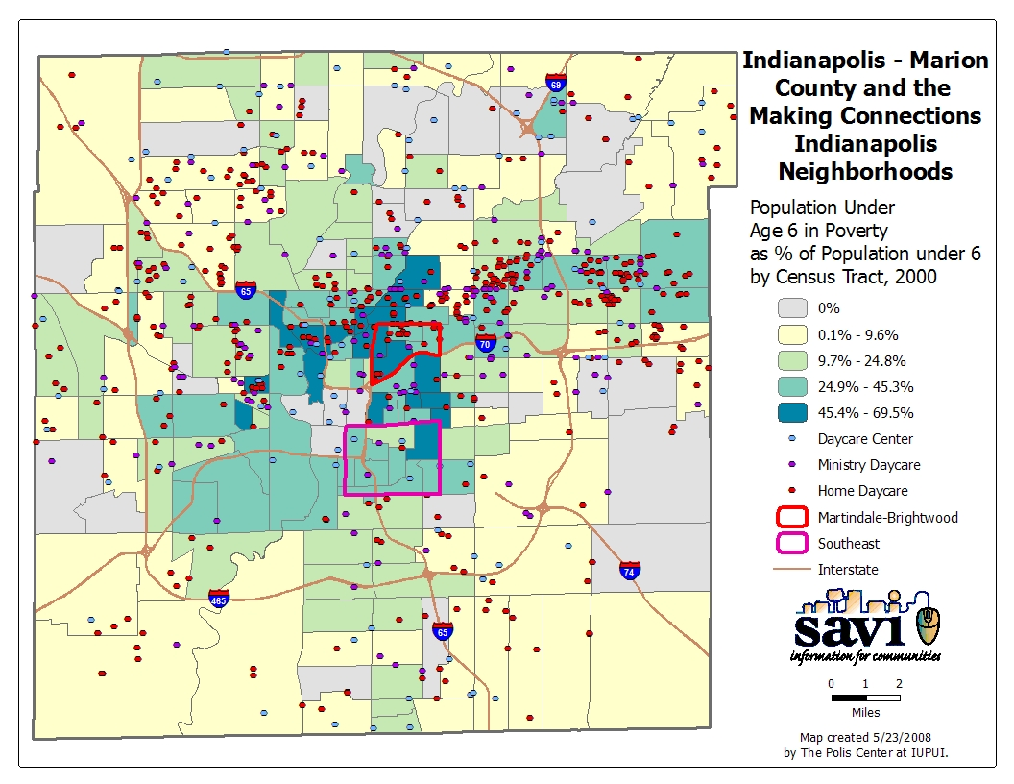
Notes:
Areas with children in poverty also are areas with lack of service (GAP)

Slide 29
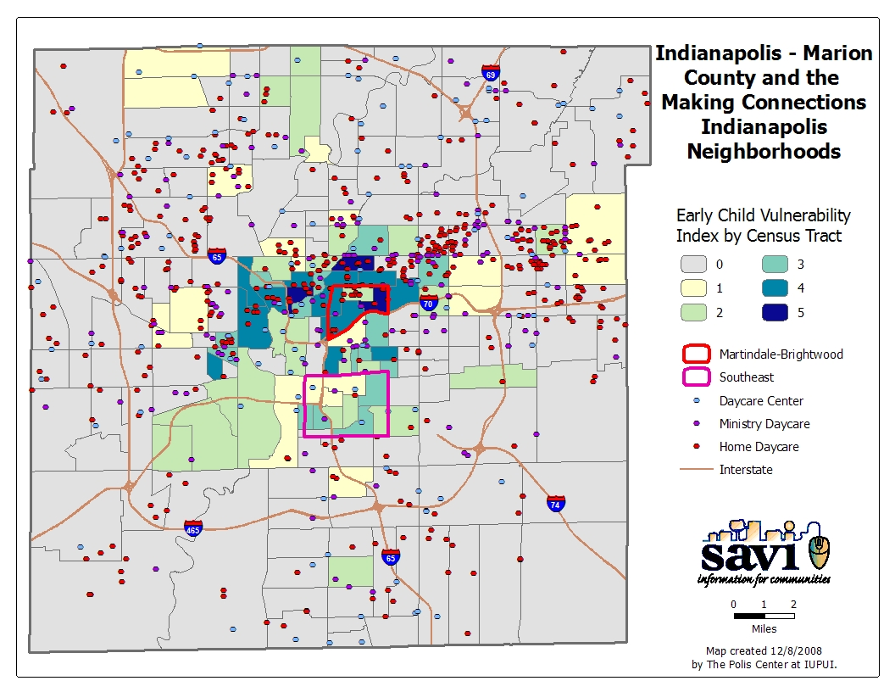
Notes:
Vulnerable areas vs. lack of services – GAP in service

Slide 30
Project Design – HOW?
How will you accomplish your goals and objectives?
What is the program you are proposing?
Describes how you propose to address the problem you just described in the prior section.
Describes the types of activities you will do and the resources you will use to do them.
Resources:
  People
  Technology
  Transportation
  Etc.
www.savi.org

Slide 31
Project Design
How can SAVI help?
Identifying potential partners
Collaborations are crucial. They demonstrate that you are leveraging resources and expertise, eliminating redundancy, and avoiding “silos.”
Mapping existing neighborhood assets can help see who else is in the neighborhood doing related work?
Who are some potential partners for our Health Knowledge Program?
Who are some potential partners for the early childhood initiative?
www.savi.org
Notes:
System-level collaborations (people offering programs on early child development)
And then once you identified your target population, neighborhood-level collaborations: daycare centers

Slide 33
Expected Results/Outcomes
– SO WHAT?
Funders require it and your board wants to know…
SO WHAT? (Outputs vs. outcomes)
What are you trying to accomplish? What do you expect to change?
What difference will your program make?
How will you know if you were successful?
Summarize the expected results and benefits of each objective.
Be clear and brief.
Don’t claim that you will change the world.
www.savi.org

Slide 34
Expected Results/Outcomes
– SO WHAT?
OUTPUT: products (reports) or services (trained 150 people)
OUTCOME: something that results in a change
INDICATOR: used to measure your progress toward an expected outcome
www.savi.org

Slide 35

Expected Results/Outcomes
– SO WHAT?
Identify measureable indicators that you can track to help determine if you are successful.
    Measure program impact
    Change over time between:
      Pre-implementation of a program
      Post-implementation of a program
www.savi.org

Slide 36
Expected Results/Outcomes
– SO WHAT?
Health Knowledge Program Example:
OUTPUT: provide health education program to middle school students
OUTCOME:
  Increase health knowledge in students
  Improve health behaviors in students
INDICATORS:
  % students who score 80% or better on health knowledge exam
  % students who eat 5 servings fruits and veggies a day
  % students who exercise 5 times a week
www.savi.org

Slide 37
Expected Results/Outcomes
– SO WHAT?
Caution: Community indicators change because of community-wide initiatives.
Children are prepared to succeed in schools is a major initiative that requires lots of partners. But, with the right collaborations, how could we make a difference?
  Outcomes:
  Indicators:
    % kids passing entrance assessment test
    % babies receiving prenatal care
    What else might we measure?
    What about neighborhood-level impact?
www.savi.org

Slide 38
Expected Results/Outcomes
Other Resources
Results-based Accountability: http://www.raguide.org/
United Way of Central Indiana Nonprofit Training Center: http://www.uwci.org/index.asp?p=178
  Outcomes Made Easy Workshop
www.savi.org

Slide 39
Evaluation - DID YOU?
Did you accomplish your goals and objectives? How well?
Did you meet your expected outcomes?
This is a very important component of the proposal and one that is often either overlooked or underdeveloped.
Summative evaluation: assessing the end results of the project
Formative evaluation: an on-going assessment process during the grant period that allows for changes and improvements to the project.
Measure quantitatively (with hard data, statistics) and qualitatively (with interviews, surveys, observations) so you are able to illustrate a more comprehensive assessment of the project.
www.savi.org
Source: http://www.claremontmckenna.edu/research/grant-writing.php
Notes:
This ties back to your expected outcomes.

Slide 40
Evaluation
How can SAVI help?
SAVI contains over 10,000 indicators
Provides the larger context
Provides tools that allow you to map your data and show your geographic reach compared to the need
Provides good numbers to show community-wide impact of community-wide initiatives
Caution: Community indicators change because of community-wide initiatives.
www.savi.org

Slide 41
Detailed Plan of Work
This is the detailed road map to how you will accomplish the program you have already described in the program design section (sometimes these two are combined).
It should include:
  Timeline (graphical representations are helpful)
  Descriptions of each major set of tasks and responsibilities from planning to implementation to evaluation
  Management structure
www.savi.org

Slide 42

Personnel (project team)
Describes everyone involved in the project, their role in the project, and their experience.
Answers the questions:
  Are you capable of doing this project? (Does the team have the appropriate expertise and experience?)
  Are you committed?
  Are you able to manage the project and be responsive to timelines?
www.savi.org

Slide 43
Budget – HOW MUCH?
How much will it cost to do the program and activities you propose? And how much are you asking from this funder?
Personnel, materials, training, travel, etc.
Be sure to justify every dollar!
Check for matching fund requirements.
Create your budget early in the grant writing process!
www.savi.org
Notes:
Reviewers will ask themselves – is this budget reasonable given the proposed work (too much or too little are equally bad)

Slide 44
SAVI Support for Grants
Useful Tools
Notes:
The Polis Center @ IUPUI
44
44
SAVI Level 1
2008
The Polis Center @ IUPUI
44

Slide 45
SAVI Support for Grants
Useful Tools
SAVI tools that can be useful:
    Community Profiles
    Maps
      Showing areas of need, target areas, extent of problem
    Charts & Graphs
      Showing trends, comparing a target area to a larger community or another community
    Tables
      Comparing geographic areas
    My Data
      Mapping existing clients against target population to show area in need of additional services
www.savi.org

Slide 46
SAVI Support for Grants
Useful Tools – Community Profiles
Notes:
The Polis Center @ IUPUI
46
46
SAVI Level 1
2008
The Polis Center @ IUPUI
46

Slide 47


Community Profiles
Over 2,000 Predefined Community Profiles
  counties, townships, census tracts, and more
Overview of the community’s demographics, economy, education, assets, and history (when available).
Dynamically updated each time the SAVI database is updated with new data.
Build your own community by grouping geographies

Slide 48
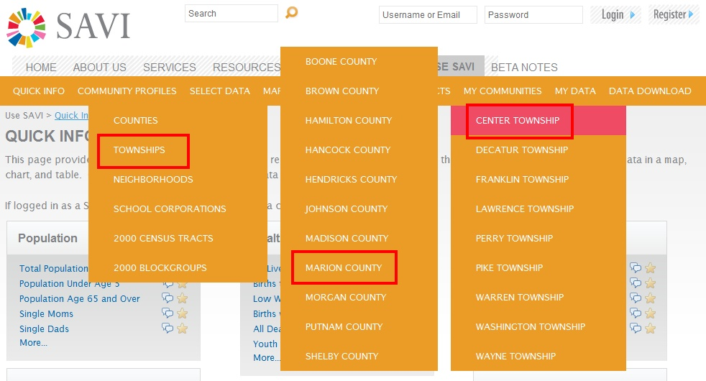
Useful Tools
Community Profiles
Click Community Profiles and select the community of interest.

Slide 49
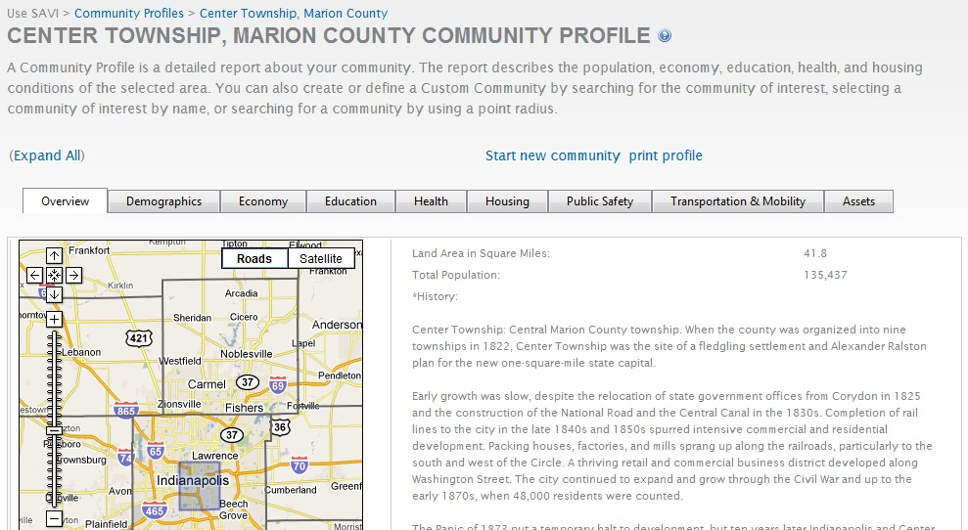
Useful Tools
Community Profiles
Click the overview, demographics, economy, education, health, housing, public safety, transportation & mobility, and asset tabs to view community’s data.

Slide 50
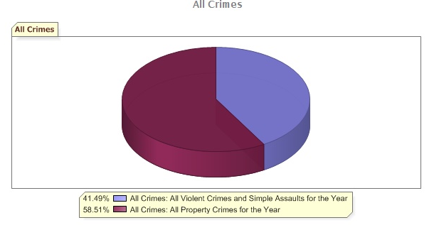
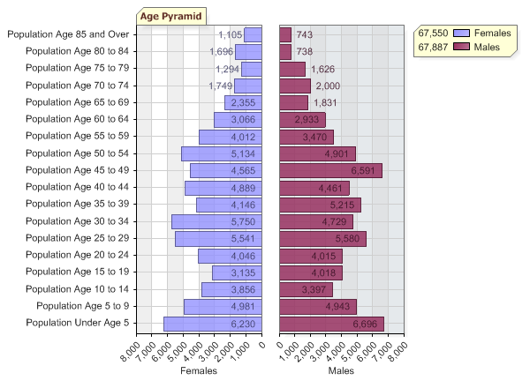
Useful Tools
Community Profiles

Slide 51
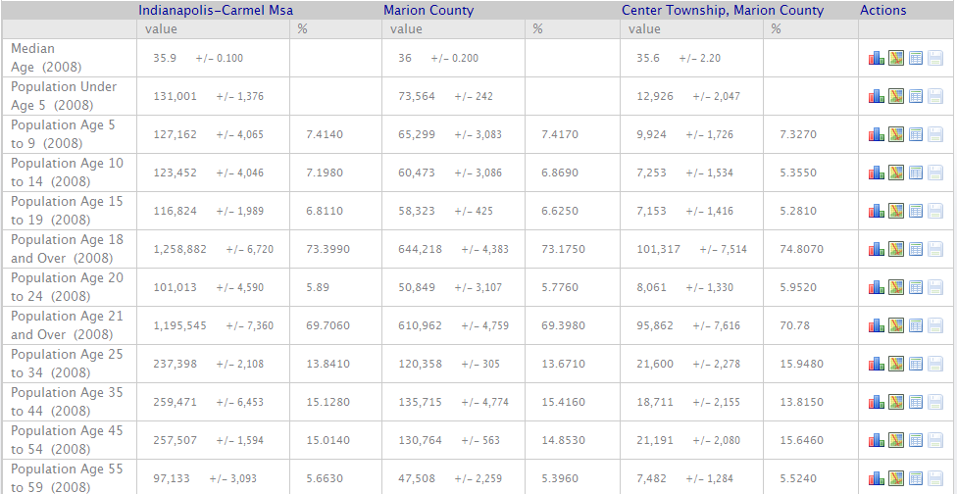
Useful Tools
Community Profiles

Slide 52
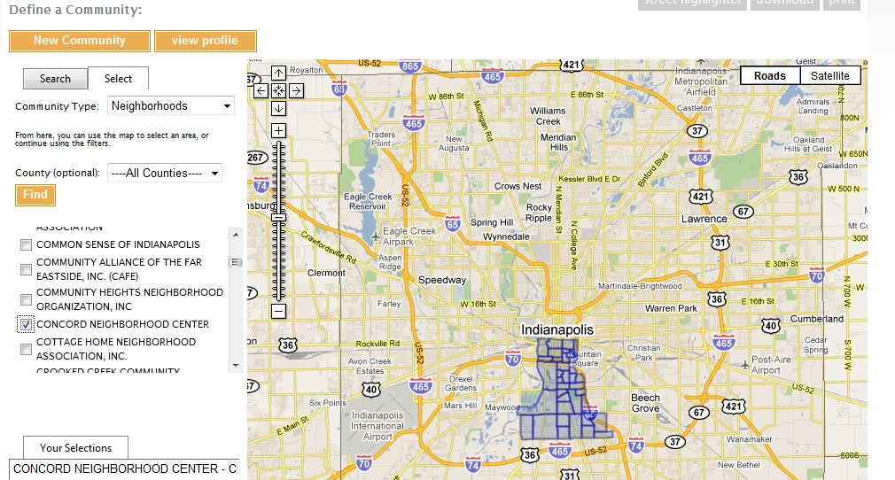
Useful Tools
Community Profiles
Community profiles available for neighborhoods too!

Slide 53
SAVI Support for Grants
Useful Tools - Maps
Notes:
The Polis Center @ IUPUI
53
53
SAVI Level 1
2008
The Polis Center @ IUPUI
53

Slide 54
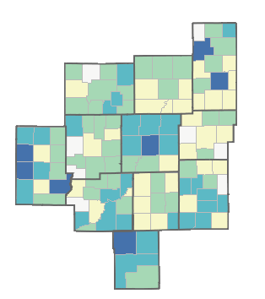
Maps
Maps allow you to view spatial distributions of your data. Social indicators such as health, crime, and income can be correlated with community assets.
For example, the distribution of unemployed persons can be paired with the location of job training programs.
Spatial analysis of data allow you to see concentrations of events, facilities, and populations that may not be readily apparent from tabular statistics.

Slide 55
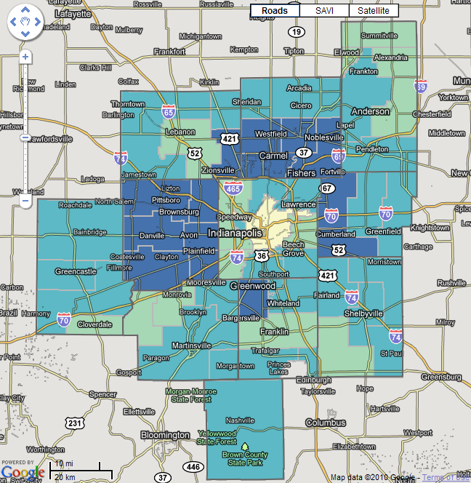
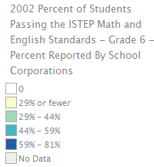
Useful Tools
Maps
This map is showing the % of student passing the ISTEP Math and English for Grade 6 in 2002. You could use a map similar to this to show a need for tutoring programs in the IPS School Corporation.
www.savi.org

Slide 56
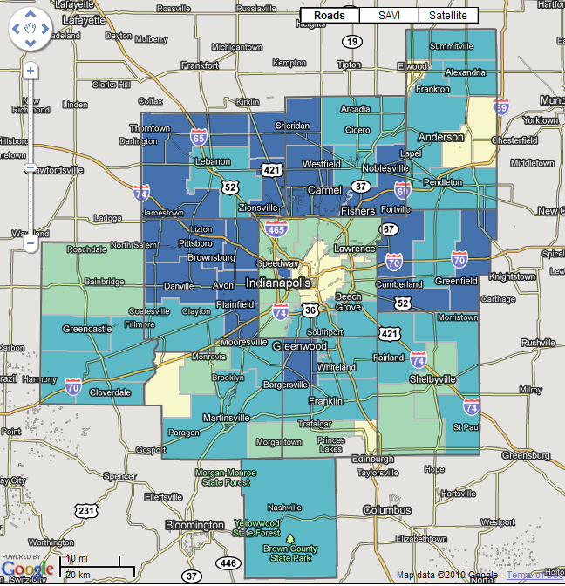
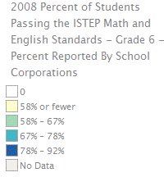
Useful Tools
Maps
This map is showing the % of student passing the ISTEP Math and English for Grade 6 in 2008. You could use a map similar to this to show the increase in the % of students passing the ISTEP Math and English for Grade 6 between data years 2002 and 2008.
www.savi.org

Slide 57
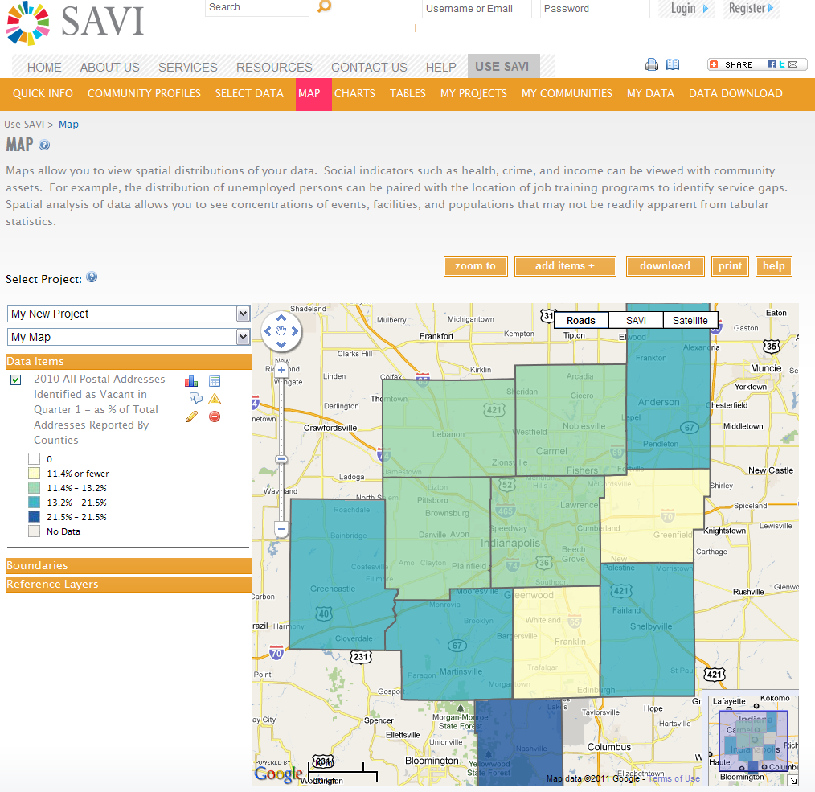

Slide 58
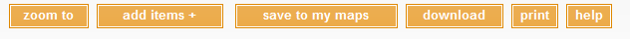
Useful Tools
Maps
Reminder of how to put a SAVI map into a word document
    Create the map
      Use the select data tab to find the indicator(s) of interest
      Choose to Map It
    You can either download or save the map
      Click the download button to download the map
      Click the save to my maps button to save the map to a project
      Click the help button for step by step instructions
    You can also print the map to add it to the appendix
      You have the option to print a black and white or color map
www.savi.org

Slide 59
SAVI Support for Grants
Useful Tools - Charts & Graphs
Notes:
The Polis Center @ IUPUI
59
59
SAVI Level 1
2008
The Polis Center @ IUPUI
59

Slide 60
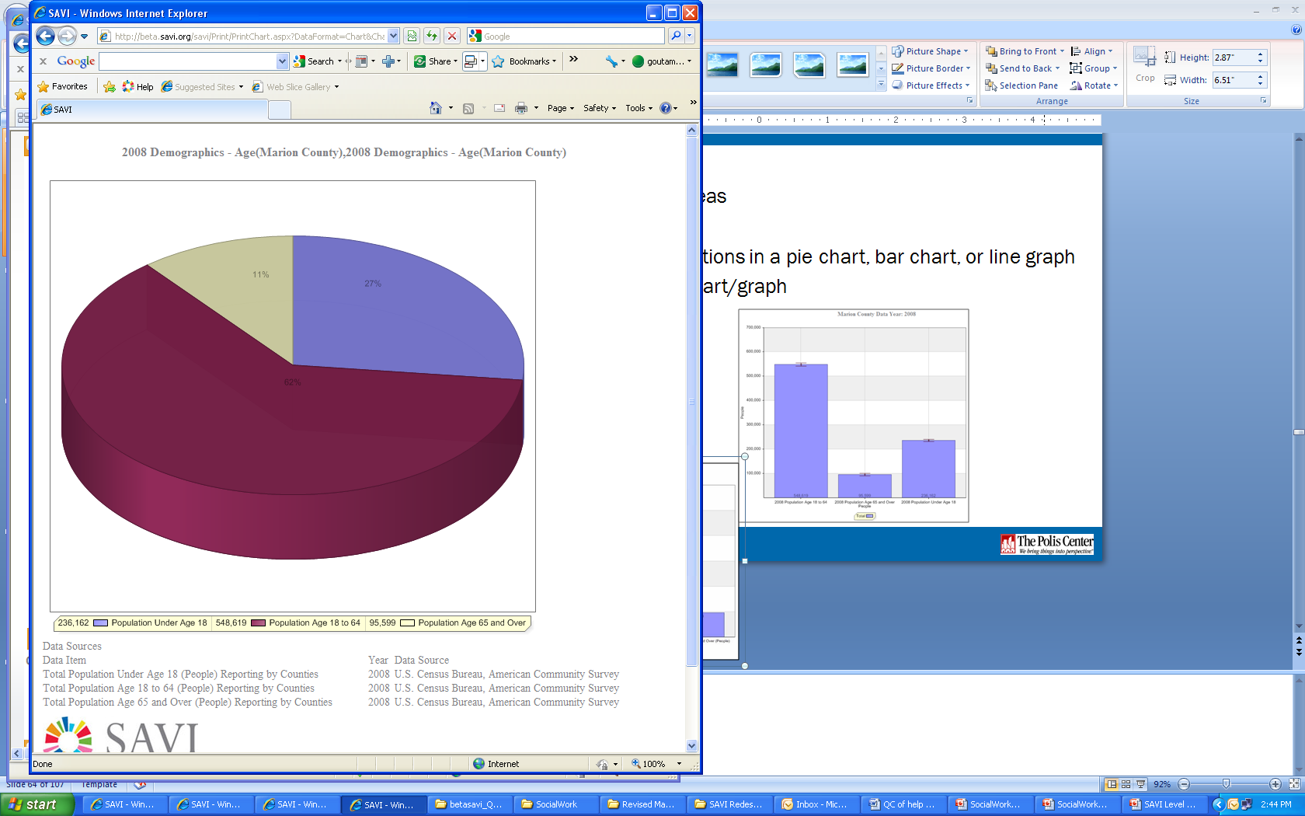
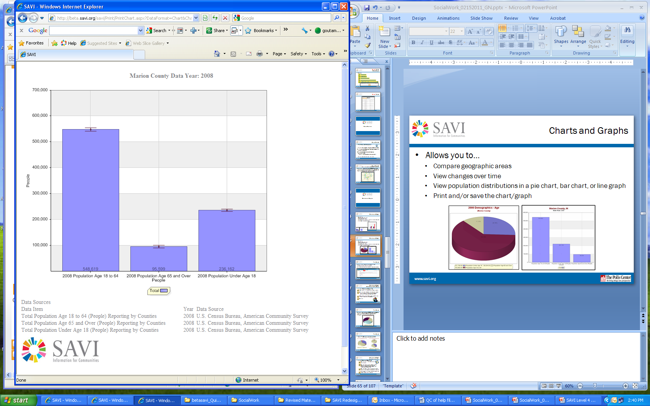
Useful Tools
Charts and Graphs
Allows you to…
Compare geographic areas
View changes over time
View population distributions in a pie chart, bar chart, or line graph
Print and/or save the chart/graph

Slide 61
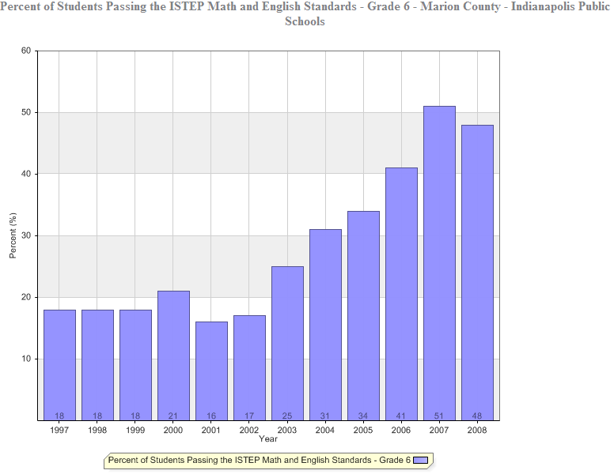
Useful Tools
Charts and Graphs
This chart is showing the increase of the % of student passing the ISTEP Math and English Standards – Grade 6 for IPS School Corporation. This could be used in your grant as a way to measure impact.
www.savi.org

Slide 62
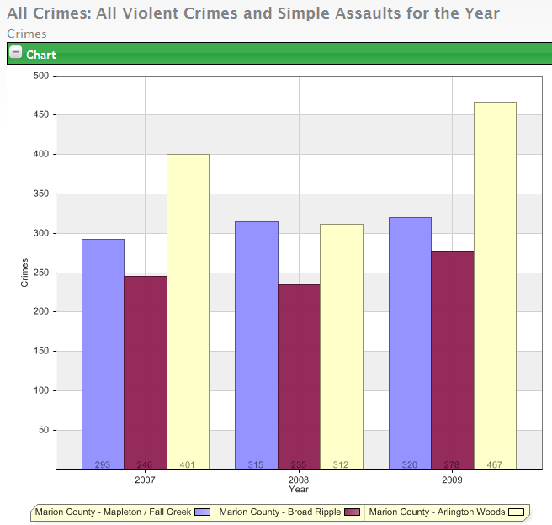
Useful Tools
Charts and Graphs
This chart is the # of Adult Part 1 Crimes in 2007, 2008, and 2009 for Mapleton/Fall Creek, Broad Ripple, and Arlington Woods neighborhoods. You could use a chart similar to this to demonstrate need in Broad Ripple.
www.savi.org

Slide 63
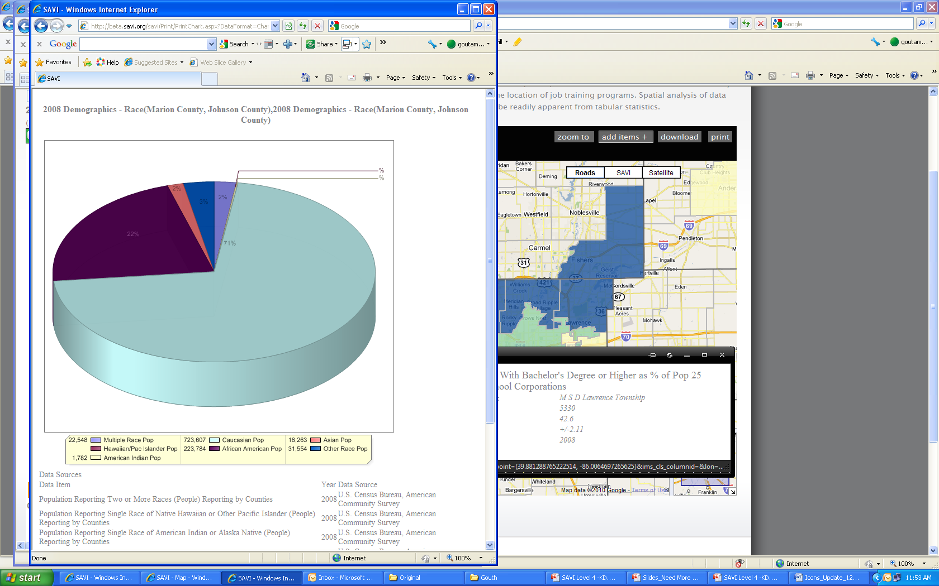
Useful Tools
Charts and Graphs
This pie chart is showing the demographics- Race of Marion and Johnson counties. You could use a chart similar to this to show the demographics of your community.
www.savi.org

Slide 64
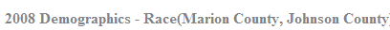
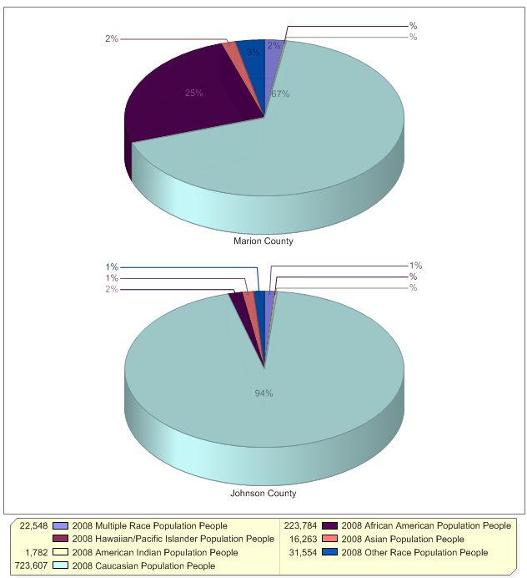
Useful Tools
Charts and Graphs
This pie chart is showing comparison charts of the demographics- Race of Marion and Johnson counties. You could view as combined chart or as comparison charts.

Slide 65
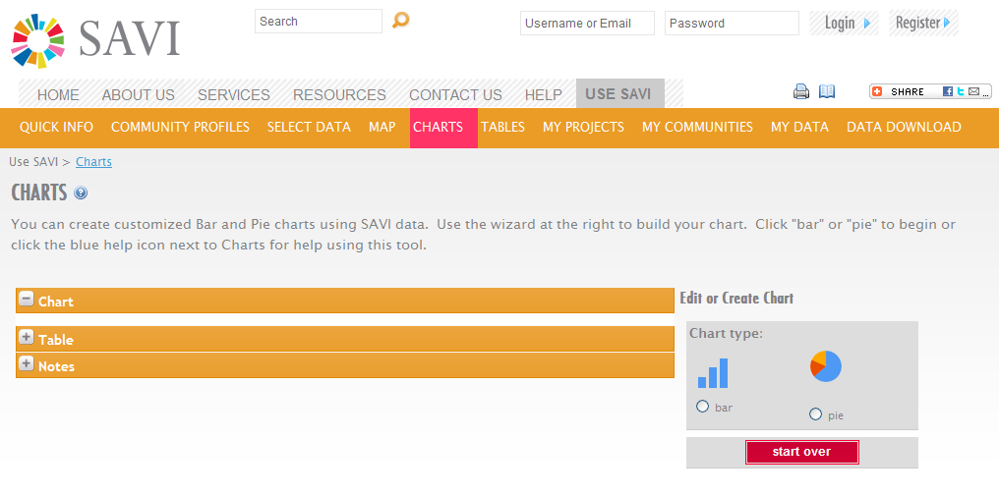
Charts

Slide 66
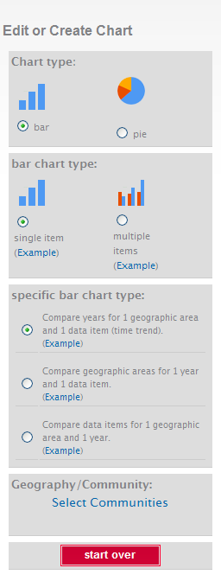
Charts
A variety of chart options are available on SAVI.
  Pie chart
  Bar chart
  Line graph
Use the charting wizard to easily create a chart.

Slide 67
SAVI Support for Grants
Useful Tools – Tables
Notes:
The Polis Center @ IUPUI
67
67
SAVI Level 1
2008
The Polis Center @ IUPUI
67

Slide 68
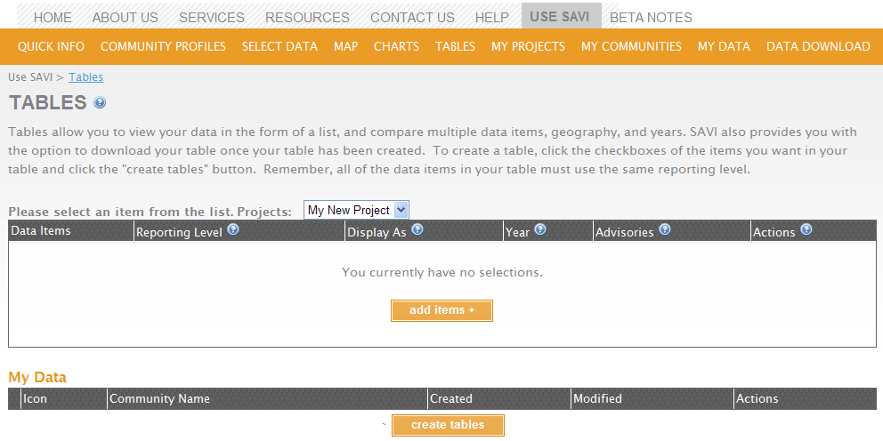
Useful Tools
Tables
Allow users to…
View the data in the form of a list
Download the data table
Compare multiple data items and years

Slide 69
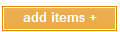
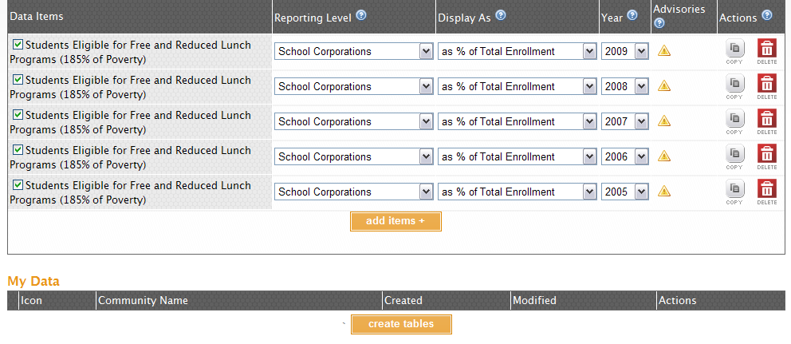
Useful Tools
Tables
If data items haven’t been selected, click the button to select the data items of interest.
After data items selected, check the box beside the items to view in the table and click create tables

Slide 70
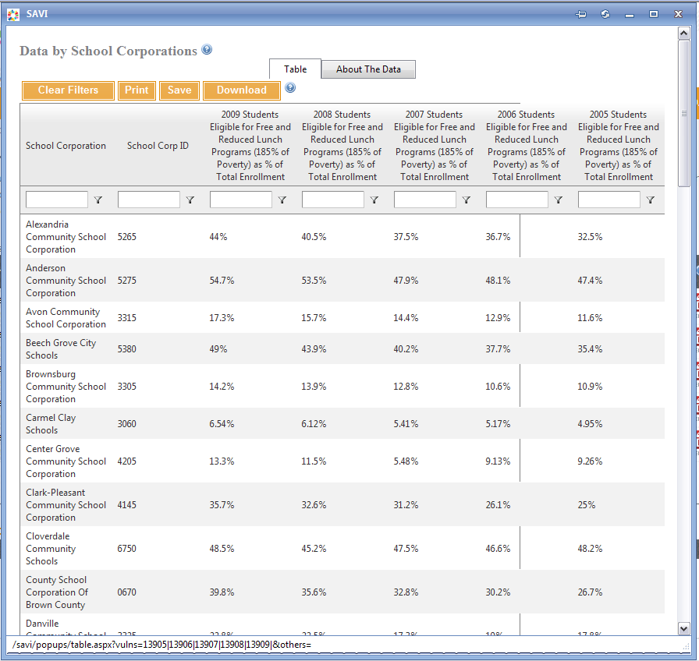
Useful Tools
Tables
The data table will open in a new window

Slide 71
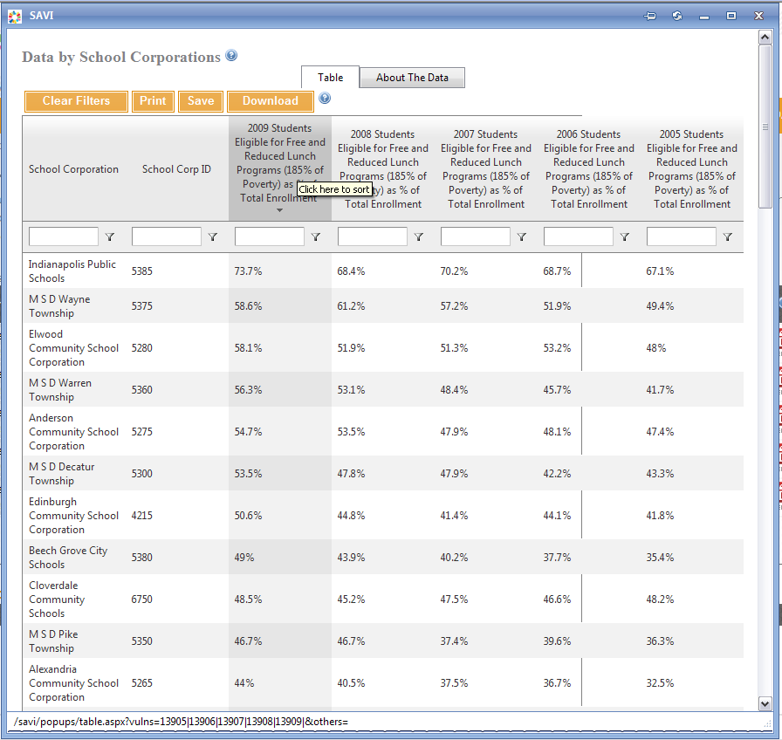
Useful Tools
Tables
To sort the table click on the column name

Slide 72
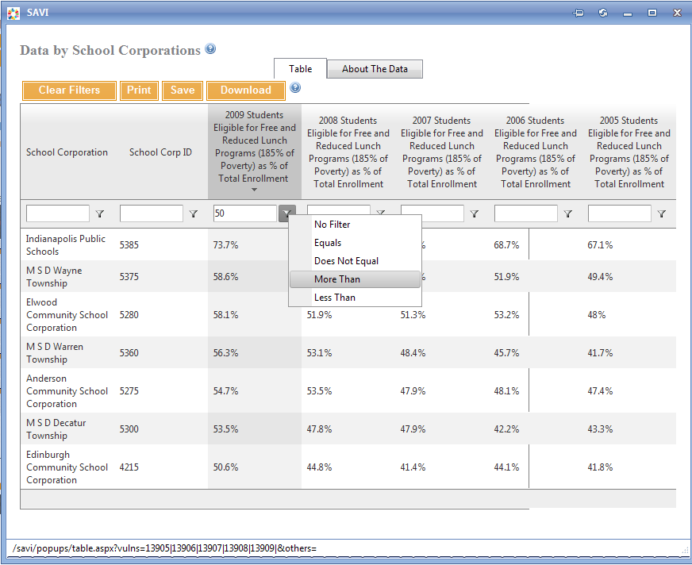
Useful Tools
Tables
To Filter a Table by a numerical value
    Type a filter parameter into the box above the column
    Click the Filter Icon next to the box
This is an example to display school corporations where the % students eligible for free and reduced lunch is greater than 50%

Slide 73
SAVI Support for Grants
Useful Tools – My Data
Notes:
The Polis Center @ IUPUI
73
73
SAVI Level 1
2008
The Polis Center @ IUPUI
73

Slide 74
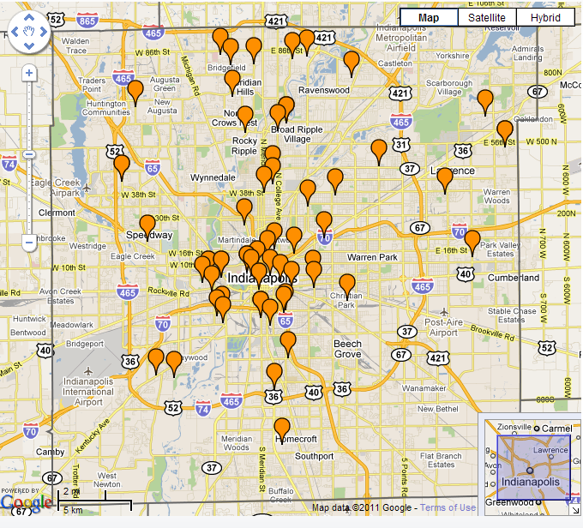
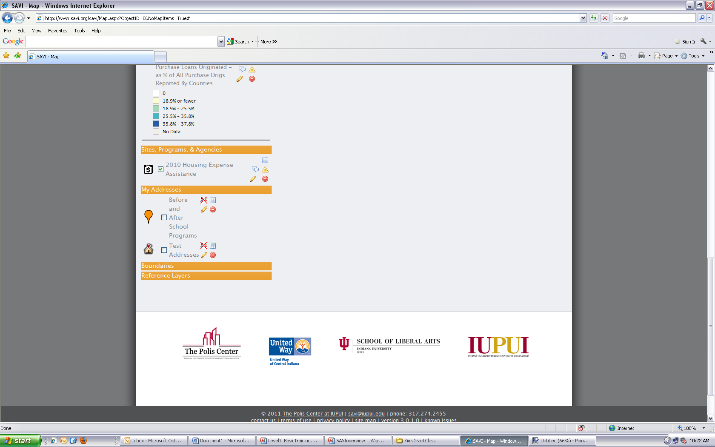
Useful Tools
My Data
Allows you to…
Upload and map your own address locations
Add detailed information to your points
View your data on a map

Slide 75
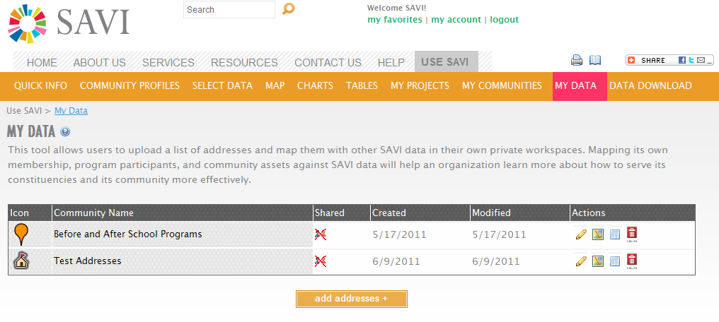
Useful Tools
My Data

Slide 76
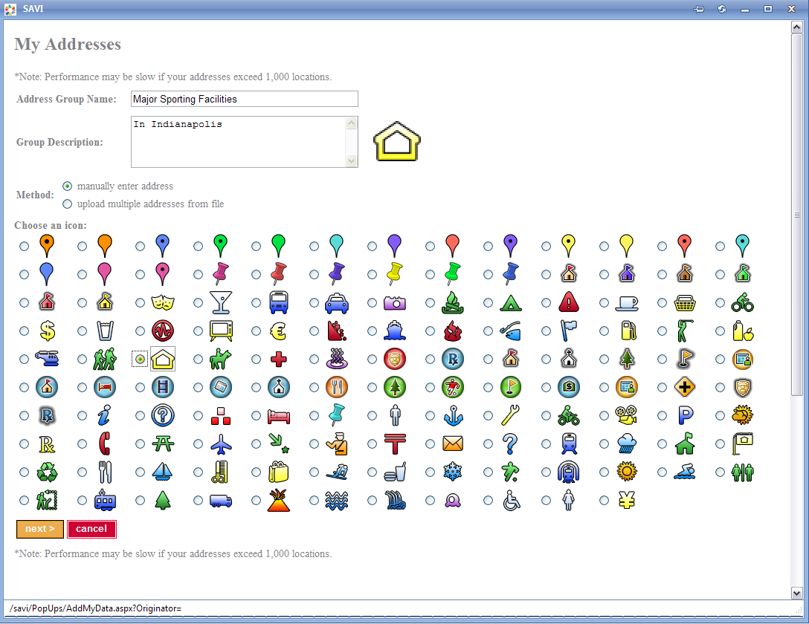
Useful Tools
My Data
You have the option to manually enter addresses or upload multiple addresses from a formatted file
Note: Performance may be slow if your addresses exceed 1,000 locations.

Slide 77
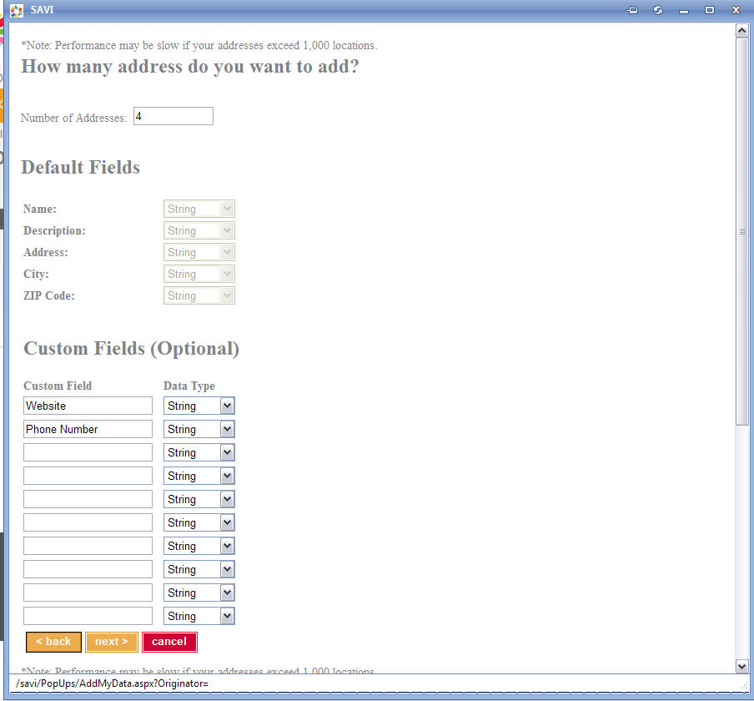
Useful Tools
My Data
Add optional custom fields to your data

Slide 78
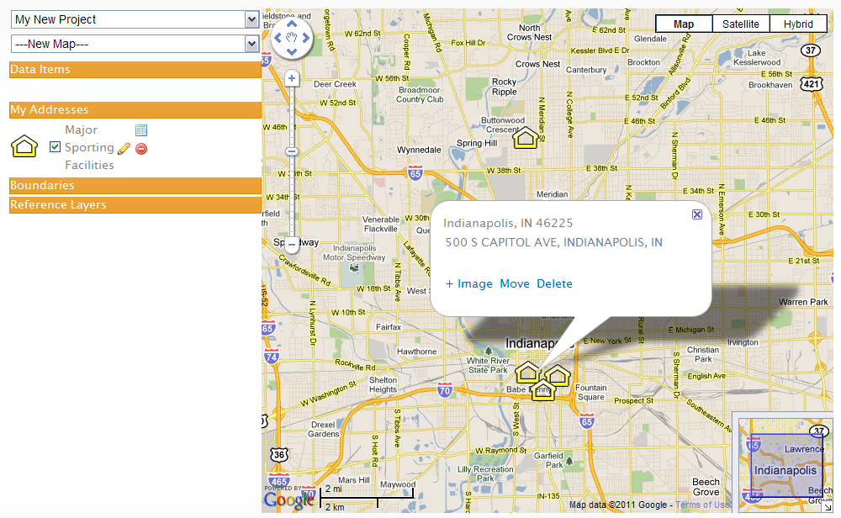
Useful Tools
My Data
Notice the ability to add an image

Slide 79
Example Grants Where SAVI Was Used
Notes:
The Polis Center @ IUPUI
79
79
SAVI Level 1
2008
The Polis Center @ IUPUI
79

Slide 80

Examples
Suite Dreams Project Play Garden
  Brief Project Description: Across the street from Riley Hospital for Children sits a deteriorated fountain which is a reminder of a remarkable landscape project that was never fully completed: Ball Nurses’ Sunken Garden and Convalescent Park. Unfortunately, only parts of the project were able to be completed. A new master plan for Ball Gardens has been developed by architects and includes restoring the sunken garden and finishing the original plan. Since the development of the original plan, there has been a great deal of growth including nearby Riley Hospital for Children and the Ronald McDonald House of Indiana. Suite Dreams Project Play Garden would include creation of a healing play area for children’s use.
www.savi.org

Slide 81
Examples
SAVI was used to help demonstrate the need of the Suite Dreams Project Play Garden.
The following information was used:
  The neighborhoods surrounding IUPUI and the Play Garden area
    15,000 children under the age of 18 living within 2.5 miles; one-third of whom are living in poverty.
    Over 50% of the children living within one mile of the play garden are obese.
  The number of parks and playgrounds within a 1, 2, and 2.5 miles radius of the play garden.
www.savi.org

Slide 82
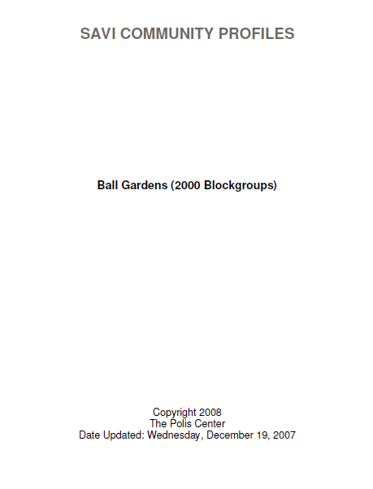
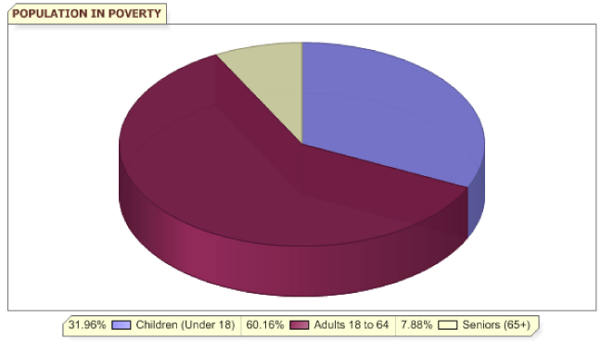
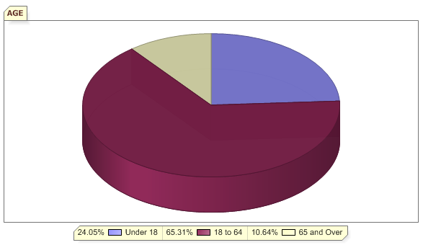
Examples
SAVI Custom Community Profile
www.savi.org

Slide 83
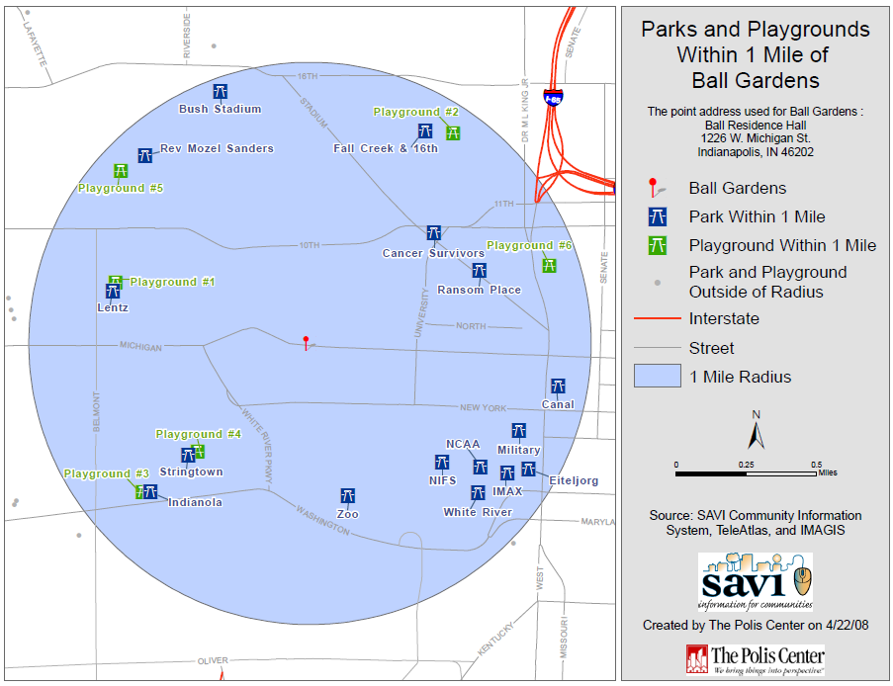
Examples
www.savi.org

Slide 84
Examples
Technology Opportunities Project
  Brief Project Description: This project was seeking to develop interactive, Internet-based tools that use geographic information (GIS) technology to allow Indianapolis’s inner city neighborhoods to access and assimilate diverse source of data about their communities. This project essentially put SAVI on the internet. Before this grant, SAVI was simply a stand alone program and only available at specific sites.
  This project targets organizations that serve people residing in the geographic center of Marion County, Center Township.
  This project was seeking to reduce disparities between Center and other Township residents.
www.savi.org

Slide 85
Examples
Used SAVI to demonstrate the existing disparities between the residents of Center Township and other townships
Created maps of the following indicators by census tract:
  2004 - Dec TANF Recipients
  2004 - Food Stamp Recipients
  2009 – all Part 1 Crimes and Simple Assaults
  2009 Births Where Mother is Age 15 to 19
www.savi.org

Slide 86
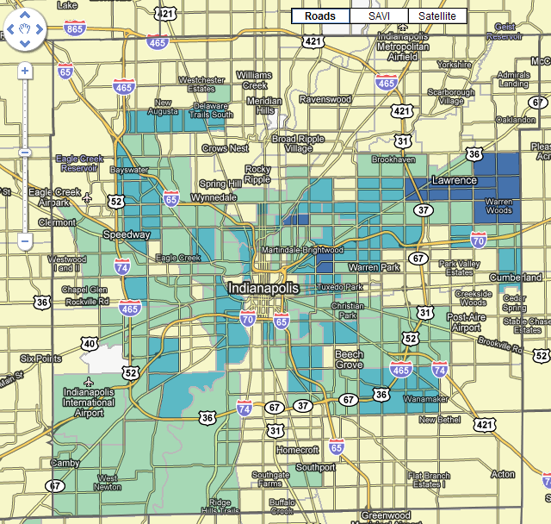
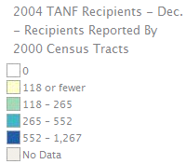
Examples
www.savi.org

Slide 87
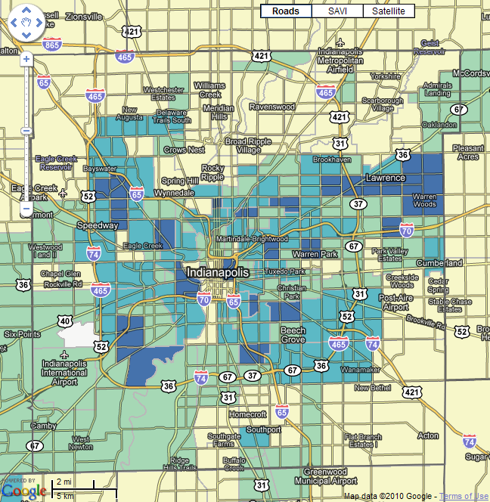

Examples
www.savi.org

Slide 88


Examples
www.savi.org

Slide 89


Examples
www.savi.org

Slide 90

Examples
Used the following table to show the demographics of Center Township in relation to Marion County
www.savi.org

Slide 91
Resources
Notes:
The Polis Center @ IUPUI
91
91
SAVI Level 1
2008
The Polis Center @ IUPUI
91

Slide 92
Resources
How to Write a Successful Grant
Website Links
  Grant Proposal Writing Tips
    http://www.cpb.org/grants/grantwriting.html
  GrantProposal.com
    http://www.grantproposal.com
  Writing a Grant
    http://www.niddk.nih.gov/fund/grants_process/grantwriting.htm
  Grant Writing Tutorial
    http://www.theresearchassistant.com/tutorial/index.asp
  Writing a Successful Grant Proposal (PDF)
    http://www.agecon.purdue.edu/newventures/Grant_Writing/EC-737%5B1%5D.pdf
    Quick Guide for Grant Applications
    http://deainfo.nci.nih.gov/extra/extdocs/gntapp.htm
www.savi.org

Slide 93
Resources
How to Write a Successful Grant
Training Links
  Local Training for Grant Seekers
    http://www.indianagrantmakers.org/s_inga/sec.asp?CID=6438&DID=13983
    http://www.uwci.org/index.asp?p=644
  On-line Grant Writing Courses
    http://www.distance-education.org/Courses/Grant-Writing-123/
  The Grantsmanship Center Training Program (samples of successful grants)
    http://www.tgci.com/gtptraining.shtml
  Preparing Successful Grant Proposals (online course)
    http://www.philanthropy.iupui.edu/TheFundRaisingSchool/CourseDescriptions/On-LineGrantProposals-Introductory.aspx
www.savi.org

Slide 94
Resources
Identifying Grant Funding
Website Links
  Find and Apply for Federal Government Grants
    http://www.grants.gov/
  GrantsWeb
    http://web1.msue.msu.edu/msue/resources/grantweb.html
  Foundation Center
    http://foundationcenter.org/findfunders/
  Researching and Identifying Grant-Making Organizations and Foundations
    http://www.proposalwriter.com/grants.html
  GrantStation - Your Fast Track to Funding
    http://www.grantstation.com/
  Federal Business Opportunities
    https://www.fbo.gov/
www.savi.org

Slide 95

Resources
Identifying Grant Funding
Indianapolis Marion County Public Library (IMCPL) Resources
  The Foundation Directory
  Directory of Indiana Donors
For more information, call IMCPL at 317-275-4100
www.savi.org

Slide 96
Resources
General Grant Resources
Website Links
  Grantmaking & Philanthropy: GrantCraft
    http://www.grantcraft.org
  Non-profit guides – Grant-writing tools for non-profit organizations
    http://www.npguides.org/
  The Grantsmanship Center
    http://www.tgci.com
  The Catalog of Federal Domestic Assistance (CFDA)
    https://www.cfda.gov/
www.savi.org

Slide 97
Resources
General Grant Resources
Training Links
  Indianapolis Marion County Public Library Grant Series Workshop
    http://www.imcpl.org/events/detail/?event_id=1747&schedule_id=13279
  IUPUI – The Center for Research and Learning
    http://crl.iupui.edu/events/
  United Way of Central Indiana – Nonprofit Training Center
    http://www.uwci.org/index.asp?p=644
www.savi.org

Slide 98
Questions
Notes:
The Polis Center @ IUPUI
98
98
SAVI Level 1
2008
The Polis Center @ IUPUI
98

Slide 99
Questions
If you have any questions or concerns about SAVI please feel free to contact
  Jay Colbert (I’ll provide Beth’s contact info if specific questions about grants)
    jtcolber@iupui.edu or savi@iupui.edu
    317.278.9212
Notes:
The Polis Center @ IUPUI
99
99
SAVI Level 1
2008
The Polis Center @ IUPUI
99

Slide 100


Social Media
You can also find SAVI on Twitter (@SAVIonline) and Facebook
http://www.facebook.com/pages/SAVI-Information-for-Communities/180316044450?sk=wall
http://twitter.com/#!/savionline
Notes:
The Polis Center @ IUPUI
100
100
SAVI Level 1
2008
The Polis Center @ IUPUI
100

Slide 101
Student Exercise
Notes:
The Polis Center @ IUPUI
101
101
SAVI Level 1
2008
The Polis Center @ IUPUI
101

Slide 102

Student Exercise
Proposed Project: A citizen task force in the Lawrence Township would like to document educational attainment to support an education-based program in the school corporation. Your group is to develop supporting documents that show the needs of the area, highlighting potential partners and possible program barriers.
www.savi.org

Slide 103
Student Exercise
Working in groups, brainstorm ideas of how you can use data to support your grant:
  Background
  Building the case
  Program Evaluation
Use SAVI to create at least one supporting document to include in your grant.
  e.g.: map, chart, table
www.savi.org

Slide 104
Fill out the Course Evaluation
Notes:
The Polis Center @ IUPUI
104
104
SAVI Level 1
2008
The Polis Center @ IUPUI
104

Slide 105

Course Evaluation

Slide 106
Student Exercise Answers
Notes:
The Polis Center @ IUPUI
106
106
SAVI Level 1
2008
The Polis Center @ IUPUI
106

Slide 107


Student Exercise
Possible supporting documents to include in grant
  First, start with the Community Profile for this MSD Lawrence Township
    SAVI Home Page
    Click Community Profiles
    School corporation
    Marion County
    Select MSD Lawrence Township
    Click View Profile
    Review the Educational Attainment of the MSD Lawrence Township
      Since we are interested in educational attainment go to education, educational attainment
www.savi.org

Slide 108
Student Exercise
  Another option would be to create a map showing Population with Bachelor’s Degree or Higher by school corporations
    Go to the select data & add items
    Select categories: Education, Attainment, College, Total and then select “Population with Bachelor’s Degree or Higher”. View the data by school corporations, as % of pop 25 and up, 2010.
    Show the map
      You may want to view the printable map version and play with the color vs. black and white option.
      You will see the color version of the map on the next slide.
    You may want to view the table for these locations too.
www.savi.org

Slide 109

Student Exercise
Click on the map to view the details for that area. A popup window will open with the exact values for the area you clicked on.

Slide 110

Student Exercise
  Possible program barriers –
    Do the MSA Lawrence Township residents speak English
      Click the Demographics section of the Community Profile for this School corporation
      View Language Proficiency statistics for MSD Lawrence Township School Corporation
www.savi.org

Slide 111
Student Exercise
  The options shown are just a few that are available from SAVI.
  Please explore the other options too.
www.savi.org

