Slide 1
Welcome!
What are we doing today?

Slide 2
Agenda:
Introduction: Data Workshop
Introduction: Data Driven Detroit
Introduction: New dataset
--Short Break--
Discussion: How do you use data?
Discussion: Interactive online data tools
Feedback: Survey & Closing

Slide 3
Who we are
The Graham Institute, a network of schools at the University of Michigan dedicated to creating and disseminating knowledge around sustainability issues, and Data Driven Detroit (D3) have partnered to initiate the Detroit Sustainability Indicators Project.
The project has two goals….

Slide 4
Goal 1:
To gather and assess data on relevant sustainability related topics (environmental, economic and social), with the intent of mapping these data and making the findings available to the public.

Slide 5
Goal 2:
To create a sustainability index for Detroit that will help inform policy and decision making and serve as a model for other urban areas working on sustainable redevelopment.

Slide 6
Research
Regional, Spatial and Temporal Mapping of Air Pollution in Detroit
Stuart Batterman, School of Public Health
Documenting and Demonstrating Neighborhood Care Dynamics in the Community Development Advocates of Detroit’s (CDAD) “Urban Homesteads” and “Naturescapes”
Margaret Dewar & Eric Dueweke, Taubman College of Architecture and Urban Planning
Joan Nassauer, School of Natural Resources and Environment & Eric Dueweke, Taubman College of Architecture and Urban Planning

Slide 7
Research
Liquid Planning Detroit: Water quality management throughout the Great Lakes watershed
Jen Maigret & Maria Arquero, Taubman College of Architecture and Urban Planning
Nicole Scholtz, University Library
Economic Disparity and Federal Investments in Detroit
Brian Min & Jowei Chen, Department of Political Science, College of Literature, Science, and the Arts

Slide 8
Research
Measuring the Greenness of Cities: A New Methodology for an Urban Sustainability Index
David Bieri, Taubman College of Architecture and Urban Planning

Slide 9
The Data Workshop:
The Sustainability Indicators project lasts 3 years.
The next two summers we will be organizing additional data workshops.
Our work today will help shape these future workshops.
Your input is critical to help us develop the tools you will use!

Slide 10
Data Workshop1:(This summer!)
D3 would like to learn how your organizations are currently using data.
Discuss common data issues you face.
Identify common datasets you use.
Determine what you would like from an interactive, online data-tool.
Build a shared understanding of the major sustainability issues facing the city.
Further develop data literacy.

Slide 11
Data Workshop 2: (Summer 2014)
With that information, we will:
Introduce prototypes of our interactive online data tools.
Conduct usability testing and receive feedback from users.
Share best practices for using new UM datasets.
Further develop data literacy.

Slide 12
Data Workshop 3: (Summer 2015)
We will be asking for your feedback, but possibilities could include:
Data Dive – D3 assists non-profits with their data questions.
Organizations host a mini conference – share how they have used the UM data & D3 tools to further their mission.
Develop a citywide sustainability agenda, grounded in data.

Slide 13
Data Primer:
A very brief introduction to data

Slide 14
Data…
You can find data all around…

Slide 15
Notes:
An image from the People Mover. If we had more data on these riders, what might it be able to tell us about how people use the People Mover. We might want to know: City of Residence, Age, Size of Party, Reason for Riding, Date of Ride, Where they got on and what their destination was.

Slide 16
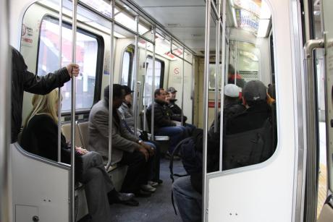
Notes:
What if we had the same data from riders on a day where ridership was more like this? What knowledge would we come away with by comparing the two datasets?

Slide 17
Data….
Organizes information so you can extract knowledge from it.
Sometimes you start with a question. Other times you might just explore data…looking for patterns.
There are several types of data that you might encounter.

Slide 18
Qualitative Data…
…everything that refers to the “quality” of something: A description of colors, texture and feel of an object, a description of experiences, and interviews are all qualitative data.
**Adapted from SchoolOfData.org

Slide 19
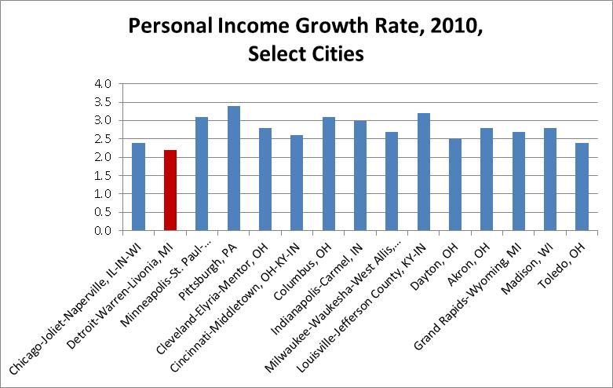
Quantitative Data…
…refers to a number. For example, the number of people, the size of an object, the price, a test score etc.
**Adapted from SchoolOfData.org

Slide 20
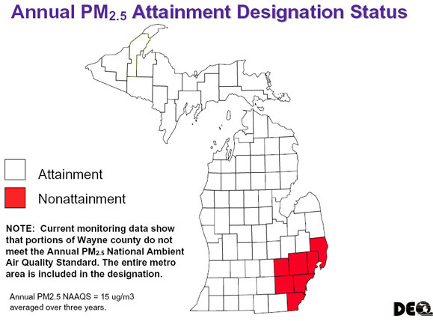
Categorical Data…
…puts the item you are describing into a “category.” Categories for people tend to include their gender, their race or ethnicity, their education background etc.
**Adapted from SchoolOfData.org
Image Source: Michigan DEQ via The Examiner

Slide 21
Discrete Data…
…numerical data that has gaps in it. This includes anything that must be represented by whole numbers, such as a top ten ranking or a score from a Likert style survey:
**Adapted from SchoolOfData.org
Image Source: http://rmsbunkerblog.files.wordpress.com/2010/09/likert-scale-2.jpg

Slide 22
Continuous Data…
…numerical data that can take on a value within a continuous range. An example would be a person’s weight, or height.
The size of your foot would be continuous, while your shoe size would be discrete.
**Adapted from SchoolOfData.org

Slide 23
Common Limitations
Data is very powerful when used appropriately. But because it can be costly and time consuming to collect and maintain data, there are often limitations.
Keeping these in mind, especially when comparing different datasets, will help you extract accurate knowledge.

Slide 24
Common Limitations:
Date of data
Is it recent enough to be relevant?
Image Source: publicdomainpictures.net
Geography
Is it point data or is it aggregated to tracks or blocks?
Can you get it for the state? Only Detroit? Region?

Slide 25
Common Limitations:
Availability
How often is this dataset updated?
What is the date of the most recent version?
Is it updated daily? Weekly? Yearly?
Is it available to the public?
Does it cost money to access?
Scale
How many records in the dataset?
Was it a census or a survey?
Notes:
*Note: Figure shows areas of coverage for 1-, 3-, and 5-year ACS Data

Slide 26
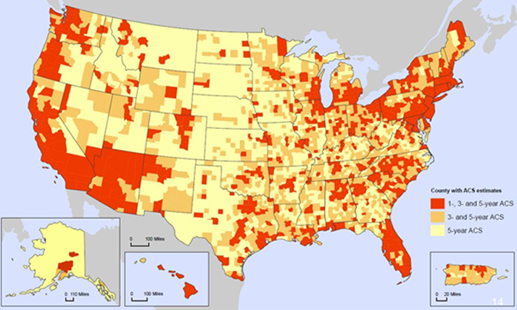
Image Source: Census Bureau
Notes:
From this map, you can see that all geographies are not surveyed equally making comparisons between some areas difficult. Also, you will notice that this map displays counties. With the ACS, analysis at the neighborhood level can be difficult due to large margins of error at the block group level or smaller.

Slide 27
Thanks!
Up next…
Introduction: Data Driven Detroit

