Slide 1

Welcome!
GIS 101:
Analyzing Data and Creating Maps
Lucas Winzenburg
Spring 2017

Slide 2


About U-Spatial
 | Support for spatial research Help Desk Training Consultation Events

Slide 3
Schedule
Morning
  Introduction to GIS & ArcMap
  Preparing Data
  Creating a Thematic Map
Lunch 12:00 – 1:00
Afternoon
  Map Elements
  Geocoding
  Basic Analysis

Slide 4
Introductions
Name & Affiliation
Any experience with GIS?
What do you want to map?
One hobby or interest

Slide 5
Accessing the data
Navigate to U-Spatial home page (http://uspatial.umn.edu/training)
  Under Workshops, GIS 101, click on Download Workshop Materials to download data
    (https://netfiles.umn.edu/u-spatial/public/GIS101.zip)
Copy to “C:\GIS101\”
Instructions in handout

Slide 6
Introduction to GIS & ArcGIS
Section 2

Slide 7
Outline
Geographic Information System (GIS)
  Functions
  Software
  Geographic/Spatial Data
Esri ArcGIS
  ArcMap
  ArcCatalog

Slide 8
Exercise 1
How many windows were on the first floor of the home you lived in when you were 12 years old?
Now that we’re thinking spatially… create a hand drawn map of your house and places near your house.

Slide 9
Exercise 1 continued…
What did you map?
What did you include/leave out?
How are features in the map related?

Slide 10
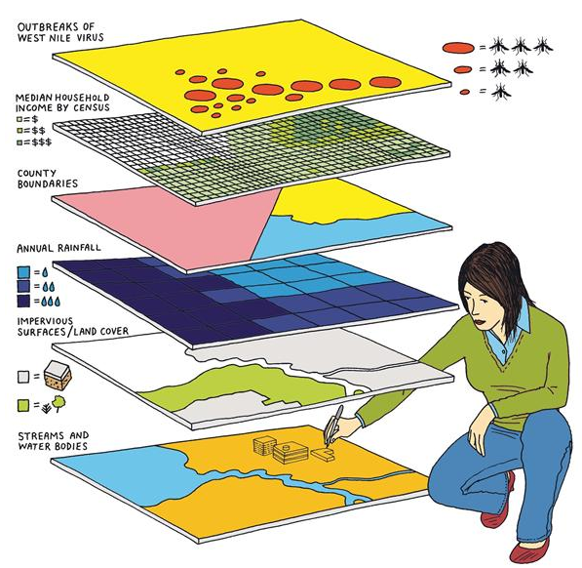
Layers
Pull apart themes of your map to make layers
Layers sit on top of one another
Spatial relationships define how these layers interact with one another
Image: Architect Magazine

Slide 11
Spatial Relationships
  Connectivity
  Containment
  Adjacency

Slide 12
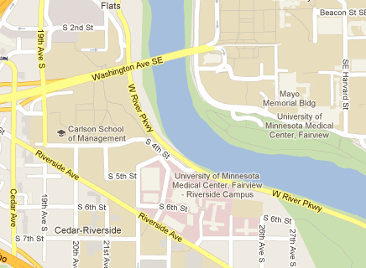
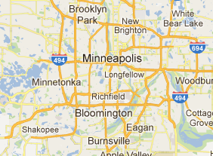
Scale
  Large scale = covers small area, think large amount of detail (i.e. 1/10,000)
  Small scale = covers large area, think small amount of detail
  (i.e. 1/1,000,000)

Slide 13
What is GIS?

Slide 14
GIS
A geographic information system (GIS) lets us visualize, question, analyze, interpret, and understand data to reveal relationships, patterns, and trends.
- esri

Slide 15
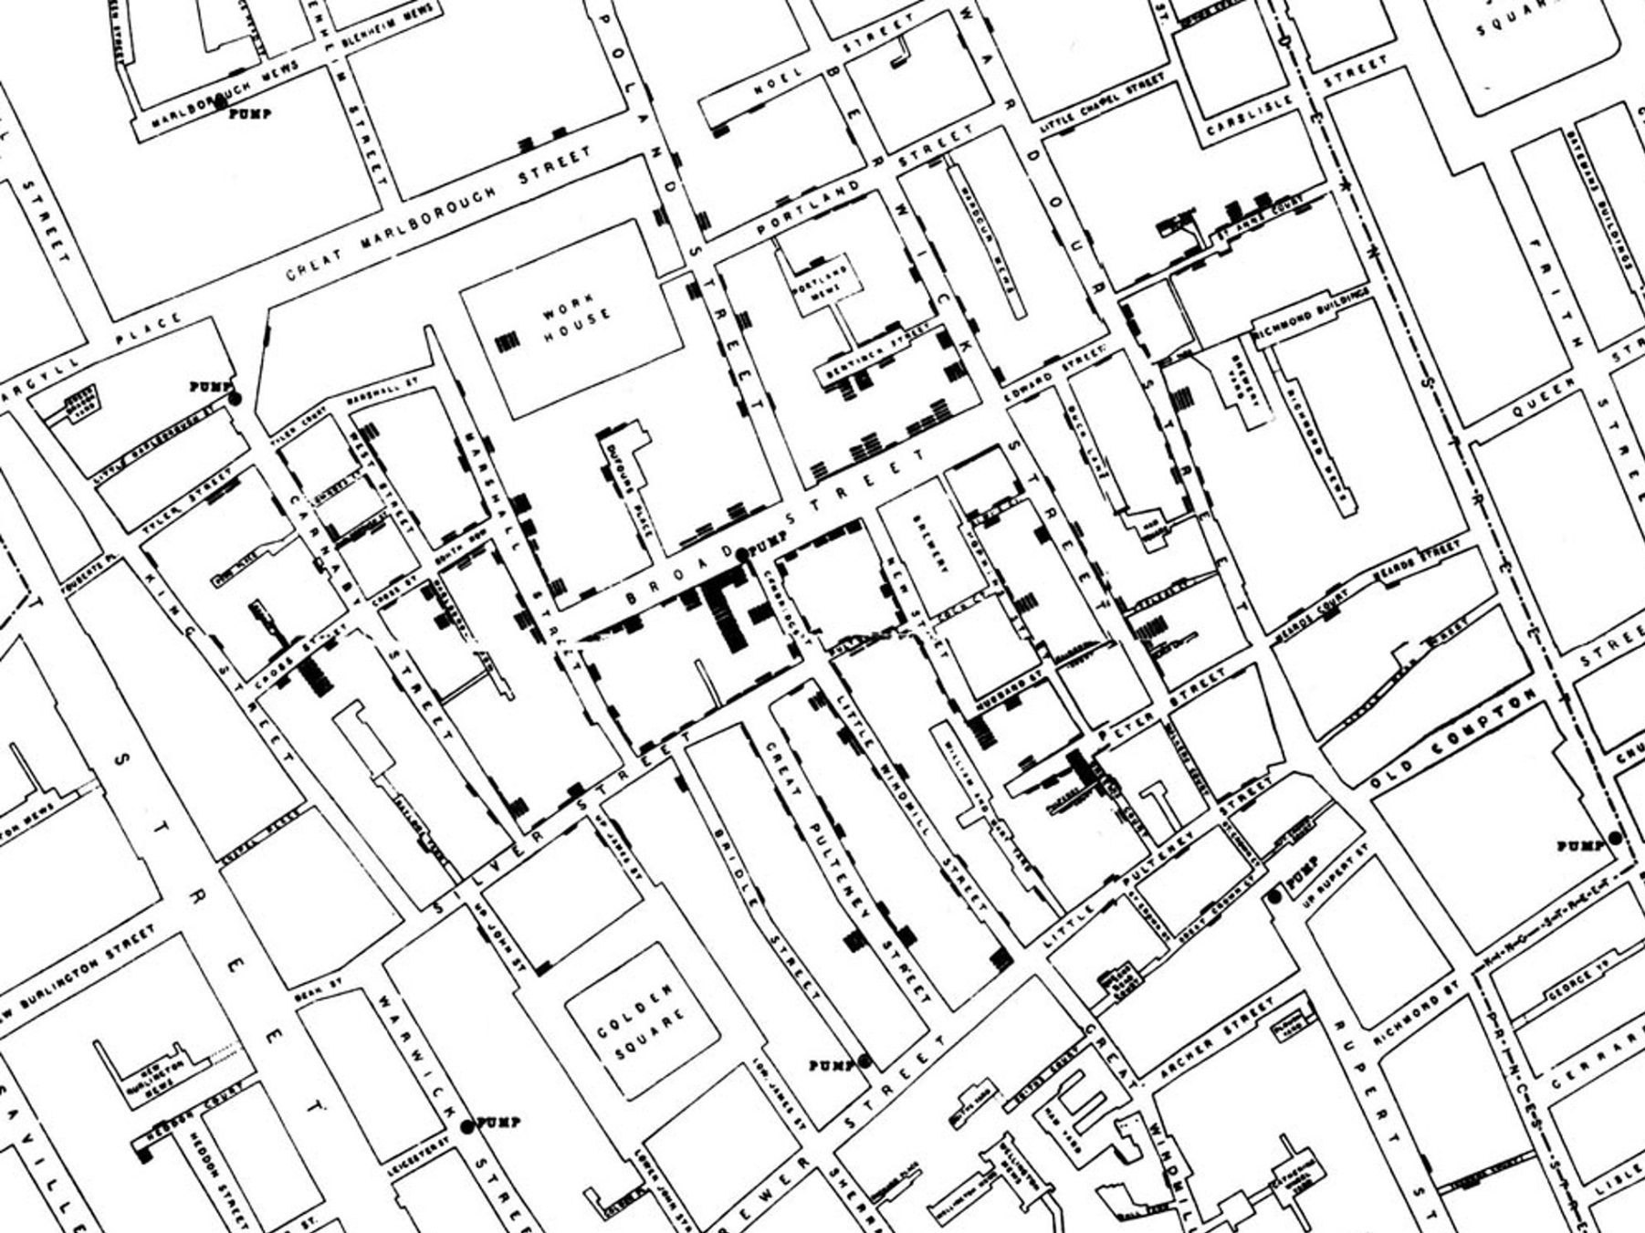

Slide 16
GIS
Geographic Information System (GIS):
An integrated system for geographic data
  Capturing data
  Storing data
  Querying data
  Analyzing data
  Displaying data
Tobler’s 1st Law of Geography
Everything is related to everything else, but near things are more related than distant things.

Slide 17

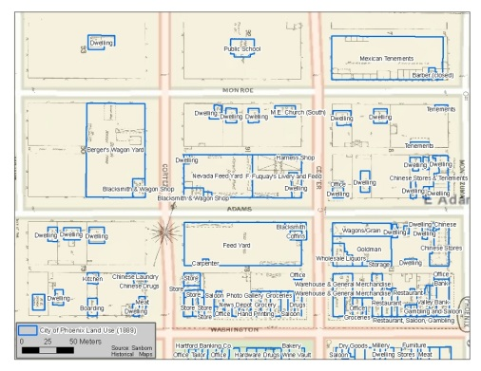

Capturing data
Digitizing
  Creating a digital copy of existing data
  Paper maps, Aerial imagery, Topography maps
  Output is a GIS friendly vector format
    CAD to shapefile conversion
GPS
  Global Positioning System
  Coverage of entire planet
  Data Formats:
    Temporal – accurate to about 14 nanoseconds
    Spatial – sub-meter accuracy

Slide 18

Storing data
Files
  Shape file
  KML (Google)
  Spreadsheet
Spatial Database
  PostGIS, Oracle, SQL Server
  Traditional database management system that also stores vector feature geometry and location data

Slide 19

Querying data
Ask a question of the data based on location or other attribute
  “How many parks are within a mile of my house?”

Slide 20
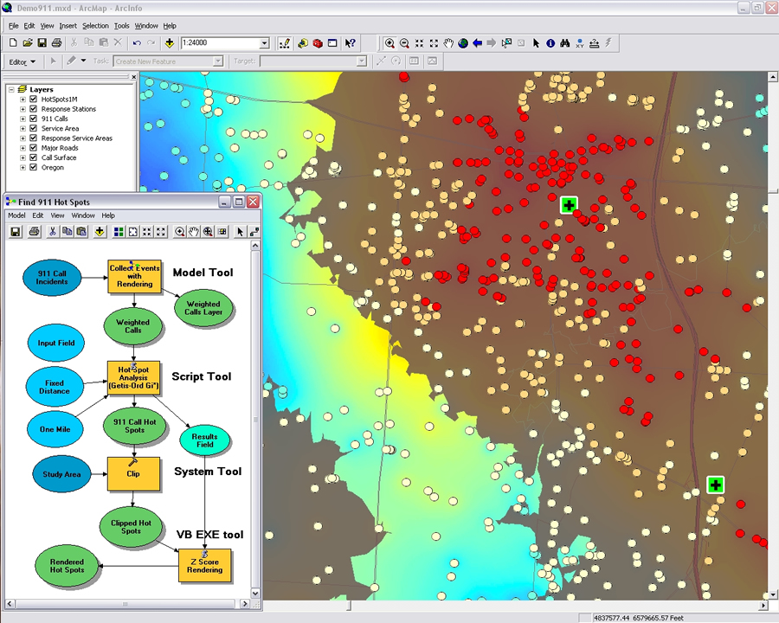
Analyzing data
Performing operations on the spatial data
  “How far am I from the nearest park?”
  Overlays
  Extracts
  Proximity
  Spatial Statistics

Slide 21
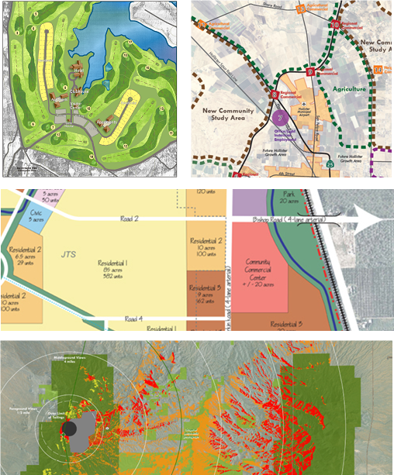
Displaying data
Mapping
  The display of spatial data for a specific purpose
  Visualization
    Re-emerging as a popular means to artistically portray traditional data
    Not necessarily spatial data
Output Format
  Print
  Web

Slide 22
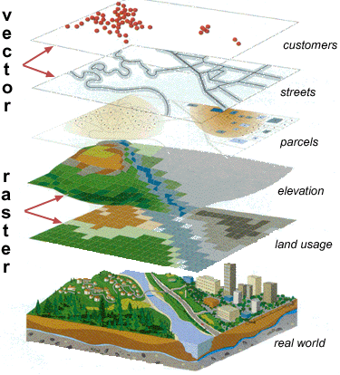
Spatial Data Models
Vector
Raster

Slide 23
Vector Data Model
Points
Lines
Polygons

Slide 24
Points
Represents a single location on Earth
Examples:
  Monitoring sites
  Polluters
  Address of study participant
  Fire hydrants
  Intersection of two streets
Points

Slide 25
Lines
String of points joined together by line segments
Has length
Examples
  Road
  River
  Bicycle trail
Lines

Slide 26
Polygons
Closed line representing a defined area on the ground
Has perimeter and area
Examples
  City
  State
  Watershed
  Census tract
Polygons

Slide 27
Spatial Data
Adds geometry to traditional data
  Geometry: location and geometric characteristics of geographic (real-world) features
  Attributes: data describing the characteristics of geographic features

Slide 28
Spatial and Tabular Data
  Geometry + Attributes
ID | Color
1 | Blue
2 | Red
3 | Green
4 | Yellow
5 | Black
Use
Hospital
Fire Dept.
Office
University
Retail
Points

Slide 29
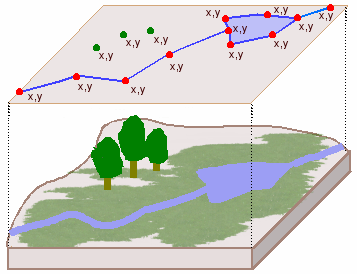
Vector Model
Vector
  Discrete entities defined by coordinate points
  Three types of vector data
    Point
    Line
    Polygon
Source: ESRI Virtual Campus

Slide 30
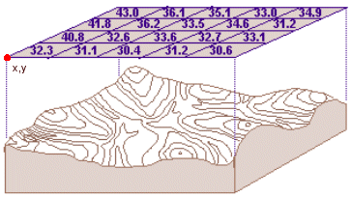
Raster Model
Composed of a regular grid of cells
Every grid cell has a value
Every point on ground belongs to a grid cell
Examples
  Elevation
  Crime hotspot
  Temperature
  Rainfall
Average elevation

Slide 31
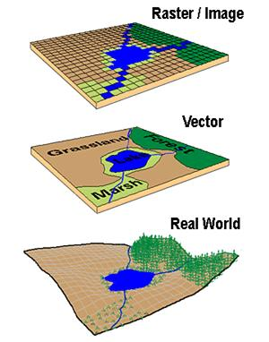
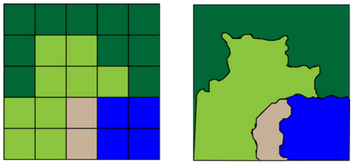
Raster vs. Vector
Different ways of displaying the “real world”
Raster
Vector
Source: University of Connecticut

Slide 32
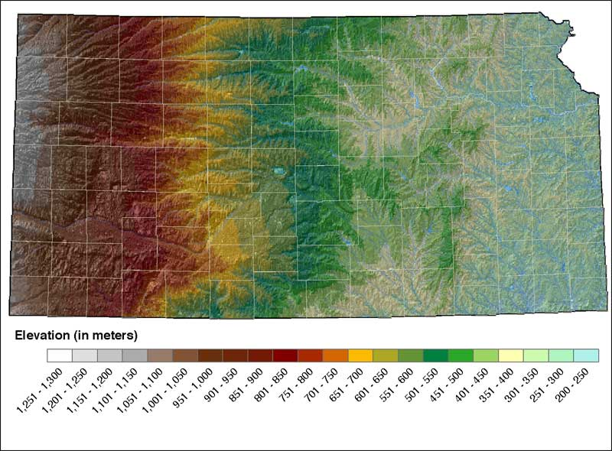
Raster and Vector
Source: Kansas Geological Survey

Slide 33
Review Key GIS Concepts
Points
Lines
Polygons

Slide 34
Review Key GIS Concepts
Capturing data
  GPS, Digitizing
Storing data
  Points, lines & polygons
  Attributes
Querying data
  How many “a” in “b”
Analyzing data
  How far is “c” from “d”
Displaying data
  Mapping
  Output
    Paper
    Web
    Table

Slide 35
Exercise 2
Open Google Maps (https://maps.google.com)
  Find your house
Objectives
  What layers do you see?
  What vector features can you identify
  (points, lines, polygons)?
  How does scale affect how the feature is represented?
  Be critical!

Slide 36
Software & GIS
Commercial vendors
  esri ($$$)
  Idrisi
  Intergraph
  MapInfo
  Manifold ($)
  Maptitude ($)
Free / open source software
  Quantum GIS (QGIS)
  GRASS
  uDig

Slide 37

esri ArcGIS Desktop
Most popular GIS application
Powerful and expensive
University site license
Part of a suite of tools
  ArcGIS Desktop
  ArcGIS Server
  ArcGIS Online

Slide 38
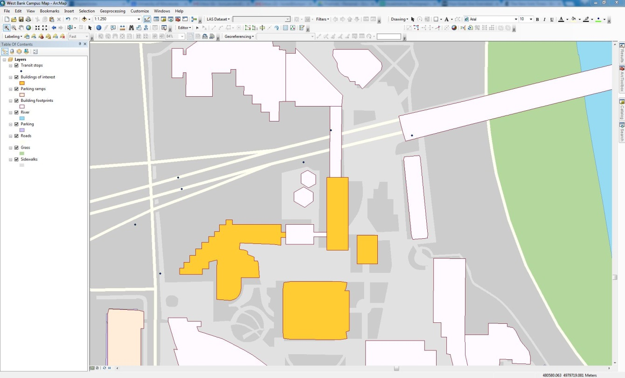
ArcMap
Display GIS data
Create maps
Query data
Analyze data
Edit GIS data

Slide 39









Icons
ArcGIS Desktop uses icons to differentiate among file types. Common ones:
Point feature class
Text file
Line feature class
Raster/grid data
Polygon feature class
Geodatabase
Annotation feature class
Map Document
Table

Slide 40
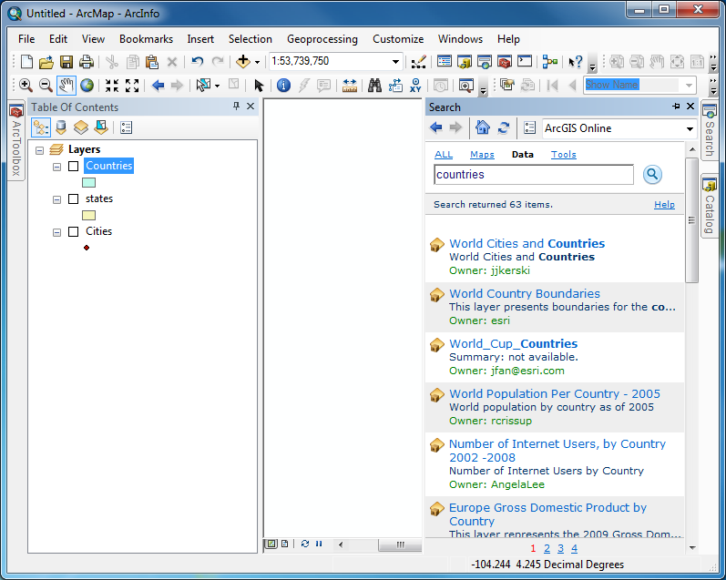
Icons

Slide 41
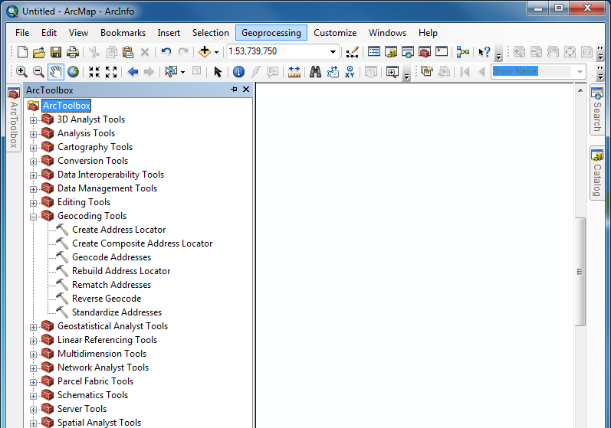
Icons
Common tools available in Geoprocessing dropdown

Slide 42
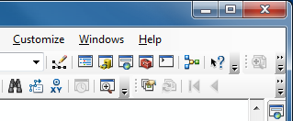
Help
Help in ArcGIS
  Desktop Help
    Contents
    Favorites
    Search
  Tool tips and context-sensitive help
    Tool names appear when the mouse is moved over them
    Click the “What’s this?” button

Slide 43
Demonstration
Using ArcMap

Slide 44
Exercise 3
1. Navigate to GIS101 Folder, then open map document located at:
  C:\ > GIS 101 > Exercise Data > ArcMapPractice.mxd
2. Explore ArcMap’s features, buttons, toolbars

Slide 45
Spatial data management
Shapefiles
Geodatabases
ArcCatalog
Metadata

Slide 46
Shapefile
Vector only data
Most common spatial data format
All GIS software will read shapefiles
Single shapefile actually consists of multiple files
  .shp – stores geometry
  .dbf – stores attributes
  .shx – index file
  .prj – projection file
  .xml – metadata file
Must keep all files together in same directory for software to recognize the shapefile (more on that in a minute)

Slide 47
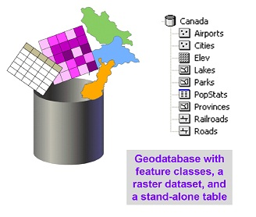
Geodatabase
Stores a set of files
Also allows for data query, data management

Slide 48
Feature Class
Layer
Grouping of one type of feature
  (i.e. points, lines, polygons)
With spatial and attribute information for each feature
A “shapefile” stored within a Geodatabase

Slide 49
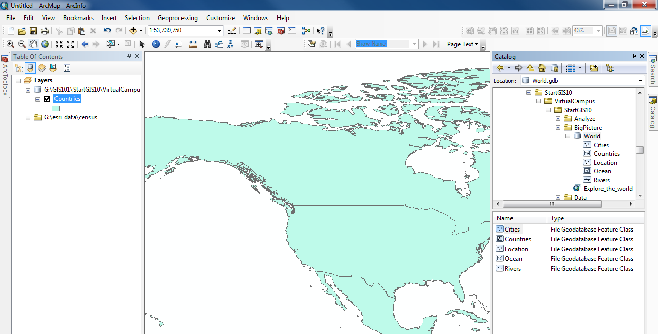
ArcCatalog
Primarily for data management
  Browse GIS data
    View geography, attributes, and metadata
  Import/export GIS data

Slide 50
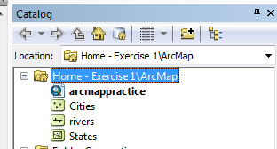
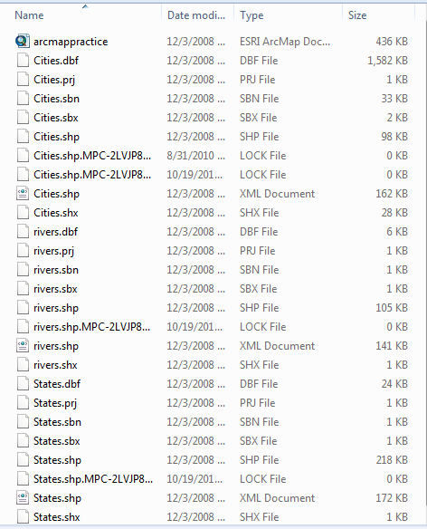
ArcCatalog: File Management
ArcCatalog
vs.
Windows Explorer

Slide 51
Metadata
  Data about data
  Describes the content, lineage, creator, distributor, processing steps, and spatial reference of the spatial data
  Helps users determine the availability and access requirements for data
  Helps users judge the quality and “fitness-for-use” of the data for their particular application
  Results only as good as input data!
  “Item Description” in ArcGIS 10.x

Slide 52
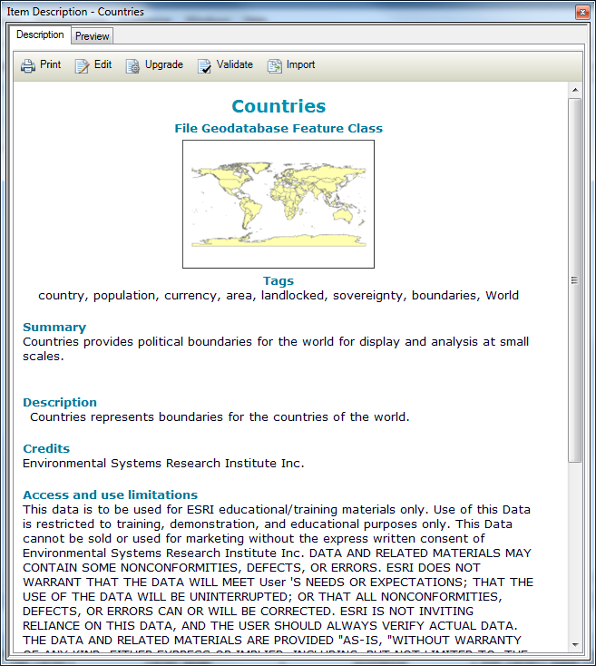
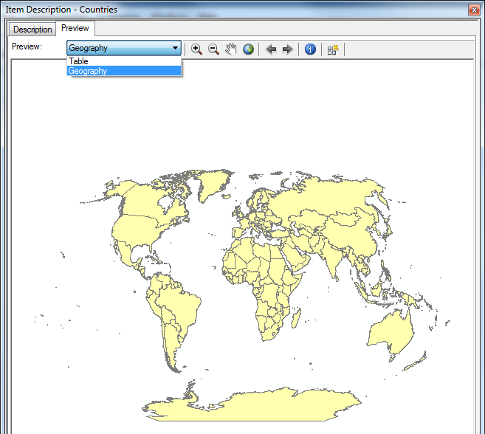
Catalog Window > Item Description

Slide 53
Demonstration
Using ArcCatalog

Slide 54
Preparing Data for use in GIS
Section 3

Slide 55
Preparing Data for Use in GIS
Data Sources
Joining Data

Slide 56
Data Sources
NHGIS
Minnesota Geospatial Commons
CDC - WISQARS
esri
Borchert Map Library
Colleagues
Tufts GeoData
Harvard World map
Natural Earth
USGS
Google

Slide 57
NHGIS
National Historical Geographic Information System
  Provides, free of charge, aggregate census data and GIS-compatible boundary files for the United States between 1790 and 2014.
  http://nhgis.org
Pre-1970 – Derived from Print Select Tables Select Geographies | 1970-2014 - Electronically Available All Tabulations All Geographies

Slide 58
Natural Resources
Watersheds
Soils
Elevation
Landcover
Aerial photographs
Water quality
  Source Example: MN Geospatial Commons

Slide 59
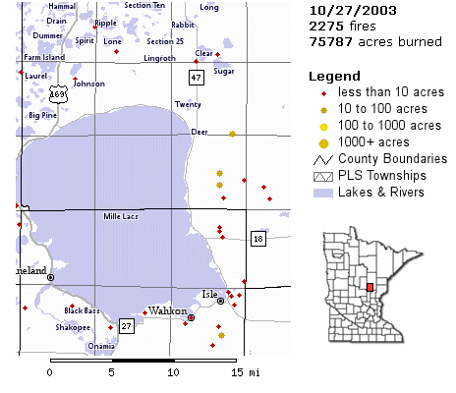
Natural Resources
Example: Wildfires in 2003 through October 27, 2003.
Source: MN Geospatial Commons

Slide 60
Public Health
Hospitals
Hospital Catchment areas
Locations of cancer patients
Toxic Release Inventory Sites
Superfund Sites
  National Center for Health Statistics
  Example Source: CDC WISQARS

Slide 61
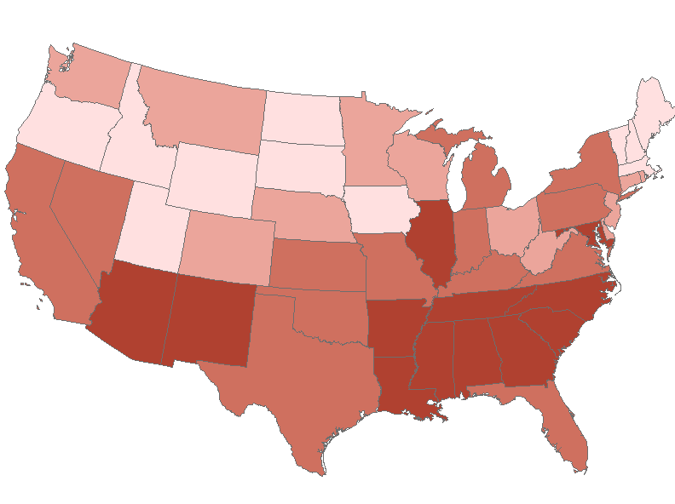
Public Health
Homicide data from CDC WISQARS had to be joined to spatial data
Homicides by State, 2005
Source: CDC WISQARS

Slide 62
Planning
Zoning
Landuse (Commercial, Residential, Industrial)
Parks
Roads
  Example Source: MN Geospatial Commons

Slide 63
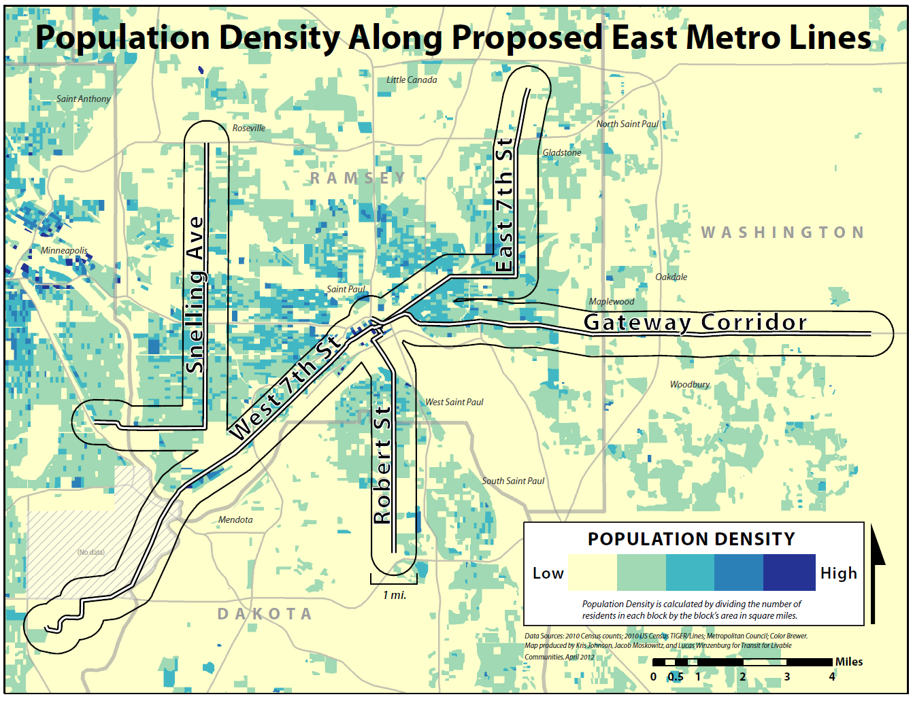
Planning

Slide 64
Demonstration esri Data Search

Slide 65
Joining Data
Attribute Tables
Primary Key/Joining Attribute
Joining
Notes:
3 key elements to talk about

Slide 66
Question?
The research question I want to map is: “What is the Homicide Rate per State during
2003-2005?”
It is rare to find a geographic file with this information already included.
You must find a table of homicides per state and a geographic file of states in order to combine them.

Slide 67
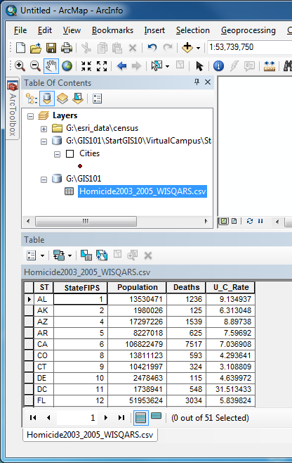
Attribute Tables
Download homicide data from CDC WISQARS
Add .csv file into ArcMap
File appears in Table of Contents
To view attribute table:
  Right-click > Open
Notes:
.xls ok too

Slide 68
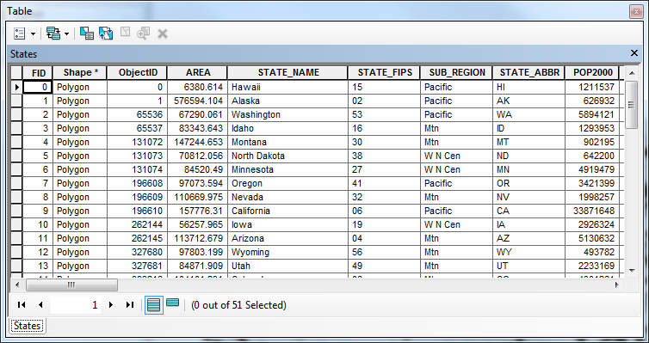
Attribute Tables
Attribute table for US States geography file
Notes:
Table continues to the right (i.e. more fields)
Also need US States geography file – because homicide data is not spatial data… next slide…

Slide 69
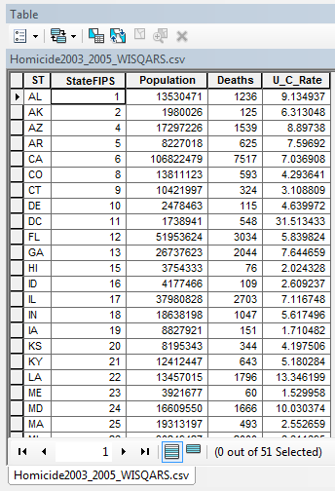
Attribute Tables
Homicide Excel File + States geography file =
Homicides per State Map

Slide 70
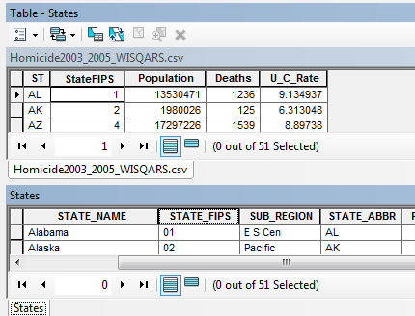
Primary Keys
Homicides Excel file
States geography file
Primary Key or Common Field is the column that matches in both sets of data. These keys are used to join the data together based on the common field. Each row of that common field must be unique.
Notes:
In order to join these 2 datasets together we need a primary key/common field.

Slide 71
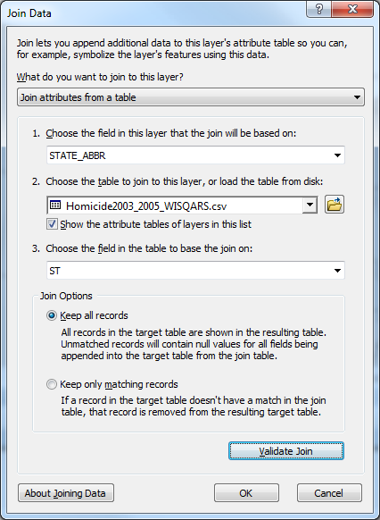
Joining Tables
Join tabular data to spatial data.
Primary key in this case is ST and STATE_ABBR
  They don’t necessarily need to have the same field name, as long as the data matches.

Slide 72
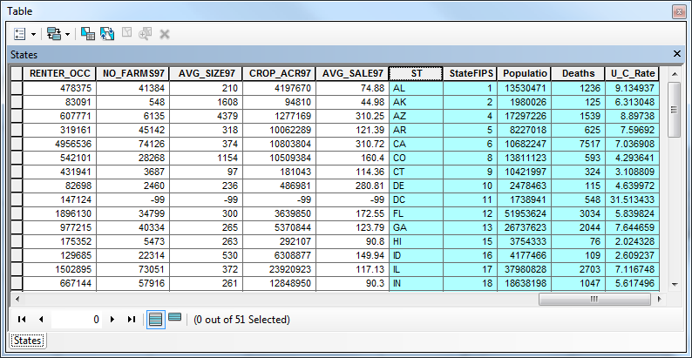
Joining Tables
Data from .csv file added to far right

Slide 73
Joining Tables
Look at Attribute tables to make sure that they are joined.
Export the layer with the joined data as a New layer to preserve the join for future use.
Notes:
Will export the layer and save as a new file/layer in an exercise

Slide 74
Joining Tables
Age Adjusted Homicide Rates per 100,000 People in the US, 2000
Notes:
Final product – can produce this after join.

Slide 75
Exercise 4
Join traditional tabular data to spatial data

Slide 76

Thematic Mapping
Section 4

Slide 77
Outline
Types of Thematic Maps
Standardizing Data
  By Population
  By Area
Classifications
  Natural Breaks/Jenks
  Quantile (Quintile)
  Equal Interval (Based on Range)
  Equal Interval (Based on a Defined Interval)

Slide 78
Types of Thematic Maps
Choropleth
Dot Density
Graduated Symbol
Isarithmic

Slide 79
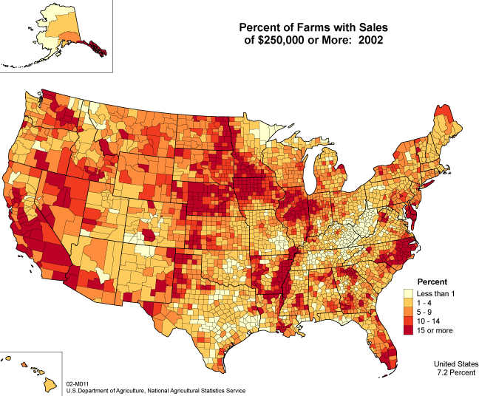
Choropleth Map
Shows value per unit using colors. Use these for comparing relative numbers
across space.

Slide 80
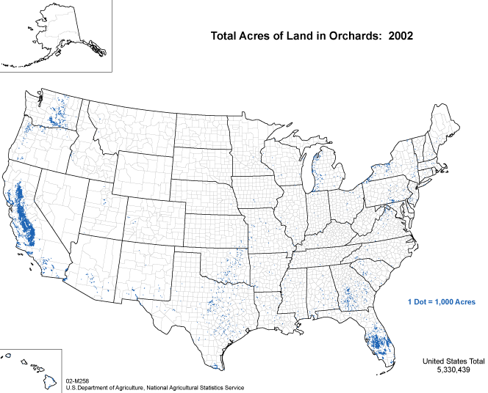
Dot Density
Shows density of phenomenon using dot (or representational dot). Use for
raw counts.

Slide 81
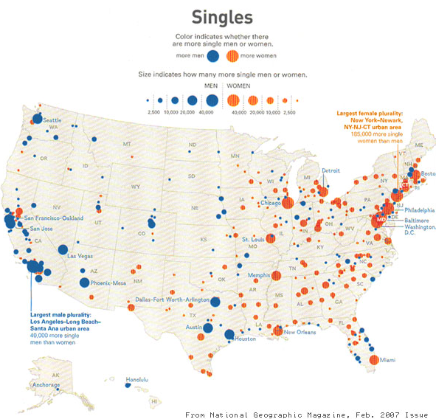
Graduated Symbol Map
The size of the symbol is representative of the value of the variable.
Difficult use well.

Slide 82
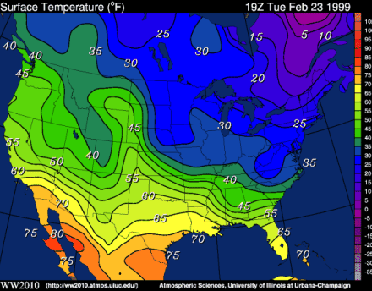
Isarithmic Map
Change in value is shown through intervals across map.

Slide 83
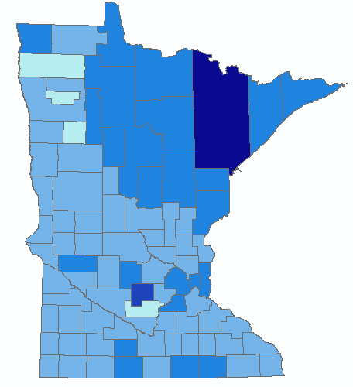
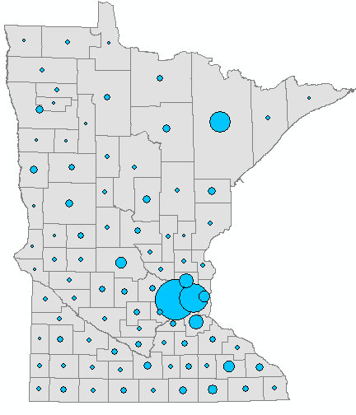
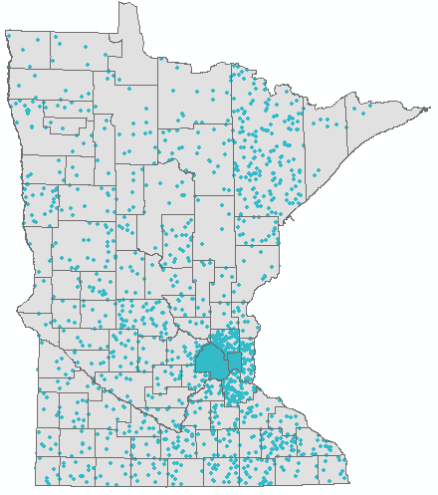
WWII Vets-- Three Maps
Choropleth Map (Normalized)
Graduated Symbols
Dot Density Map

Slide 84
Data Standardization
Data should usually be standardized
  Ability to compare areas
By Population
  Per person, Percentages
By Area
  Density

Slide 85
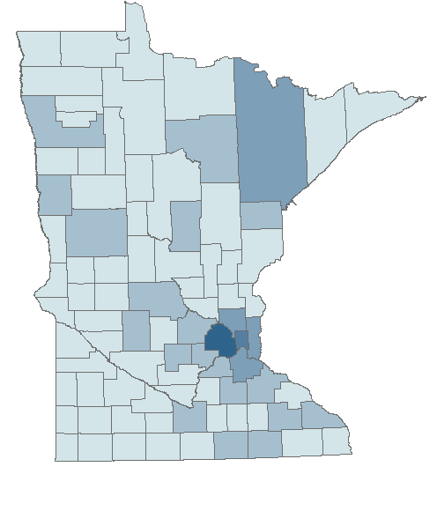
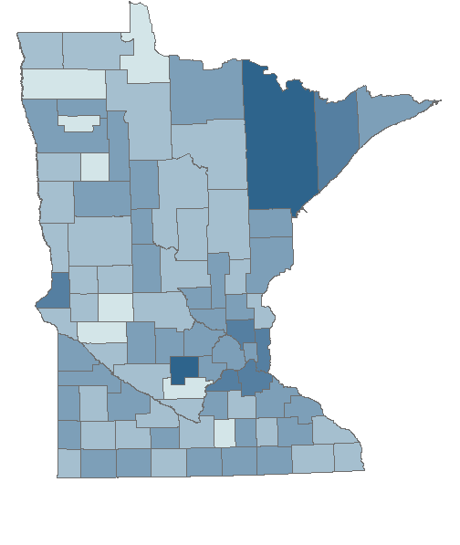
Data Standardization
Unstandardized
Normalized

Slide 86
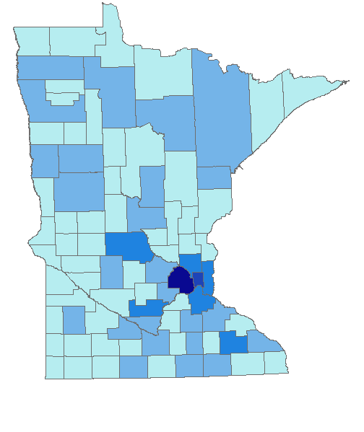
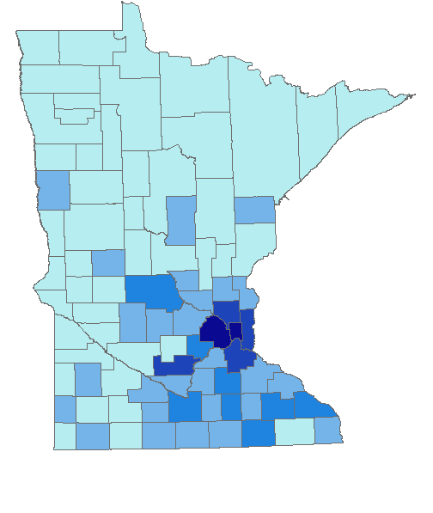
Data Standardization
Unstandardized
Normalized

Slide 87
Classification
Natural Breaks/Jenks
Quantile
Equal Interval Based on Range
Equal Interval not Based on Range/Defined Interval

Slide 88
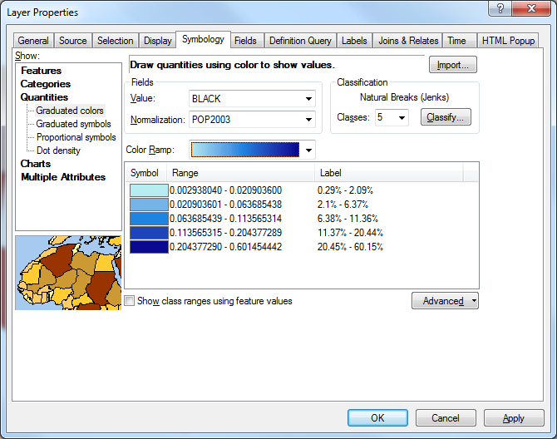
Classification Methods
Generally, 5-7 classes are appropriate.
People can only tell the difference between about 6 colors.

Slide 89
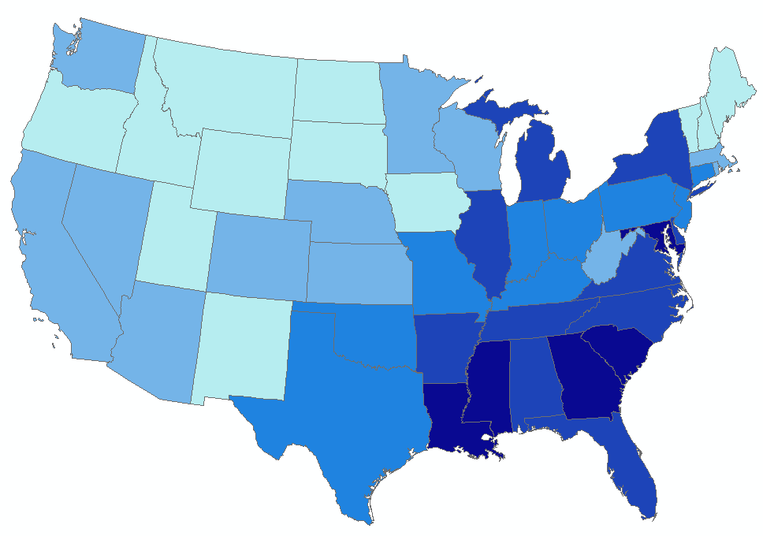
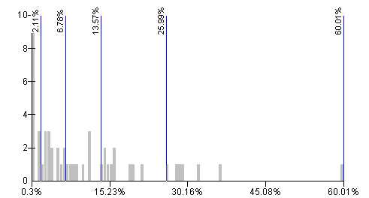
Natural Breaks (Jenks)
Natural Breaks has intervals that are created using natural clustering of the data.
It maximizes variance between groups and minimizes variation within groups.

Slide 90
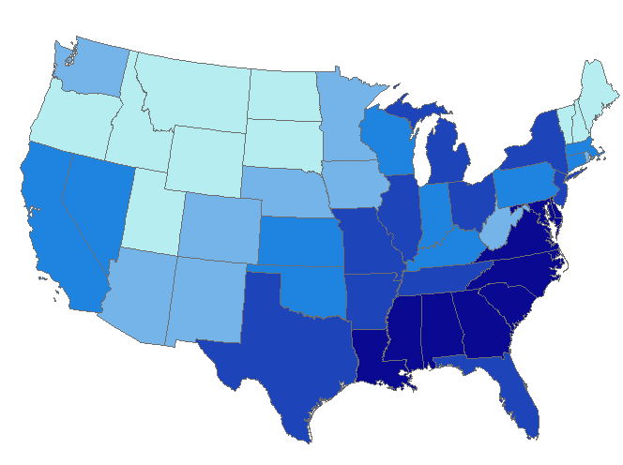
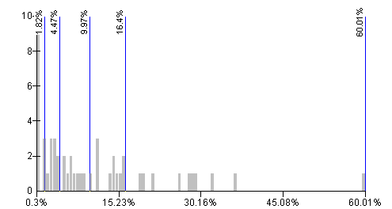
Quantile
Quantile has equal numbers of data in each class– sometimes
called Quintile for 5 classes

Slide 91
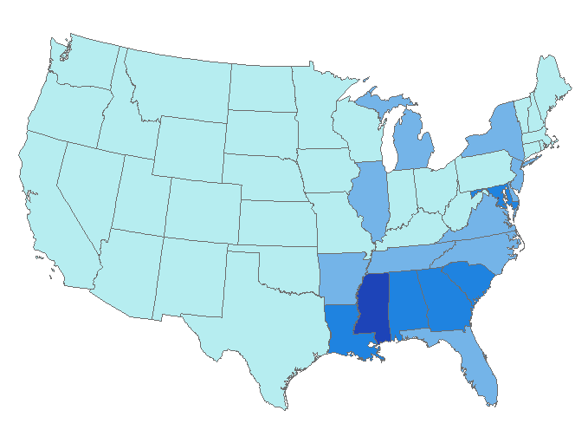
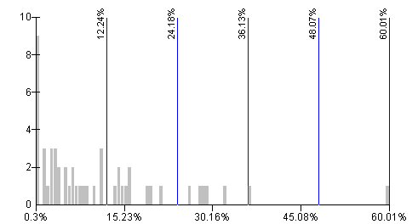
Equal Interval (Based on Range)
Equal-sized subranges

Slide 92


Defined Interval
Equal Interval not based on Range
Good for comparing values across time
Legends may be easier for audience to read

Slide 93




Classification: Method Comparison
Natural Breaks
Equal Interval
Standard Deviation
Quantile

Slide 94




Classification: Class Comparison
2
3
4
5
Notes:
Same data presented four different ways:
Mean family income in the last 12 months (2010)
2006-2010 American Community Survey 5-Year Estimates
Table S1901
Natural Breaks (Jenks) classification – 2,3,4,5 classes

Slide 95
Exercise 5
Create a choropleth map using your joined data

Slide 96

Lunch Break (West Bank)
Carlson Dining Food Court – Lower Level
  Zoca (Made to Order Mexican)
  Burger Studio
Humphrey Center – Lower Level
  Bistro West Restaurant
Blegen Hall – Lower Level
  Papa John’s
  Subway
Mondale Hall – Lower Level
  Sullivan Café

Slide 97
Map Elements
Section 5

Slide 98
Map Elements
Title
Legend
Scale
Source Information
Projection
Color
Geographical Context
Visual Hierarchy

Slide 99


Slide 100

Well Designed Map

Slide 101
Title
Largest type on map
Titles should include :
  Theme
  Place
  Time
  “Minneapolis Bicycle Trails, 2017”

Slide 102

Legend
Explains all the symbols used in the map
Should be easy to read and understand
Place where there is “white space” in the map
Symbols should be grouped by type:
  Points
  Lines
  Polygons

Slide 103
Legend
Default Legend
Better Legend

Slide 104
Scale
Represents map to real-world ratio. Can be expressed:
  Scale Bar
  Representative Fraction (1:40,000)
  Statement (1 inch = 1 mile)
Scale bar is easiest and required if map will be reproduced in different sizes
Use units that make sense for audience (Kilometers Vs. Miles)
Place in empty space

Slide 105
Scale
Scale Bar:
Representative Fraction: 1:3,448,439
Word Statement: 1 Inch is Equal to 54 Miles

Slide 106
Source Information
This text box may include:
  Data Source (Census, NHGIS, MDH, etc.)
  Date of Data Collection
  Copyright
  Cartographer(s)
  Projection
Should be small, but visible. Place in corner, below, under legend, etc.

Slide 107

Source Information

Slide 108
Projection
Earth is spherical, maps are not
Projections allow for “best” views of specific areas
Will not be covered in detail but
  Different Scales use different projections
  States have their own projections
  MN counties have their own projections

Slide 109


Mercator Vs. Peters
Mercator
Peters

Slide 110



Projection
Undefined projection
UTM 15N
MN State Plane

Slide 111


Projection continued...
UTM 19N
NTF Paris Centre France

Slide 112
Color
Think about other maps you’ve seen
Color means something!
  Red?
  Blue?
  Browns?
  Greens?
Color schemes:
  Ramp, Diverging, Qualitative Data
www.colorbrewer2.org

Slide 113

Arc options

Slide 114

Arc options
Quantiles!

Slide 115

Arc options

Slide 116
Colorbrewer
Colorbrewer Website

Slide 117



Color
Ramp/Sequential: “Suited to ordered data that progress from low to high.
Lightness steps dominate the look of these schemes with light colors for low data
Values to dark colors for high data values”

Slide 118
Ramp/Sequential Colors
Percent of Elderly Living in Poverty
2005, by PUMA

Slide 119

Color
Diverging Color Scheme: “Equal emphasis on mid-range critical values and extremes at both ends of the data range. The critical class or break in the middle of the legend is emphasized with light colors and low and high
are emphasized with dark colors that have
contrasting hues.”
Generally not good for
printing in black and white
because the color of the
extreme values will look
the same.

Slide 120
Diverging
Elderly Living in Poverty,
Percent Change 1980-2005 by PUMA
Extreme Decrease
Moderate Decrease
No Change
Moderate Increase
Extreme Increase

Slide 121

Color
Qualitative Data: “Do not imply magnitude difference between legend classes, and hues are used to create the primary visual differences between classes. Schemes are best suited to representing nominal or categorical data.”

Slide 122

Qualitative

Slide 123
Color
Colorblindness
Printability
  Proper color on printed copies
  Grayscale
Projector
  Test beforehand!

Slide 124

North Arrow?

Slide 125

Geographical Context

Slide 126

Geographical Context
Labels, Lakes, Rivers, Oceans, Borders, Adjacent States/Countries, Landforms, etc.
Geographical contexts helps people unfamiliar with the study area know at what
they are looking.

Slide 127
Visual Hierarchy
The idea that what’s most important should be the most visible
  Distraction from supplemental map elements should be minimized
  Spatial data should be the most visible

Slide 128


Visual Hierarchy
Bad Map
Better Map
Source: http://www2.bc.cc.ca.us/cs/cmesel/Carto_Design/lesson1/mod01_les01_top02_1.html

Slide 129
Well Designed Map

Slide 130
Well Designed Map
TITLE
LEGEND
PROJECTION : Ramsey County
COLOR: colorbrewer
GEOGRAPHIC CONTEXT: other cities, lakes, rivers
SCALE
SOURCE

Slide 131



Working in Layout View
Put the map in “Layout View”
Create guidelines around the edges of the map
Snap map to these guidelines

Slide 132

Working in Layout View
Data View Toolbar
Zoom in
Zoom out
Pan
Full Extent
Fixed zoom in
Fixed zoom out
Back (Previous extent)
Forward (Next extent)
Select features
Clear selection
Select elements (pointer)
Identify
Layout View Toolbar
Zoom in
Zoom out
Pan
Zoom whole page
Zoom to 100%
Fixed zoom in
Fixed zoom out
Go back to previous extent
Go forward to next extent
Zoom control

Slide 133
Exercise 5 continued…
Use ArcMap to create a well-designed map

Slide 134
Geocoding
Section 6

Slide 135

What is Geocoding?
The process of assigning geographic coordinates to an address
3333 21st Ave S Minneapolis MN 55407 becomes…

Slide 136
Why Geocode?
Table → Map
Common examples:
  Business mapping competitor locations
  Public health workers mapping disease outbreaks
  Community group mapping projects
  DNR mapping impacts of emerald ash borer

Slide 137


Theory of Geocoding
Break up address into its components
Use street reference data to locate address
1053 Idaho Ave W, St Paul, MN 55117
Address #
Street Name
Street
Type
Street
Direction
City
State
Zip Code
ZOOM
1098
1099
St Paul, MN
1053

Slide 138
Geocoding
Geocoding Process:
  Gather the tabular data you want to geocode (addresses)
  Create/(Use) Address Locator
  Use Geocoding Tool to geocode addresses
  Rematch Addresses

Slide 139


Address Locator
Saint Paul Road System – 11,307 line segments

Slide 140

Address Locator
Use Create Address Locator Tool
  ArcToolbox
  Search
Address Locator Style
  US Address – Dual Ranges
Reference Data
  Street Layer

Slide 141
Address Locator continued…
Field Map
*From Left: FRADDL
*To Left: TOADDL
*From Right: FRADDR
*To Right: TOADDR
Prefix Direction: FEDIRP
*Street Name: FENAME
Suffix Type: FETYPE
Suffix Direction: FEDIRS
Left Zip Code: ZIPL
Right Zip Code: ZIPR

Slide 142

Tabular Data
Typically Excel spreadsheet or CSV file
Address Information must include
  Name
  Address
  Zip Code
Any other information for Analysis
  Categorical or Quantitative data
    Yes/no, how many, what kind, etc.

Slide 143

Geocoding Data
Use Geocode Addresses tool
  ArcToolbox
  Search
Output Feature Class
  save as

Slide 144

Geocoding Data
Geocoding Toolbar
  Customize menu > Toolbars > Geocoding
  Choose Address Locator
  Review/Rematch Addresses

Slide 145
Review/Rematch Addresses
Successful geocoding:
  High percentage of matches
  Matches of over 80%
To fix addresses with low scores:
  Incorrect Zip Code -- Zip codes change over time
  Incorrect Spelling
  Address not in reference area
  Alternative street name
  Other typos, mistakes in numbers, etc

Slide 146

Rematching Addresses

Slide 147

Rematching Addresses

Slide 148

Rematching Addresses

Slide 149
Exercise 6
Geocode all St. Paul Public Schools using tabular data

Slide 150
Geocoding Review
Be careful which locator service you use, online geocoders are not HIPAA compliant
Geocode to the appropriate geographic scale, can take care of confidentiality issues
A high match score does not mean the point is accurate, best practice is to choose a small percentage of results to review
Valid address does not necessarily mean correct location! e.g. 3500 Cedar Avenue, Minneapolis, MN 55407

Slide 151
Basics of Analysis
Section 7

Slide 152
Outline
Spatial Analysis Examples
Selecting
  Interactive
  By Location
  By Attribute
Proximity
Overlay
Generalization

Slide 153
Spatial Analysis Examples
Density of population around social services offices
Demography around areas of high crime
Site selection of interest
Proposal for new bike path – how many people live within 1 mile of proposed path

Slide 154


Selecting
Interactive Selection
  Use the selection tool to select the features that you would like
    Click on or draw shape around features
  Hold Shift and click to select multiple features

Slide 155
Select by Location
Select features from Target layer(s) that ______ Source layer feature.
  Intersect
  Are within a distance of
  Contain/Completely Contain
  Are within/Are completely within
  Are identical to
  Touch the boundary of
  Share a line segment with
  Are crossed by the outline of
  Have their centroid in

Slide 156

Select by Location
Cities within the Everglades Ecosystem

Slide 157


Select by Location
Cities within 5 Miles of a River

Slide 158

Select by Location
Attribute table shows selected features in blue
To view only selected features in table, click “Show selected records” button at bottom of table

Slide 159

Select by Attributes
Select from certain attributes on the attribute table
Use formula system where attribute is:
  Equal to
  Greater than
  Less than
  AND, OR, NOT

Slide 160


Select by Attributes
States with Average Family Size
greater than 3.5

Slide 161


Select by Attributes
States with Average Family Size
greater than 3.5 OR Average Family
Size is less or equal to 3

Slide 162


Tools for spatial analysis
Proximity
  Buffer
Overlay
  Spatial Join
  Intersect
  Union
  Clip
Generalization
  Dissolve

Slide 163
Proximity
Locating features based on distances to other features
Buffer proximity analysis

Slide 164

Proximity
Buffer
  Creates a polygon around a feature or features
  May be used on points, lines, or polygons
Source: ArcGIS Desktop Help

Slide 165

Proximity
Source: ArcGIS Desktop Help

Slide 166

Proximity

Slide 167

Proximity

Slide 168
Overlay
  Combine layers to create new, more useful layers
  Output layer inherits overlay layer’s attributes
  Number of output shapes and attributes depends on overlay process

Slide 169
Overlay
Spatial Join
  Can also be considered a proximity analysis tool
  Join data on spatial location
  Appends attributes of one layer to another
  Creates a new layer/feature class

Slide 170

Overlay - Spatial Join Example
Question: How many cities (pop > 10,000 or state capital) are in each state?

Slide 171

Overlay - Spatial Join

Slide 172

Overlay – Spatial Join

Slide 173


Overlay – Spatial Join
Answer: There are 19 cities that meet the criteria in Hawaii, 3 in Alaska, 97 in
Washington, etc.

Slide 174
Overlay
Other Overlay Functions
  Intersect
  Union
  Clip

Slide 175

Overlay
Intersect
  Common features are maintained
  Input: point, lines, or polygons
  Overlay: polygon
  Output: same geometry or lower as input
  Extent: Shared area only
Source: ArcGIS Desktop Help

Slide 176



Overlay - Intersect Example
Where are the broadleaf forests that are within one mile of a major river (i.e. habitat for vector of disease)?
+
=
MN DNR Data

Slide 177

Overlay
Union
  New layer with combined polygons
  Input: polygon
  Overlay: polygon
  Output: polygon
  Extent: complete geographic extent of both input and overlay
Source: ArcGIS Desktop Help

Slide 178
Overlay - Union Example
Show how income and school catchment areas are related
CAUTION: Be Careful about assumptions
NHS
&
>100K
NHS
&
<30K
NHS
&
30-99K
North HS
< $30,000
> $100,000
=
$30,001-99,999
+
SHS
&
>100K
SHS
&
30-99K
South HS
SHS
&
<30K

Slide 179

Overlay
Clip
  (like a “cookie cutter”)
  Input: point, line, or polygon
  Clip: polygon
  Output: same as input
  Extent: same as the clip feature extent
Source: ArcGIS Desktop Help

Slide 180

Overlay - Clip Example
You have all the roads in the state, but only want them for a county.

Slide 181

Generalization
Dissolve
  Aggregate features together based on a specific attribute or attributes
  Aggregated features may include summaries of any attributes in the input features
  i.e. Counties into Regions/Districts

Slide 182
Exercise 7
Select by Attribute to find high schools
Select by Location to find gas stations near high schools
Buffer & Spatial Join to determine count of convenience stores near all schools
OR
Exercise 8
Determine an ideal city based on 4 specific criteria using selection, intersection, and dissolve.

Slide 183
Closing
Section 8

Slide 184
Other Resources
U-Spatial Training
  Mapping 101: Spatial Analysis using ArcGIS Online
ESRI Virtual Campus: www.esri.com/training
  Getting Started with GIS (for ArcGIS 10)
  Contact U-Spatial for Virtual Campus access
ArcGIS software on campus
  Single user license is $200 at Utools Check with your department first, may already have it!
  One-year trial version available to students and faculty

Slide 185
Classes to take at UMN
GIS 5573 – Desktop Mapping
GEOG 5561 – Principles of GIS
GIS 5571 – ArcGIS 1
GIS 5572 – ArcGIS 2
FR 5131 – GIS for Natural Resources
PA 5271 - Geographic Information Systems: Applications in Planning and Policy Analysis
Master’s of GIS degree
PhD in Geography

Slide 186
U-Spatial Help Desk
Free GIS help for students/staff/faculty
Email, phone, in person (Blegen 420)
We advertise by word of mouth, please help!
Business cards/flyers in back

Slide 187
Trivia! Question 1/3:
  The process of assigning geographic coordinates to an address is called ____________.
Geocoding

Slide 188
Trivia! Question 2/3:
What is the name of this overlay tool?
Hint: “Cookie cutter”
Answer: Clip

Slide 189
Trivia! Question 3/3:
What are the three basic building blocks of vector data?
Answer: Points, Lines, and Polygons

Slide 190
Thanks!
Questions?
  U-Spatial Help Desk (uspatial@umn.edu)
Course Survey
  Sent via e-mail

