Slide 1
Welcome!
Open Firefox
Go to: https://bit.ly/data-usability-sf

Slide 2
Data Usability
Cleaning your data for optimal use
Jason Lally, Instructor
Data Academy Course

Slide 3
Objectives
Learn how to use functions in Excel to clean and prepare data for analysis, including:
Using Paste-Transpose and SEARCH and FIND functions to create categorical variables
Creating Fiscal Years from dates
Preparing addresses using CONCATENATE
Learn new “mindsets” for approaching data preparation and cleaning

Slide 4
Outline
What’s usability?
Module 1 – Describing Data
Module 2 – Prepping and Cleaning (Eviction Notices)
Wrap up
Notes:
Jason: queue up Celeste for giving a refresher on what’s been covered and additional context

Slide 5
Usability Definition
Usability is the ease of use and learnability of a human-made object. The object of use can be a software application, website, book, tool, machine, process, or anything a human interacts with.
- Wikipedia, Dec 10, 2014

Slide 6
Usability Definition
Usability is defined by 5 quality components:
Learnability: How easy is it for users to accomplish basic tasks the first time they encounter the design?
Efficiency: Once users have learned the design, how quickly can they perform tasks?
Memorability: When users return to the design after a period of not using it, how easily can they reestablish proficiency?
Errors: How many errors do users make, how severe are these errors, and how easily can they recover from the errors?
Satisfaction: How pleasant is it to use the design?
- Jakob Nielsen, Principal, Nielsen Norman Group

Slide 7
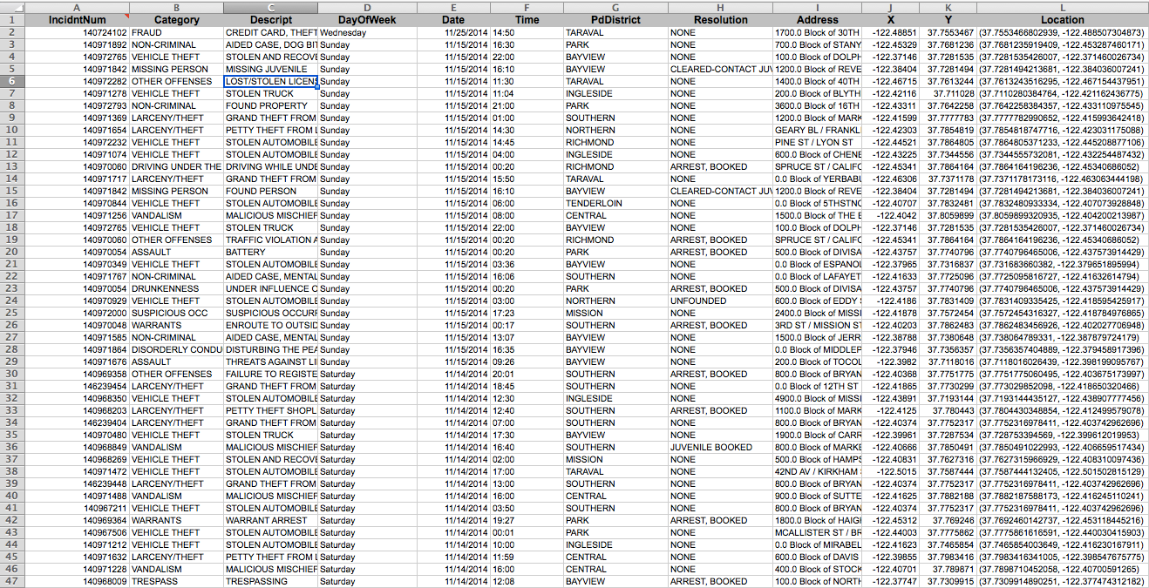
Data Interface

Slide 8
Why do we care?

Slide 9
Examples

Slide 10
Photo by Todd Heisler/The New York Times

Slide 11
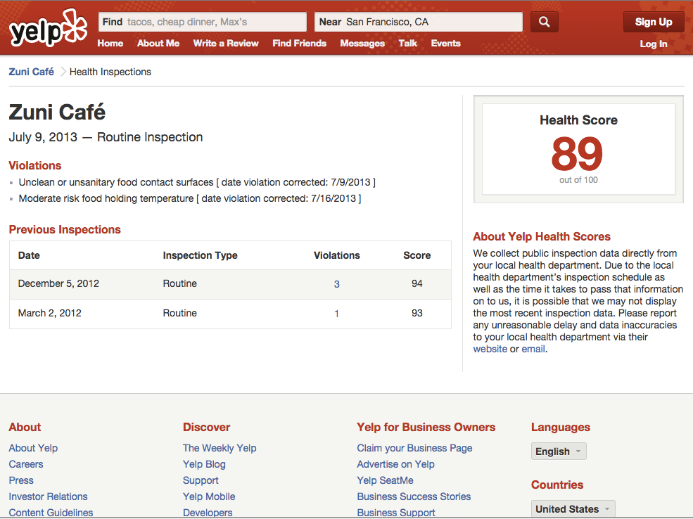

Slide 12
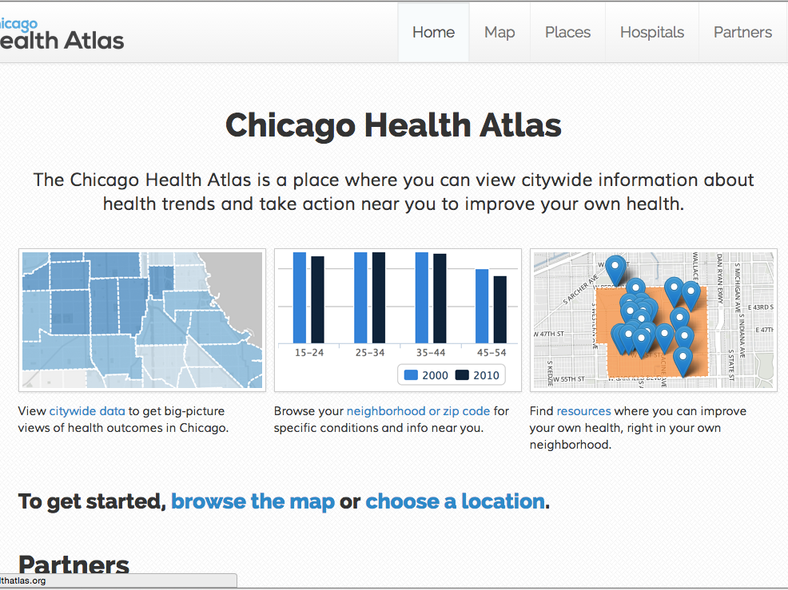

Slide 13
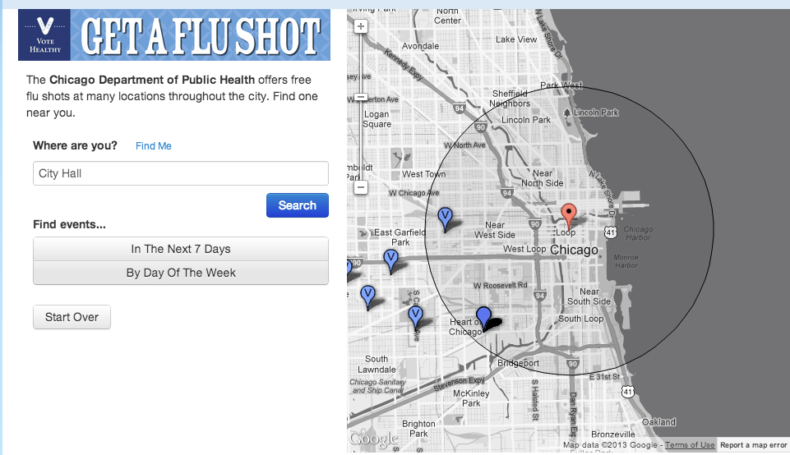

Slide 14
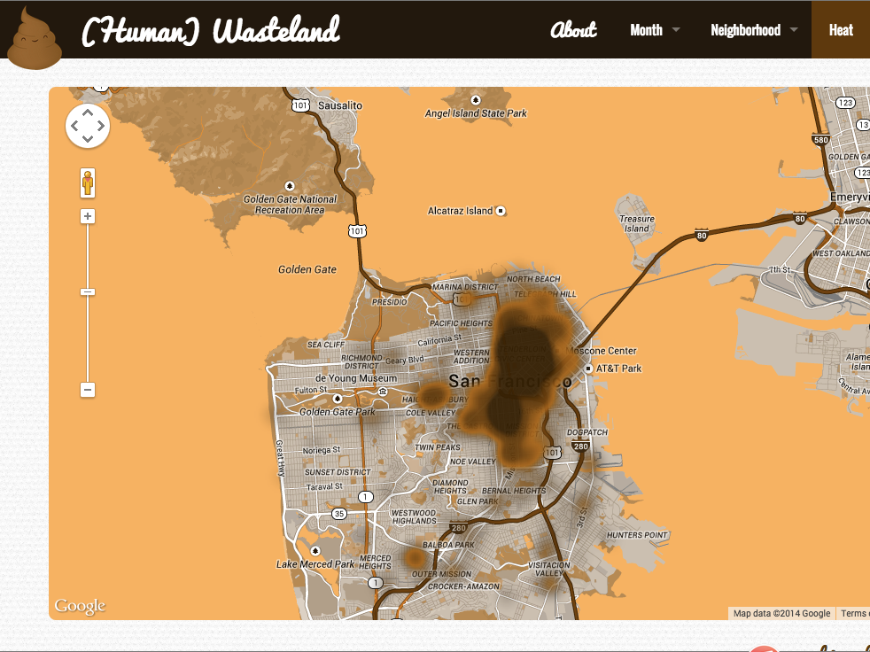

Slide 15
Others?

Slide 16
Data Usability Principles

Slide 17
What challenges have you had?

Slide 18
1. Think of your user

Slide 19
2. Document

Slide 20
3. Build in feedback loops, talk to your users

Slide 21
4. Make systems work for you when you can

Slide 22
Data usability principles
Think of your user
Document
Build in feedback loops
Make systems work for you when you can

Slide 23
Module 1 – Describing Data

Slide 24
Module 2 – Cleaning Data

Slide 25
Coding multi-choice categorical variables
Working with dates
Preparing addresses

Slide 26
Coding multi-choice categorical variables
Objective: to transform records with multi-choice categories into data that is easy to analyze in a pivot table.

Slide 27
Coding multi-choice categorical variables
SEARCH(L1,I2)
Look for text within other text, which returns the character number where that text starts

Slide 28
Coding multi-choice categorical variables
SEARCH(L$1,I2)
Freeze reference to a row (absolute reference)

Slide 29
Coding multi-choice categorical variables
SEARCH(L$1,$I2)
Freeze reference to a column (absolute reference)

Slide 30
Coding multi-choice categorical variables
IF(SEARCH(L$1,$I2)>0,1,0)
Use logical function (if) to return only 1’s (for true) and 0’s (for false)

Slide 31
Coding multi-choice categorical variables
IFERROR(IF(SEARCH(L$1,$I2)>0,1,0),0)
Finally, do a quick check for errors and return 0 if there’s an error

Slide 32
Working with dates
Objective: aggregate dates by calendar and fiscal year

Slide 33
Working with dates
YEAR(B2)+(MONTH(B2)>=7)
Creating fiscal years off of dates in a dataset

Slide 34
Preparing addresses
Objective: combining addresses into a single field

Slide 35
Preparing addresses
C2 & " " & D2 & " " & E2 & " " & F2 & ", " & G2 & " " & H2
Concatenate multiple fields into one
Number & Street & Suffix & City & , & State & Zip

Slide 36
Preparing addresses
IFERROR(LEFT(C2,FIND("-",C2)-1),C2)
Advanced: Cleaning up address ranges

Slide 37
Flexible matching
Objective: to join data from two separate spreadsheets (datasets) while maintaining flexibility

Slide 38
Flexible matching: VLOOKUP
VLOOKUP(lookup_value, table_array, col_index_num, range_lookup)
VLOOKUP finds things in another table or a range by row. The lookup value is often a unique identifier in the lookup table. *Note: VLOOKUP requires the lookup value identifier to be the first column in the lookup table
Learn more

Slide 39
Flexible matching: MATCH
MATCH(lookup_value,lookup_array,match_type)
MATCH returns the index (ordered number) of a matched value from an array (row or column)
Learn more

Slide 40
Flexible matching: Putting VLOOKUP and MATCH together
You can use VLOOKUP and MATCH together to join many columns based on a unique ID. It’s flexible because you can use the header names as variables in your MATCH formula. Just change or add header names and the formula will pull in data from a different column in the lookup table.
Best for: joining data between multiple spreadsheets and multiple columns

Slide 41
Flexible matching: Putting VLOOKUP and MATCH together*
VLOOKUP expects an index number, and that’s what MATCH outputs. When joining two datasets together, you can use the headers as variables in your MATCH formula. To make this flexible matching, note the absolute column and row references. Below is an annotated example:
VLOOKUP(
'Dataset Inventory'!$I2, - the value you want to lookup
'Published Data'!$A:$T, - the range you want to search in
MATCH( - returns the index number of a header value
'Dataset Inventory'!S$1, - the header to lookup
'Published Data'!$A$1:$T$1, - the range to lookup within
0 – return an exact match for MATCH
)
,FALSE – return an exact match for VLOOKUP
)
*Refer to Excercise3_VlookupMatch_Example.xlsx

Slide 42
Flexible matching
INDEX(reference,row,column)
Index returns a value by row and column number

Slide 43
Flexible matching
MATCH(lookup_value,lookup_array,match_type)
Match returns the index (ordered number) of the matched value from array

Slide 44
Flexible matching
INDEX(
'Index-Match'!A:C, - reference
MATCH('Eviction Notice Data 2013'!A2,’Lookup'!A:A,0),
- row number
MATCH('Eviction Notice Data 2013'!J$1,’Lookup'!$1:$1,0) – column number
)

Slide 45
Relevant courses
Intro to Tableau
How to become productive in Excel (intro course)
Publishing data on the open data portal
More at http://datasf.org/academy

Slide 46
Thanks!
Please take the survey
https://www.surveymonkey.com/r/GJWBYFG

