Slide 1
Data Sharing, Storage, & Consent

Slide 2
Today’s Agenda
Time | Topic
8:30 – 8:45 AM | Eat, network, and get settled
8:45 – 9:15 AM | Foundation Updates
9:15 – 9:55 AM | How do we use data? Recommendations for starting or improving data collection techniques.
9:55 – 10:25 AM | Consent for treatment vs. Consent for data
10:25 – 10:30 AM | Wrap Up Evaluation of Training

Slide 3
Questions
How many of you started your career with the plan of helping people?
How many of you planned to collect, organize, house, and interpret data?
How many of you had extensive training before starting your career on organizing, housing, and interpreting data?

Slide 4
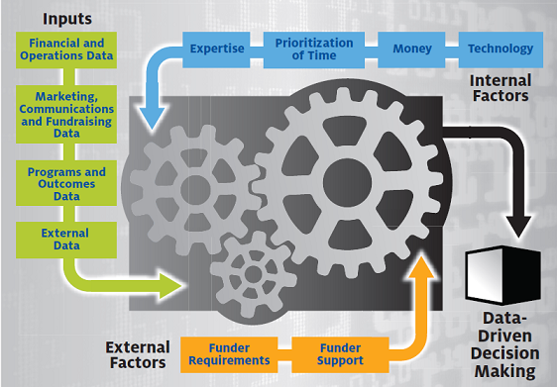
So why do we need data?

Slide 5
Data in and of itself is not useful. Untouched, unmanipulated, unchanged, it’s valueless, but once transformed, it can serve any number of purposes. The nonprofit sector is still trying to figure out how to transform its data into something valuable. Nonprofit leaders need to continue to mature and invest in the resources necessary to help their staff navigate this process.
Collected Voices: Data-Informed Nonprofits, 2014, p. 6

Slide 6
As a group…
How are we doing?
How does this compare to other organizations nationwide?

Slide 13
Why is the collection and use of data so hard?
The “why”
Many NPOs collect data to report back to funders and program evaluation
The “why not”
Top three challenges to data collection are lack of time, lack of money, and lack of training
The “who”
Program staff is generally in charge of all things data

Slide 14
Prioritization and Time
Difficulties in collecting and interpreting data may be related to the ability of staff to prioritize and make time for measurement.
Make the measurement piece part of the program work by aligning data collection to the organization’s process for program delivery
Try to integrate data collection into everyday work duties

Slide 15
Recommendations
Start somewhere
Begin with small measures, acknowledge small successes
Connect your goals to your mission with your metrics
Data is useful when it measures the organizational success
Don’t start with obsessing over outcomes
Learn from others
Change your culture to value data
Share meaningful information to get staff comfortable with the data
Train staff

Slide 16
Shape Data Plans with Strategic Planning
Figuring out what data to track
Collecting and analyzing the data
Presenting the data clearly
Revisit these challenges

Slide 17
Data Protection Laws
US does not have one single data privacy framework or directive (Hasty, Nagel, and Subjally, 2013,p.1)
Made of combination of federal and state laws and regulations (Hasty, Nagel, and Subjally, 2013,p.1)

Slide 18
Federal Laws
Health Insurance Portability and Accountability Act (HIPAA)
“applies to all Covered Entities that collect, maintain, use, or disclose personal health information” (Hasty, Nagel, and Subjally, 2013, p.3).
Family Educational Rights and Privacy Act (FERPA)
“protects the data included in students’ educational records, and applies to all educational agencies and institutions that receive applicable funding from the US Department of Education, including non-profits” (Hasty, Nagel, and Subjally, 2013, p.4).
Gramm-Leach-Bliley Act (GLBA)
“requires that financial institutions ‘respect the privacy of its customers and protect the security and confidentiality of those customers’ non-public personal information” (Hasty, Nagel, and Subjally, 2013, p. 5 - 6)
501(c)(3) are not highlighted here, but those engaging in financial activities regulated by the Federal functional regulators, the state or the FTC are included Hasty, Nagel, and Subjally, 2013, p. 6)

Slide 19
Best Practices
Provide a data privacy policy and data consent forms to customers, clients, and donor and update it at least annually.
Once a data privacy policy is in place, ensure your organization’s staff are properly trained and prepared to follow the policy. Check that employees comply with the policy.
Do not collect or retain personal information on customers or employees unless necessary.
Minimize gathering and using sensitive information from individuals, such as social security numbers or financial accounts information.
Consider appointing data protection officers to keep ahead of changes in the law and ensure your organization remains up to date and compliant
Structure and enforce external agreements to ensure that any data transferred or shared between entities remains protected.
Hasty, Nagel, and Subjally, 2013, p. 18-19.

Slide 20
Protect Individuals’ confidentiality and get informed consent
Anonymous – you do not know who provided responses
Confidential – you know or who can find out, but you keep that information to yourself
https://www.citiprogram.org/
Group 2 Social & Behavioral Investigators and Key Personnel
Social and Behavioral Responsible Conduct of Research

Slide 21
Basic Elements of Informed Consent
Purpose and Description
Risks
Benefits
Alternatives
Confidentiality
Greater Than Minimal Risk
Contact Information
Voluntary Participation
Items in red are the areas where you will specifically talk about the data you’re collecting, who will have access to raw data versus aggregated data, and who to contact with questions.

Slide 22
What are your current practices for data privacy?
Think (3 minutes)
Pair (3 minutes)
Share

Slide 23
References
Hasty, R., Subjally, M., & Nagel, T. (2013). Data Protection Law in the USA. Advocates
for International Development.
Nonprofit Technology Network. (2012). The state of nonprofit data.
Nonprofit Technology Network. (2014). Collected voices, data-informed nonprofits.
Privacy. (2011, September 11). Retrieved from
http://nonprofitanswerguide.org/privacy/

