Slide 1
Data101 with Community Facts

Slide 2
Welcome!
Mingming Zhang
Data and Research Analyst @ The Piton Foundation
You can reach me at mzhang@garycommunity.org

Slide 3
Agenda
Introduction
Data 101 presentation
Data basics with Community Facts
Make a data plan
Break
Group Activity - Make a data plan to solve your
work-related problem
Reflection

Slide 4
Goal
Dive into it!
Get to know the power of
Data Visualization
Get a list of Open Data Sources & Tools
Digest with practice

Slide 5
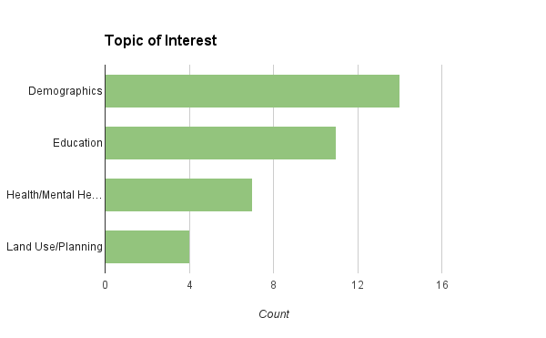
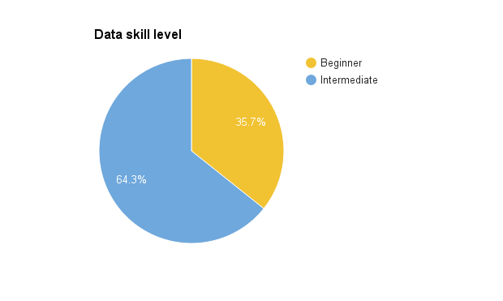
Introduction
How do you use/plan to use data in your work?

Slide 6
Data basics with Community Facts
1
Let’s get started

Slide 7
Welcome to the data world - Community Facts
www.denvermetrodata.org

Slide 8
What is Data?
Data is a collection of different pieces of information or facts obtained from counts, measurements or experiments
to draw conclusions,
to answer a research question,
or just have an idea of what is going on regarding a particular issue

Slide 9
Data Information

Slide 10
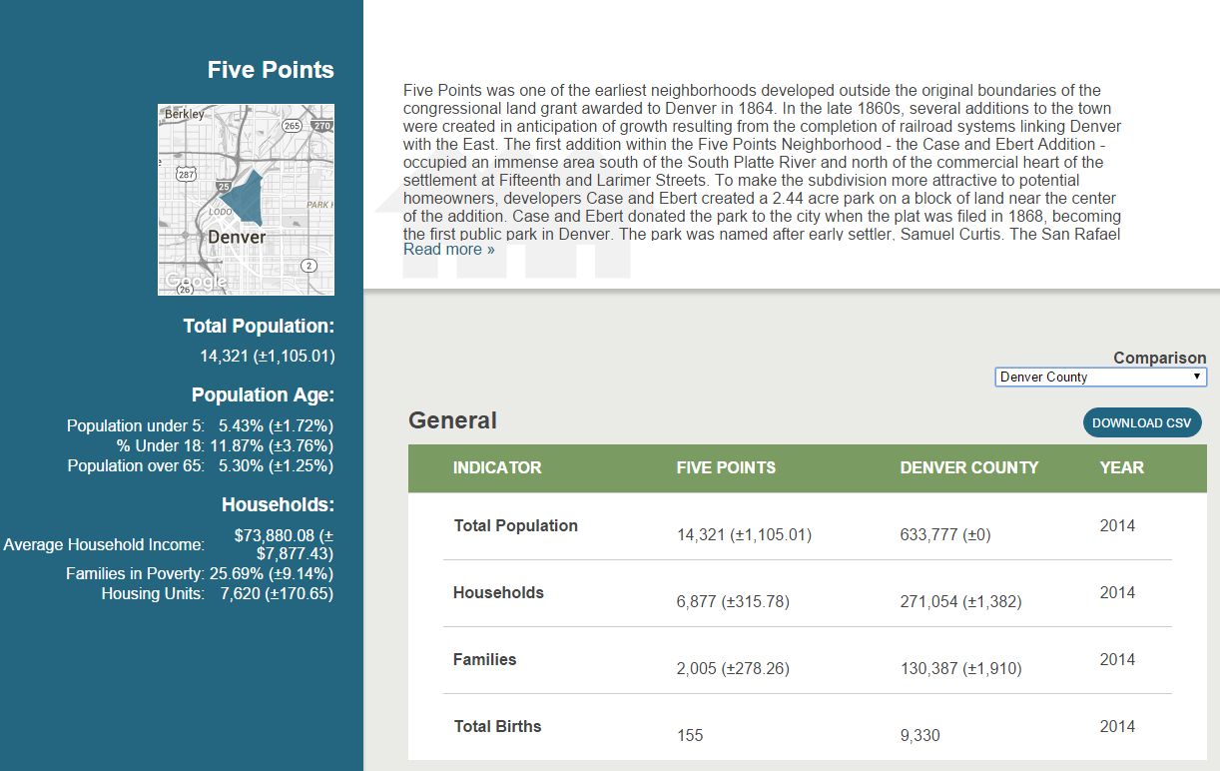
Text
Number
Text
Location
...
Location
Number
http://denvermetrodata.org/neighborhood/five-points?comparison=08031

Slide 11
Context
Time
Indicator
Category
...
Measure
Number
Count
Mean
Percentage
Standard Deviation
…
Dimension

Slide 12
271,054 Households
Data → Measure + Dimension
Measure
In Denver County
Dimension

Slide 13
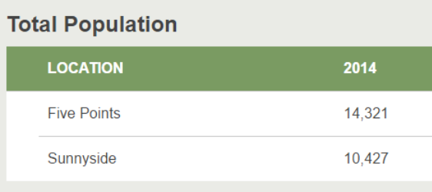
Data have two different components
Dimension
Measure
http://denvermetrodata.org/advanced-search/false/neighborhood/14,128,153/52/26,62/false/false/10/all

Slide 14
Data from workshop registration survey sample result
Attendee | Data Skill | Used CF | First week
A1 | Beginner | Yes | Yes
A2 | Beginner | No | No
A3 | Beginner | Yes | Yes
A4 | Intermediate | Yes | No

Slide 15
If you can measure it,
you can manage it

Slide 16
Data from workshop registration survey sample result
Attendee | Data Skill | Used CF | First week
A1 | Beginner | Yes | Yes
A2 | Beginner | No | No
A3 | Beginner | Yes | Yes
A4 | Intermediate | Yes | No

Slide 17
Data from workshop registration survey
Dimensions | Count
Intermediate(Data Skill) | 1(25%)
Beginner(Data Skill) | 3(75%)
Existing CF user | 3(75%)
Registered in the first week | 2(50%)
Count vs Percentage

Slide 18
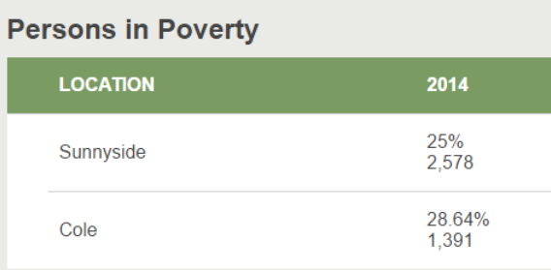
Count vs Percentage
http://denvermetrodata.org/advanced-search/false/neighborhood/226/52/62,18/false/false/9/all
Notes:
For example, let’s pull a table in community facts

Slide 19
2,578(25%) + Sunnyside & 2014 & Persons in Poverty
1,391(28.64%) + Cole & 2014 & Persons in Poverty
Data → Measure + Dimension
LET’S REVIEW
http://denvermetrodata.org/advanced-search/false/neighborhood/226/52/62,18/false/false/9/all

Slide 20
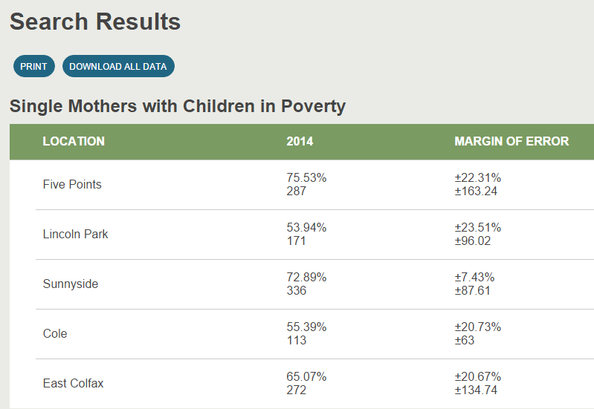
To explore your data...
To explore your data...
http://denvermetrodata.org/advanced-search/false/neighborhood/236/52/26,41,9,62,18/false/false/9/all

Slide 21
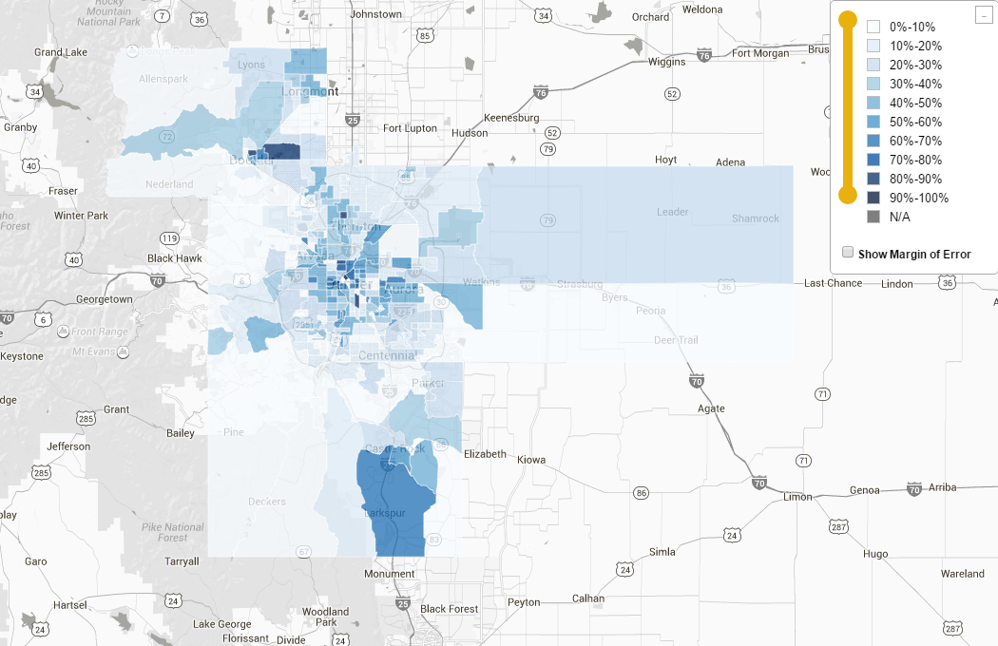
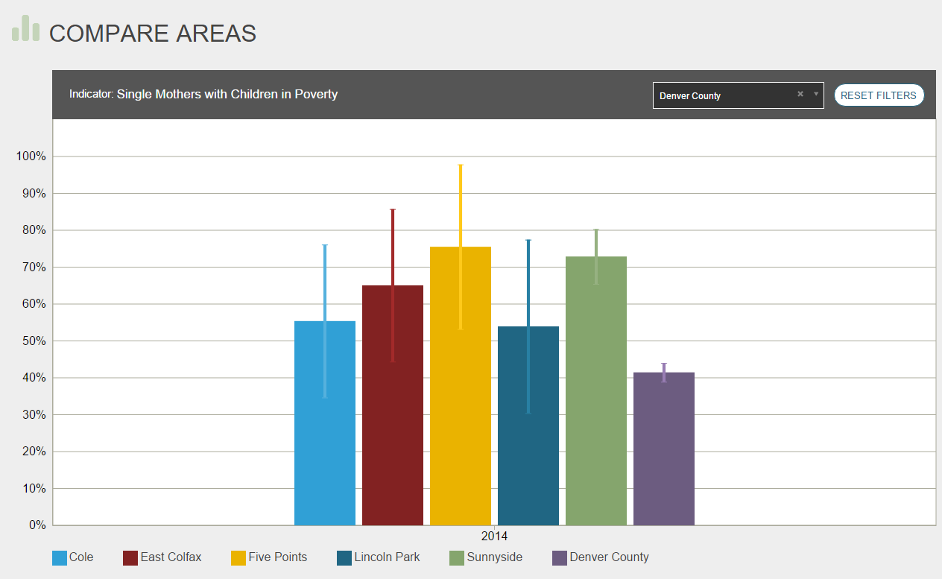
To explore your data...
http://denvermetrodata.org/map/false/neighborhood/236/52/all/false/false/9/false
http://denvermetrodata.org/compare/0/neighborhood/236/52/26,41/false/08031/9/true

Slide 22
To explore your data...
The Power of Data Visualization:
Communication Effort Survey Evaluation

Slide 23
Data is not perfect...
Five Points 53.22% - 97.84%

Slide 24
Average vs Median
Income
2,3,5,12,58K
16K 5k

Slide 25
LET’S REVIEW
Data Visualization helps us understand our data efficiently
Chart
Map
Different types of measure may represent different information
Do not compare different types of measure

Slide 26
Know your data source

Slide 27
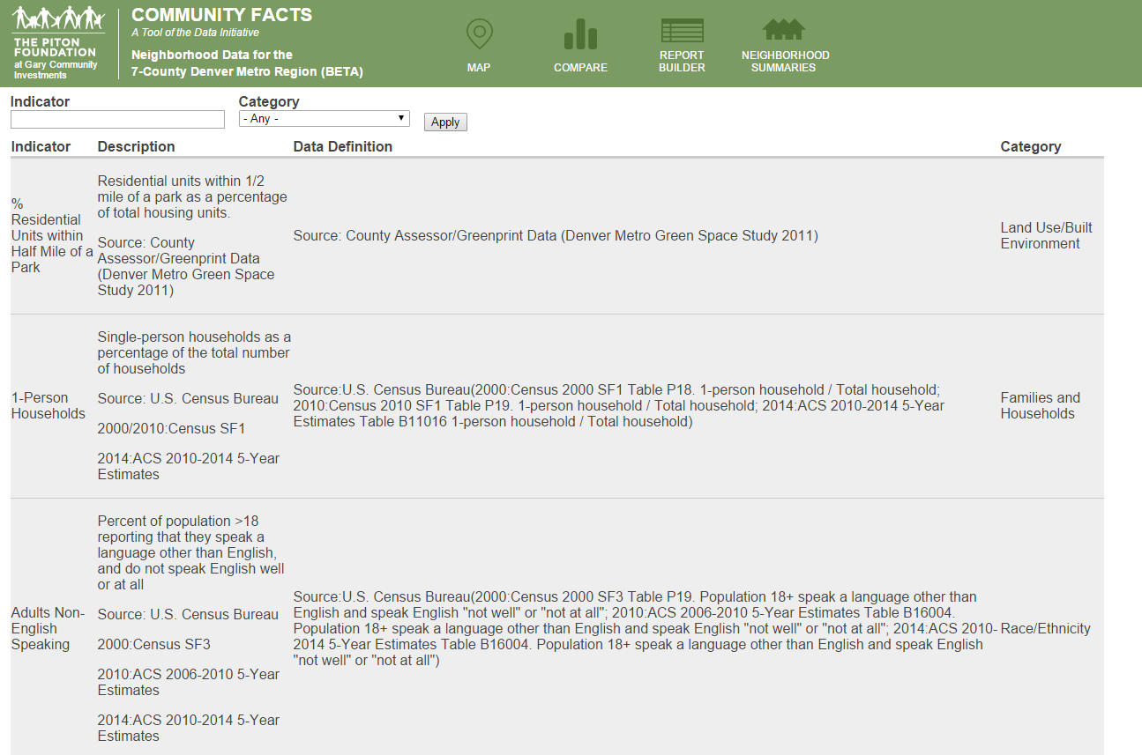
http://denvermetrodata.org/indicators
Neighborhood Summary
Report Builder
https://www.socialexplorer.com/data/ACS2010/metadata/?ds=ACS10&table=B25014

Slide 28
LET’S LIST SOME OPEN DATA SOURCE
General
State agencies
Federal agencies
Census
ESRI
Regional councils(DRCOG)
OpenColorado
Colorado Information Marketplace
The Piton Foundation
Data Engine
Demographic
Census
U.S. Bureau of Labor Statistics
LEHD
Health/Mental Health
CDPHE
Tri-County
Education
Colorado Department of Education
School District(DPS, APS)
Built Environment
County Assessor
Jurisdiction website
CHAFA
The List
Notes:
I'm going through this fast, you can explore this list during the break

Slide 29
LET’S LIST SOME FREE TOOLS without coding
Map
ArcGIS online
- Piton’s page
Google Fusion table + Google Maps
CartoDB
Mapbox
QGIS
...
Chart
Google Sheet
Tableau public
Piktochart
Infogr.am
Chartblocks
Plotly
LibreOffice
...

Slide 30
Q & A

Slide 31
Review - Community Facts examples
Neighborhood Summary
Search information and view in table
Create Chart
Create Map
Find data source

Slide 32
Quiz!

Slide 33
How to transfer your idea to actionable plan
2
Ask the right question(s) before you touch data

Slide 34
Be S.M.A.R.T
Specific
Measurable
Attainable
Relevant
Time-bound
Targeted neighborhood's median income increase by 15% in 5 years
Improve the household income in targeted neighborhoods
ACS(median income, census tract)
Demographic
One year

Slide 35
What’s your problem? What do you want to get from data? | Improve schools’ performance --Get the current status --Which group of students needs help
Dimension | Education Extend: Denver Public School District Year: 2009-2014 Unit: School
Measure
School Performance
Student Demographics
Student Demographics
Test Scores
Student Household Income
….
CO
School Grade
SPF
Race & Ethnicity
3rd Grade Reading
or
C
C
N/P
N/P
N/P

Slide 36
Break
Whoa! You made it, aren’t you proud?

Slide 37
Group Activity -Make a plan to solve the problem
Explore the data source
Propose your data problem
5-10 minutes Refine the problem statement
Develop the rest of the plan
2 minutes each group present the plan
Vote for the problem you want to solve
Top 2
Join one group

Slide 38
What’s your problem? What do you want to get from data? | Improve schools’ performance --Get the current status --Which group of students needs help
Dimension | Education Extend: Denver Public School District Year: 2009-2014 Unit: School …..
Measure
School Performance
Student Demographics
Student Demographics
Test Scores
Student Household Income
….
CO
School Grade
SPF
Race & Ethnicity
3rd Grade Reading
C
C
N/P
N/P
N/P

Slide 39
THANKS!
Any questions?
mzhang@garycommunity.org

Slide 40
CREDITS
Special thanks to all the people who made and released these awesome resources for free:
Presentation template by SlidesCarnival
Photographs by Unsplash

