Slide 1
Data 101:
Finding Stories in Data
Western Pennsylvania Regional Data Center
Carnegie Library of Pittsburgh

Slide 2
Data without (strong) storytelling
Creator | Reader
Data work may feel like “extra work” | Chart/map/visualization may be forgettable or unengaging
Data may feel removed from organizational mission or the “why” of your work | Data may feel impersonal or even offensive

Slide 3
Storytelling essentials
Who (audience)
What/When/Where (the data/thing/place/time you are looking at)
Why (goals)
How (techniques)
Everyone brings personal context (and potentially bias!) to storytelling (and story reading)
Ellie Balk
http://elliebalk.com/#/youarehere/

Slide 4
Dataset first steps (ask some questions!)
Where did this data come from?
What information does it contain? What are the fields?
What sorts of stories can it tell us?
What won’t we be able to learn - what is missing?
What type of data is this? Geographic? Chronological? Categorical?
Does the type of data give clues about what sorts of stories it might contain?

Slide 5
Common types of data stories
Let’s look at some examples!
Factoid Story
Interaction Story
Comparison Story
Change Story
Personal Story
Notes:
Going to give examples of each of these types of stories, with a focus on visualizations built without a computer as a core tool. The point is telling a good story.

Slide 6
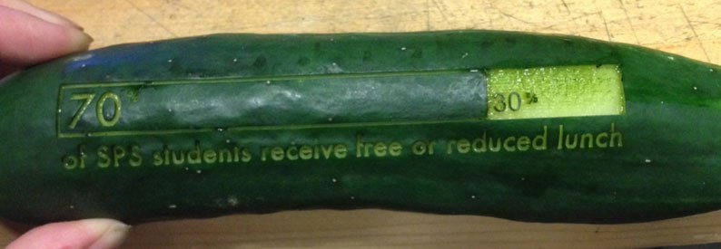
Factoid Story
Rahul Bhargava
https://datatherapy.org/2014/08/11/lasers-food-data-telling-a-story-about-food-security/

Slide 7
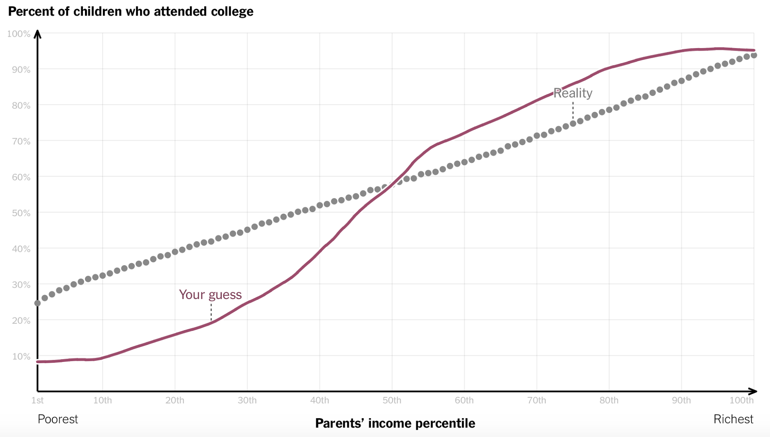
Interaction Story
Gregor Aisch, Amanda Cox, and Kevin Quealy
You Draw It: How Family Income Predicts Children’s College Chances http://www.nytimes.com/interactive/2015/05/28/upshot/you-draw-it-how-family-income-affects-childrens-college-chances.html

Slide 8
Comparison Story
American Kills (Sebastian ErraZuriz)
http://www.meetsebastian.com/sebastian-errazuriz-design-art-american-kills-public-work/

Slide 9
Comparison Story
Center for Urban Pedagogy
http://welcometocup.org/Projects/UrbanInvestigations/IfYouCanMakeItHere

Slide 10
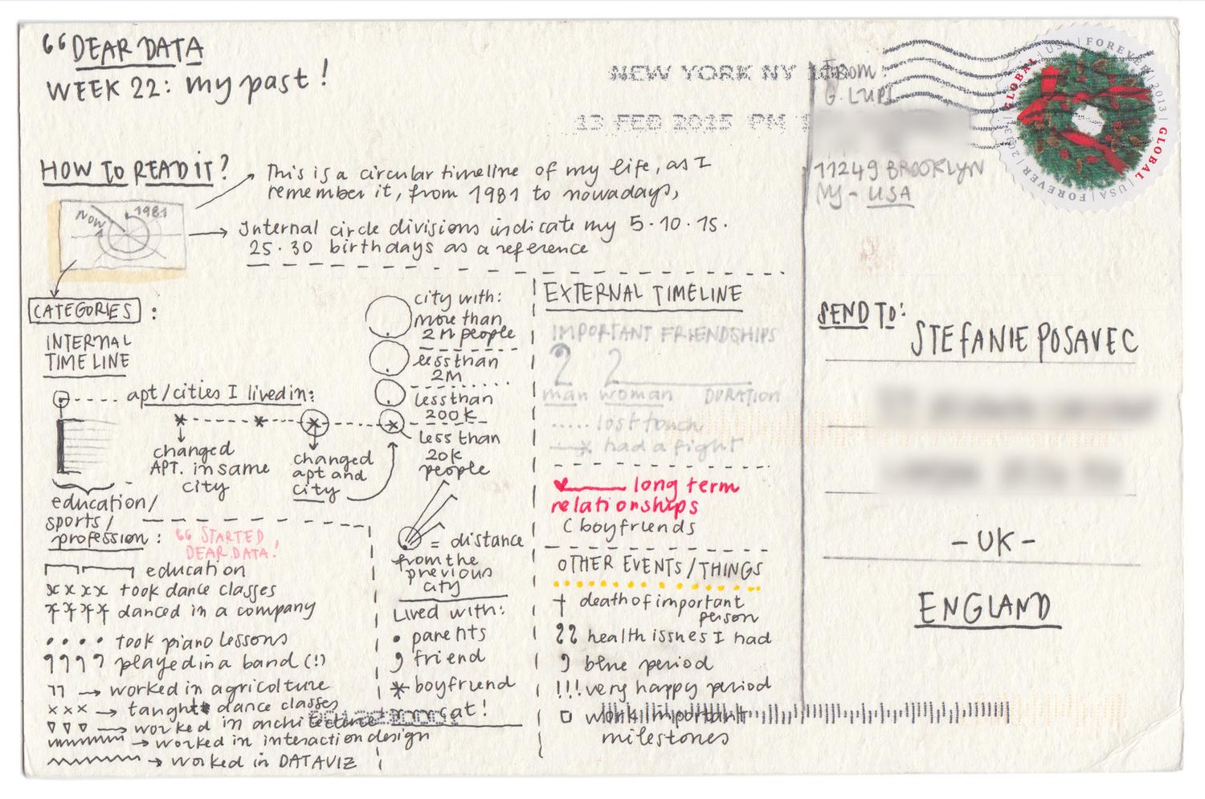
Change Story
Giorgia Lupi
http://www.dear-data.com/by-week/#/week-22-a-week-in-our-past/

Slide 11
Personal Story
Hunger Through My Lens (Belinda)
http://hungerthroughmylens.org

Slide 12
Combining story types: near & far
“Near and Far” - Grover - Sesame Street - Scott Klein via Jacob Harris
https://source.opennews.org/en-US/learning/connecting-dots/
Notes:
Near = specific/personal (your school, your city, a single person)
Far = general (broad meaning and context)
Don’t stress over what type of story something is - the “types” are just guides (and lots of authors define the types differently)

Slide 13
Stories that ask questions
Finding and telling data stories can be iterative
Create stories that lead you to better questions
Why is this happening?
Why is this number so low (or so high)?
Did something change (either in “real life” or in the data methodology)?
Who should I talk to?
Why does this matter? How does this affect people? Policy?

Slide 14
Responsible storytelling
Brilliant Maps @brilliantmaps
Critique via Jacob Harris
https://source.opennews.org/en-US/learning/connecting-dots/
Notes:
The problem is that once you get past the original shock of the image, there is nothing else to learn. Are the clusters random or significant to the underlying geography of Baghdad’s neighborhoods? Did the violence surge and wane or has it maintained a constant level of carnage from one year to the next? Neither of these questions are hard to explore, and the lack of such context means the reader can only gasp in doge-like awe (“Wow! Such dots. Very violence.”) and walk away with the general impression that Baghdad is a horribly dangerous place
There are “close to home” examples, too - maps that might restigmatize communities. Asset-oriented approach is critical.

Slide 15
Reading other people’s stories
What story was the information designer trying to tell?
What data did they use?
What techniques did they use?
Are the data and techniques appropriate for the story?
Is the story trustworthy?

Slide 16
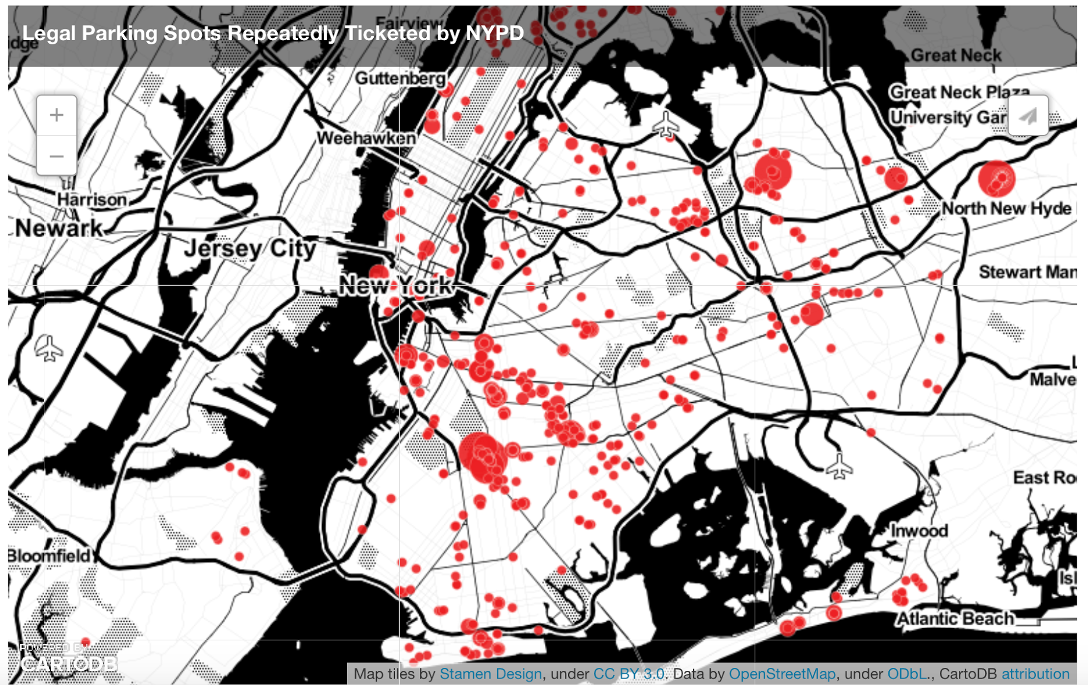
Technology can help uncover stories...
Easily handle larger datasets
Run descriptive statistics
Explore, experiment, & iterate more quickly
Open the door to more reader-directed, interactive stories
Ben Wellington
http://iquantny.tumblr.com/post/144197004989/the-nypd-was-systematically-ticketing-legally

Slide 17
...or contribute to confused & ineffective storytelling
Temptation to stick with software defaults
Flash over substance
Losing sight of the people behind the data points
Sarah Slobin
https://source.opennews.org/en-US/learning/what-if-data-visualization-actually-people/
Notes:
The Trials/Severity Index
Could we get data on each of the children? What if each child had a set of charts that accompanied them when we introduced them?
We need to remember that behind the data are stories and inside those stories are people and those people are connected to the statistics in a way that we never will be, regardless of how badass we are with our tools, how rockstar-smart our code is, or how facile we are in manipulating the information.

Slide 18
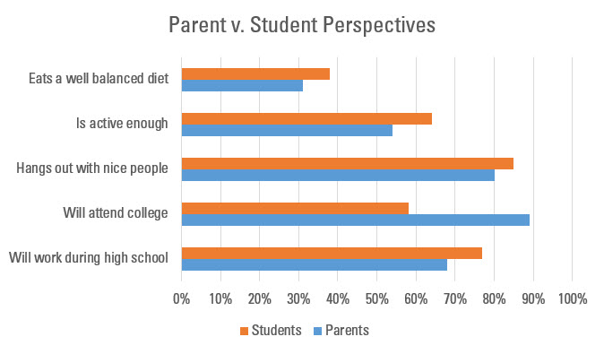
What’s your point?
Stephanie Evergreen
http://stephanieevergreen.com/most-important-question/
Notes:
Example of defaulting to a chart/not thinking about story

Slide 19
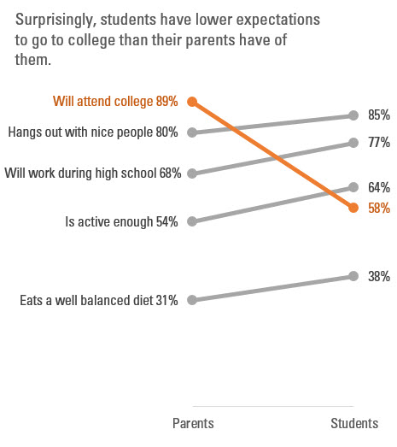
What’s your point?
Stephanie Evergreen
http://stephanieevergreen.com/most-important-question/

Slide 20
Long story short...the fundamentals of storytelling matter with or without technology.
So let’s tell some stories!

