Slide 1
Process Evaluation Basics with Communities Count:
A Communities of Opportunity Workshop
August 12, 2019
Kris Johnson, Kim Tippens & Mariko Toyoji

Slide 2
PURPOSE OF THIS WORKSHOP
Through this workshop we aim to equip attendees with the knowledge and tools to build local evaluation capacity that utilizes a strong equity approach to highlight your organization’s strengths as well as identify opportunities for new or continued program investment and development.
Why process evaluation matters
How process evaluations differ from other evaluations
Data collection: what method when
What is a good survey/focus group question
Data collection planning and follow-up
Analyzing and interpreting findings
Notes:
Start with introductions. Name, org, and if you would like please share something you and your org are doing that should be celebrated, that you want to share more visibly.
So we planned to cover…. And we can alter this plan – if you all prefer to talk over performance measures or other things quickly, let us do that.

Slide 3
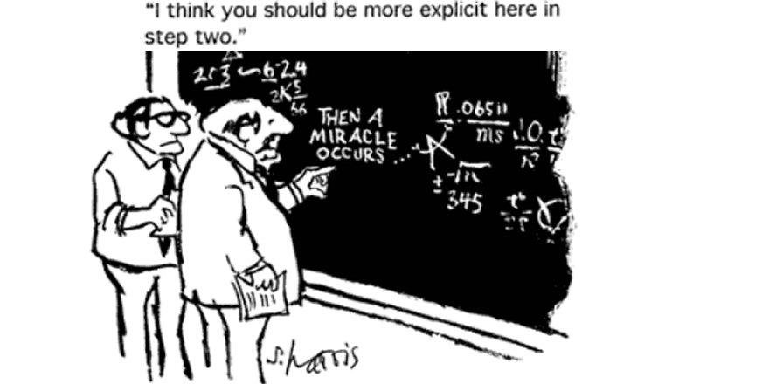
Why a process evaluation?
Notes:
Process and implementation studies help identify how things are working, what are barriers and successes, what needs improvement – are things happen as they should, are organizational supports in place to support the work.

Slide 4
How do process evaluations differ from other evaluations?
Process
Study how things happened, in what context, answers specific questions
Systematic data collection & analyses
Outcome Impact
Follow sample over time to observe outcomes/strategy or program impact
Often uses comparison or control group
Continuous Quality
Defined/fixed set of values/objectives
Iterative (e.g. plan, do, study, act)
Notes:
Quantitative
Qualitative

Slide 5
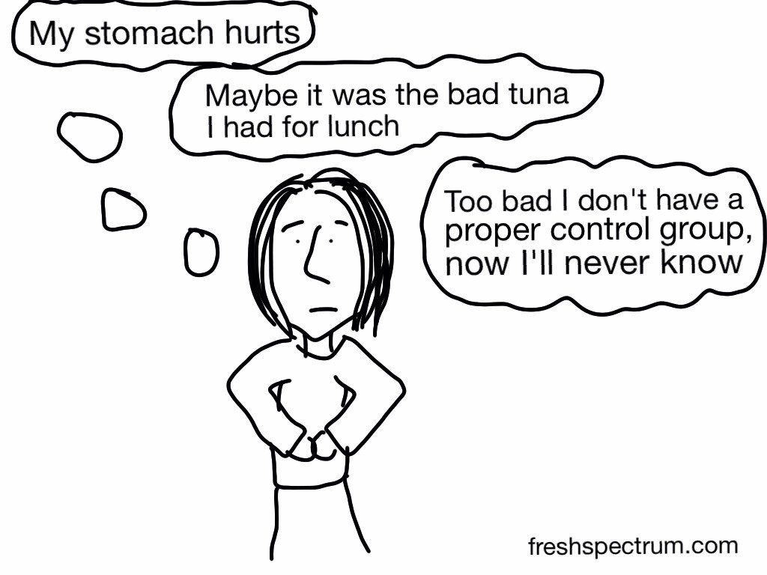
Are comparison & control groups necessary to measure outcomes?
Notes:
Comparison and control groups are not always necessary, and not always possible. They are most beneficial for outcome/impact evaluations. Even then, however, one can conduct an impact study using matched cases (one to one), or using statistics and modeling to examine change over time.

Slide 6
Community- based participation approach leads to more accurate data
Focuses on participatory co-learning
Involves system development and local community capacity building
Empowers and assists participants increase control
Balances study and action
Community members and evaluators contribute equally in joint, cooperative process.
Notes:
Before we dive into a discussion about surveys versus focus groups and what data collection to use, let’s talk briefly about two frameworks useful to process evaluation. Community based participation (CBPR) and implementation science – both can help inform your process evaluation.
Note: Objectives of a CBPR
What does this look like? In its most participatory form, community representation, voice and decision making in each step of process – design, data collection, analysis, interpretation.
Wallerstein, Duran et al. 2018

Slide 7
Community-led evaluation: community defines issue & questions, creates data collection tools, recruits participants & collects data, analyzes data, disseminates findings, generates & implements action plans
Community helps identify questions, provides responses, generate solutions based on findings
Community helps identify issues and questions, provides some responses
Community answers questions
Community
Participation
Continuum
Evaluators fully collaborate with community at every stage
Evaluators conduct research, analysis, dissemination, design intervention
Evaluators conduct research, analysis, dissemination, design intervention
Evaluators design study & ask questions
Notes:
Community participation is on a continuum, and where a specific project falls can be related to deadlines/schedule, funder, and capacities.

Slide 8
Implementation Science Resources
Effective Strategy
Supportive
Context
Positive Impact
Strong Implementation
Notes:
Implementation science focuses on what we need in order to have practice changes picked up and fully implemented by practioners.
Formal definition: the study of methods and strategies to promote the uptake of interventions that have proven effective into routine practice, with the aim of improving population health.
Based on observation that we can identify what works, and when we implement more widely (scale up), we are getting low returns – 5-15% implementing well.
Resources: Alison Mertz and others at UNC- Chapel Hill have supported implementation learning in public health, education, early learning and child welfare
https://nirn.fpg.unc.edu/ai-hub
https://nirn.fpg.unc.edu/publications-resources

Slide 9
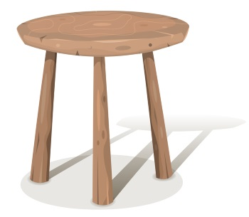
Best Practice Drivers
Effective Implementation &
Positive Change
Staff
Competencies
Organizational
Capacity
Leadership
Characteristics
Notes:
Drivers are key components of capacity and infrastructure that influence a program’s success. Core pieces needed to sustain programs and strategies.
Staff competencies: coaching, training, selection
Leadership: adaptive decision making, supportive (aware)
Org capacities: decision support data system, facilitating administration (policies, procedures, structures), and systems Intervention Driver (the external variables, policies, environments, systems or structures that influence or have impact on an implementing organization)
Having these supportive pieces in places increases that the likelihood that a strategy or program will be well-implemented – have a positive impact.
We want you to be aware of this resource/content in case it helps inform your future evaluation and data collection efforts
https://nirn.fpg.unc.edu/module-2/implementation-drivers

Slide 10
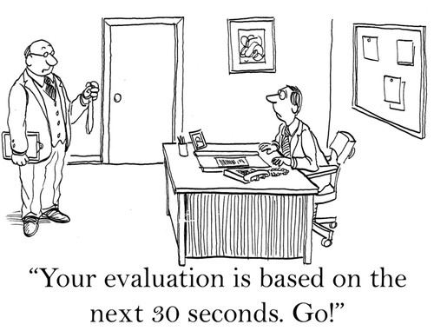
Collecting the information - When to use what data collection method
Surveys
Checklists
Interviews
Focus groups
Observation
Documentation
Performance measures
Pre-existing data resources
Notes:
So you have a framework, an evaluation question stemming from theory of change or logic model (what you want to know). Now what data to collect and how?
Quantitative data are counts, answer questions like how many.
Qualitative data are narrative often, answer questions like what, why, how did it work.
(note: This slide is really just to note topic shift, roughly 3-45 seconds here and most of time spent next slide. )

Slide 11
Technique | Ideal Use | Limitations
Survey, questionnaire, checklist | Quickly and/or easily get lots of information from people in a non- threatening way | might not get careful feedback wording can bias client's responses are impersonal For surveys, may need sampling expert may not get full story
Interview | Fully understand someone’s thoughts, or learn more about survey answers | can take a lot of time can be hard to analyze and compare can be costly interviewer can bias client's responses
Focus group | Explore a topic in depth through group discussion | can be hard to analyze responses need good facilitator for safety and closure can be difficult to schedule 6-8 people together
Observation | Collect data based on actual processes & practice | can be difficult to interpret seen behaviors can be complex to categorize observations can influence behaviors of people being observed can be expensive
File/doc review, existing data | Get data without interrupting people, sufficient data exist to answer question | often takes much time info may be incomplete need to be quite clear about what looking for data restricted to what already exists

Slide 12
Writing a good survey question
Keep it simple: one individual question at a time
Make question clear, specific and direct
Use familiar, understandable language & vocabulary
Avoid biased or loaded words/terms
Answers should be mutually exclusive (not overlap)
Answers are complete/exhaustive (all possibilities present)
List most important questions first
Do not force responses
Keep survey short and relevant
Introduce purpose and note who to contact with questions
Test the survey beforehand whenever possible
Notes:
A well-worded question will mean the same thing to everyone
Answers are complete/exhaustive (all possibilities present) - For example, if the respondent may not know the answer to your question, include a "don't know" response.
A good reference: https://www.uxbooth.com/articles/the-essential-guide-to-writing-effective-survey-questions/
Audio and text: https://www.quickanddirtytips.com/education/grammar/how-to-write-good-survey-questions

Slide 13
How can these questions be improved?
Which of the following do you drive?
Car
Truck
SUV
Do you like the revised website with more, easier-to-find resources more than the prior one?
Yes
No
How satisfied are you with the amount and type of data support you receive?
Satisfied
Neither satisfied nor dissatisfied
Dissatisfied
Should concerned parents use infant car seats?
Yes
No
I don’t know

Slide 14
Before data collection: Why develop procedures?
Write down data collection procedures – being specific and precise helps counter biases
When possible, pretest or pilot your survey or focus group questions (e.g. interview a potential participant using questions, ask whether questions clear)
Create a one-page information sheet about the purpose of data collection and how confidentiality will be protected
Inform or request consent for participation, include
Purpose of effort/data collection
Contact person and details for any questions
Potential risk to participants
How confidentiality is kept secure
Identify how data will be received, stored, saved and analyzed (plan for it a bit)
Notes:
Note on consent – participants should understand what you're doing in the evaluation and how any information associated with them will be reported. You should clearly state terms of confidentiality regarding access to evaluation results. They should have the right to participate or not. Either have them read and sign consent form, or have information sheet which indicates that remaining to participate (or continuing with survey) indicates consent

Slide 15
Analyzing & coding qualitative results
Framework is evaluation question
Goal is to capture concepts and ideas raised
In some instances, like interviews, one can count respondents in a category. Note limitations of this –do the numbers have meaning?
Participant responses are examined for content and themes
These can be coded and categorized
Notes:
Refer to next training for qual methods

Slide 16
After data collection: Analyzing & understanding results
Work from evaluation question
Not all data involve statistics
When used, statistics should be understandable to audience
All findings should be scrubbed to protect individual identity
Qualitative data usually coded to identify themes
Share findings with others to check interpretation
Be transparent about limitations
Notes:
Refer to next training for qual methods

Slide 17
How do we request assistance, or ask questions about assistance?
email CommunitiesCount@kingcounty.gov
Or Contact Kris Johnson
krijohnson@kingcounty.gov, (206) 263-0245
Communities Count, Public Health Seattle & King County

