Slide 1
DATA 101
strangers & stickers & string &
DATA LITERACY FOR ALL!
paper & pens &
felt & friends &
Notes:
15 slides x 20 seconds each
Data 101: Paper & pens & felt & friends & strangers & stickers & string & data literacy for all!.

Slide 2
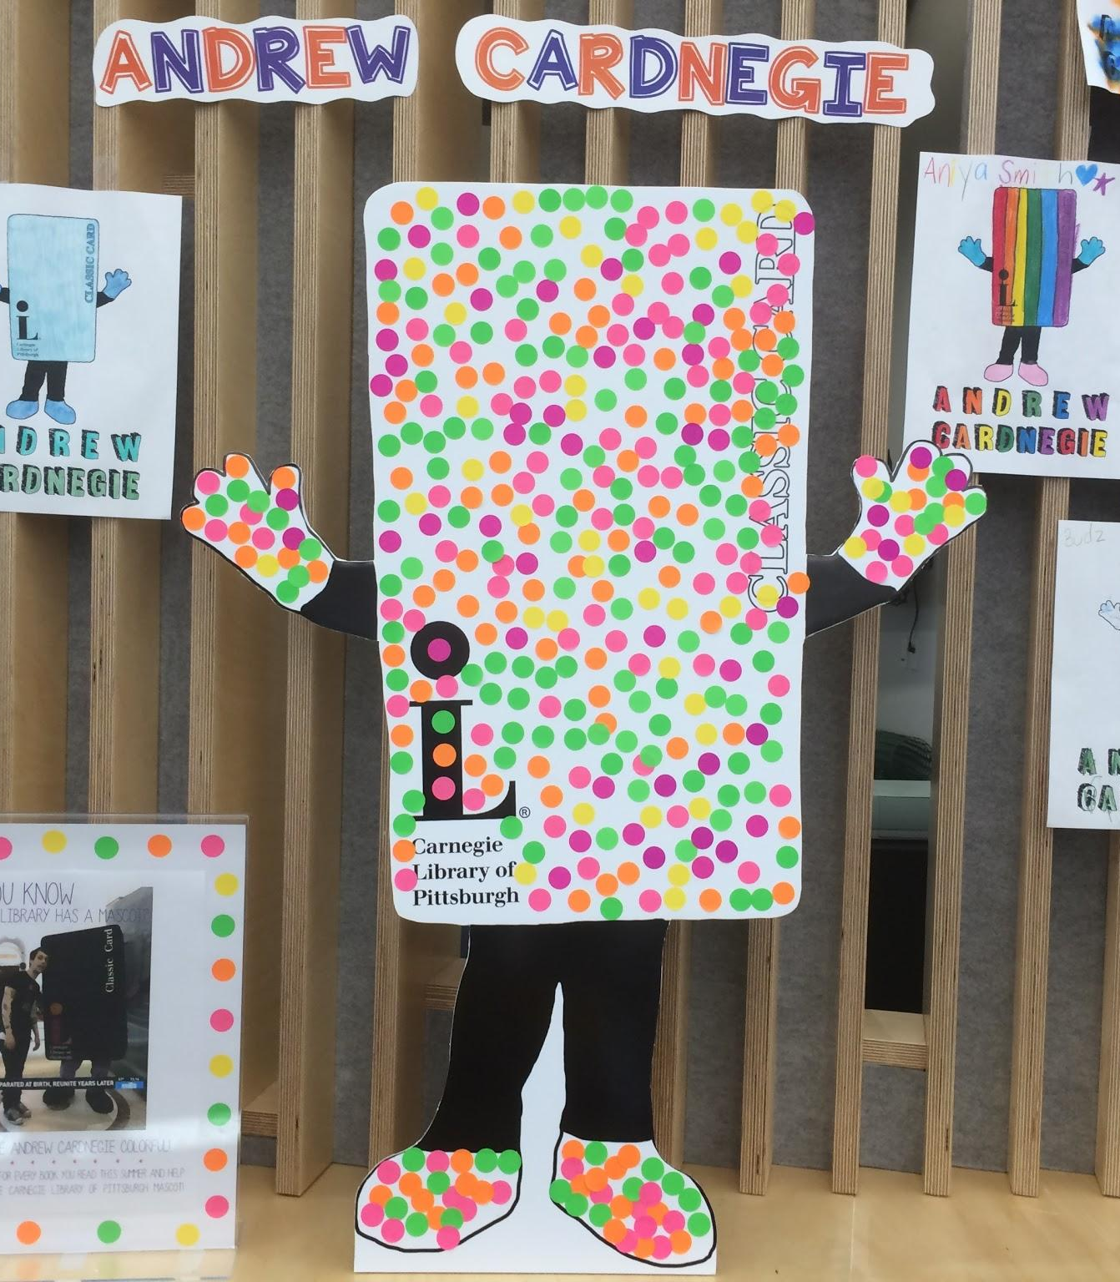
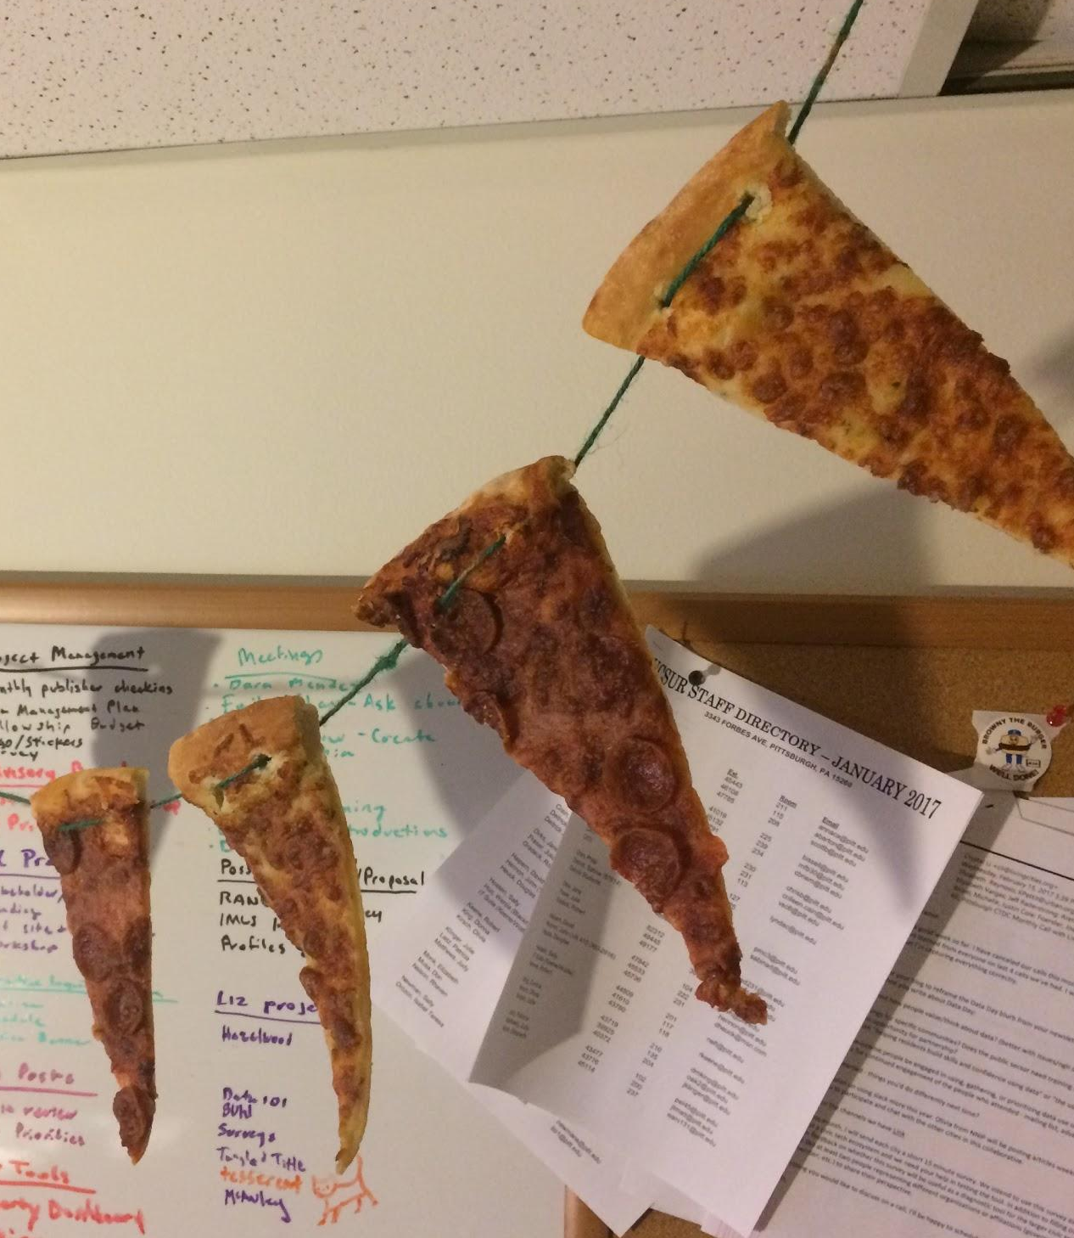
Notes:
Our partnership - CLP & WPRDC/UCSUR (let me know if you want something here that isn’t hanging pizza slices!)

Slide 3
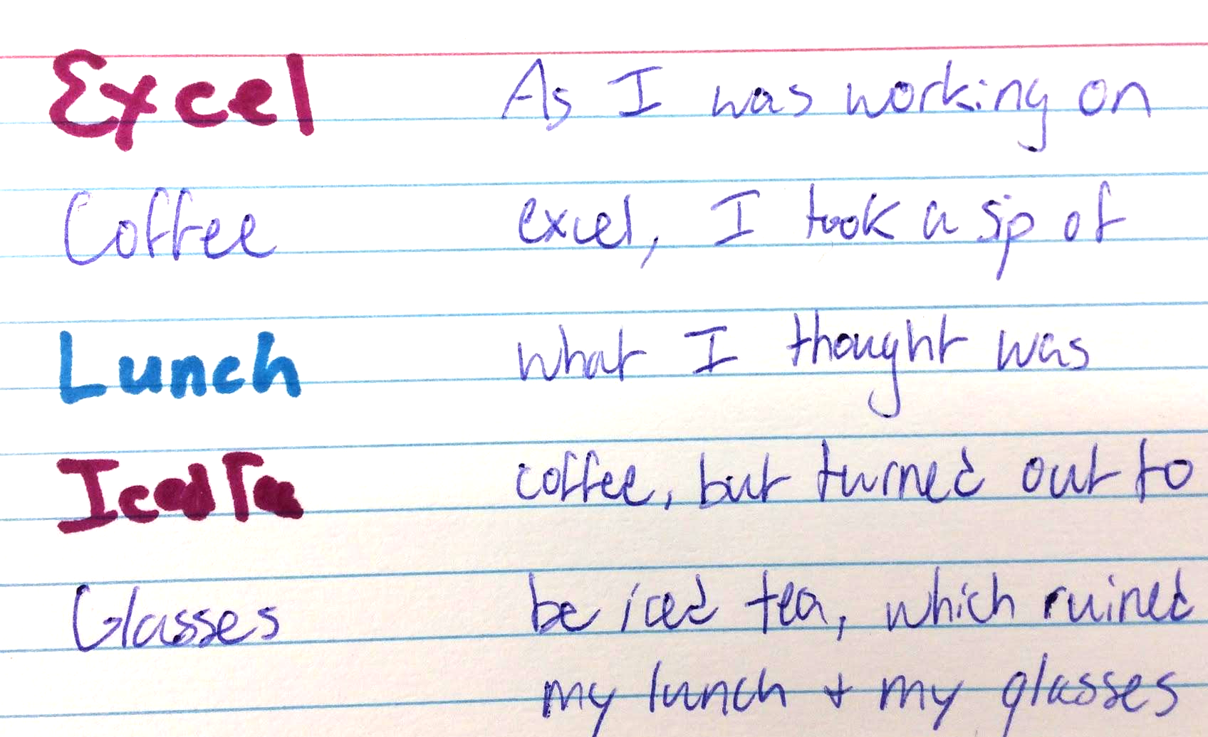
Notes:
What is data (we don’t have great pics from What is Data - it is fine, I can cover it in one slide and then transition!)

Slide 4
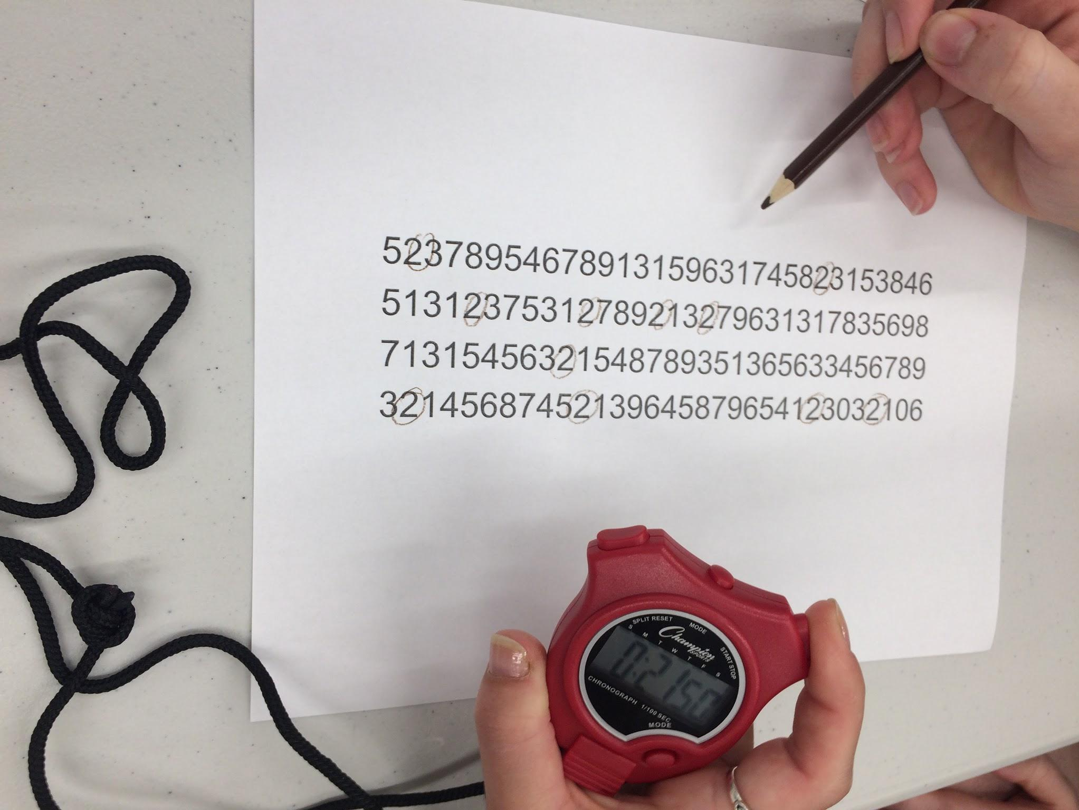
Notes:
Charts

Slide 5
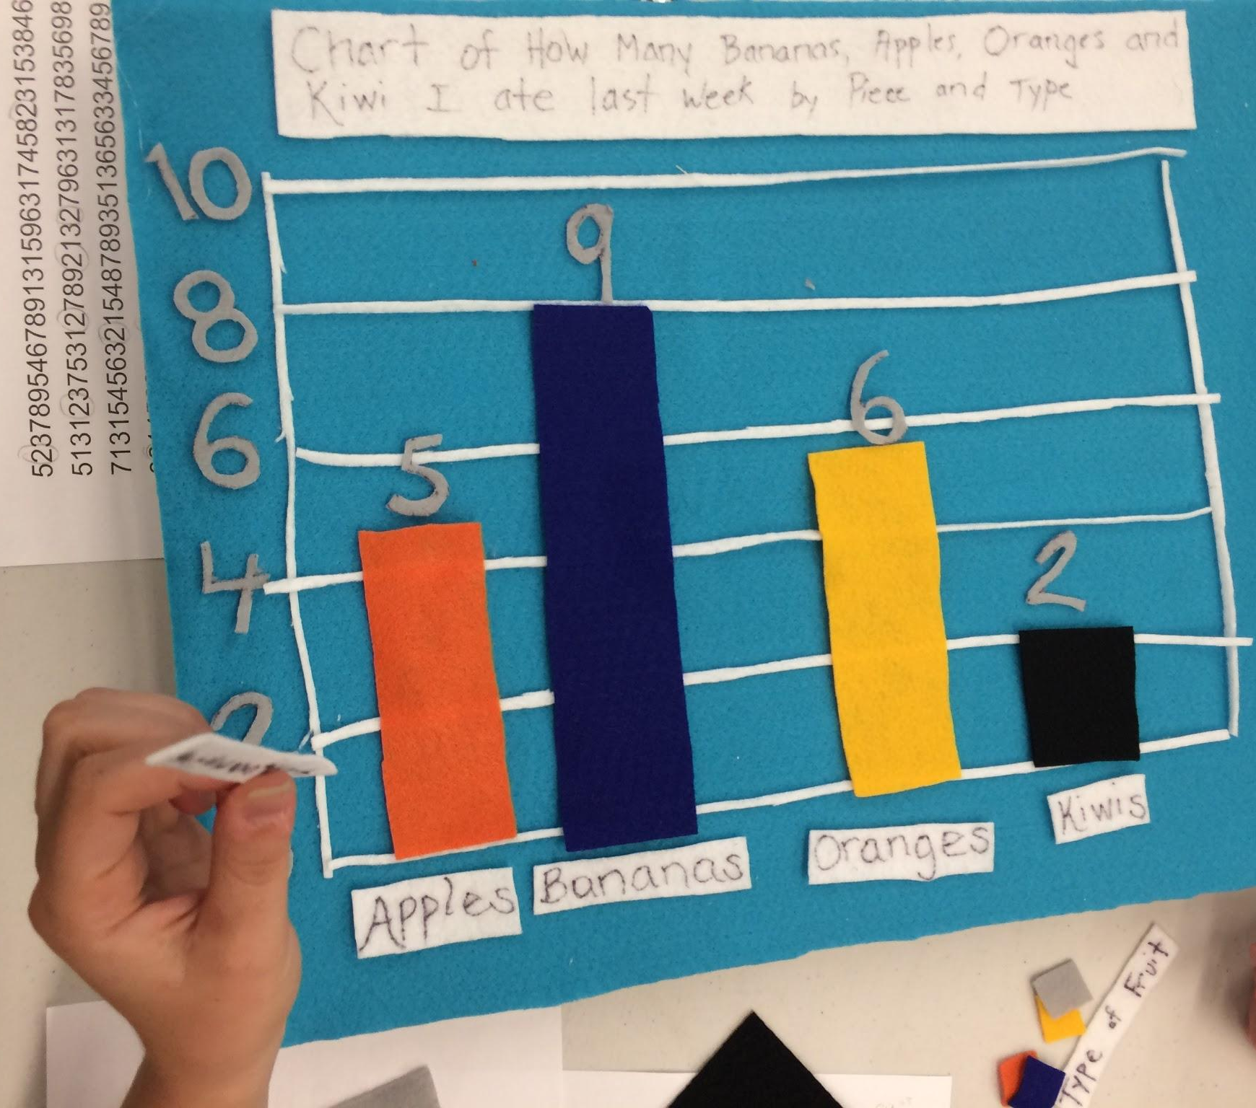
Notes:
Charts

Slide 6
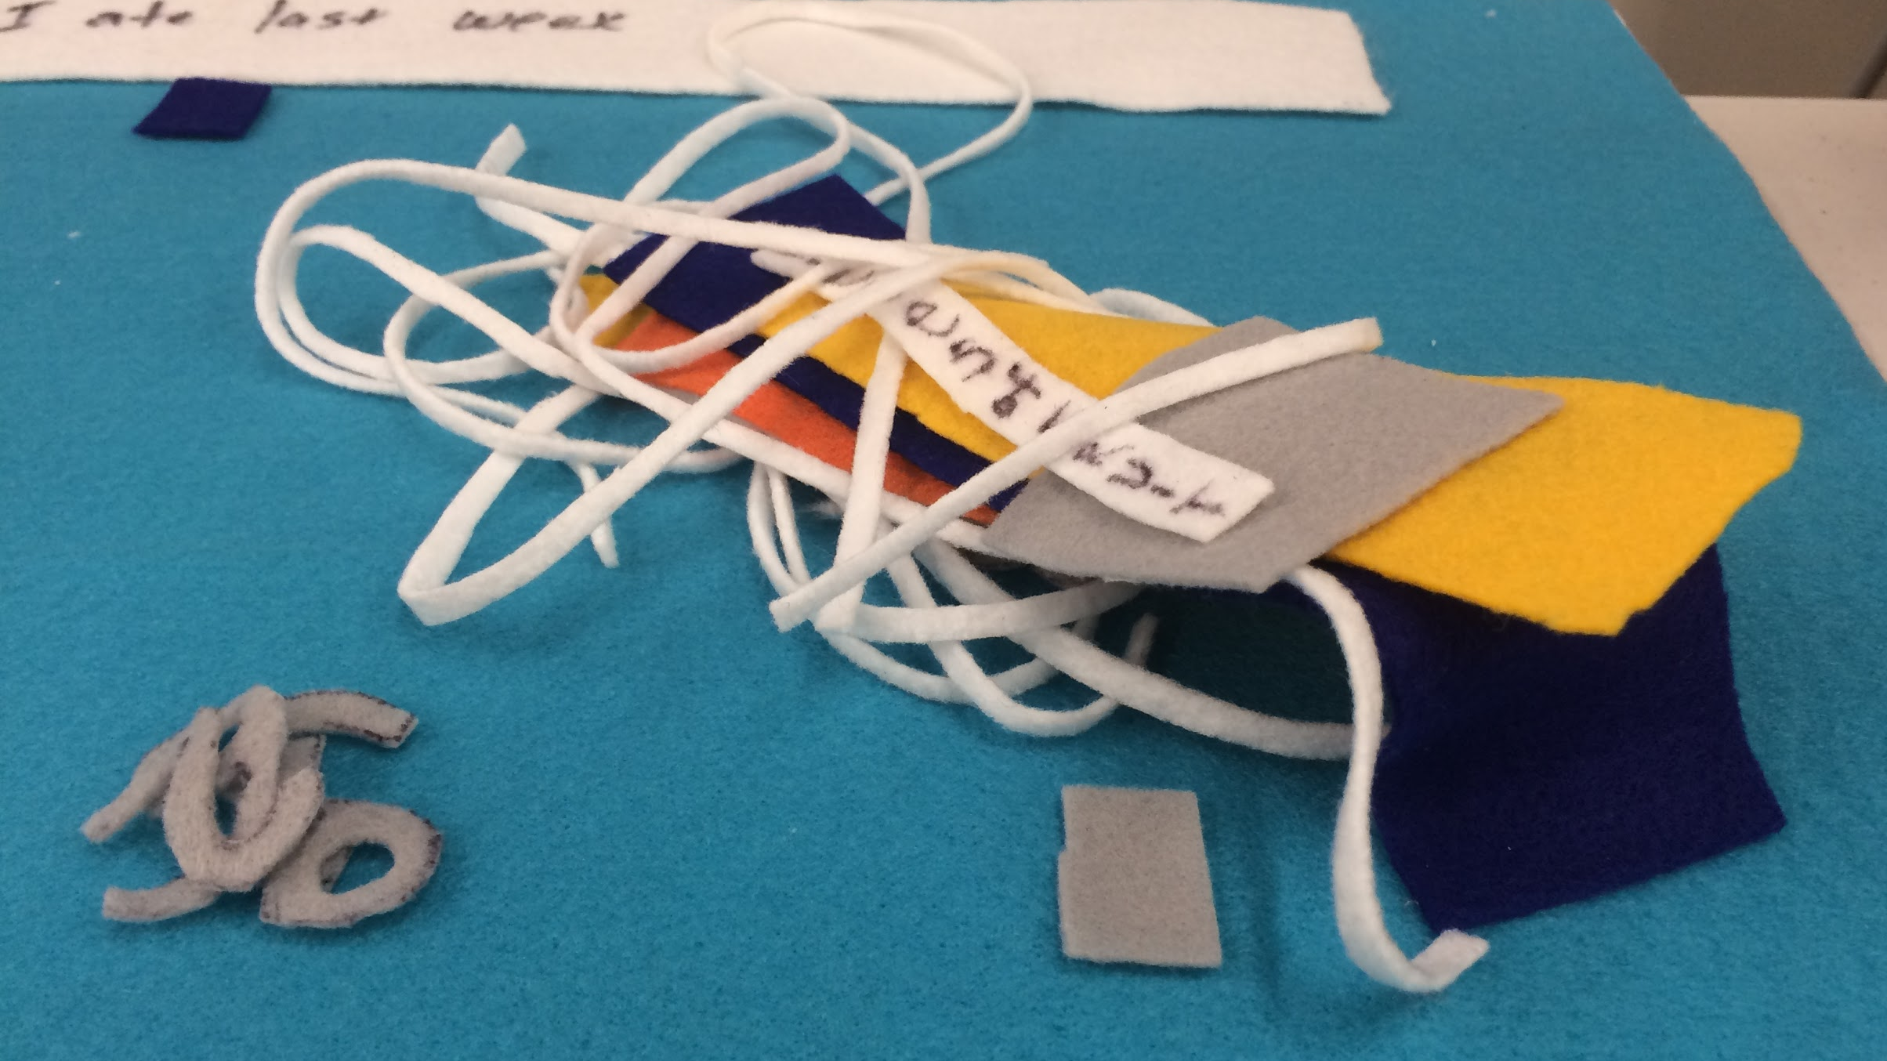
Notes:
Charts

Slide 7
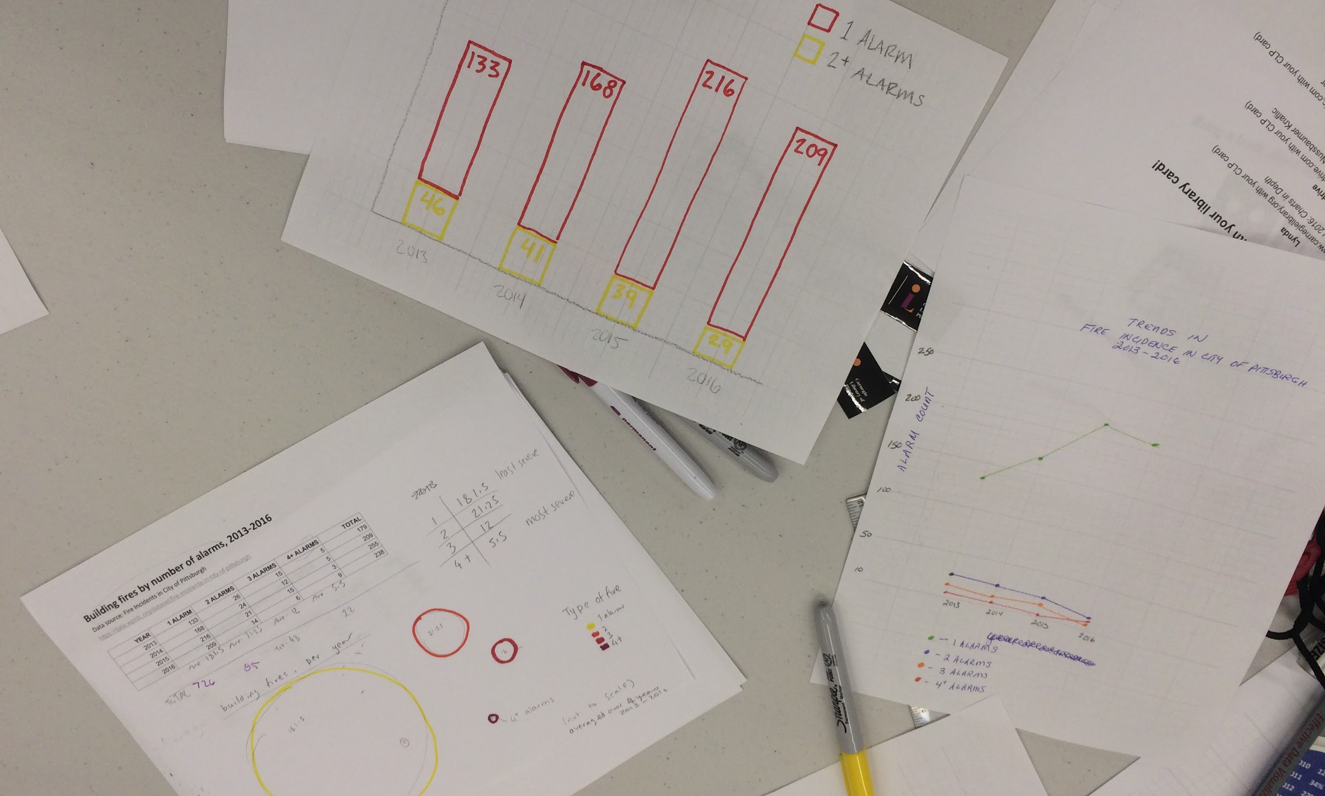
Notes:
Charts

Slide 8
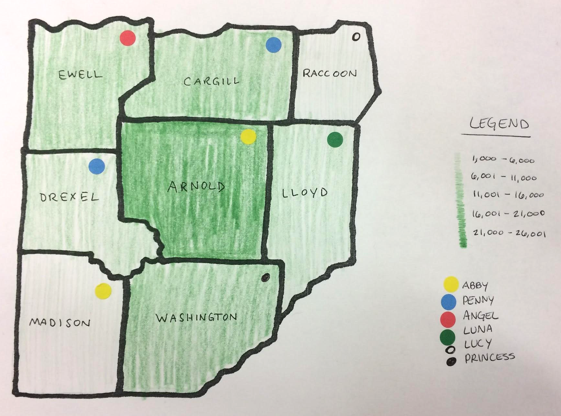
Notes:
Mapping

Slide 9
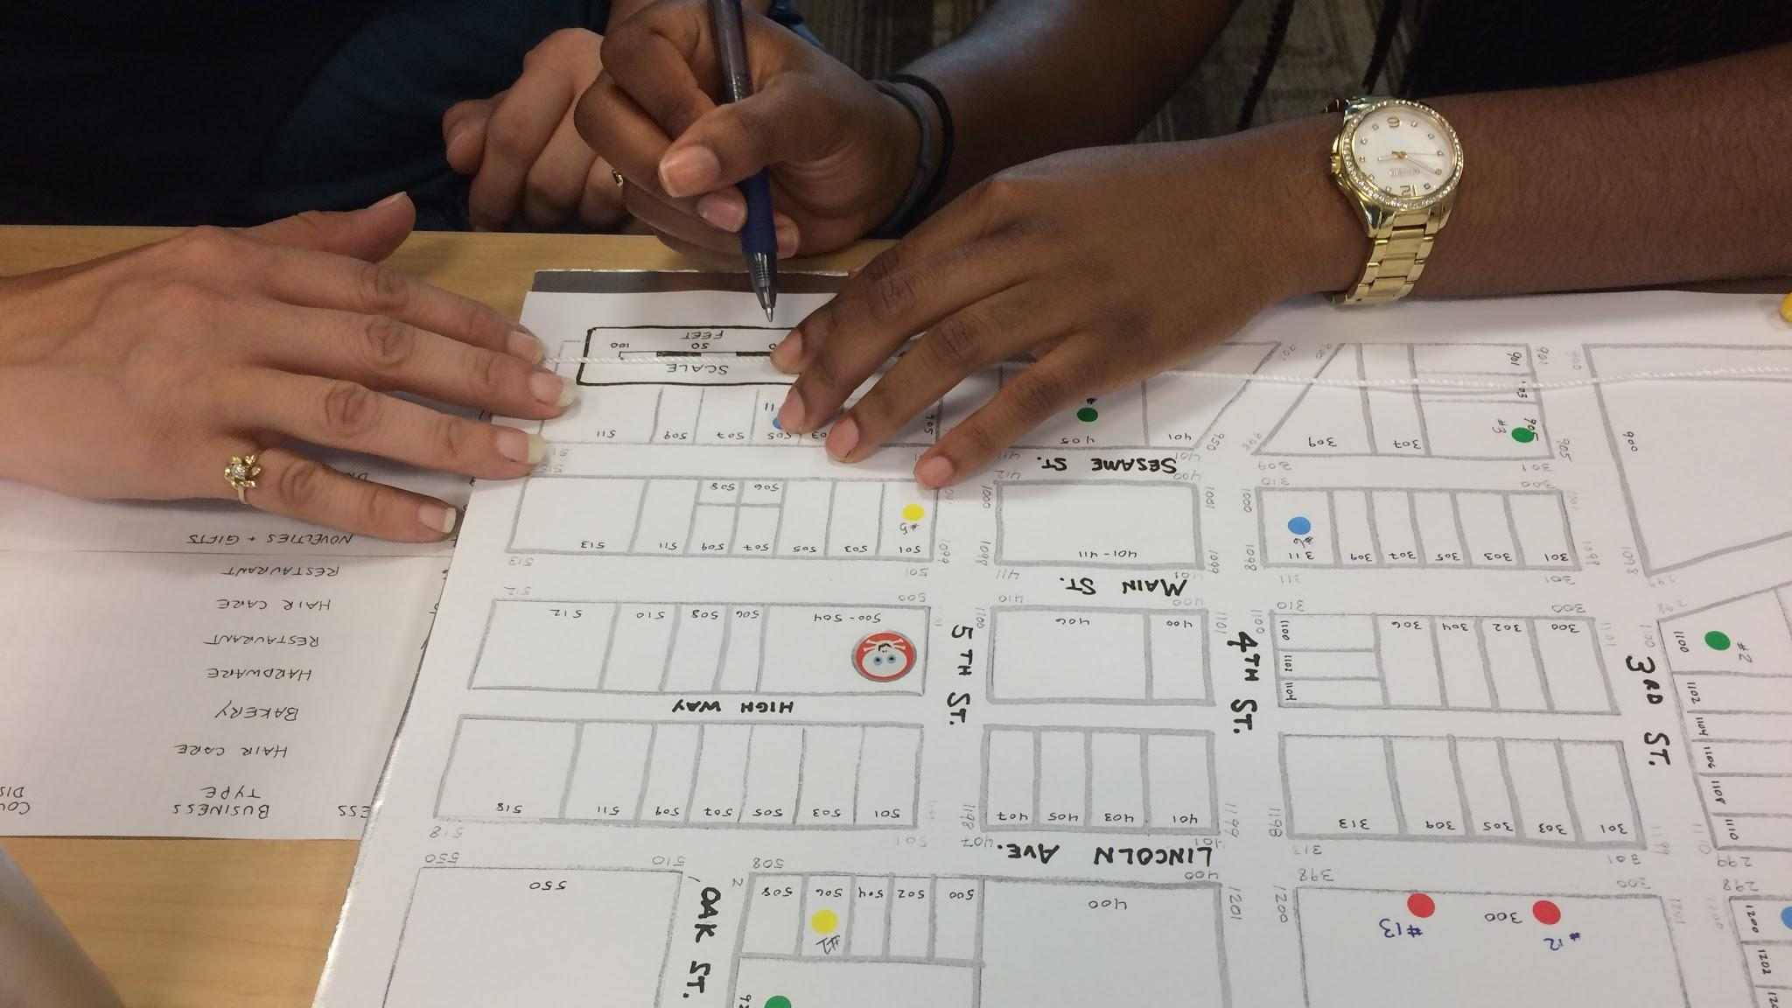
Notes:
Mapping

Slide 10
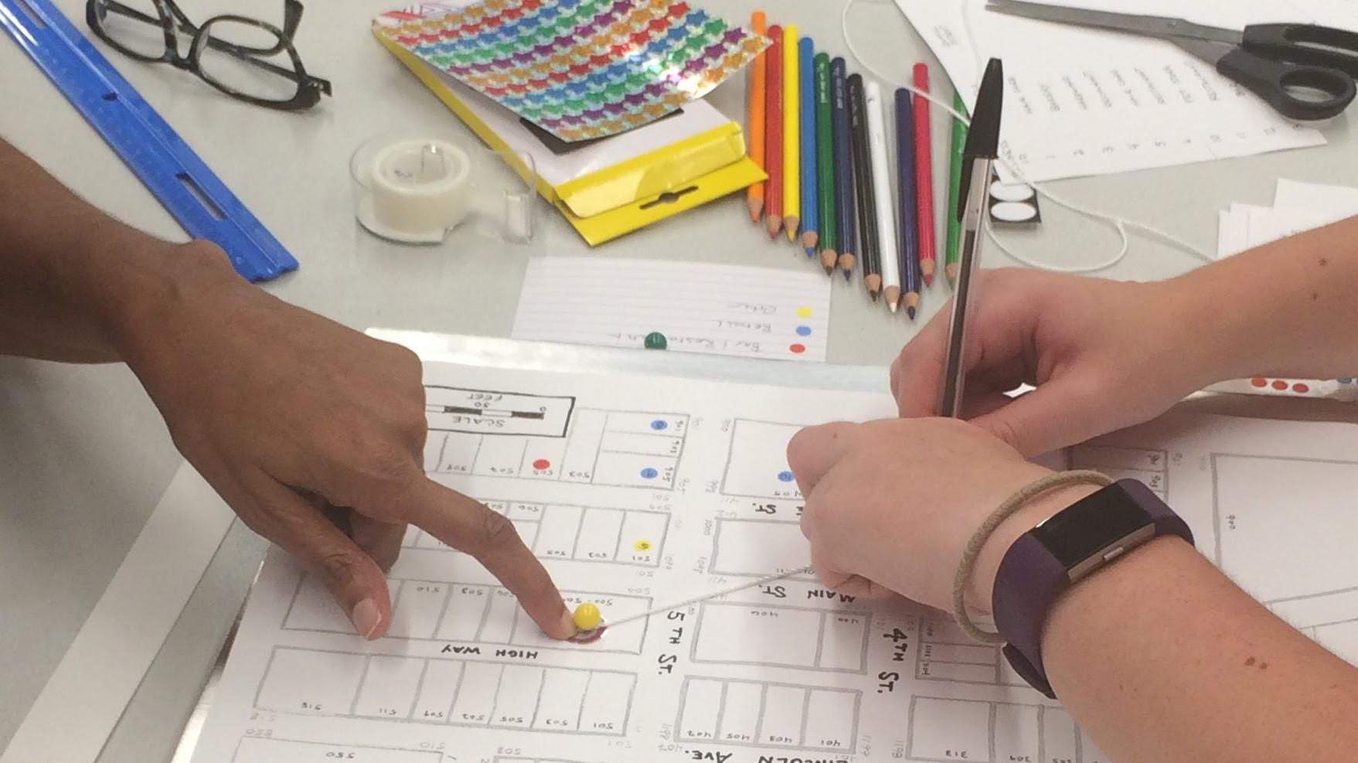
Notes:
Mapping @ Knoxville

Slide 11
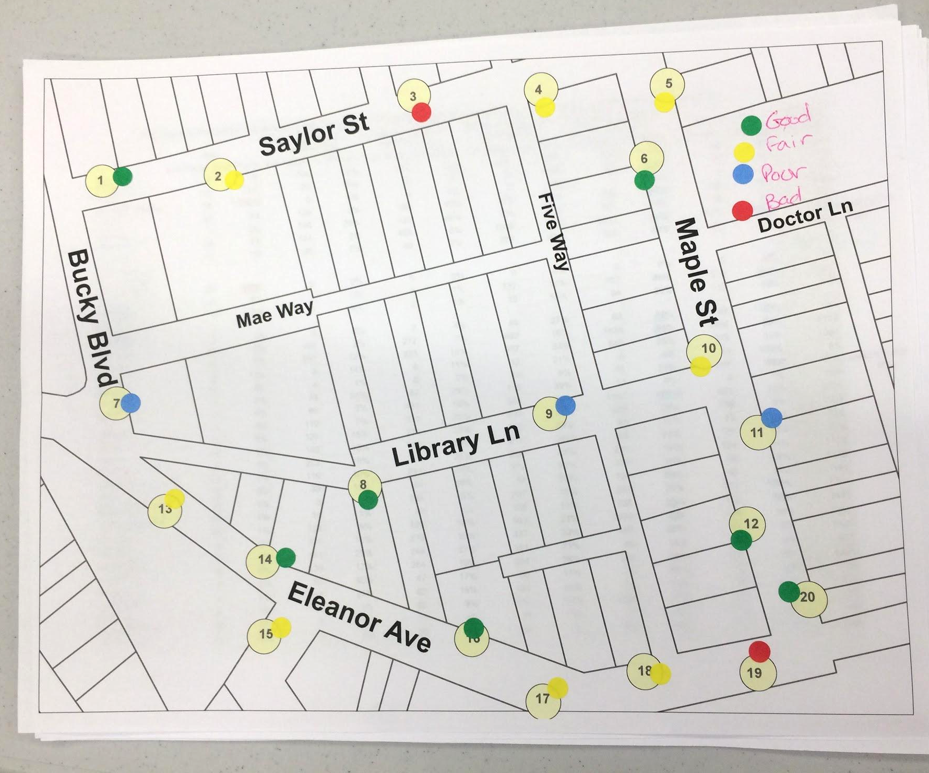
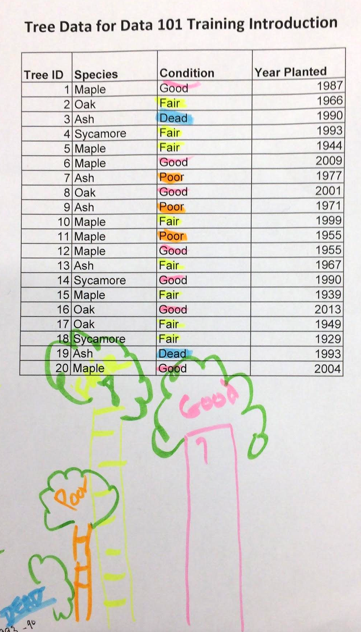
Notes:
Finding Stories

Slide 12
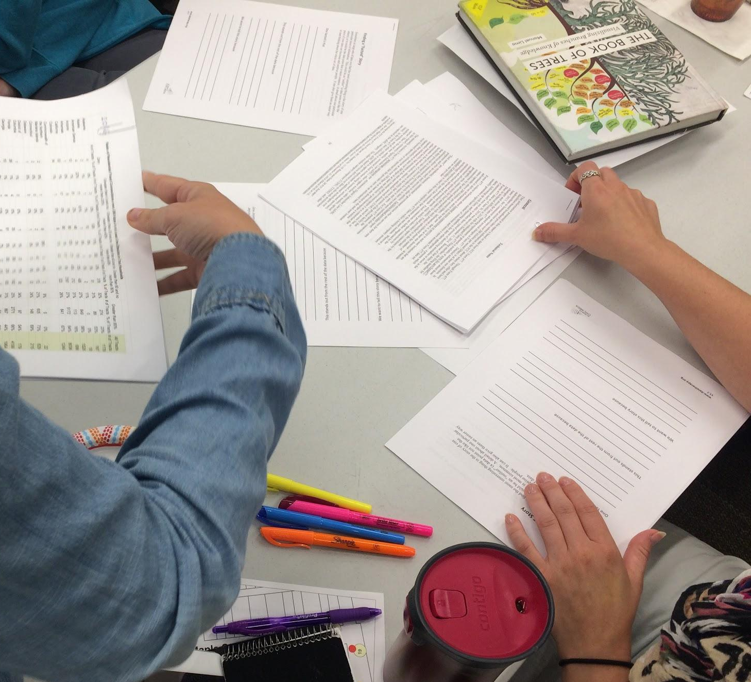
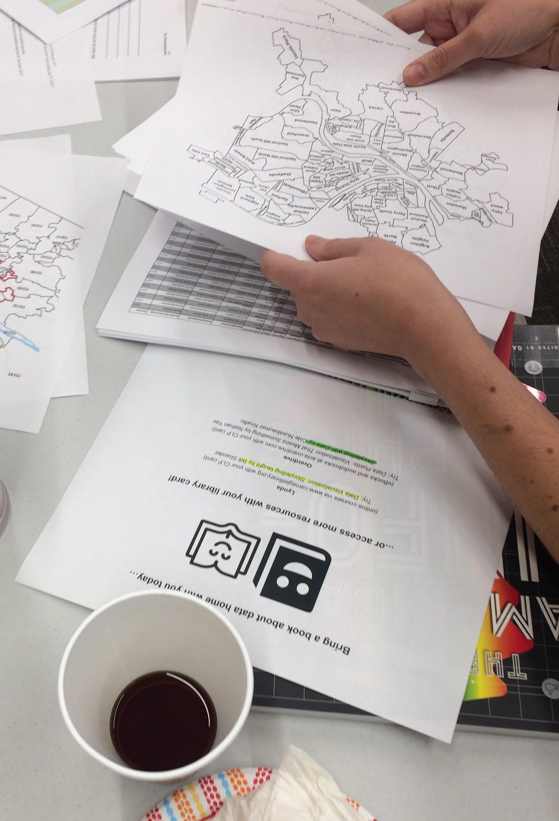
Notes:
Finding Stories

Slide 13
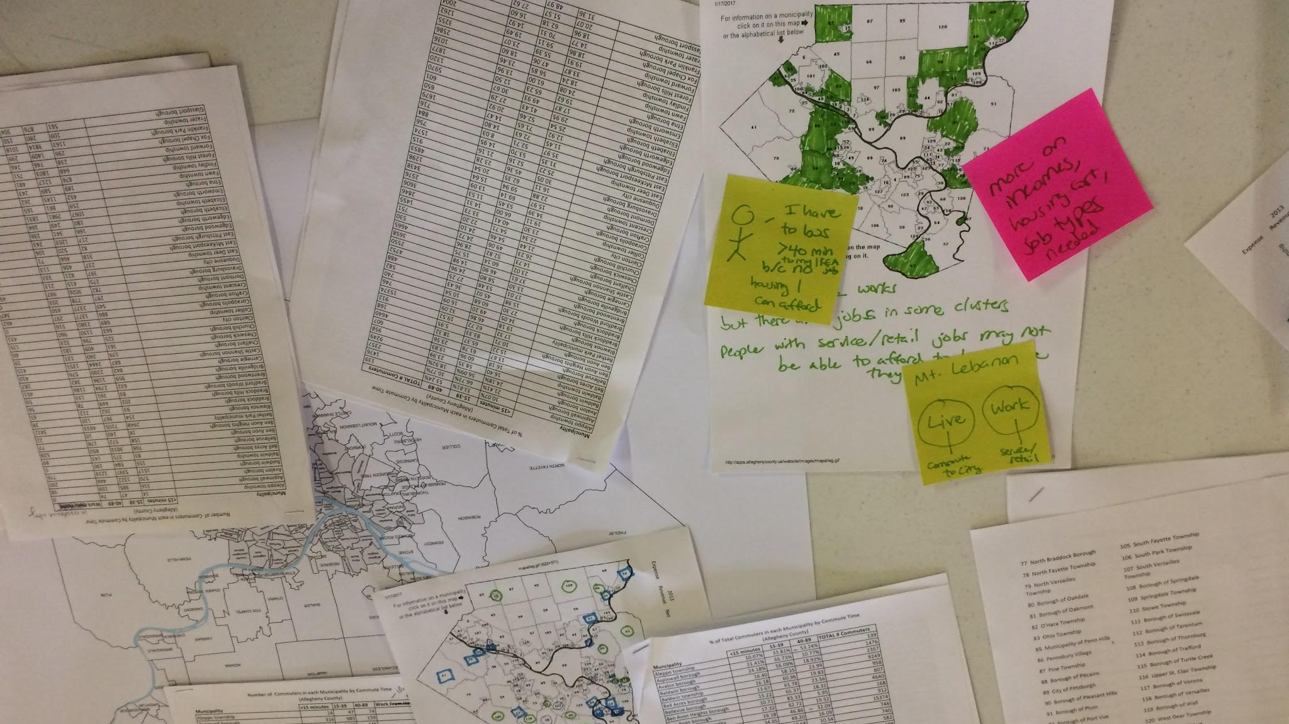
Notes:
ACLA Finding Stories

Slide 14
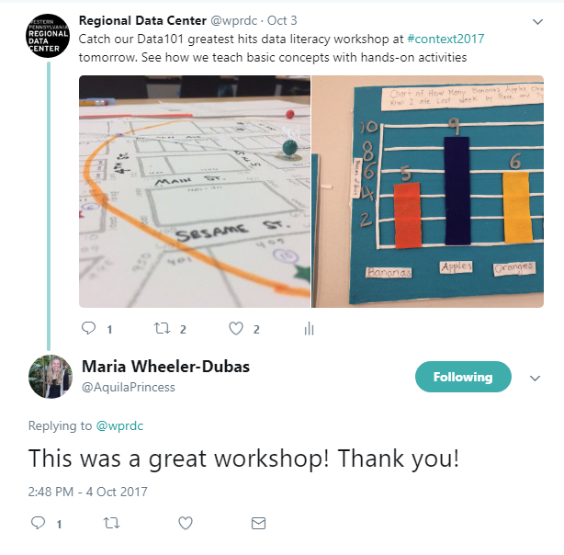
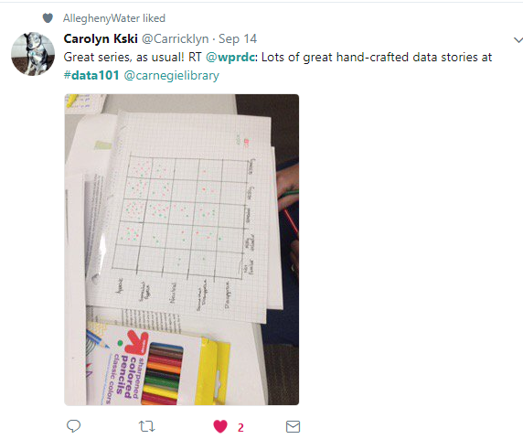
“NO COMPUTERS!! A+++ lots of hands-on activities using a variety of materials - kept me interested”
“Thanks so much for making it fun!
“The various exercises really made me stop and think of how to look at mapping and apply it at my job”
“I loved how interactive it was and I always love opportunities to disengage with our computers and work through things with our hands and minds”
“I liked collaborating with others interested in data from different backgrounds”
Notes:
What I’d like to put here is some photos of 1-2 interesting comments from our satisfaction surveys so that we center our users.

Slide 15
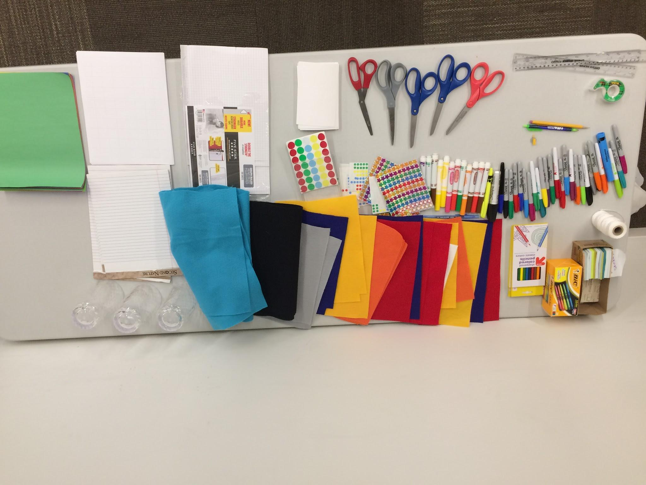
THANK
YOU!
Notes:
Thank you! Get your toolkit and do this all yourself!

