Slide 1
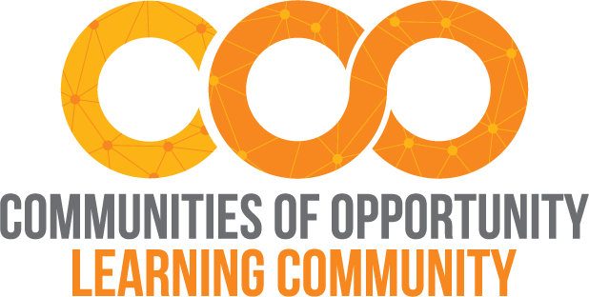
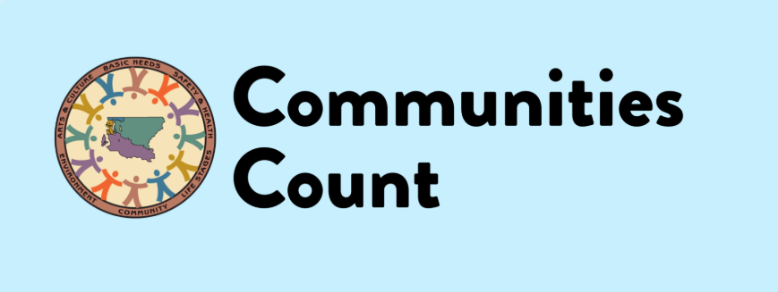
Evaluation Basics with Communities Count:
A Communities of Opportunity Workshop
January 16, 2020
Vanessa Quince
Notes:
Content will address the following:
Why evaluation matters
Evaluation methods
Creating an evaluation plan
How to decide what data to collect

Slide 2
PURPOSE OF THIS WORKSHOP
Through this workshop we aim to equip attendees with the knowledge and tools to build local evaluation capacity that utilizes a strong equity approach to highlight your organization’s strengths as well as identify opportunities for new or continued program investment and development.
Why evaluation matters
What is a good evaluation
Defining the question
Evaluation methods
Deciding what data to collect
Analyzing and interpreting findings
Creating an evaluation plan
Notes:
The purpose behind this workshop is to support community members and partners to conduct their own evaluations. Anyone can plan and do an evaluation, and do it well. In fact, making sure the people involved and most affected by the work being evaluated are involved in every stage of the evaluation will help ensure that results are useful and accurate.
Note for presenters - We start with introductions, and something about our work that we want to celebrate, share what works. This is also a good time to talk about what people want out of the session; do people have evaluations they are planning and want to discuss.

Slide 3
Why evaluate?
To gain insight, learn
To see strategy or program impact
To support & empower people
To increase equity & support social change
Notes:
Evaluation should be useful to you, help inform learning and next steps. Evaluation can and should help support people that are affected by strategy or program being evaluated– either by empowering them, identifying needed supports, or channeling people’s voice. Similarly, evaluation can and should support equity achievement and social change.
Ideally, evaluation helps you determine - what do I need to know to make the decision I need to make?
(Optional discussion – animated slide so bullets come in with a second click)

Slide 4
What is a good evaluation?
Community-based, participatory
Equitable
Accurate, reliable
Useful, actionable information
Notes:
Evaluation frameworks give guidelines to focus questions, methods, analyses and interpretation. Evaluation methods include how to get accurate, reliable information. A community-based participatory research (CBPR) approach can help lead to more accurate results, and we’ll talk about how in a minute.
The field is also moving toward equitable evaluation, which emphasizes that evaluators should be aware of equity at all times and consider equity issues at every evaluation stage. This means, for example, thinking about how access differs, do findings differ for some groups, does data collection include asking about systemic barriers and opportunities. But also creating chances and opportunities to understand strengths.
An accurate evaluation conducted in partnership with community within an equity frame is more likely to result in useful actionable findings
Resources:
https://www.equitableeval.org/
https://www.racialequitytools.org/evaluate

Slide 5
 | Participatory | Conventional
Who drives evaluation? | Community residents, project staff and other stakeholders | Funders and program managers
Who determines progress indicators? | Members of community, project staff, other stakeholders, evaluator | Evaluator and outside experts
Who is responsible for data collection, analyses, report? | Shared responsibility of evaluator and participating stakeholders | Evaluator and outside experts
What is role of local evaluator? | Coach, facilitator, negotiator, “critical friend” | Expert, leader
When is this evaluation type useful? | Questions about implementation difficulties Questions about program effects on beneficiaries Information wanted on stakeholder knowledge or views | Need for independent judgement Specialized knowledge needed from experts Indicators standardized
What are the costs? | Time, energy & commitment from local residents, staff and stakeholders Coordination of many players Training, skills development & support for key players Potential for conflict | Consultant & expert fees Lose of critical information that only stakeholders can provide
What are the benefits? | Local knowledge Verification of information (validity) Builds knowledge, skills & relationships among community residents and other stakeholders | Independent judgement Standardized indicators to compare with other evaluation findings
https://depts.washington.edu/ccph/pdf_files/Evaluation.pdf
Notes:
What are some of the questions, challenges and concerns that you have heard about evaluation? A common critique of traditional evaluation is that methods and findings can suffer because the right people are not involved in the process.
Public Health Seattle and King County, especially the Assessment Policy Development and Evaluation division, strive for community participation in every part of evaluation work, to the degree possible. Our aim is to make sure that we bring diverse perspectives and voices into the room. When possible, community members lead the evaluation – by picking the questions investigated, deciding what data to use and how to collect the information, what findings mean and how best to turn findings into action steps. At a minimum, we make sure to empower people to be involved to the degree possible.
Remember everyone can participate or lead evaluations and that it is not just limited to those with expertise. This chart compares traditional and participatory evaluation – what they are and what steps are taken in participatory approaches to empower and involve community members.
A key point to note is that CBPR is a continuum - full 100% partnership is rare but the ideal.
Source: https://depts.washington.edu/ccph/pdf_files/Evaluation.pdf

Slide 6
Defining the question
What strategy or program do you want to evaluate?
What do you want to know about?
Notes:
These frameworks, approaches, define the evaluation processes and help ensure equity, community voice, utility.
So now we have a guiding framework and are ready to define our evaluation question and design a study.
What are we evaluating, how does it work? What if we want to know, did things happen as they should, and were partnerships effective?
Theories of change and logic models, ideally, express what you are hoping to accomplish, what and why a strategy or program are hoping to achieve.

Slide 7
COO Evaluation Questions
What is the current state of equity in housing, health, economic vitality, and community connection?
What forces are driving or blocking progress towards partner goals? How do partners respond?
How are policies and systems changing over time?
How is the partner community changing?
What is COO’s contribution?
Notes:
We usually start with one or more questions – what do we want to know?
Here are the Communities of Opportunity evaluation questions as an example:
Notice how the questions are neutral, we're not assuming success or failure, looking at how policies are changing over time.

Slide 8
Role of logic model & change theory
Notes:
A great tool to help guide evaluation is a theory of change, or a logic model. Theory of change – can be as simple as a series of sentences. Logic model articulates theory of change, and basic structure shown here.
Definitions -
Inputs are the various resources available to support the strategy/program (e.g., staff, materials, curricula, funding, equipment)
Activities are the action components of the strategy/program (e.g. develop or select a curriculum, write a plan, implement a curriculum, train educators, pull together a coalition). These are sometimes referred to as process objectives.
Outcomes are the intended accomplishments of the strategy/program. They include short-term, intermediate, and long-term or distal outcomes.

Slide 9
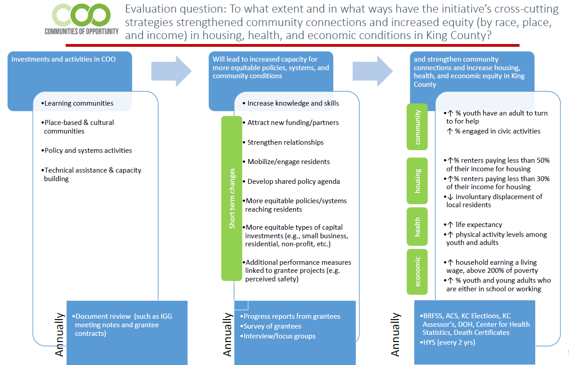
Notes:
the Communities of Opportunity logic model (simple version) as an example

Slide 10
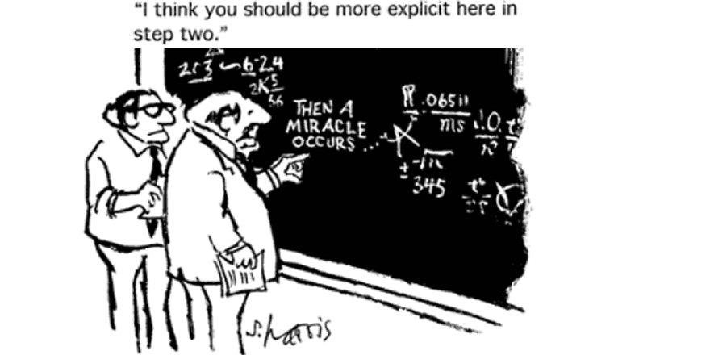
Studying Process and Implementation
Notes:
Once you have a research question, you can decide study methods and data collection approach.
Specifically, there are 35 different types of evaluation. But generally, they fall into two types – process and outcome. Outcome and impact evaluations look what happened as a result of a strategy/program.
Process and implementation evaluations study how things are working - are things happening as we intended, what are barriers and successes, what needs improvement – are things happen as they should, are organizational supports in place to support the work.

Slide 11
Collecting the information
Surveys
Checklists
Interviews
Focus groups
Observation
Document/case reviews
Performance measures
Pre-existing data resources
Notes:
Once you have a research question, you can decide study methods and data collection approach.
Please see the handout which reviews advantages and disadvantages of each method, generally speaking.
Quantitative data are counts, answer questions like how many.
Qualitative data are more narrative often, answer questions like what, why, how did it work.
Ideally, equity and community members are considered/have a role in drafting, testing and implementing data collection methods and protocols.
These are some of the ways we can collect data. If you are interested in a particular method, we are also holding survey, focus group and other workshops throughout the year. We also provide technical assistance for any of these topics or others that are specifically related to the needs of your organization. You can just ask for support (see last slide for more information).

Slide 12
COO Partner-level Measures
How much partners are doing (counts are COO-wide)
Number of local residents attending and participating in seminars, trainings, workshops or events
Number of people participating in community engagement, service and civic participation, including volunteering, mentoring and community organizing
Number of new leadership roles by local residents
Number of organizational relationships developed that directly support goal achievement
Any other relevant counts emerging from reporting forms
How well they are doing it (common successes and challenges are COO-wide)
Primary and secondary barriers to goal achievement
Primary and secondary factors supporting goal achievement
Effectiveness of coalitions (progress toward their self-identified goals)
Number of policies and systems activities in progress
Notes:
Performance measures can be part of an evaluation, and can stand alone. To be part of an evaluation, the performance measures need to relate/answer your evaluation question(s).
The COO performance measures are listed here.
Blog with baseline results:
https://www.coopartnerships.org/blog/2019/7/2/evaluation-points-to-early-successes-among-partners-to-advance-equity

Slide 13
COO Partner-level Measures
Is anyone better off (COO-wide: partners’ self-described early outcomes showing how partner communities say they are changing)
Perception that solutions are being developed to overcome barriers to housing, health, economic opportunity, community connections and related policy & systems change objectives
Perceptions that primary concerns are being addressed through local government decisions and policy priorities
Perceived access to shops, goods and services, recreational amenities, community spaces and affordable health care
Resident perception of community stability and cohesion
Notes:
Additional COO performance measures.
The COO measures rely on the results-based accountability approach to evaluation. They answer 3 key questions: How much did we do, how well did we do it, and is anyone better off. For more information, see: https://clearimpact.com/results-based-accountability/
Blog with baseline results:
https://www.coopartnerships.org/blog/2019/7/2/evaluation-points-to-early-successes-among-partners-to-advance-equity

Slide 14
Analyzing Data & Understanding Results
Work from evaluation question
Not all data involve statistics
When used, statistics should be understandable to audience
All findings should be scrubbed to protect individual identity
Qualitative data usually coded by themes
Share findings with others to check interpretation
Be transparent about limitations
Notes:
This slide reviews some key points to think about and remember when analyzing and interpreting data and results. As with other stages of evaluation, equity and community-based participation are important in this stage. For example, are findings equitable or do they differ for any key subgroups? Did we check with community members to make sure our interpretation of results is accurate, correct? How do they interpret the results?
Again, remember you can reach out for technical assistance when you get to this stage, and you can also get support for any stage.

Slide 15
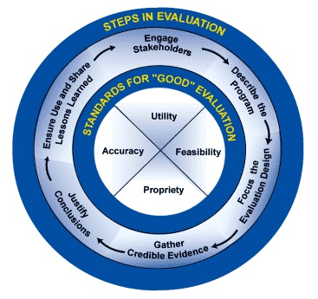
Evaluation Planning
Notes:
There are a number of online resources to help you understand the key stages of an evaluation. Here’s an example from U of Kansas, community toolbox: https://ctb.ku.edu/en/table-of-contents/evaluate/evaluation/framework-for-evaluation/main
A good evaluation is going to be useful and give you good information. When evaluators are engaging with community, we get more useful and accurate information. Ideally, community is involved at each phase. And in each phase, we are thinking about equity and how to examine and think about equity.
Evaluation can and should go to equity and ideally should lead to action stops rather than a report that no one is going to read.
Another basic framework to help plan an evaluation is to consider the following questions:
1. DEFINE – what is the strategy or program? How does it work?
2. PLAN – what information is needed, how to evaluate
3. IMPLEMENT – How do I evaluate the program
4. INTERPRET – how do I interpret results
5. INFORM & REFINE - how do I use the results

Slide 16
Upcoming Workshops
Future Workshops:
Developing your own community survey​
2/27/2020, 1-3pm ​
White Center Library ​
Sign up here: Developing your own community survey​
What is a process evaluation? ​
3/4/2020, 1-3pm ​
Kent Regional Library​
Sign up here: What is a process evaluation?​
​
Finding & Using Data to tell Stories​
2/13/2020, 10:30am-12:30 pm ​
Rainier Beach Branch Library​
Sign up here: Finding & Using Data to tell Stories​
OR​
3/12/2020, 1-3pm ​
White Center Library​
Sign up here: Finding & Using Data to tell Stories ​

Slide 17
How do we request assistance, or ask questions about data and evaluation?
Free Data Consultation and Technical Assistance
Email: Communitiescount@kingcounty.gov
See more data and trainings, visit us at:
www.communitiescount.org

