Slide 1


Data Analysis Basics:
Using Excel or Google Sheets
A Communities of Opportunity Workshop
December 4, 2019
Mariko Toyoji, Sara Jaye Sanford, Vanessa Quince

Slide 2
PURPOSE OF THIS WORKSHOP
Through this workshop we aim to equip attendees with the knowledge and tools to build local data and evaluation capacity that utilizes a strong equity approach to highlight your organization’s strengths as well as identify opportunities for new or continued program investment and development.
What will we cover today?
Introductions
Types of data
Managing and organizing data
How to analyze your data
Using your data
Questions & open discussion
Notes:
Acknowledge the expertise in the room and encourage people to share
Start with introductions. Name, org, what brought them to the training that day
People welcome to ask you to questions, clarification

Slide 3
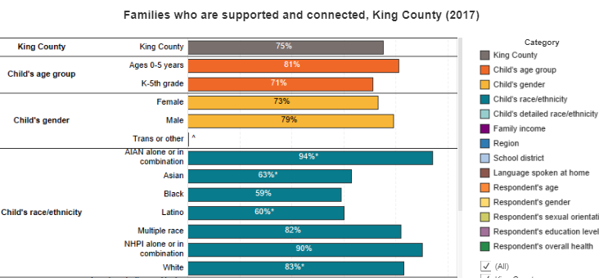

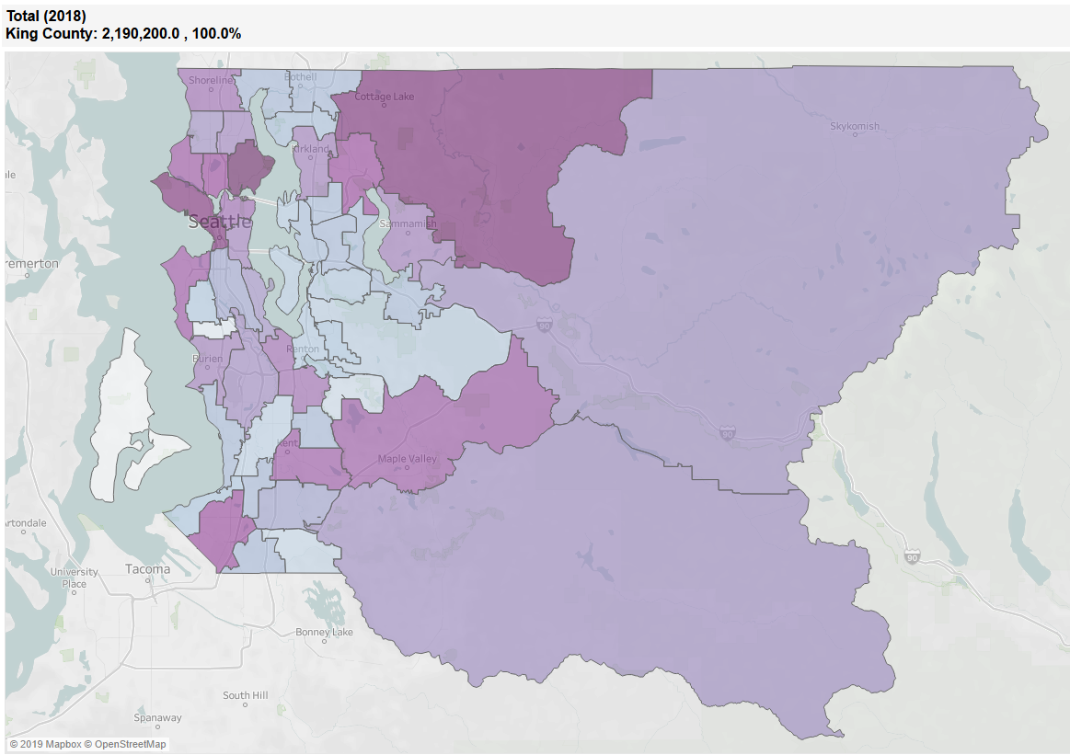

What is Data?
Numbers
Stories
Maps
Images/Videos
Notes:
Data is information, and it can take many forms. Although we often think of numbers as data (quantitative), there is so much rich information in stories, maps, images that are valuable. Today’s training will focus on analyzing quantitative data, but using many types of data can be an effective way to help tell your story.

Slide 4

What kinds of data does your organization use?
Common types of data:
Survey data
Feedback forms
Program or client data
Operations data
Stories
Population Data

Slide 5
Data Life Cycle
Collect Data
Process and Clean Data
Analyze Data
Interpret and Share
Store and Archive
Disposal
Our Focus For Today
Notes:
Collecting working with and managing data is an ongoing, cyclical process with many steps to consider as you collect, analyze, use and manage your data

Slide 6
What does analysis do for data?
Analysis is the transformation of data make it more useful for interpretation
  Can help identify patterns
  Provides us with insights to guide our decision making
  Can help us see if we are making progress towards goals
Keep an open mind. Analysis findings can surprise us and challenge our assumptions
  Avoid “cherry picking” or selecting only data or findings that are favorable or align with your expectations.
  Consider your own bias or assumptions when working with data
Notes:
Analysis helps you make meaning from your data
Counts or Sums of numbers
Percentages and ratios
Trends: Changes over time
Descriptive Statistics: Average/Mean, Median, Mode, Range
Inferential Statistics: t-test, Analysis of Variance (ANOVA),
Performance measurement is generally defined as regular measurement of outcomes and results, which generates reliable data on the effectiveness and efficiency of programs.
Another consideration to keep in mind when analyzing your data is confirmation bias, which is the tendency to interpret new evidence through the lens of existing beliefs, rather than approaching new evidence at face value

Slide 7
Basic Analysis Steps
Identify your questions
Guiding questions help focus and inform the type of analysis you select
Process and Clean
Organizing your data and taking steps to identify and address inaccurate or incomplete information
Recode
Substituting values in your dataset with new values to make them more useful for your analysis.
Analyze
Using calculations and/or visualization to prepare and transform data for interpretation
Notes:
Plan for all parts of these
Identify your question or purpose
Guiding questions help focus and inform the type of analysis you select
Process and Clean
Organizing your data and taking steps to identifying and addressing inaccurate or incomplete information from your dataset: important for quality assurance
Recode
Substituting values in your dataset with new values to make them more useful for your analysis.
Analyze
Using calculations and/or visualization to prepare and transform data for interpretation

Slide 8
Where does your data live?
Spreadsheets
Google Forms
Survey Monkey and similar programs
Paper
Notes:
These are some of the common tools for managing your survey data. You may use more than one! For example, you may use Google Forms to enter your responses, and then download your data as a spreadsheet.
Many tools out there, but we are going to go over using spreadsheet software as we were told that it was a common tool that is used among partners, and can be accessed for free or at low or no cost
One of the most basic and useful tools for managing and analyzing your data is the SPREADSHEET. If you don’t have Microsoft office, there are free options including Google Sheets, or OpenOffice. In a few minutes, we’ll look at some ways to analyze data in excel.
If you did an online survey, it is likely already in a system like Google Forms or SurveyMonkey. If not, they may still be useful to you. If you did your survey on paper, you will need to enter the data somewhere so that all of the responses are in one place and you can analyze them. Unless you have many hundreds of responses, this can be tedious but doesn’t take too long.
Using Google forms is free, you just need to sign in with a Google account. There are fewer question options than some products you pay for, but the look is streamlined, and there are no limits to how many questions are in your survey or how many responses are entered.
SurveyMonkey and other products like Qualtrics are also options. SurveyMonkey has a free version, but limits surveys to 10 questions and 100 responses, so consider whether that will meet your needs. If you have a paid account, you don’t have these limits, and there are other features like more question types, and the opportunity to filter or sort your responses.
If you have partners, it’s worth asking what they use, so you can integrate wherever possible.
If you’re collecting sensitive information, be sure it’s saved securely.
For those of you looking to start working with a data management system, there’s a decision support tool we will share the link to.
Question: Have you had good or bad experiences using any of these tools? Are there additional tools you would recommend?

Slide 9
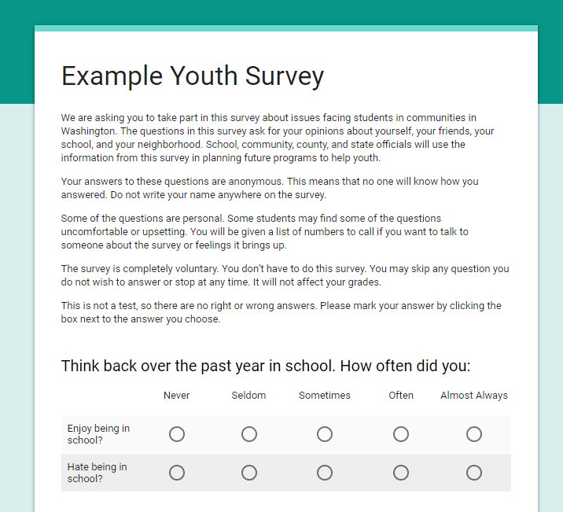
Let’s look at an example…
https://docs.google.com/forms/d/e/1FAIpQLSc8PEkICYBX1p28CVdWTiL_0FdFtHn9gMIJa1NRXpxFiF4FRA/viewform?usp=sf_link
Notes:
Today we’ll be using an example from Google Forms. We made an example survey and put questions similar to what might be used to collect information about a program into a Google Form and filled out some responses that we’ll be looking for today. You can see what that looks like here.
In many ways there’s no one right way to do all this – it depends on your data, the tools and other resources at your disposal, and your own preferences. What we’ll be looking at today is an EXAMPLE that I hope will be helpful. It’s not intended to tell you how you have to collect, manage, or analyze your data.
[Scroll through all of survey]
Reference: demographic spreadsheets available for questions & minimum reporting

Slide 10
Let’s look at an example…
Notes:
I’ve filled in this survey by having a few colleagues randomly fill it out to give us some data to use as an example. This is what it looks like from “the back end,” what I can see when I’m signed into Google Forms. Let’s go there now.
Exit powerpoint – go to previously set up Google Forms page
Scroll through results
Give examples of how you could use them to provide data for performance measures: example, % of students who agree or strongly agree that they can talk to a teacher one on one (yes + YES!)
Specifically, what are the: NUMERATORS, DENOMINATORS, AND PERCENTS

Slide 11
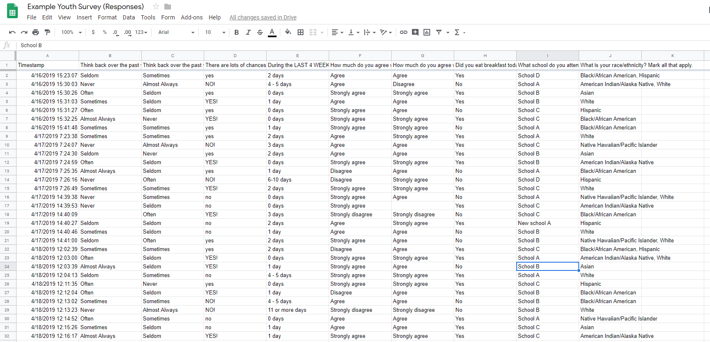
What if you want to know more?
https://docs.google.com/spreadsheets/d/15e1LemWEbanCUxsGm8lqf7OVq66shJph6UByT7bIbyg/edit#gid=406495052
Notes:
However, if you don’t get what you want within your survey program, you can download your responses as a spreadsheet. In Google Forms, you can choose to open your results in Google Sheets or download it into Excel. Both of these programs are very similar in how you can use them to analyze spreadsheets. I’ll be sharing this in the google drive folder after the webinar so you can explore it later if you like.
We’ll look at that now.
Exit powerpoint. Walk through examples:
Why might you want to collapse something? Maybe you offered more groups than we’re asking you to report. Maybe you offered a variety of responses and want to boil them down into two groups. Demo how to recode things you want to group together (i.e. “often” & “almost always”) using the sort function
How to use filter to get numerator, denominator, and percent – ex. Percent of multiple race students that can talk to a teacher one on one
How to calculate % of students who could talk one on one to a teacher (by hand based on summary; in spreadsheet)
What is another question we could ask? How might we answer it? Work through example together.

Slide 12
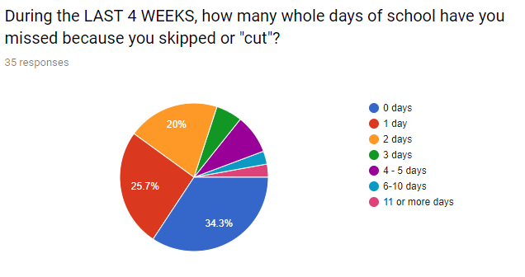
Using your data to tell your story
How would you turn this data into a statement?
Notes:
Now that you’ve crunched some numbers, how would you use them to communicate? Here’s an example. What kind of statements could you make from this?
Examples:
About a third of students did not cut any days in the past month!
80% of students cut two or fewer days in the past month.
20% of students cut three or more days in the past month.

Slide 13
Asking questions of your data
Are you surprised by any of your results?
Why or why not?
Are there difference among various demographic groups?
Notes:
Once you have analyzed your data, it’s time to use it!
What are some questions you could ask of your data?
What are other ways that you could use it?

Slide 14


Communicating your data
Hand: Take action!
Head: Think!
Heart: Feel!
Notes:
When you use your data to communicate – for example with staff, volunteers, donors, or potential funders, think about three elements. How can you combine a data point with stories, pictures, or other information to reach all three?
Does anyone have examples of how they have created or seen data used effectively to communicate?

Slide 15

Tips For Storing and Protecting Your Data
Backup data on a regular basis
Data stored on paper, thumb drives, portable hard drives etc. should be locked in a secure location
Consider keeping data stored under password protection and using encryption when transferring data
Consider limiting access to sensitive or identifying data on a “need to know” basis
When possible store identifying data separately or delete it
Dispose of data you no longer need
Notes:
This is a high level summary of considerations you might want to make when storing your data. You should also follow or consult with your IT standards and policies. These will vary based on the type of data you are working with. Some data like education and certain health data have their own standards that should be followed. Some partnerships have data sharing agreements, and may have policies about the storage and transfer of data. Identifiable information should be stored and handled with additional precaution
Identifying data is information like names, address, phone number, email address,

Slide 16
Selected Resources
Data Playbook (Schusterman Foundation): https://www.schusterman.org/playbooks/data/
Best Practices for Data Analysis of Confidential Data: https://ria.princeton.edu/human-research-protection/data/best-practices-for-data-a
Making Wise Decisions: A Step-by-Step Guide to Selecting the Right Data System:
https://www.publicprofit.net/Making-Wise-Decisions
Analyzing and Visualizing with Excel (EdX): https://www.edx.org/course/analyzing-and-visualizing-data-with-excel
Notes:
Non-exhaustive list

Slide 17

Questions & Discussion

Slide 18
Upcoming workshops
More workshops coming in 2020…
Survey Design
Evaluation Planning
Process Evaluation
Data Visualization
Data Storytelling Workshop Series

Slide 19
How do we request assistance, or ask questions about data and evaluation?
Free Data Consultation and Technical Assistance
Email: CommunitiesCount@kingcounty.gov
See more data and trainings, visit us at: www.communitiescount.org

