Slide 1
Growing Challenges in the North Texas Corridor
Anthony Galvan

Slide 2
The North Texas Footprint

Slide 3
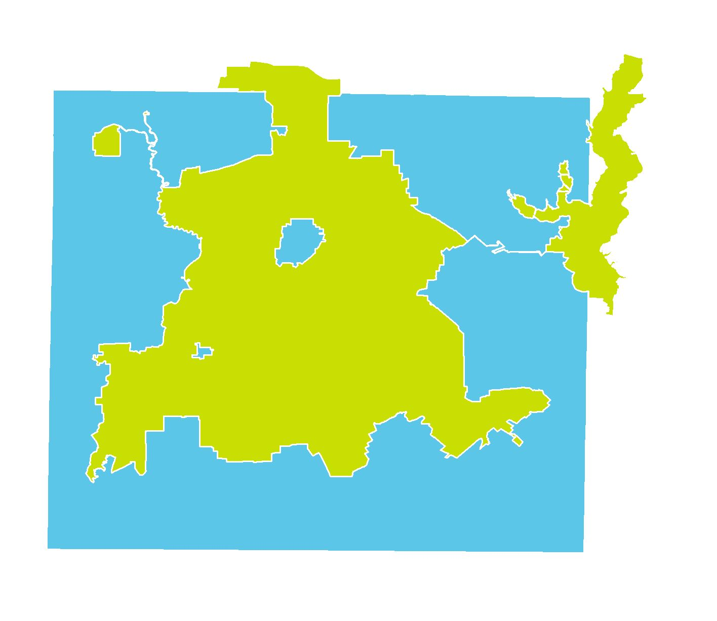
Dallas and Dallas County

Slide 4
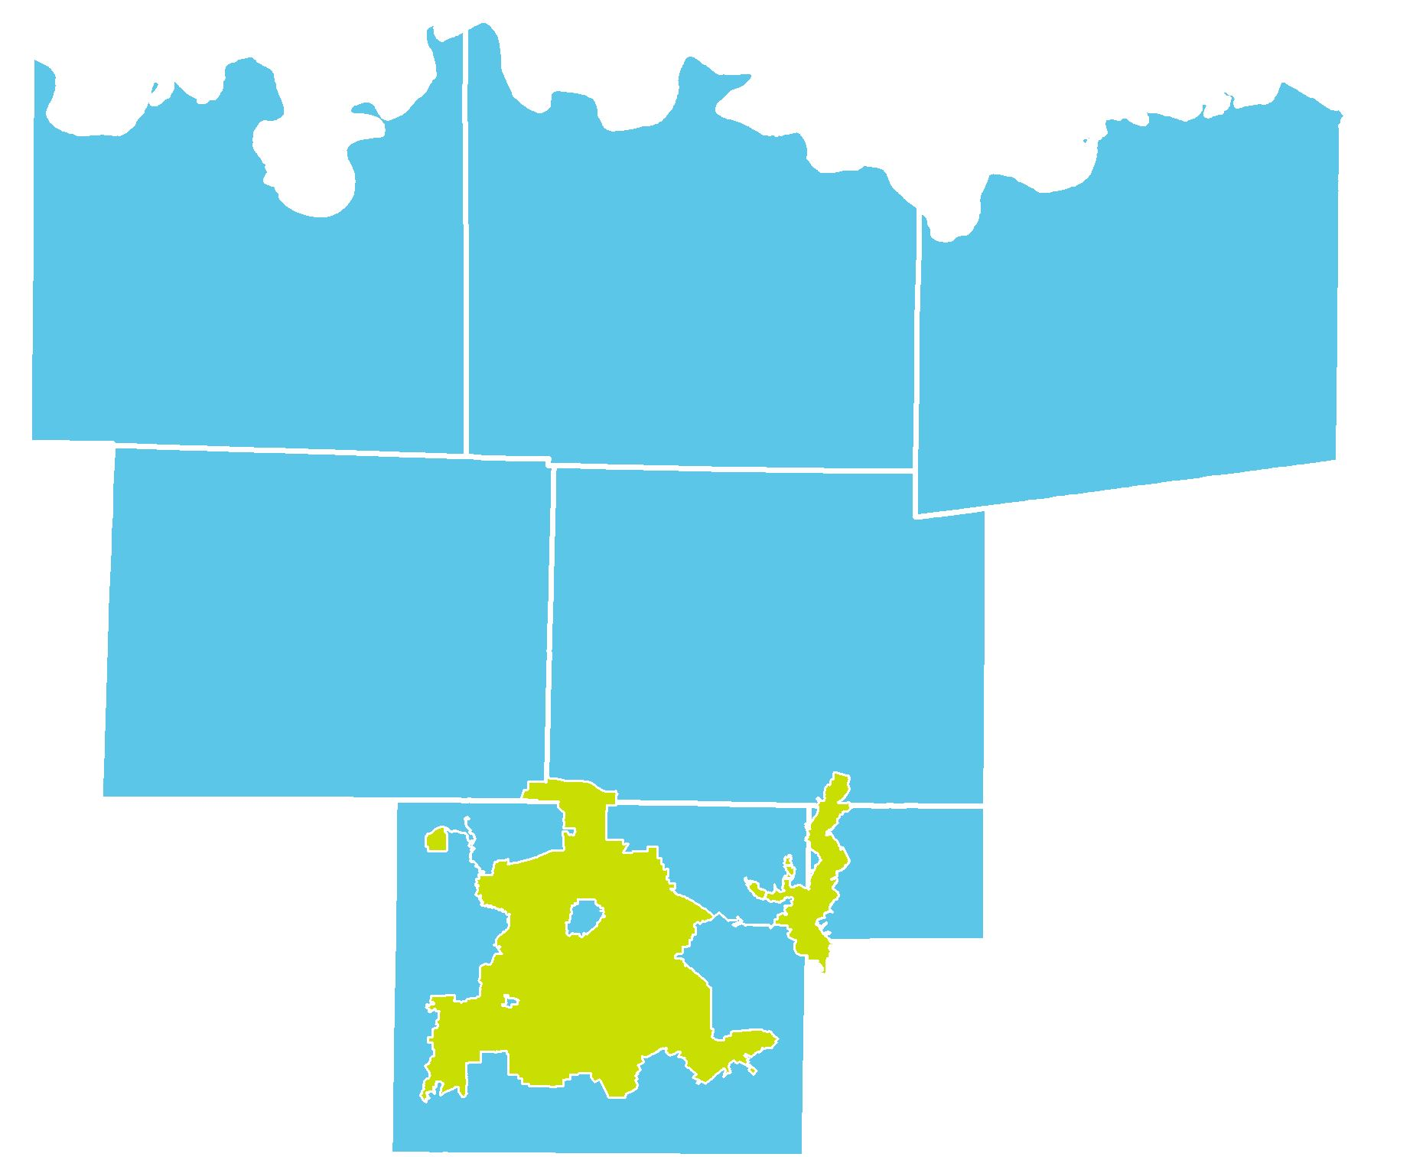
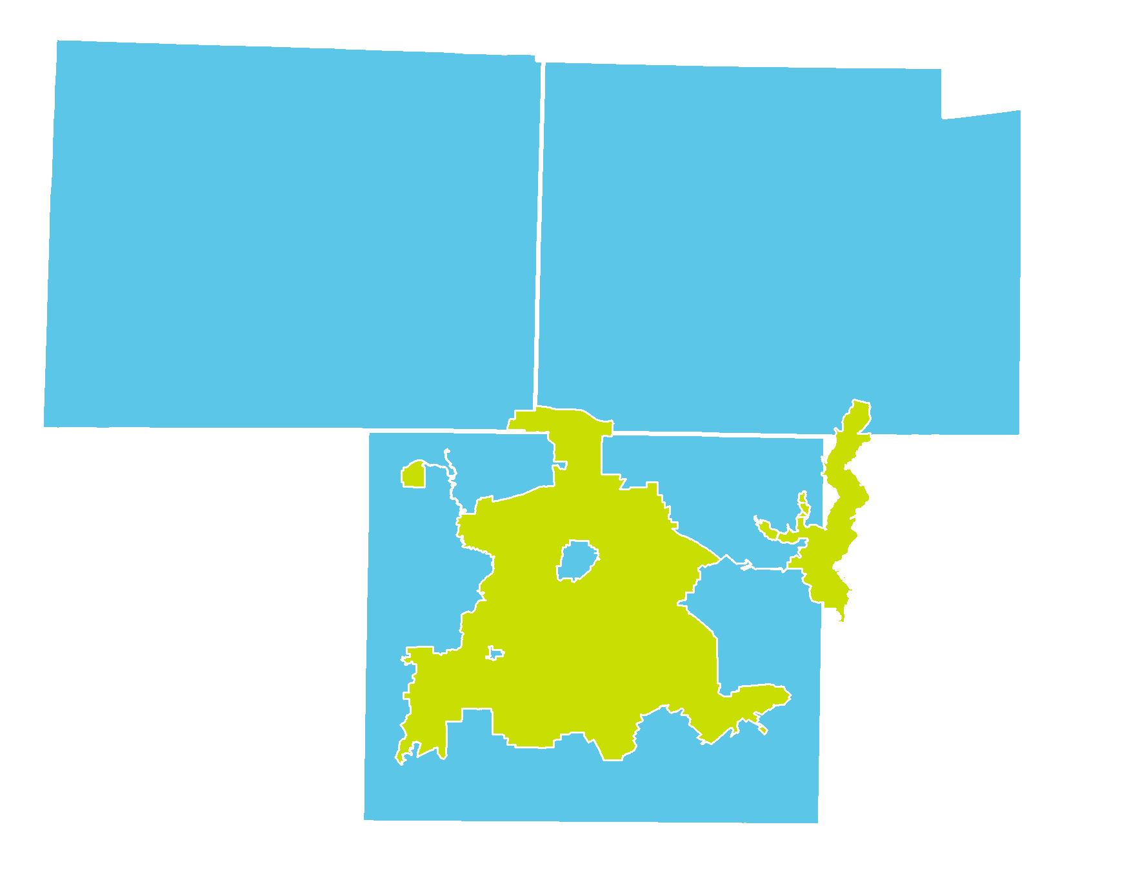
Suburban Dallas and the North Texas Corridor
Denton County
Grayson County
Collin County
Cooke County
FanninCounty
6,800 Square Miles
Denton County
Collin County
116 Miles
Rockwall County

Slide 5
Suburban Poverty in North Texas

Slide 6
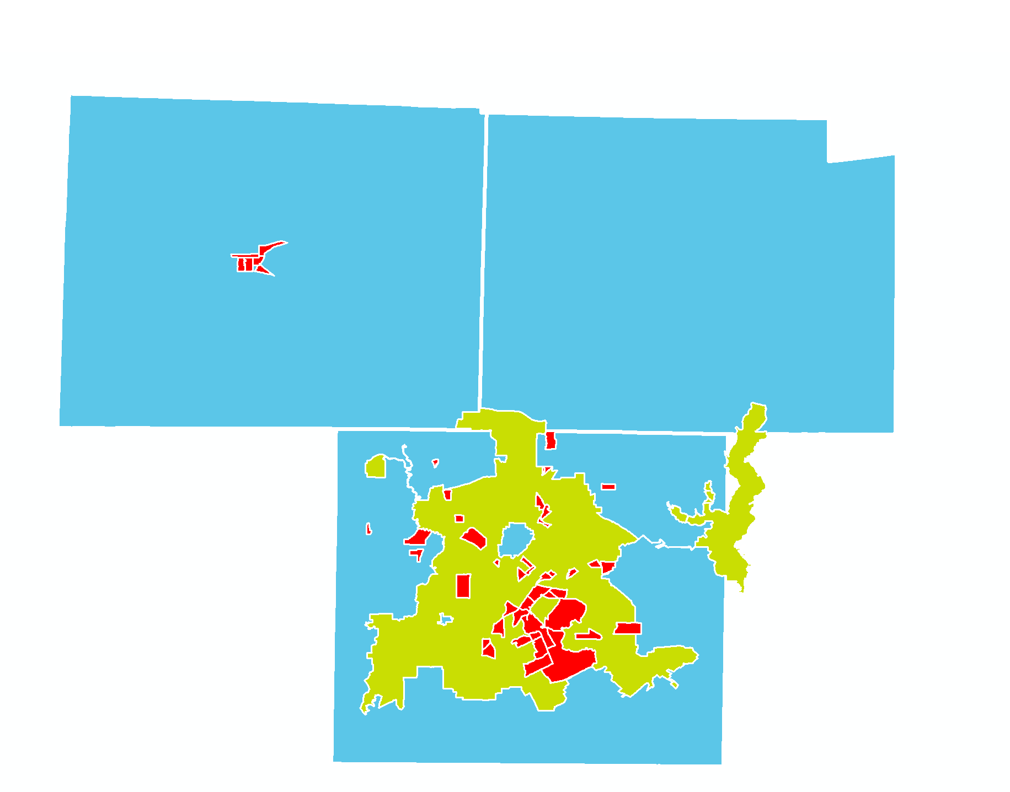
Concentrated Poverty in the Suburbs
Denton County
Collin County

Slide 7
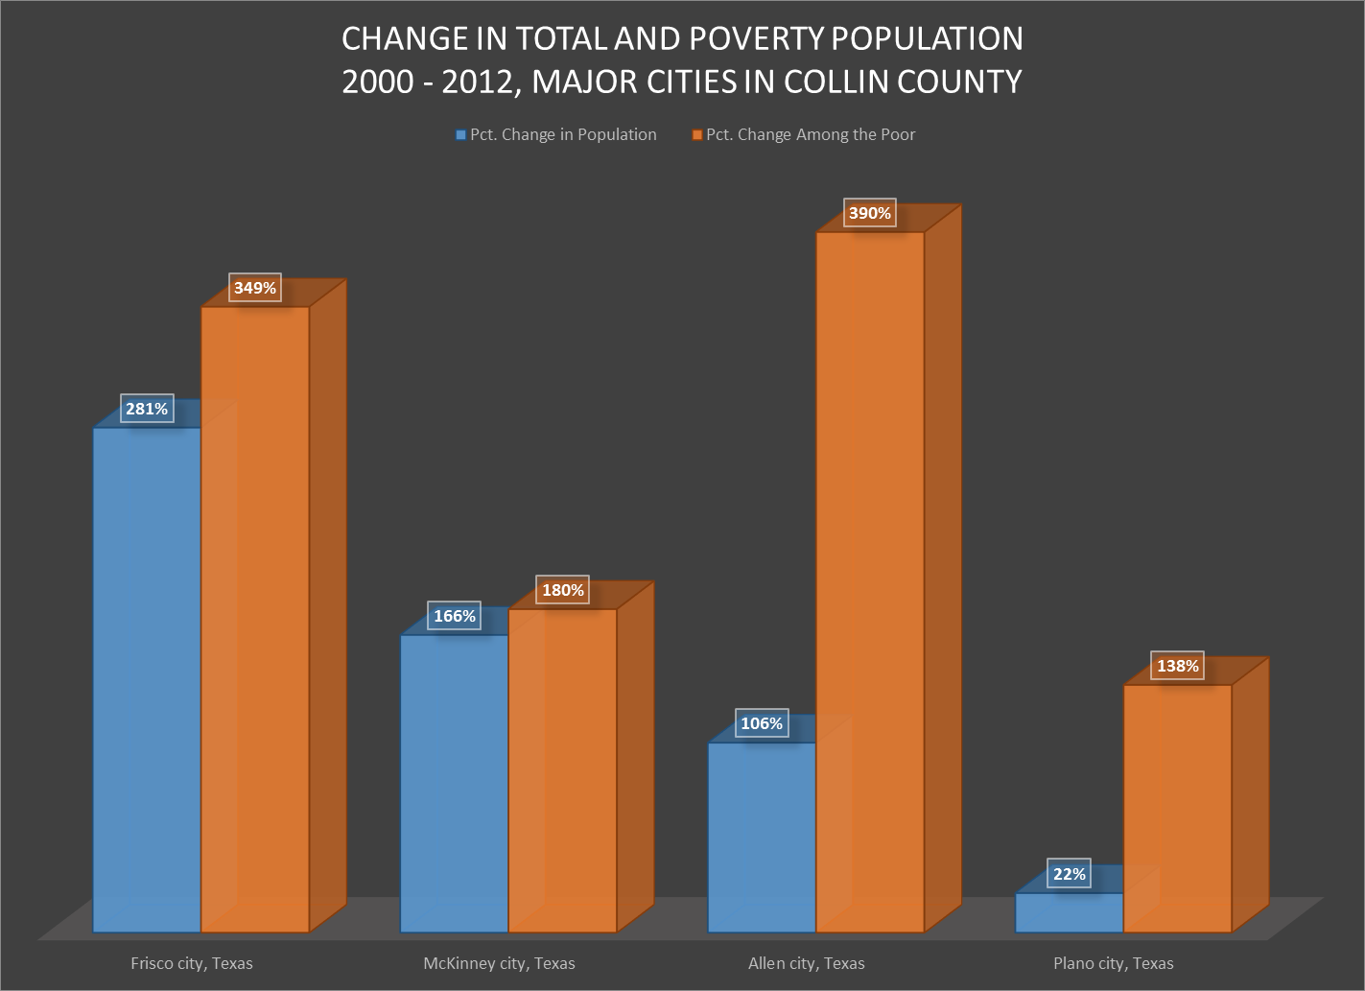
Rapid Growth in Population and Poverty

Slide 8
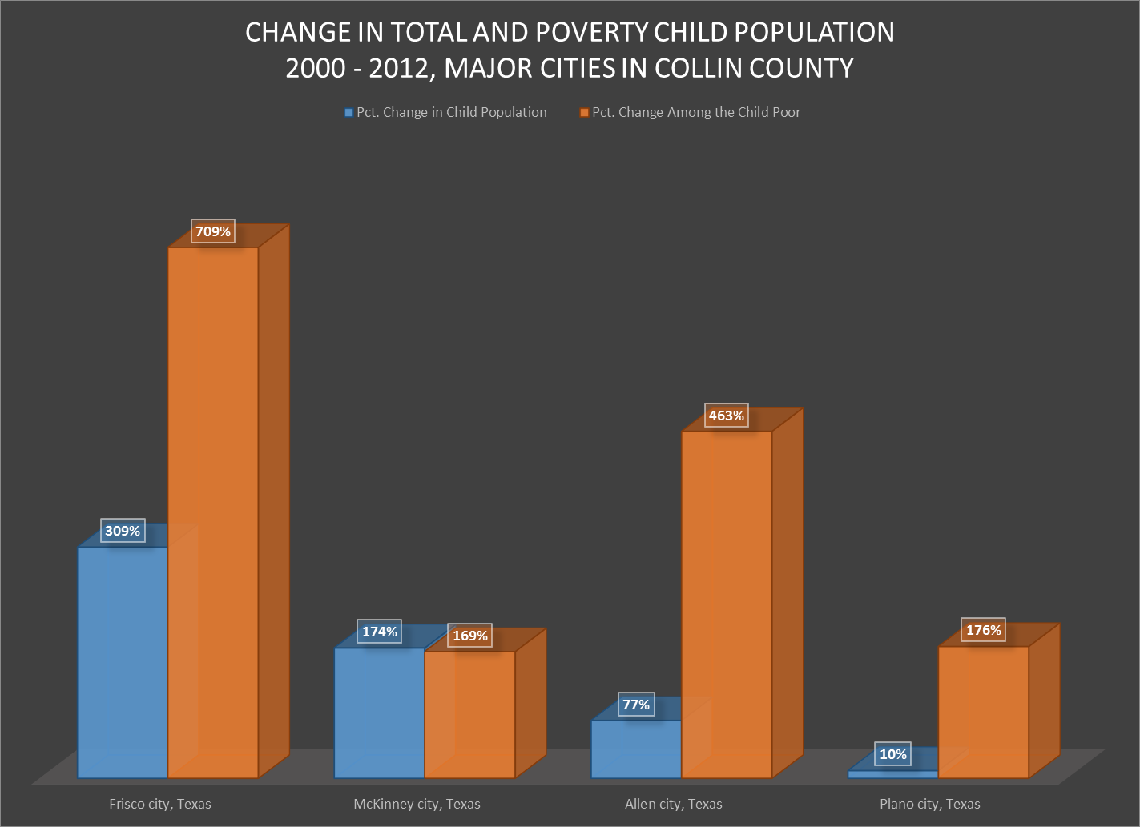
Childhood Population and Poverty

Slide 9
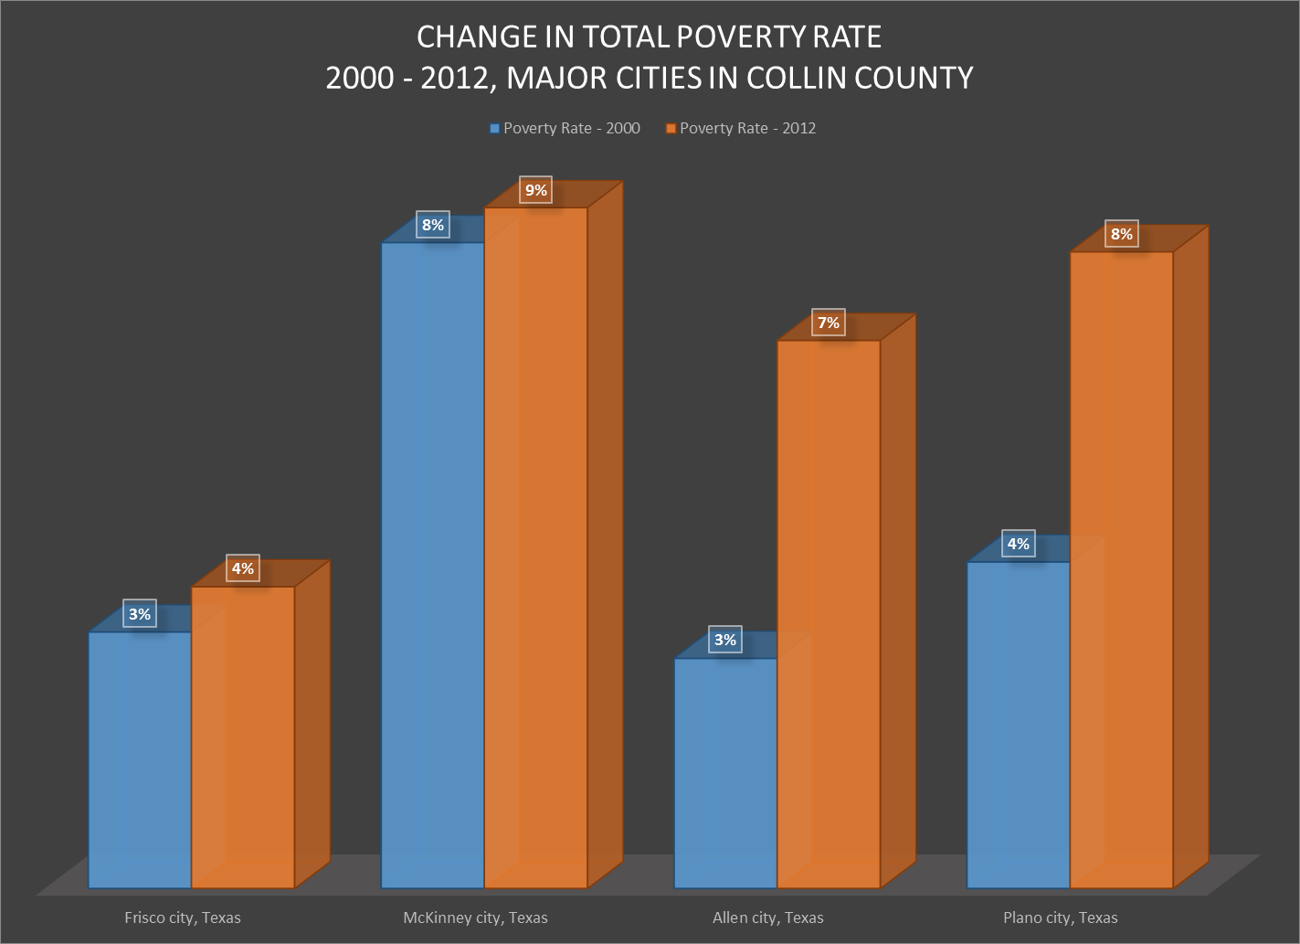
Poverty Rates – 2000 - 2012

Slide 10
Data Collection Challenges

Slide 11
Characteristics of Suburbs and Exurbs that Affect Data Collection
Varying and sparse populations
Inadequate staff
Technological deficiencies
Inconsistent reporting practices
Jurisdictional conflicts and differences

Slide 12
Varying and Sparse Populations
Affects which Census products can be used to describe a geography.
Affects data masking practices:
Birth Data
Death Data
School Data

Slide 13
Inadequate Staff and Technological Deficiencies
Smaller jurisdictions and agencies lack the staff to handle effective reporting
Out-of-date technology prevents smaller jurisdictions from tracking and reporting:
Police Departments
Health Departments

Slide 14
Inconsistent Reporting and Jurisdictional Differences
Across several counties and municipalities, policies for data collection, reporting and retention vary:
Police Departments
Schools and School Districts
County Courts

Slide 15
Overall Impact of these Challenges
Data sources can vary significantly across geographies
Smaller and non-urban geographies may lack data altogether
Comparisons across these geographies are nearly impossible
Differences are difficult to communicate to a wide audience

Slide 16
800 W Campbell Road
Mailstop WT20
Richardson, Texas 75080
972.883.5430
iupr.utdallas.edu
iupr@utdallas.edu

