Slide 1
NNIP Partner Participation Reports
ROB PITINGOLO
April, 2016
Notes:
Good morning.
I’m going to talk briefly about participation in the NNIP network and introduce a new report that we’ve created to track metrics of participation for each partner organization in NNIP.

Slide 2
Assessment of NNIP, 2002–13
Published by Aspen Institute Roundtable on Community Change in 2014
Supported by the John D. and Catherine T. MacArthur Foundation
Assessment of NNIP as a network and possible directions for NNIP’s future
2
Notes:
In 2012 the Macarthur foundation supported an assessment of the NNIP network to evaluate our strengths and weaknesses.
Pat Auspos conducted over 70 interviews with NNIP partner staff and published her report in 2014.
One of the things that came out of the assessment was the finding that the strength of the network is tied to the participation of individual partners.

Slide 3
Assessment: Partners value peer learning
“As members in a peer network, partner staff members value having others to talk with who understand what they do, face common challenges, and are willing to share solutions.”
3
Notes:
The assessment found that one of the things that partners valued most about NNIP is the peer network.
We all work in different cities but it’s nice to know others who do similar work and share the same values.
In fact, many partners have contact with each other without coordination by NNIP HQ.

Slide 4
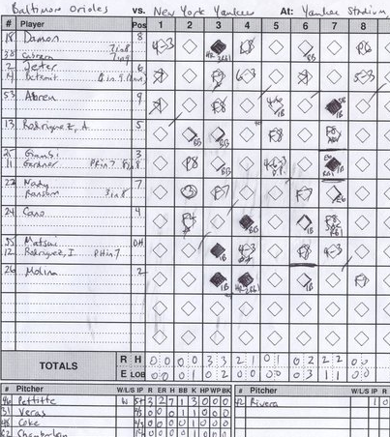
Assessment: Use a scorecard to keep track of participation
Suggestion from the assessment:
“Keep a scorecard on how partners participate, and remind them of their obligation. Point out the opportunity cost to the network of having members who don’t participate in meetings, webinars, and website updates.”
4
Notes:
One of the recommendations from the assessment was to create a ‘scorecard’ to keep track of how partners participate.
This could also be used to measure the opportunity cost to the network when they don’t attend meetings or update the website.

Slide 5
Partners as stewards of NNIP
Martin & Gradeck lead the NNIP stewardship session at Fall 2015 meeting.
Notes:
Hopefully many remember the great session that Sheila and Bob hosted in Dallas on network stewardship.
We heard some stories about partners interacting with each other directly, such as …[?]

Slide 6
NNIP stewardship diagram
Source: Martin & Gradeck, 2015
Notes:
Here is the Venn diagram that Shiela and Bob developed to show the different ways that to participate in NNIP.
Some of these are easy for us to track at HQ, but many are things that we don’t always know are happening.
We are developing a system for self-reporting, but please let me know if you have any ideas or feedback.

Slide 7
Introducing the NNIP Partner Organization Participation Report
Still in Beta testing
Emailed to partner staff on Monday, April 4
Tracking on five primary metrics
Please give me feedback for the next version!
Health
Vital Stats
Crime
Housing
Notes:
Now I’m going to introduce our new partner participation report.
I emailed these to partner staff on Monday, so please let me know if you think you should have gotten one and didn’t.
This is still in BETA so if you have feedback please find me during the meeting so that we can talk about how to improve the report for future versions.

Slide 8
Introducing the NNIP Partner Organization Participation Report
Designed both for partners and HQ
Partners can see extent of staff engagement
HQ will evaluate our practices to make participation easier
Health
Crime
Housing
Notes:
The report shows metrics for your individual organization next to the median for the entire network (when applicable).
For example, Partners attended 4 out of the last 5 meetings at median and the median SNIP score is 5.
We plan to use this both as a tool to see how partners are doing and to evaluate from HQ perspective what’s working and what needs to change.

Slide 9
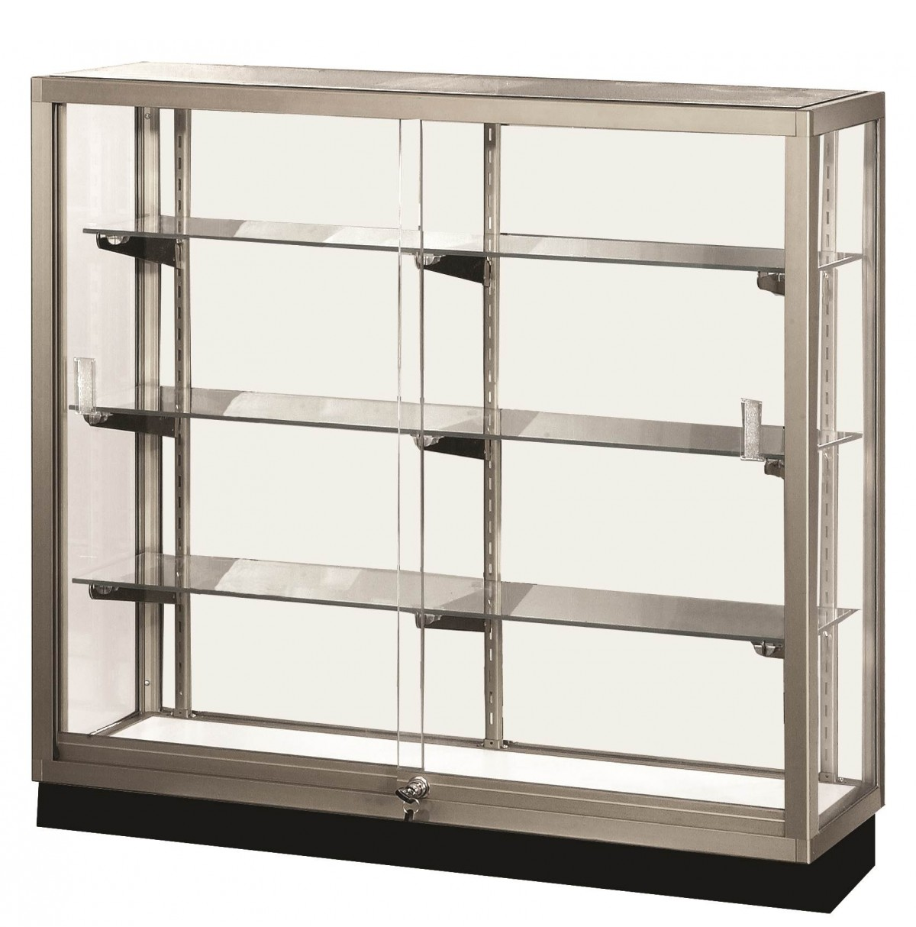
Participation report components
Meeting Attendance
Data Inventory
Website Updates
NNIP Logo Badge on Website
Idea Showcase Attendance
Notes:
Here are the components of this version of the report.
Do you attend these meetings?
Do you update the NNIP website on a regular and timely manner?
Do you keep your data inventory up-to-date?
Is the NNIP logo badge on your website?
Have you attended an Idea Showcase webinar?

Slide 10
Partner meeting attendance
Notes:
Meeting attendance is one of our strongest participation metrics.
We have 29 partners here in San Antonio. We’ve average around 27 partners at each meeting.

Slide 11
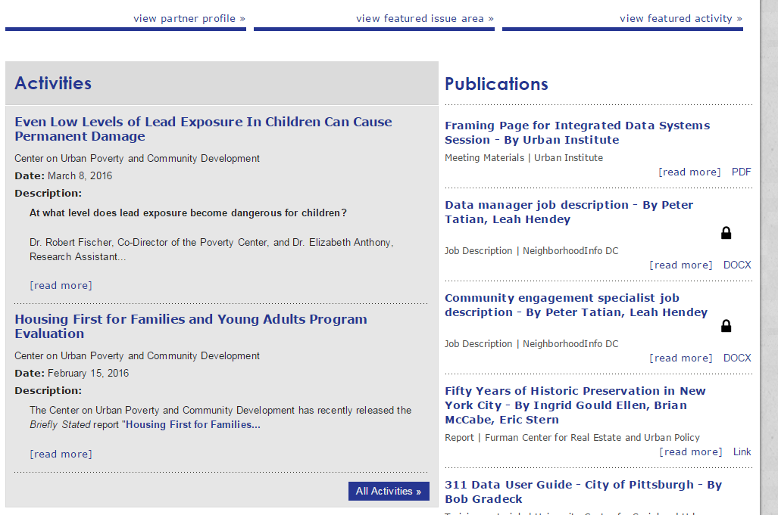
Update the NNIP website
Notes:
Partners are expected to update the NNIP website every quarter.
It’s a great way to show off the work you’re doing and help other partners keep up.

Slide 12
Display NNIP partner badge on your own website!
Notes:
Great example from Rise.
This is low hanging fruit, we’d like to have all partners have this on their website by May.

Slide 13
Maintain data inventory
SNIP Stats:
Range: 0-10
Mean: 3.8
Median: 5
Overdue (9)
Up-to-date (27)
13
Notes:
Partners are expected to update their data inventories once per year. The most recent happened last fall before the Dallas meeting.
Here are the SNIP numbers, they will be even better once all partners are up-to-date on their inventories.

Slide 14
Idea Showcase attendance
Notes:
Showcase participation is considerably lower than meeting participation.
This is one that we can look at from HQ and assess whether it’s worth continuing.

Slide 15
Comments Welcome!
Rob Pitingolo
rpitingolo@urban.org

