Slide 1
RI’s Workforce Data Quality Initiative (WDQI) Project
Megan Swindal, PhD
Providence, RI

Slide 2
Federal Goals
Develop or improve state workforce longitudinal data systems to include Unemployment Insurance (UI) wage and claims data, training data
Goal is P-20W system
Use longitudinal data to analyze performance of education and workforce training programs
Notes:
WDQI is a collaborative partnership at the Federal level between the Departments of Labor and of Education.

Slide 3
Notes:
In error, RI is not colored blue in this map from the federal WDQI grant program, but it has gotten two rounds of funding so far (the second just beginning to be implemented).

Slide 4
In 2012, RI Department of Labor and Training (DLT) identified ProvPlan as its “designated research partner” in WDQI application
Needed to amend RI Employment Security Act to authorize sharing of individual-level workforce data
Through WDQI funding, RI one of ~18 states with full-scale capacity to link data across the P20-W continuum
Notes:
The development of this system has been six years in the making and has involved numerous agencies, strategic partnerships, and a braided funding approach. Needed to change legislation.
An increasing number of states have the P-20W capacity, although that capacity varies.

Slide 5
In first funding round, DLT’s objective was to connect workforce data to the DataHUB + demonstrate potential impacts of such linkages
Produce Data Stories pointing to actionable strategies for policy makers and practitioners

Slide 6
SWICA (Wage Data)
Employer: name, address, ERN (state employer record number), EIN, NAICS Employee: SSN, first name initial, last name (first 9 letters) Wage: quarterly total, hours worked
Unemployment Insurance (UI) Claims Data
Claimant name, address, SSN, date of birth Claim date, first & last pay dates, total credits, weekly rate, balance, dependency allowance
WIA Participants, TAA Registered Apprenticeship Wagner-Peyser, VETS Data
Participant name, date of birth, SSN, and demographic information Training program/service dates and types; employment status and wages pre- and post-training; GED and credential attainment; competency test scores; participating employer information
Notes:
Quarterly, from 3Q 2011. Thus far we have Wage data in the HUB. The other data are stalled in state procurement with DLT’s database vendor.

Slide 7
Six Data Stories
RI’s College to Career Landscape
Young Adults in RI’s Education-to-Career Pipeline
Health Care and Social Assistance in RI
Adult education’s impact on employment
Brain drain of RI-educated workers
TBD
Notes:
The first three are published on the DataHUB, the other three are in progress

Slide 8
Notes:
This visualization from our first data story for the project had a big impact and, unlike some of our analyses (!), was seen by a number of policymakers.

Slide 9
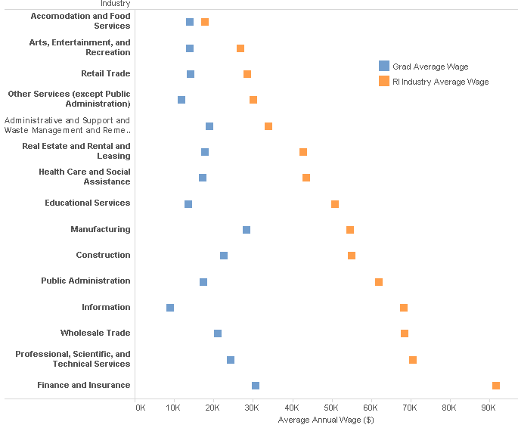
Notes:
We’ve been able to look at graduates of our 3 public colleges/universities and assess their wages and industries of employment at different points post-graduation. This is a visualization of wages for a cohort that was in 8th grade in Rhode Island public schools in the 2005-06 school year.

Slide 10
Notes:
We’ve looked more closely at certain employment sectors like Health Care to see what the wage distribution is for different employer types like Hospitals or Nursing Facilities. This visualization doesn’t use any linked data—just the wage files alone.

Slide 11
Goals for this Round
Expand Workforce Longitudinal Data
WIOA (workforce development programming)
Credentials (certificates, certifications, licenses) that are part of the workforce data system, including credentials awarded by third-parties
Registered apprenticeship data
Notes:
This fall, DLT will launch a statewide effort to expand registered apprenticeship into non-traditional industries – resulting in a 250% increase in the number of registered apprentices in the state. The outmoded registered apprenticeship data system will be modernized later this year using Rhode Island’s existing SLDS funds.

Slide 12
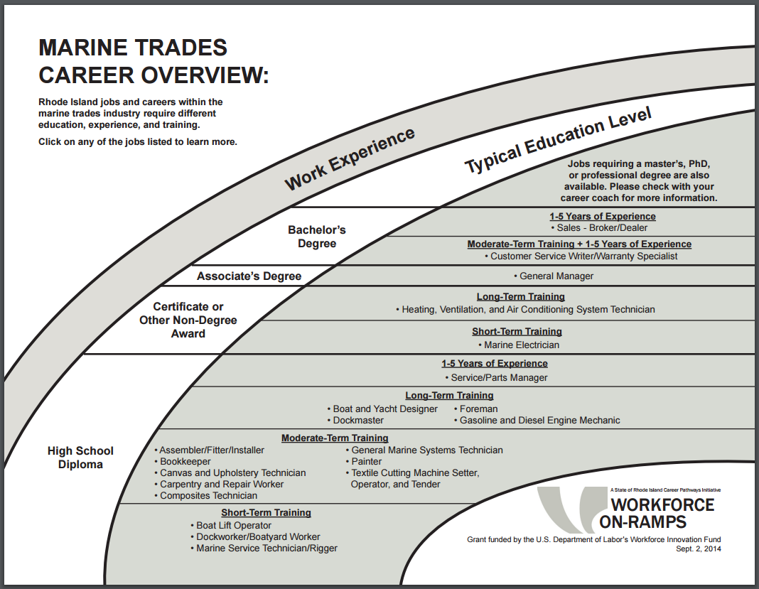
Improve Workforce Data Quality
Training and industry partnership programs: participant-level information
Notes:
Improve the quality of data collected in conjunction with incumbent training and industry partnership programs. To date, employers and industry associations provide only aggregate-level outcomes; now we can access participant-level information in order to promote greater linkage along the education-workforce continuum.

Slide 13
Some continued barriers:
Out-of-state workers
CIP-SOC crosswalk
Notes:
More than most states, we have a lot of in- and out-migration of workers which complicates analysis of the education-to-workforce pipeline.
The national CIP-SOC (field of study-occupation) crosswalk is increasingly inadequate, both because of specialization in the labor market and state-level variations. We’re working with our WDQI partners to create a RI-specific crosswalk which should help us better understand whether the credentials we’re producing are a good fit for the jobs in demand.

Slide 14
Potential research questions
How does the availability of workforce development programs align with the state’s forecast for job growth?
Are Rhode Island’s post-secondary institutions offering the types of degree programs that employers want for their new hires?
Which employers/industries are shown to be effective in helping ex-offenders find employment, thus helping to reduce rates of recidivism?

