Slide 1
Understanding The 606’s impact on the neighborhood housing market
September, 2016
Presented by the Geoff Smith at the National Neighborhood Indicators Partnership Meeting (Cleveland)
SOURCE: PHOTO VIA FLICKR CREATIVE COMMONS/MATTHEW WILDER
Notes:
Understanding the role that public investment plays in driving neighborhood change has been a key recent question in urban policy
IHS had an opportunity examine this issue around a major new linear park system that was recent built on a formerly abandoned rail line on Chicago’s northwest side
IHS’s project looked at how the housing market responded to the announcement and opening of the 606 park system

Slide 2
What is The 606?
606 West
606 East
SOURCE: TRUST FOR PUBLIC LAND
Notes:
Area ½ mile around 606.
Key feature of trail is that it cuts though communities with very different characteristics
This is appealing because it connects these neighborhoods and residents in a way that they weren’t previously
Presents risks because it creates and amenity that brings new demand for housing to the neighborhood

Slide 3
The 606 linear park region has two different neighborhoods
Demographic characteristics of the eastern and western neighborhoods adjacent to the 606
 | 606 East | 606 West
Median Household Income, 2009-14 | $115,924 | $49,701
Poverty Rate, 2009-14 | 4.8% | 25.5%
Share Renters, 2009-14 | 41.5% | 61.5%
Non-White Share, 2009-14 | 21.2% | 78.9%
Source: IHS CALCULATONS OF American communities survey DATA - 5-year, 2009-14
Notes:
Demographically, the has been a sharp demographic difference between the neighborhoods adjacent to the eastern and western halves of the 606
Focus on west

Slide 4
The 606 linear park region has two different neighborhoods
Housing characteristics of the eastern and western neighborhoods adjacent to the 606
 | 606 East | 606 West
Share of Properties Impacted by Foreclosure, 2005-2014 | 7.1% | 24.1%
Median Single Family Sales Price, 2015 | $815,000 | $450,000
Share of property sales to business buyers, 2015 | 4.8% | 20.7%
Source: ihs data clearinghouse
Notes:
Also key differences from a housing market perspective difference between the neighborhoods adjacent to the eastern and western halves of the 606
Focus on west

Slide 5
The 606 linear park region has two different neighborhoods
606 West
606 East
SOURCE: IHS DATA CLEARINGHOUSE
Notes:
Shows the housing stock for an area ½ mile buffer around the 606.
Describe map colors
Largely different types housing:
Yellow and gold parcels are single family homes and condos
Blue and darker blue are multi-unit rental properties

Slide 6
How will this investment impact surrounding communities?
The 606 West neighborhoods had characteristics indicating certain types of risk
High concentration of populations vulnerable to displacement
Renters
Lower-Income
Non-white
Attractive investment potential
Near strong market
Relatively low values
Substantial small rental housing stock
Higher number of distressed properties
Notes:
Because the trail cuts through neighborhoods with different characteristics, raises questions about the impacts will vary.
606 West has characteristics would indicate:
High share of populations potentially vulnerable to displacement
Housing market that at risk of rapidly losing affordability due to increased attractive investment potential

Slide 7
Applying the IHS Price Index to Understand The 606
Focus on single family house prices
Special cut of the IHS Price Index data and model was used to understand
Trend - Price trends for a half mile buffer around 606
Distance Premium - How proximity to the 606 affected sales prices
Location - How trends and proximity varied for western and eastern sections

Slide 8
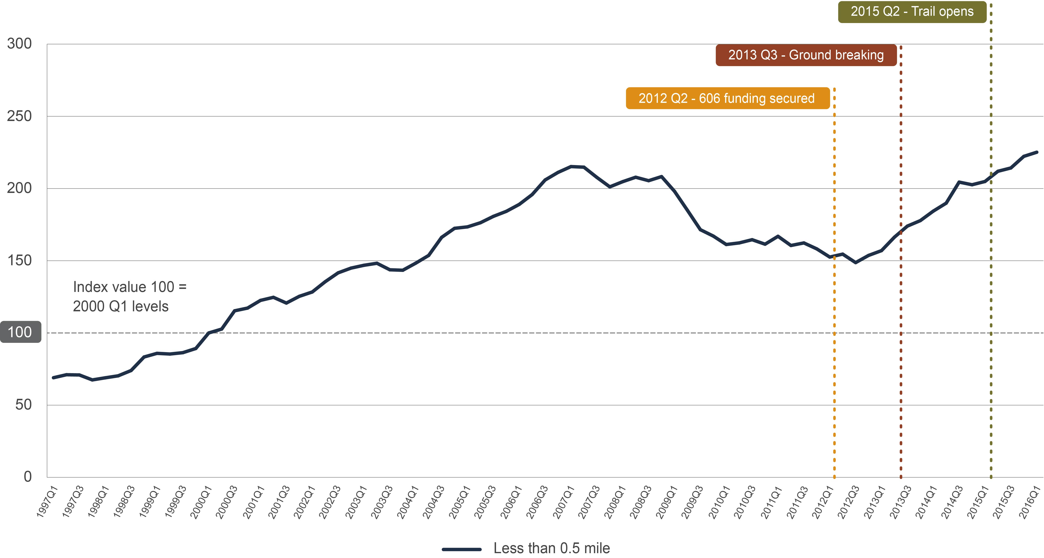
Price trends along The 606
Quarterly price trends for single family homes within ½ mile of The 606, 1997 to 2016 1Q
Source: IHS Cook county house Price index 2016 1q
Notes:
Chart tracks SF sales price trends for an area ½ mile buffer around the 606
The index is pegged to prices in 2000
Three key milestone dates are flagged:
Funding secured to begin construction – 2012 Q2
Groundbreaking – 2013 Q3
Opening – 2015 Q2

Slide 9
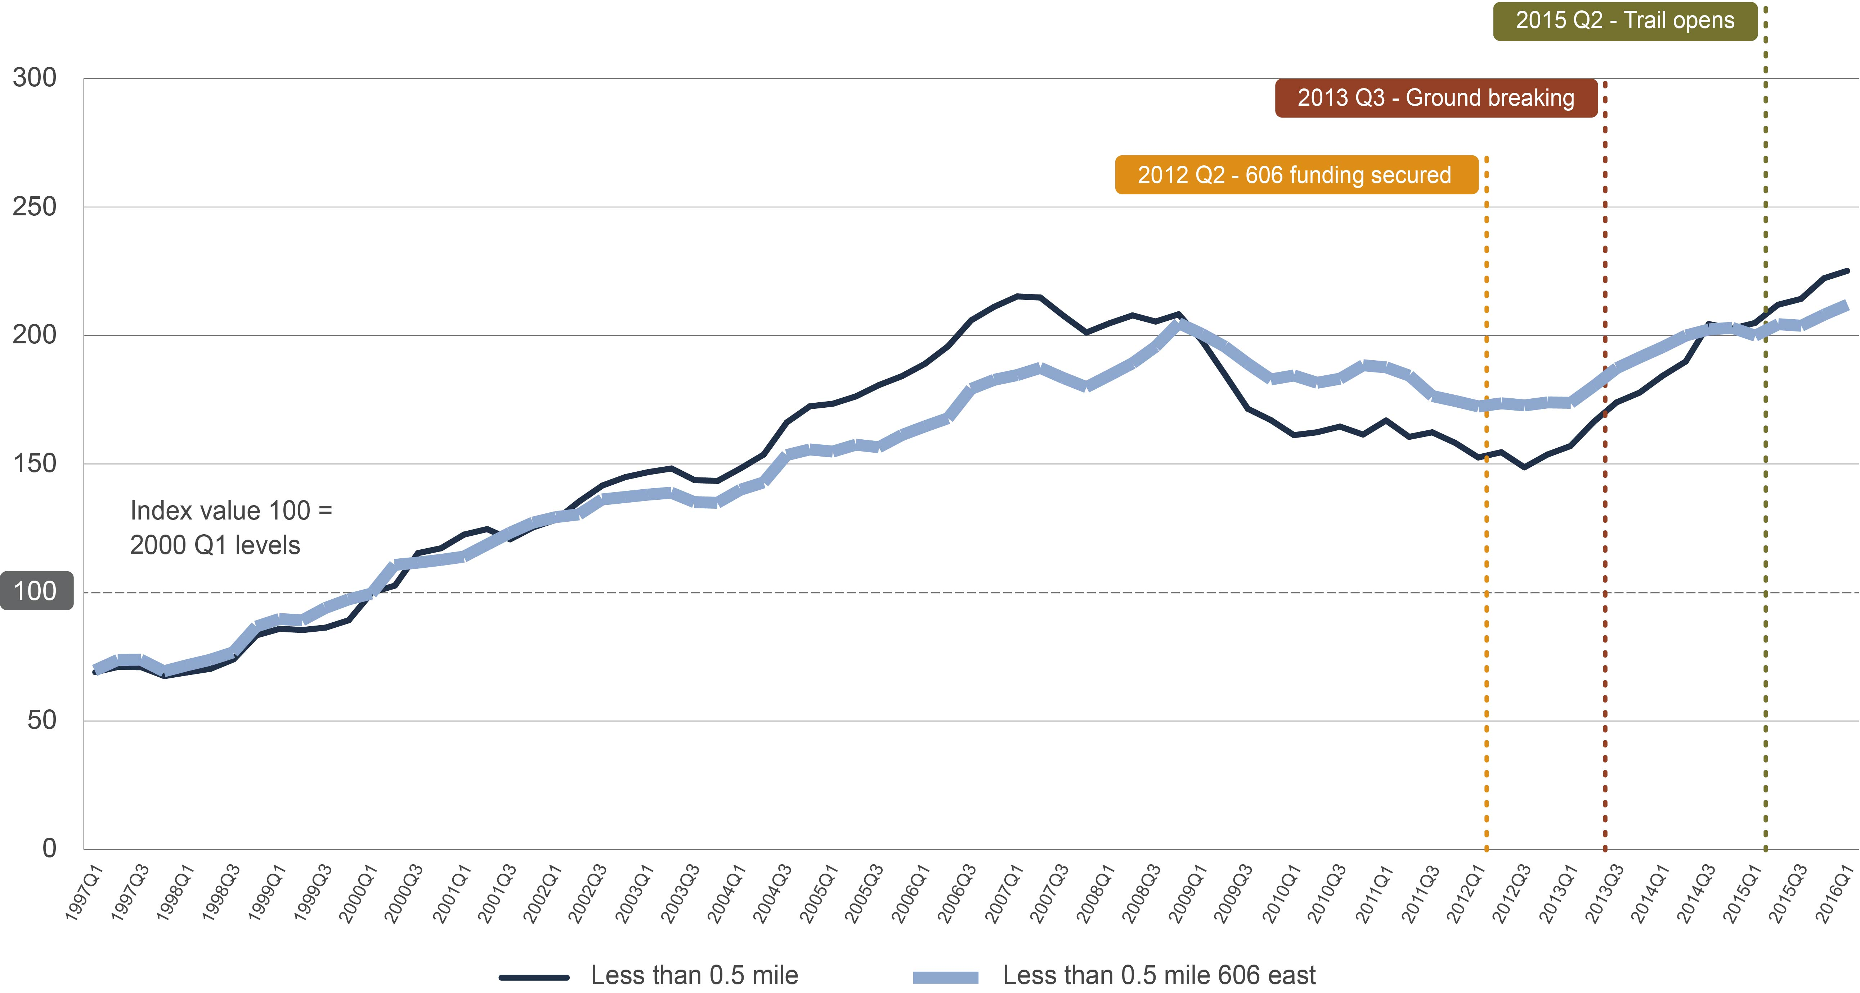
Price trends along The 606
Quarterly price trends for single family homes within ½ mile of The 606, 1997 to 2016 1Q
Source: IHS Cook county house Price index 2016 1q
Notes:
Shows price trend for 606 East and 606 West
606 East:
Characteristics of a stable and strong market
Not much bubble or crash
Current prices 3.5% above bubble peak

Slide 10
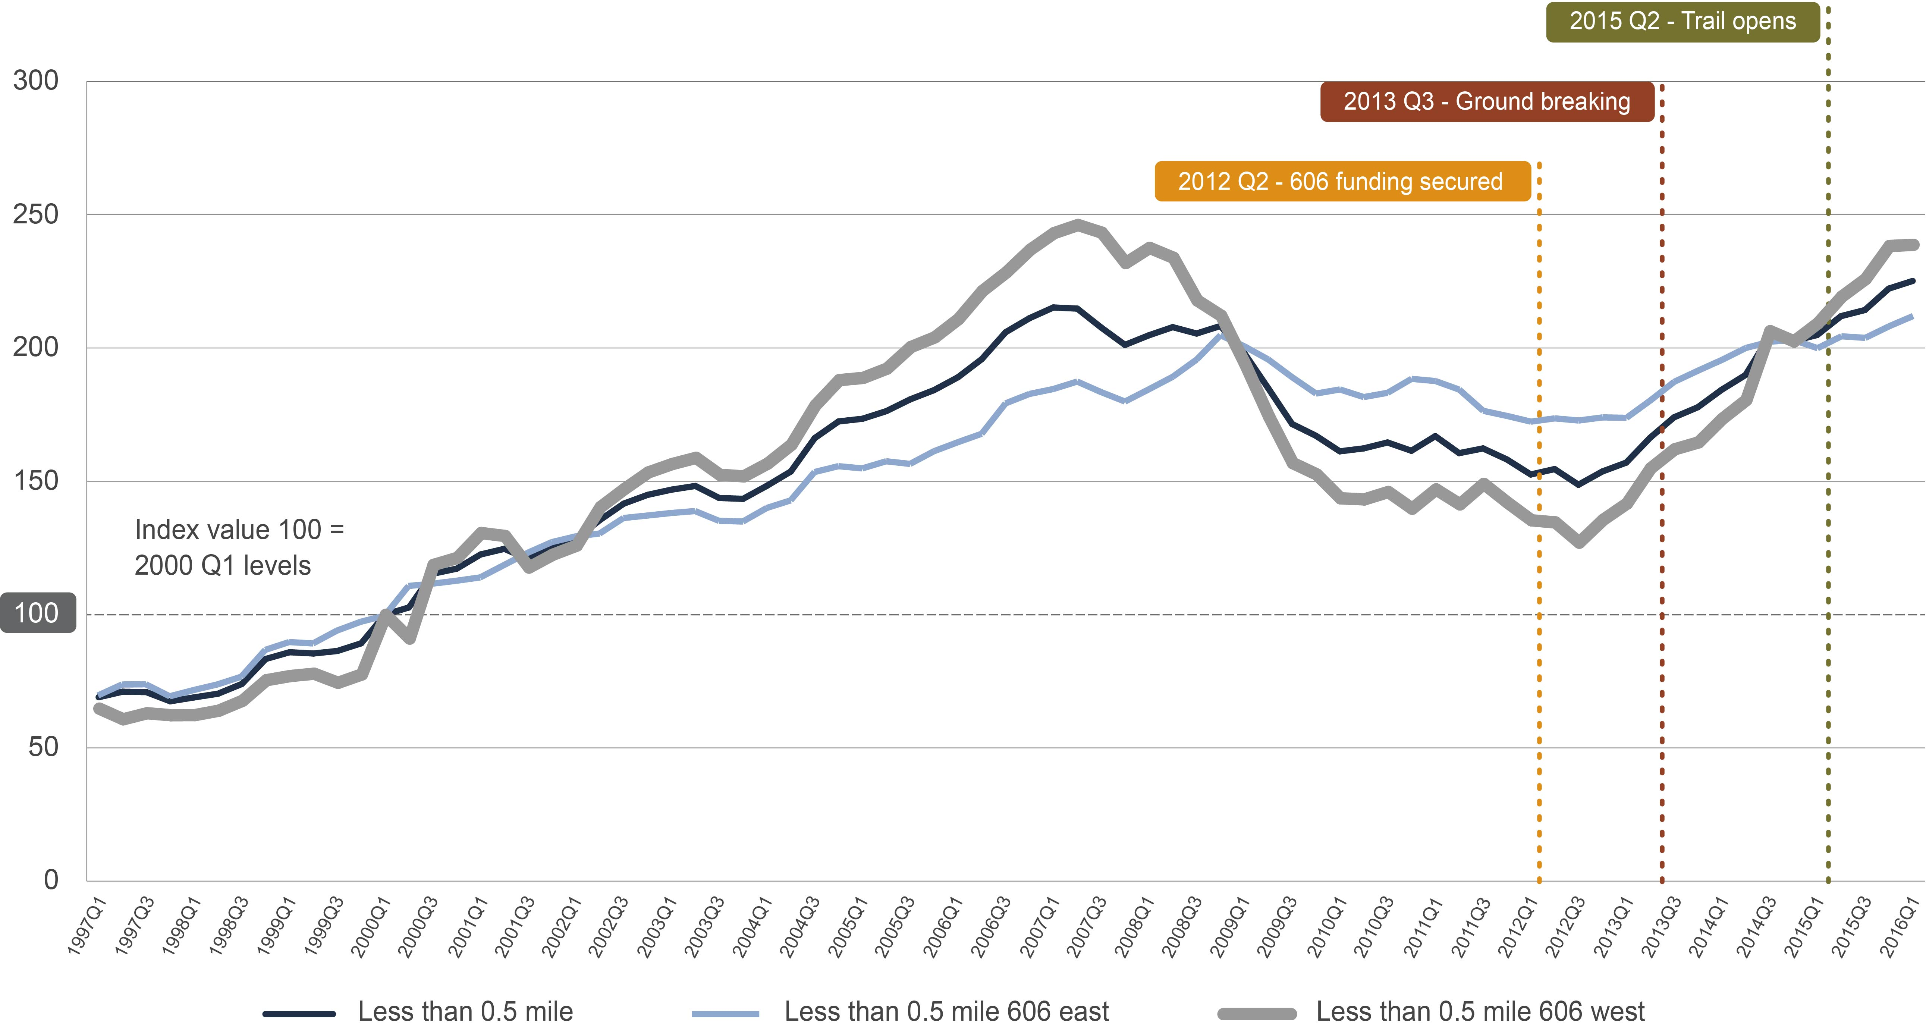
Price trends along The 606
Quarterly price trends for single family homes within ½ mile of The 606, 1997 to 2016 1Q
Source: IHS Cook county house Price index 2016 1q
Notes:
606 West
Trend line characteristics of less stable, more volatile, rapidly appreciating market
Had a fairly substantial run up in prices during the bubble years
Sharper crash
Very strong recovery almost near previous peaks
Acceleration of recovery coincides with 606

Slide 11
Is there a premium for being near The 606?
Price premium for being located within 1/5 mile of The 606, pre-2012
Pre-606
Source: IHS calculations of data from IHS Cook county house Price index 2016 1q
Notes:
Previous data show price trends, but not necessarily the impact of the 606
This slide shows that prior to 2012 being within 1/5 of a mile of the trail – disamenity

Slide 12
Is there a premium for being near The 606?
Price premium for being located within 1/5 mile of The 606, pre-2012 and post-2012
Pre-606
Source: IHS calculations of data from IHS Cook county house Price index 2016 1q
Notes:
After 2012 when the 606 was officially in motion:
606 East
-Being within 1/5 mile had no effect on prices in 606 east
-Prices increases were related to other factors
606 West – Being near trail led to a 22% price premium

Slide 13
How does the distance premium change in 606 West
Change in price premium by distance (miles) from The 606 along 606 West
Source: IHS calculations of data from IHS Cook county house Price index 2016 1q
Notes:
We know the trail opening had an effect
Effects of the trail decline with distance
After ½ mile it becomes less significant.

Slide 14
What does this mean in actual value?
Distance premium for 1/5 Mile applied to median SF home in 2015
$450,000
Source: IHS calculations of data from IHS Cook county house Price index 2016 1q
Notes:
For the median SF property in 2012 in 606 East:
2015-$815,000
Median SF property 606 West
2015 - $450,000
Can attribute 22% of that price, or over $100,000 to the 606 premium

Slide 15
Implications
Public investments impact surrounding neighborhood housing markets
That impact varies based on underlying neighborhood characteristics
There is a geographic zone where the impact is most significant
Important considerations for proactive and targeted policy development to mitigate displacement and lost affordability related to future public investments or major projects
Notes:
Understanding these characteristics is important when developing any targeted and proactive policy to mitigate displacement and affordability risk related to future public investments or major projects

