Slide 1
Connecticut 2015 Community Wellbeing Survey
DATAHAVEN
Mary Buchanan, Project Manager

Slide 2
Summer 2012:
2012 Community Wellbeing Survey interviews
2014-Spring 2015:
Sponsors & partners recruited
Spring 2013:
2013 Community
Index published
2014-Spring 2015:
Survey Design
Spring-Summer 2015:
2015 CWS Interviews
Fall 2015:
Survey data released
Winter 2016:
Partner projects released
2016-2017:
Planning for
2018 CWS
Spring 2016:
Community Index
reports published
DATAHAVEN
Data for Community Action

Slide 3
Motivation behind 2015 Survey
Valuable – 2012 Community Wellbeing Survey data highly useful to partners
Sustainable – Hospitals’ CHNA requires assessment every 3 years
Longitudinal – Overlap with 2012 survey
Comparable – Expansion of geography of study
DATAHAVEN
Data for Community Action

Slide 4
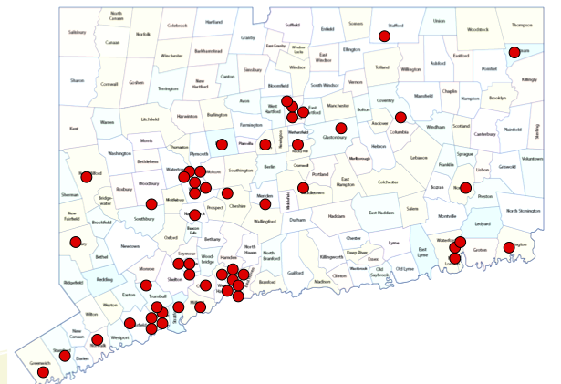
Our Partners
Over 100 stakeholders statewide
Roles: Advisors, funders, partners
Areas: Health care institutions, local & state gov’t, universities, foundations
DATAHAVEN
Data for Community Action

Slide 5
Designing the Survey
Engaged advisors from philanthropy, government, health care institutions, workforce boards
Preserved key questions from 2012 Survey
Identified new material from existing local & national surveys
→ Single health & quality of life program
DATAHAVEN
Data for Community Action

Slide 6
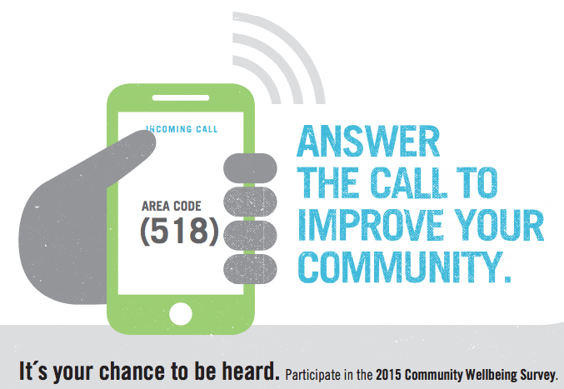
Survey Process
Siena Research College conducts surveys & weights data
Landline and cell phones
Randomized number and household member
English and Spanish
Zip codes targeted based on hard-to-reach populations
Partners spread survey awareness
DATAHAVEN
Data for Community Action

Slide 7
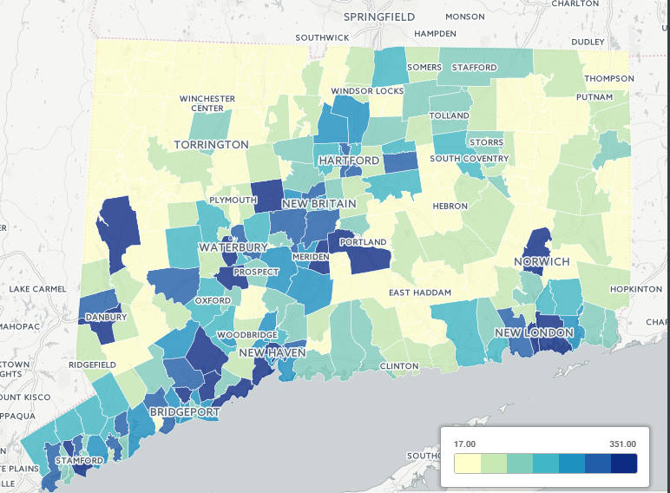
Survey Process
16,000 interviews from May-Oct. 2015
All 169 towns in CT covered
DATAHAVEN
Data for Community Action

Slide 8
Benefits of the data
Public
Local-level
High-quality
Cost-effective
Unavailable from other sources
Compares state, region, town, & neighborhood
Encourages collaboration between stakeholders
DATAHAVEN
Data for Community Action

Slide 9
Findings
DATAHAVEN
Data for Community Action

Slide 10
Findings
DATAHAVEN
Data for Community Action

Slide 11
Findings
DATAHAVEN
Data for Community Action

Slide 12
Findings
DATAHAVEN
Data for Community Action

Slide 13
Findings
DATAHAVEN
Data for Community Action

Slide 14
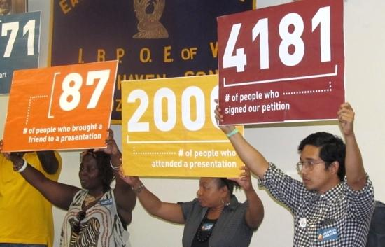
Uses of the data
DATAHAVEN
Data for Community Action

Slide 15
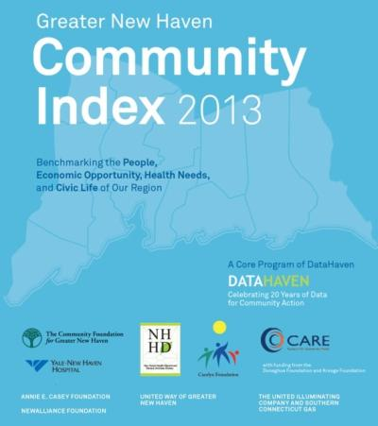
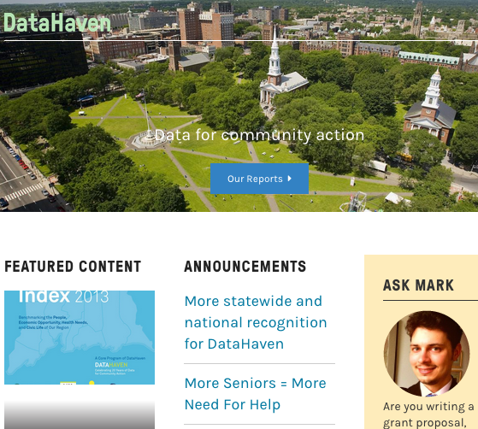
Up next from DataHaven…
2018
Community
Wellbeing
Survey
DATAHAVEN
Data for Community Action

