Slide 1
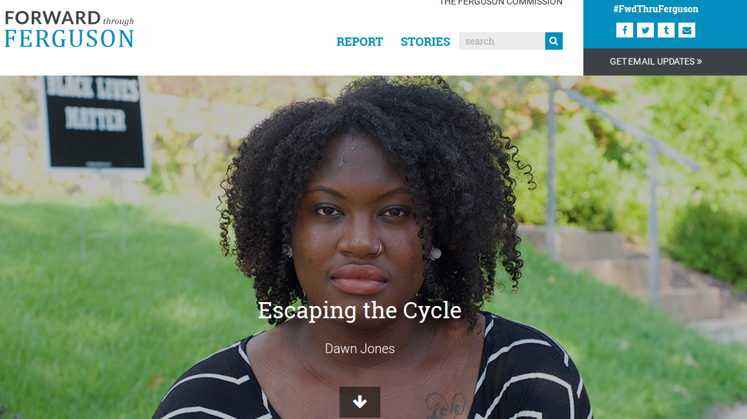
“The Cycle”
At one point, I had four warrants because I couldn’t afford to get car insurance, I couldn’t afford to get my car registration, and pay my property taxes…. So I would get pulled over, and I would explain this to the cops...but they would always give you a ticket. You can’t afford to pay the ticket, because if you could, you would’ve gotten your car taken care of. So you end up not being able to pay the ticket, and then you get a warrant.
I want to see the justice system working with the community saying, “This is something that we require of you, but I know that right now you can’t do it. So what can we do? How can we work with you to get that taken care of?” Otherwise, the cycle’s just going continue because these are poor people that just don’t have the money.
Notes:
Another example from DOJ report: 2007. $151 + fees for illegally parking. 7 FTA charges from 2007-2010. Each FTA = arrest warrant & new fines/fees. 2007-2014: Arrested twice, 6 days in jail, paid $550 to court. Attempted partial payments but court wouldn’t accept anything less than payment in full. As of December 2014 still owes $541 (after paying $550).

Slide 2
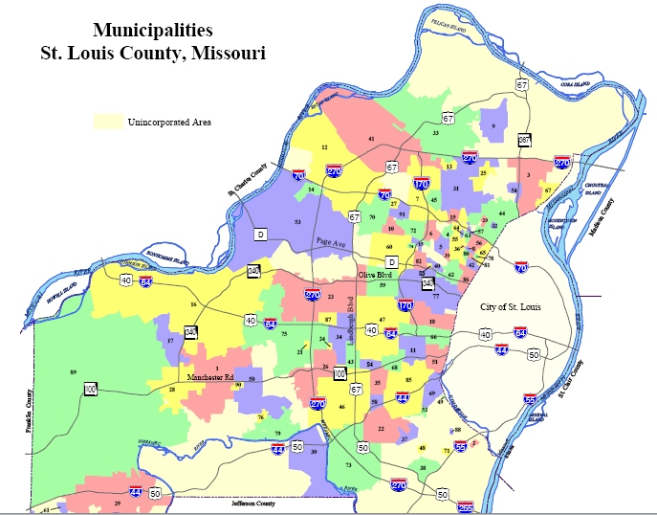
Local government fragmentation
At least five separate data vendors
Confusion over where/when to pay fines
Underutilized warrant amnesty programs
Limited online payment options
Community service programs at judge discretion(or not at all)
Lack of quality metrics/open data
Compounding Challenges
Notes:
Limited information if you are a person just trying to navigate system. Information presented isn’t presented in a way that is easy to understand.

Slide 4
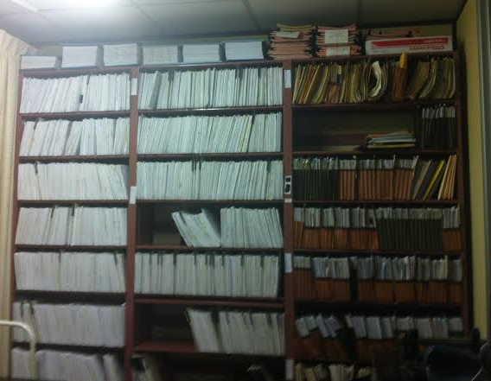
Our Work So Far
Observational research of court practices
Court clerk, municipal judge, and civil rights lawyers buy-in
Steering Committee (from both tech & justice circles)
Tara Pham hired as project manager
Surveys of court users in collaboration with UMSL
Process evaluation
Training for CDCs on civic tech ecosystem

Slide 5
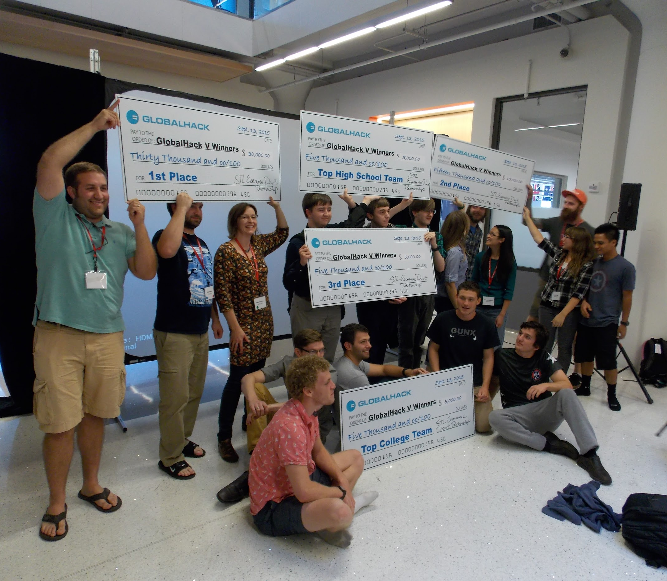
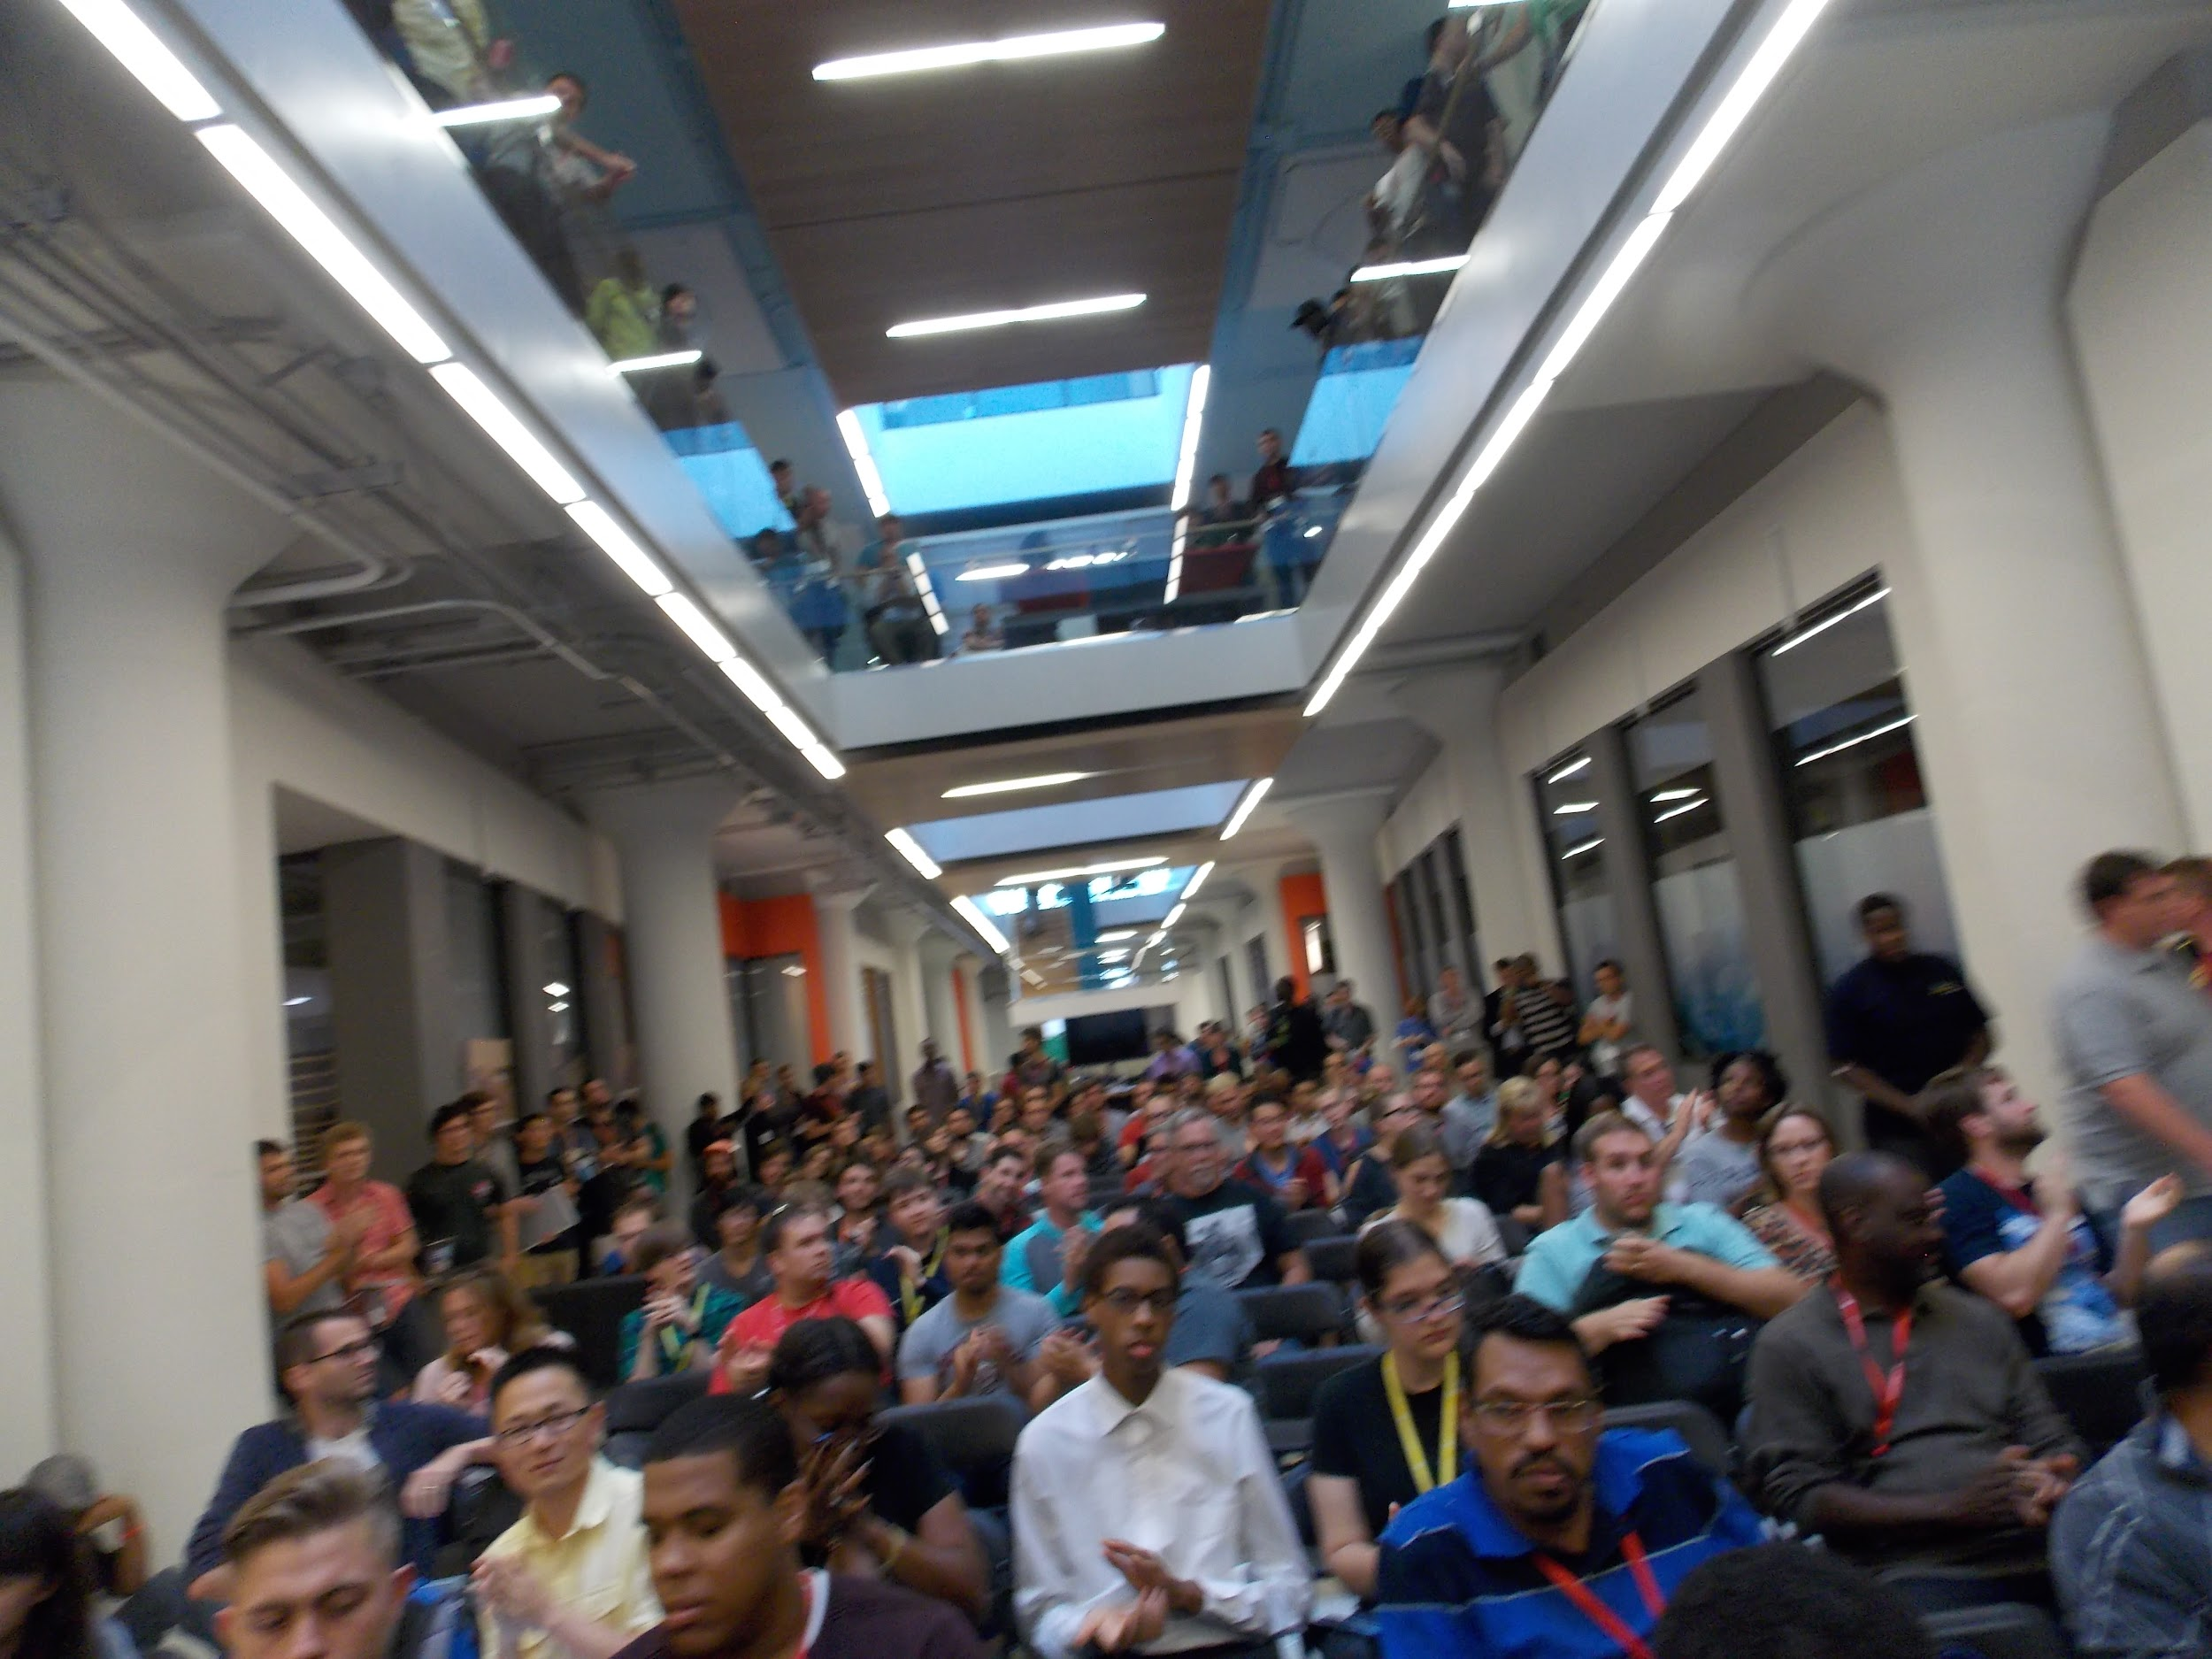
GlobalHack V

Slide 6
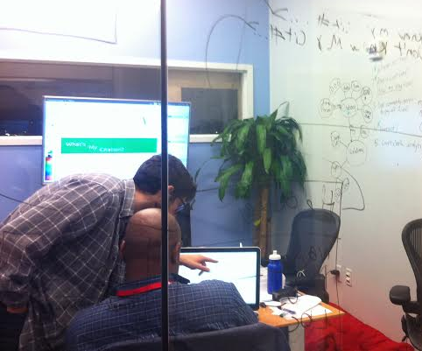
GlobalHack V

Slide 7
Work towards implementation of a hybrid of GlobalHack solutions with local government stakeholders (some of whom judged GlobalHack!)
Challenges of getting buy-in for projects in prototype stage?
Agile development/transparency?
User testing with community/locally-driven design
Trainings and education for community at large
Inclusive economic opportunities (LaunchCode, etc.)
Identify measurable outcomes for courts work as well as ecosystem growth
Continue mapping local civic tech ecosystem
Next steps include but are not limited to...

